Slide 3
Who am I?
I am a blessed demonstration of God’s power
Who are we?
We are dead people made alive

Slide 4
We are a New Body of People in Christ
Ephesians 2:11-22

Slide 5
We were separated from God (Eph 2:11-12)
We were far from God Himself

Slide 6
God
Talk-Reveal-Protect-Prosper
Abraham = Isaac = Jacob (Israel)
Everyone on earth

Slide 7
Jew
Gentile

Slide 8
We were separated from God (Eph 2:11-12)
We were far from God Himself
We were far from God’s elect people
We were far from God’s covenants

Slide 9
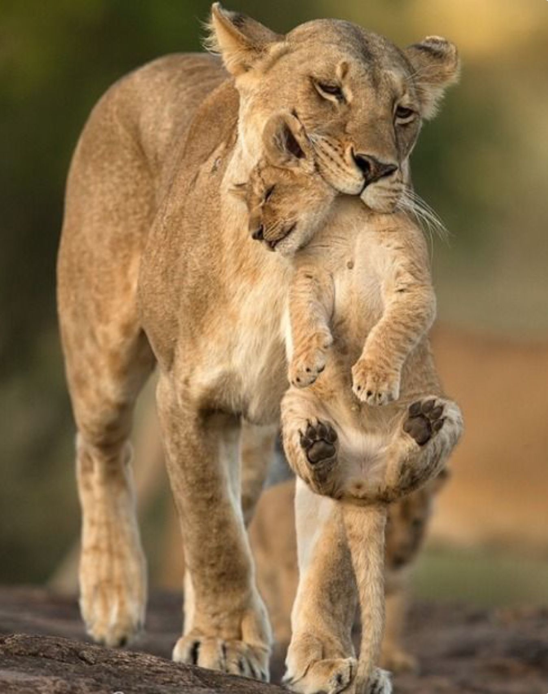
We are now brought near to God (Eph 2:13-18)
Christ makes peace with God by paying for our sin
Christ makes peace with God by fulfilling the Law
Christ makes peace with God by proclaiming the gospel message

Slide 10
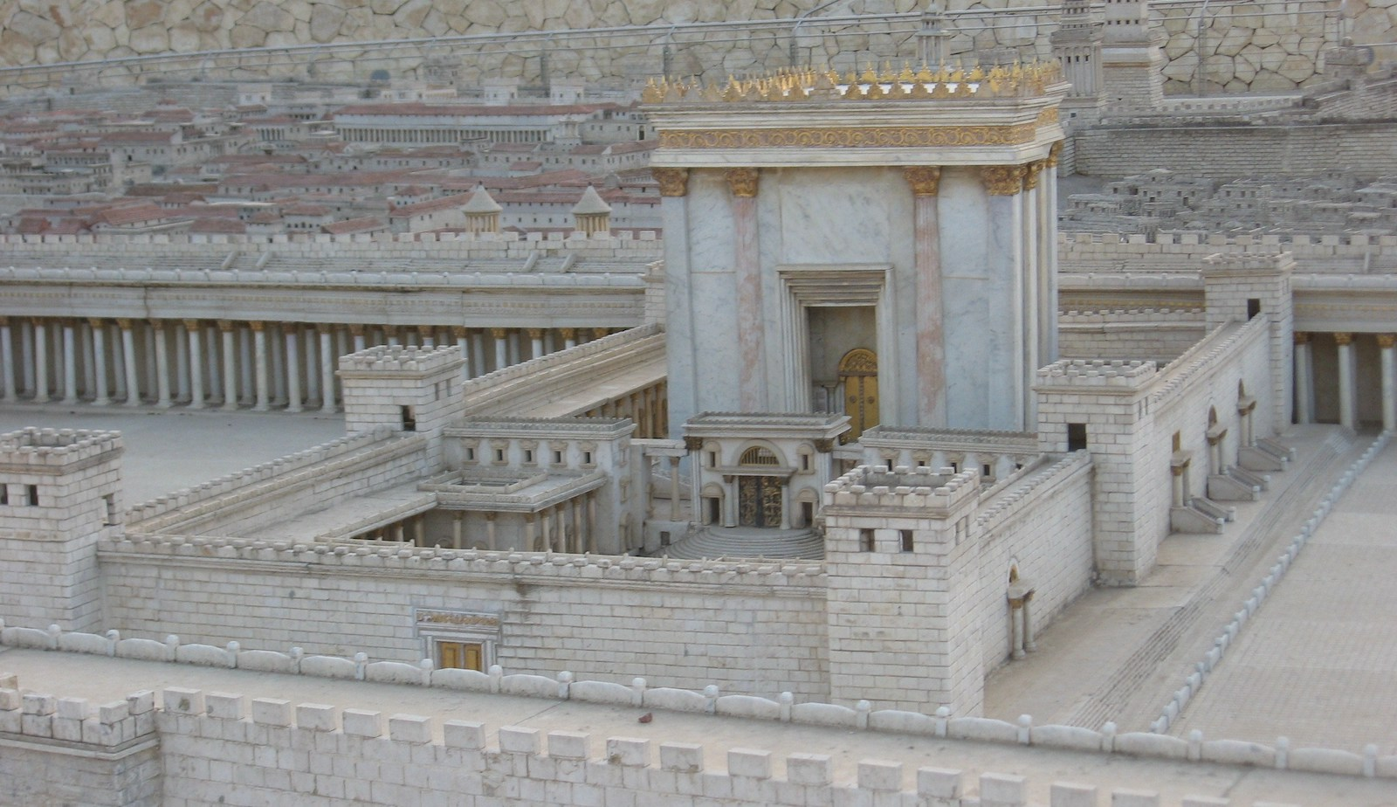
We are built up in Christ (Eph 2:19-22)
We are elevated to a new status (v. 19)
We become a dwelling place of God (vs. 20-22)

