Slide 1
“I sometimes wonder if good and thoughtful people have ever been more depressed about the human predicament than they are today. Of course every age is bound to have a blurred vision of its own problems, because it is too close to them to get them into focus. And every generation breeds new prophets of doom. Nevertheless, the media enable us to grasp the worldwide extent of contemporary evil, and it is this which makes the modern scene look so dark.”

Slide 2
“It is partly the escalating economic problem (population growth, the spoliation of natural resources, inflation, unemployment, hunger), partly the spread of social conflict (racism, tribalism, the class struggle, disintegrating family life) and partly the absence of accepted moral guidelines (leading to violence, dishonesty and sexual promiscuity). Man seems incapable of managing his own affairs or of creating a just, free, humane and tranquil society. For man himself is askew.”
John Stott

Slide 3


Slide 4

We are Dead People Made Alive
Ephesians 2:1-10

Slide 5
Psalm 51:5
Behold, I was brought forth in iniquity,
and in sin did my mother conceive me.

Slide 6
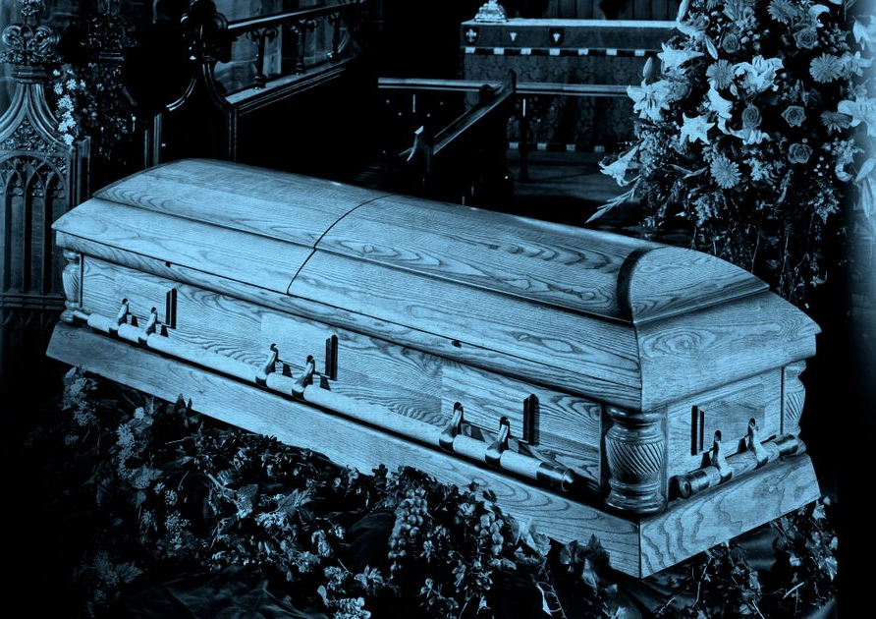
We were dead (Ephesians 2:1-3)
We violate God’s holy commands (vs. 1-2a)
“Before God we are both rebels and failures.”
John Stott

Slide 7
We were dead (Ephesians 2:1-3)
We violate God’s holy commands (vs. 1-2a)
We walk according to ways of the rest of the world (v. 2b)

Slide 8

“Their behavior has been determined by the powerful influences of society’s attitudes, habits, and preferences which were alien to God and his standards.”

Slide 9
We were dead (Ephesians 2:1-3)
We violate God’s holy commands (vs. 1-2a)
We walk according to ways of the rest of the world (v. 2b)
We think according to the lies of the devil (v. 2c)

Slide 10
2 Corinthians 4:4
In their case the god of this world has blinded the minds of the unbelievers, to keep them from seeing the light of the gospel of the glory of Christ, who is the image of God.

Slide 11
John 12:31
Now is the judgment of this world; now will the ruler of this world be cast out.
Colossians 1:13
He has delivered us from the domain of darkness and transferred us to the kingdom of his beloved Son,

Slide 12
We were dead (Ephesians 2:1-3)
We violate God’s holy commands (vs. 1-2a)
We walk according to ways of the rest of the world (v. 2b)
We think according to the lies of the devil (v. 2c)
We are controlled by impulses of the sinful flesh (v. 3a)

Slide 13
James 1:13-14
¹³ Let no one say when he is tempted, “I am being tempted by God,” for God cannot be tempted with evil, and he himself tempts no one. ¹⁴ But each person is tempted when he is lured and enticed by his own desire.

Slide 14
James 4:1
What causes quarrels and what causes fights among you? Is it not this, that your passions are at war within you?

Slide 15
We were dead (Ephesians 2:1-3)
We violate God’s holy commands (vs. 1-2a)
We walk according to ways of the rest of the world (v. 2b)
We think according to the lies of the devil (v. 2c)
We are controlled by impulses of the sinful flesh (v. 3a)
We are subject to God’s wrath (v. 3b)

Slide 16
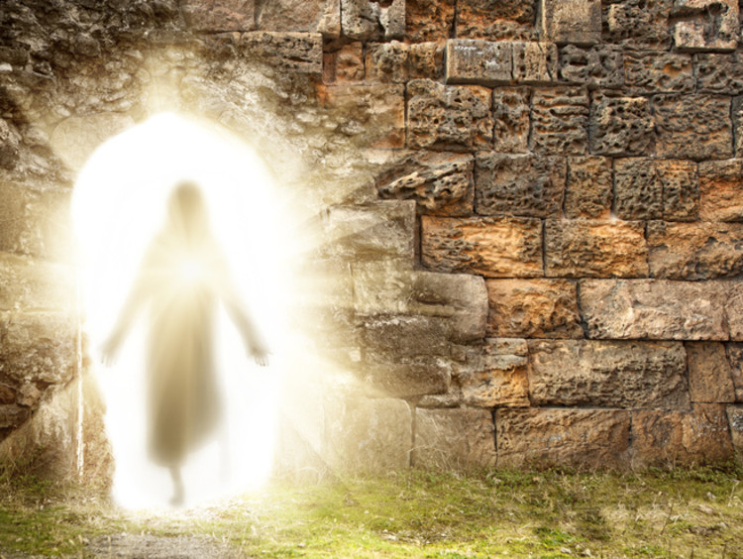
God made us alive (Ephesians 2:4-10)
He acts according to His nature of mercy (v. 4)
He unites us with His Son (vs. 5-7, 10)

Slide 17
BEFORE AFTER
Under God’s wrath Receive His rich mercy
Dead Alive in Christ
Subject to the devil Raised and seated with
Christ
Follow this world Live in heavenly places in
Christ
Succumb to sinful Created workmanship in
impulses of the flesh Christ Jesus
Walk in trespasses and Walk in good works
sins

Slide 18
God made us alive (Ephesians 2:4-10)
He acts according to His nature of mercy (v. 4)
He unites us with His Son (vs. 5-7, 10)
He humbles us (vs. 8-9)
Philippians 1:29
For it has been granted to you that for the sake of Christ you should not only believe in him but also suffer for his sake,

