Slide 1
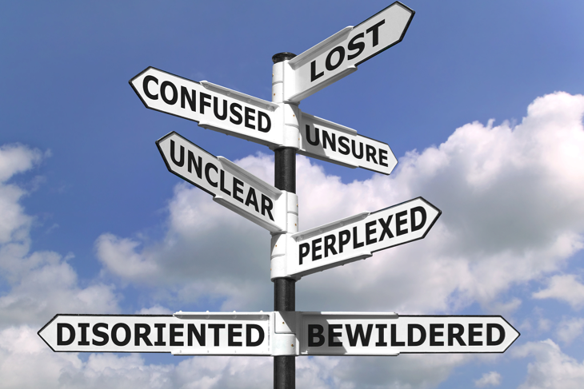

Slide 3
I am a Demonstration of God’s Power
Ephesians 1:15-23

Slide 4
“Paul prays that his readers might appreciate the extraordinary value which God places on them. He views them as in his beloved Son and estimates them accordingly. And this is true of all who are ‘in Christ’. . . . May we live consistently with this high calling and accept with gratitude and true humility the grace and glory that he has lavished on us.”
Peter O’Brien

Slide 5
Live with gratitude for truth and love (vs. 15-16)
1 John 3:10-11
¹⁰ By this it is evident who are the children of God, and who are the children of the devil: whoever does not practice righteousness is not of God, nor is the one who does not love his brother. ¹¹ For this is the message that you have heard from the beginning, that we should love one another.

Slide 6
Live with gratitude for truth and love (vs. 15-16)
1 John 4:7-8
⁷ Beloved, let us love one another, for love is from God, and whoever loves has been born of God and knows God. ⁸ Anyone who does not love does not know God, because God is love.

Slide 7
Live with gratitude for truth and love (vs. 15-16)
Live with intention to mature in Christ (vs. 17-23)
Secure in God’s plan of redemption (18a)

Slide 8
James 2:5
Listen, my beloved brothers, has not God chosen those who are poor in the world to be rich in faith and heirs of the kingdom, which he has promised to those who love him?

Slide 9
Live with gratitude for truth and love (vs. 15-16)
Live with intention to mature in Christ (vs. 17-23)
Secure in God’s plan of redemption (18a)
Marveling over future inheritance (18b)

Slide 10
Mark 10:29-31
²⁹ Jesus said, “Truly, I say to you, there is no one who has left house or brothers or sisters or mother or father or children or lands, for my sake and for the gospel, ³⁰ who will not receive a hundredfold now in this time, houses and brothers and sisters and mothers and children and lands, with persecutions, and in the age to come eternal life. ³¹ But many who are first will be last, and the last first.”

Slide 11
Matthew 10:42
And whoever gives one of these little ones even a cup of cold water because he is a disciple, truly, I say to you, he will by no means lose his reward.

Slide 12
Live with gratitude for truth and love (vs. 15-16)
Live with intention to mature in Christ (vs. 17-23)
Secure in God’s plan of redemption (18a)
Marveling over future inheritance (18b)
Confident in living by God’s power (19-23)

Slide 13
“It was not mere moral reformation effected by rational considerations; nor was it a self-wrought change, but one due to the almighty power of God.”
Charles Hodge

