Slide 3
Ephesians spiritual development
Before
After
Later on
Occult oriented
(Acts 19)
Strong leaders
(Acts 20)
Sound but Cold
(Revelation 2)

Slide 4
Who Am I? I am united with Christ (Eph 1)
Who Are We? We are a new people (Eph 2-3)
How do we glorify God as a new people? We live different lives (Eph 4-6)

Slide 5
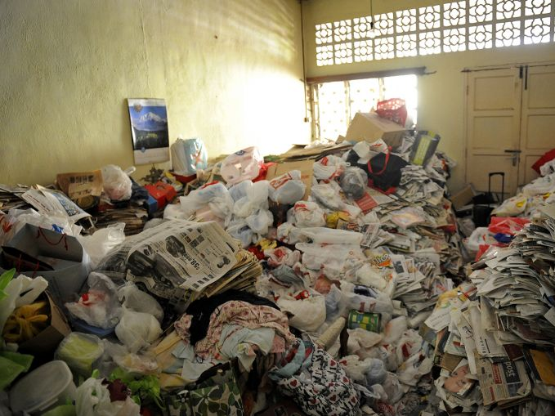

Slide 6
I am Blessed by God to be in Christ
Ephesians 1:1-14
God blessed us by changing us spiritually (vs. 1-3)
God blessed us by choosing us (v. 4a, 5a)
When did He choose us?
How did He choose us?

Slide 7
Acts 13:48
And when the Gentiles heard this, they began rejoicing and glorifying the word of the Lord, and as many as were appointed to eternal life believed.

Slide 8
“This doctrine, in a broad sense, may be defined as an act of choice whereby God selects an individual or group out of a larger company for a purpose or destiny that He appoints. In a more restricted sense, it is God’s gracious and sovereign choice of individual sinners to be saved in and through Christ. We cannot fully comprehend the ways of God, but we may be sure that in His wisdom He knew that this was the way whereby the greatest possible blessing would eventually come to the largest number of persons.”
Curtis Vaughn

Slide 9
I am Blessed by God to be in Christ
Ephesians 1:1-14
God blessed us by changing us spiritually (vs. 1-3)
God blessed us by choosing us (v. 4a, 5a)
God blessed us by purifying us (v. 4b)

Slide 10
James 1:2-4
² Count it all joy, my brothers, when you meet trials of various kinds, ³ for you know that the testing of your faith produces steadfastness. ⁴ And let steadfastness have its full effect, that you may be perfect and complete, lacking in nothing.

Slide 11
Romans 5:3-5
³ Not only that, but we rejoice in our sufferings, knowing that suffering produces endurance, ⁴ and endurance produces character, and character produces hope, ⁵ and hope does not put us to shame, because God's love has been poured into our hearts through the Holy Spirit who has been given to us.

Slide 12
I am Blessed by God to be in Christ
Ephesians 1:1-14
God blessed us by changing us spiritually (vs. 1-3)
God blessed us by choosing us (v. 4a, 5a)
God blessed us by purifying us (v. 4b)
God blessed us by adopting us (vs. 5-6)

Slide 13
Romans 8:15
¹⁵ For you did not receive the spirit of slavery to fall back into fear, but you have received the Spirit of adoption as sons, by whom we cry, “Abba! Father!”

Slide 14
I am Blessed by God to be in Christ
Ephesians 1:1-14
God blessed us by changing us spiritually (vs. 1-3)
God blessed us by choosing us (v. 4a, 5a)
God blessed us by purifying us (v. 4b)
God blessed us by adopting us (vs. 5-6)
God blessed us by redeeming us from sin (vs. 7-8)
God blessed us by communicating His salvation plan to us (vs. 9-10)

Slide 15
I am Blessed by God to be in Christ
Ephesians 1:1-14
God blessed us by granting us a future inheritance (vs. 11-12)

Slide 16
Romans 8:16-17
¹⁶ The Spirit himself bears witness with our spirit that we are children of God, ¹⁷ and if children, then heirs—heirs of God and fellow heirs with Christ, provided we suffer with him in order that we may also be glorified with him.

Slide 17
I am Blessed by God to be in Christ
Ephesians 1:1-14
God blessed us by granting us a future inheritance (vs. 11-12)
God blessed us by securing us (vs. 13-14)

Slide 18
I am Blessed by God to be in Christ
1. God blessed me by changing me spiritually
2. God blessed me by choosing me
3. God blessed me by purifying me
4. God blessed me by adopting me
5. God blessed me by redeeming me from sin
6. God blessed me by communicating His salvation plan to me
7. God blessed me by granting me a future inheritance
8. God blessed me by securing me

