Slide 1
Which Worldview?
Seeing the world through God’s revelation

Slide 2
What is a Worldview?
A worldview is a comprehensive conception or apprehension of the world especially from a specific standpoint

Slide 3
God’s Revelation
God reveals Himself as God (Genesis 1:1, 3)
God establishes reality
Human significance (Genesis 1:27)
James 3:9
With it we bless our Lord and Father, and with it we curse people who are made in the likeness of God.

Slide 4
God’s Revelation
God reveals Himself as God (Genesis 1:1, 3)
Romans 5:12
Therefore, just as sin came into the world through one man, and death through sin, and so death spread to all men because all sinned—
God establishes reality
Human significance (Genesis 1:27)
Marriage (Genesis 2:18, 21-25)
Mission (Genesis 1:26; 2:15)
There are consequences for rebelling against God’s worldview (Genesis 2:16-17)

Slide 5
The World’s Replacement Worldviews
God’s Word does not reveal reality
(Genesis 3:1, 4)
God has no authority
(Genesis 3:5)
Humans replace God and propose new reality
(Genesis 3:5)

Slide 6
Vs.

Slide 7
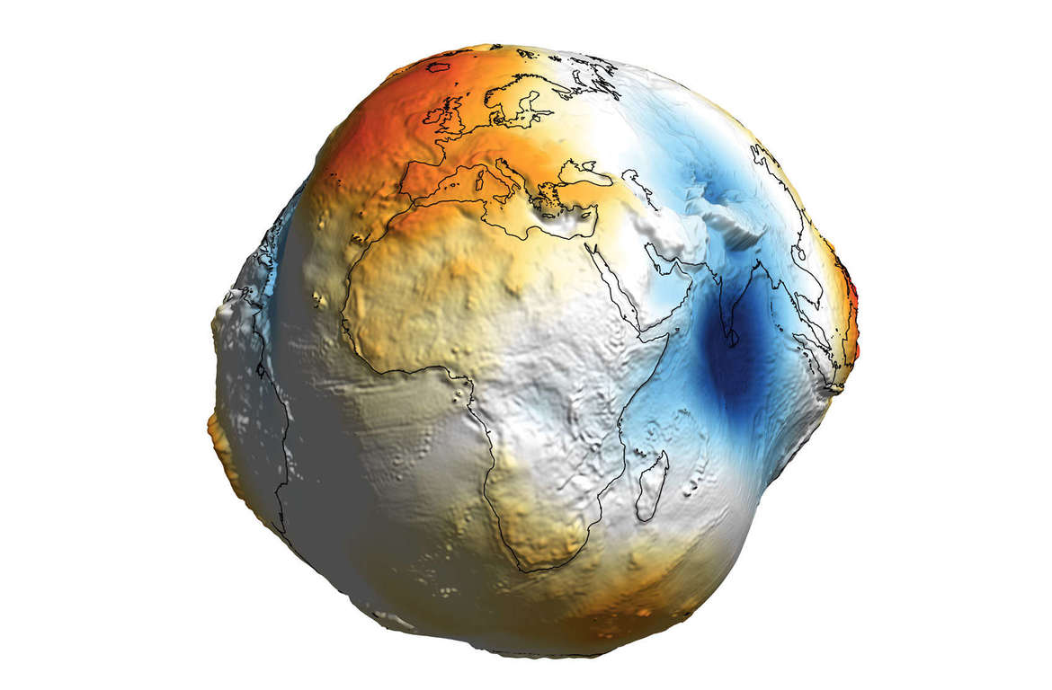
The Uncertainty of Hybrid Models

Slide 8
The Uncertainty of Hybrid Models
2 Corinthians 10:3-6
³ For though we walk in the flesh, we are not waging war according to the flesh. ⁴ For the weapons of our warfare are not of the flesh but have divine power to destroy strongholds. ⁵ We destroy arguments and every lofty opinion raised against the knowledge of God, and take every thought captive to obey Christ, ⁶ being ready to punish every disobedience, when your obedience is complete.

Slide 9
The Uncertainty of Hybrid Models
Jude 1:3
Beloved, although I was very eager to write to you about our common salvation, I found it necessary to write appealing to you to contend for the faith that was once for all delivered to the saints.

Slide 10
Biblical worldview
Divine revelation
Hybrid worldview
Uncertain mixture
Secular worldview
Human speculation
God
World
God
World
God
World

