Slide 1
Notes:
Sermon preached by Matthew Lyle on 25 July 2021 at Crossroads International Church
Focus: God’s Presence
Corporate Bible Reading: Psalm 133
Songs:
1) We Gather Together
2) In Christ Alone
3) Victory in Jesus
Words in BOLD/UNDERLINE/CALL CAPS mark a PowerPoint animation or slide transition.
Sermon manuscript included in PowerPoint notes section.
Milwaukee Bucks logo: https://upload.wikimedia.org/wikipedia/en/4/4a/Milwaukee_Bucks_logo.svg
Chelsea logo https://en.wikipedia.org/w/index.php?curid=22765065
Alabama Crimson Tide loge: https://en.wikipedia.org/wiki/Alabama_Crimson_Tide_football#/media/File:Alabama_Crimson_Tide_logo.svg
Background Photo by Ray Hennessy on Unsplash
https://unsplash.com/photos/gdTxVSAE5sk

Slide 2
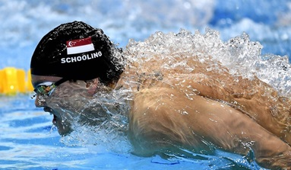
Notes:
When you hear good news you want to shout it out. Last week, the MILWAUKEE BUCKS won their first NBA championship in 50 years.
At the end of May, CHELSEA won the Champions League final, it was only their second ever Champions League Title.
Who knows, maybe in a few weeks, SINGAPORE can celebrate Joseph Schooling winning another gold medal at the Olympics.
When your team wins, you want everyone to know, you celebrate, you shout out the good news.
Of course, any list of champions must include the ALABAMA CRIMSON TIDE, an American College football team, who won the most recent National Championship for the 2020 season.
In fact, looking back the past 11 YEARS,
Milwaukee Bucks logo: https://upload.wikimedia.org/wikipedia/en/4/4a/Milwaukee_Bucks_logo.svg
Chelsea logo https://en.wikipedia.org/w/index.php?curid=22765065
Alabama Crimson Tide loge: https://en.wikipedia.org/wiki/Alabama_Crimson_Tide_football#/media/File:Alabama_Crimson_Tide_logo.svg
Background Photo by Ray Hennessy on Unsplash
https://unsplash.com/photos/gdTxVSAE5sk

Slide 3
Notes:
the Tide have actually won a total of 6 national championships. It’s almost expected for the Alabama Crimson Tide to win the National Championship, but It's still good news and Alabama fans everywhere will celebrate.
Do you know what else is good news? Something you want to shout out as if your favorite team WON THE CHAMPIONSHIP?
Milwaukee Bucks logo: https://upload.wikimedia.org/wikipedia/en/4/4a/Milwaukee_Bucks_logo.svg
Chelsea logo https://en.wikipedia.org/w/index.php?curid=22765065
Alabama Crimson Tide loge: https://en.wikipedia.org/wiki/Alabama_Crimson_Tide_football#/media/File:Alabama_Crimson_Tide_logo.svg
Background Photo by Ray Hennessy on Unsplash
https://unsplash.com/photos/gdTxVSAE5sk

Slide 4
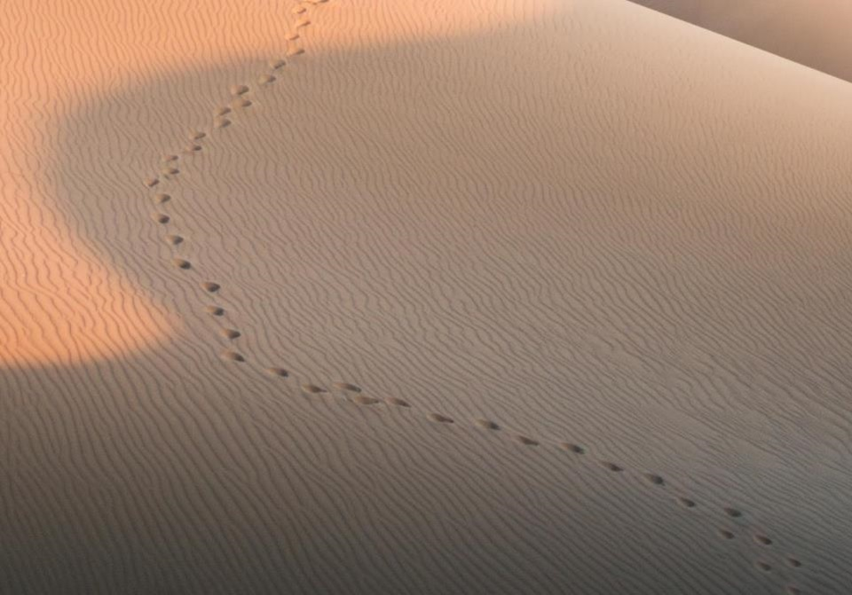
GOOD NE WS
ON THE MO VE
God’s work through the early church in
Acts
Notes:
The gospel. The word gospel literally means “good news.” That is why we called this series Good News on the Move: God’s work through the early church in Acts.
This is a unique title we church elders came up with to describe the book of acts. The title is original –but not really creative. If you look at the New Testament, the first four books are the gospels. First, the “good news” according to Matthew, the “good news” according to Mark, then “good news” according to Luke, and finally the “good news” according to John.
And what do the four books of “Good News” tell us? They tell us about Jesus.
The next book in our New Testament, after the Gospels, IS ACTS.

Slide 5
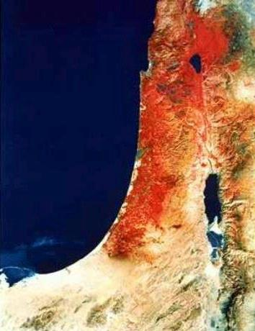
Acts 1:8 NLT
“ends of the earth"
"But you will receive power when the Holy Spirit comes upon you. And you will be my witnesses, telling people about me everywhere—in Jerusalem, throughout Judea, in Samaria, and to the ends of the earth."
Samaria
Jerusalem
Judea
Notes:
In Acts vs. 1:8, Luke, the author, tells us the main point of the entire book of Acts. He says, “But you will receive power when the Holy Spirit comes upon you. And you will be my witnesses, telling people about me everywhere-in Jerusalem, throughout Judea, in Samaria, and (finally) to the ends of the earth.”
Be my witnesses simply means telling people about Jesus. Where are they to tell this witness, this gospel, this good news?
--Jerusalem
--in Judea and Samaria,
--and to the ends of the earth
So we have the “gospel” or “good news” on the move. That’s how we got the first part of our title. As for the second part, we have to CONTINUE SUMMARIZING:

Slide 6
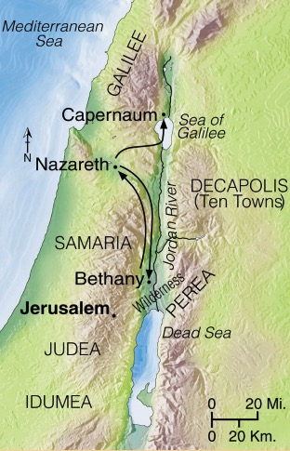
Progress Reports
Key Verse: 1:8
2:47b
6:7
1:1–6:7
And each day the Lord added to their fellowship those who were being saved (Acts 2:47b)
So God’s message continued to spread. The number of believers greatly increased in Jerusalem, and many of the Jewish priests were converted, too (Acts 6:7).
Adapted from Stanley D. Toussaint, BKC; Jeremy Chew, EAST
Notes:
As we continue in the book of Acts, we see Luke give us several progress reports.
FOR EXAMPLE, in the 2nd part of vs. 2:47, he states, “And each day the Lord added to their fellowship those who were being saved.”
THEN IN CH 6 vs. 7, he states, “God’s message continued to spread. The number of believers greatly increased in Jerusalem, and many of the Jewish priests were converted, too.”
The church was growing. The miraculous part was that it was growing despite OPPOSITION.

Slide 7
Opposition & Response
External
Internal
Notes:
There was external opposition in the form of the apostles being arrested and thrown in jail multiple times.
There was internal opposition in the form of church workers holding back, lying about what they were doing, and strife between groups of people.
In all these cases, it was God working through the early church that overcame this opposition and resulted in the CHURCH GROWING.

Slide 8
God's Plan
The church didn’t follow God's Plan:
so God caused Acts 8:1
Acts 1:8 NLT
Acts 8:1 NLT
“ends of the earth"
"But you will receive power when the Holy Spirit comes upon you. And you will be my witnesses, telling people about me everywhere—in Jerusalem, throughout Judea, in Samaria, and to the ends of the earth."
"Saul was one of the witnesses, and he agreed completely with the killing of Stephen. A great wave of persecution began that day, sweeping over the church in Jerusalem; and all the believers except the apostles were scattered through the regions of Judea and Samaria."
Samaria
Jerusalem
Judea
Notes:
We know from Acts 8:1 that God’s plan was for the Church to grow by the Apostles and other believers being witnesses. Being witnesses
--in Jerusalem
--in Judea and Samaria,
--and to the ends of the earth
But it looks like the Church isn’t really following God’s plan. They were just witnessing in Jerusalem.
What happened NEXT? We read in Acts 8:1 that “A great wave of persecution began that day, sweeping over the Church in Jerusalem; and all the believers except the apostles were scattered through the regions of Judea and Samaria.”
When God’s plan is for the believers to witness in Judea and Samaria, God will make a way for believers to witness in JUDEA AND SAMARIA.

Slide 9
God's Plan
The church didn’t follow God's Plan:
so God caused Acts 8:1
Acts 1:8 NLT
Acts 8:1 NLT
“ends of the earth"
"But you will receive power when the Holy Spirit comes upon you. And you will be my witnesses, telling people about me everywhere—in Jerusalem, throughout Judea, in Samaria, and to the ends of the earth."
"Saul was one of the witnesses, and he agreed completely with the killing of Stephen. A great wave of persecution began that day, sweeping over the church in Jerusalem; and all the believers except the apostles were scattered through the regions of Judea and Samaria."
Samaria
Jerusalem
Judea
Notes:
In this case, God is working, not through the early Church, but through Saul, who is not only an unbeliever; he is actively and viciously persecuting the church.
Luke writes that “Saul was one of the witnesses, and he agreed completely with the killing of Stephen.”
So, the result of the persecution by Saul was that the believers began to witness, not just in Jerusalem, but also in JUDEA AND SAMARIA.

Slide 10
Progress Reports
Key Verse: 1:8
2:47b
6:7
8:40
9:31
1:1–6:7
6:8–12
Adapted from Stanley D. Toussaint, BKC; Jeremy Chew, EAST
Notes:
As we continue in our review of Acts we see Philip, witnessing in Samaria. You can find that in Acts ch 8.
THEN SOMETHING interesting happened. Acts 9:31 tells us, “The church then had peace throughout Judea, Galilee, and Samaria, and it became stronger as the believers lived in the fear of the Lord. And with the encouragement of the Holy Spirit, it also grew in numbers.
WHAT HAPPENED between Acts 8:1 (where Saul persecuting the church and had the believers scattering) and Acts 9:31 (where the believers had peace)? Saul’s conversion, which you can read at the beginning of Acts ch 9.
Luke gives a few more PROGRESS REPORTS,

Slide 11
Progress Reports
End of the Earth
Key Verse: 1:8
2:47b
6:7
8:40
9:31
12:24
16:5
19:20
1:1–6:7
6:8–12
Acts 13–20
Adapted from Stanley D. Toussaint, BKC; Jeremy Chew, EAST
Notes:
Luke writes in
In vs. 12:24 Meanwhile, the word of God continued to spread, and there were many new believers.
In vs. 16:5 So the churches were strengthened in their faith and grew larger every day.
And in vs. 19:20 So the message about the Lord spread widely and had a powerful effect.
What I find interesting is that, although it was persecution that caused the believers to witness throughout Judea and Samaria, it was the Holy Spirit, working through the elders at the Church at Antioch that continued this work through the believers..
If you recall from Acts ch 13 vs.2, “One day as these men were worshiping the Lord and fasting, the Holy Spirit said, “Appoint Barnabas and Saul for the special work to which I have called them.” So after more fasting and prayer, the men laid their hands on them and SENT THEM on their way.” This led to 3 missionary journeys that Luke writes about in chapters 13-20.
After these 3 journeys, Paul returns to Jerusalem with plans to eventually go to ROME.

Slide 12
¹⁰ One of the things I
always pray for is the
opportunity, God willing, to come at last to
see you. ¹¹ For I long to visit
you so I can bring you some spiritual gift that will help you grow strong in the Lord. ¹² When we get together, I want to encourage you in your faith, but I also want to be encouraged by yours.
Notes:
Sometimes God’s plans are not our plans.
You see, Paul’s plan was to go and visit the believers in Rome.
While in Ephesus, he wrote to the Roman believers telling them, “One of the things I always pray for is the opportunity, God willing, to come at last to see you. 11 For I long to visit you so I can bring you some spiritual gift that will help you grow strong in the Lord. 12 When we get together, I want to encourage you in your faith, but I also want to be encouraged by yours.
But, when Paul gets to Jerusalem and is worshipping in the temple, a riot started, Paul is getting beat up, so the Romans come and ARREST PAUL.

Slide 13
¹⁵ But the Lord said,
“Go, for Saul is my chosen instrument
to take my message
to the Gentiles and
to kings, as well as
to the people of
Israel.
Acts 9:15 NLT
Paul Speaks to:
the crowd
the High Council
Governor Felix
Governor Festus
King Agrippa
Ch 20-26
Notes:
Instead of going to Rome like he planned, Paul is thrown in jail. He ends up being in prison for over 2 years, just waiting for a fair trial.
But we see God working through Paul throughout this period, which you can read about in chapters 20-26.
Shortly after his arrest, he has an opportunity to
address the crowd gathered at the temple.
He then addresses the Jewish High Council, and
later his case is heard by the Roman Governor Felix.
Felix sits on the case for 2 years, so when he is replaced,
Paul speaks to Governor Festus. It's here that Paul appeals to have his case heard by Caesar.
Festus, unsure of what to charge him with before sending him to Rome, asks King Agrippa for help.
All this is part of GOD’S PLAN, as we saw back in Acts 9:15 that, “the Lord said, “Go, for Saul is my chosen instrument to take my message to the Gentiles and to kings, as well as to the people of Israel.”
When God’s plan is for Paul to speak to kings, God will make a way for Paul to speak TO KINGS.

Slide 14
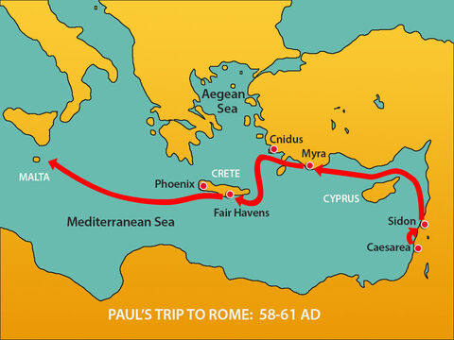
¹¹ That night the Lord appeared to Paul and said, “Be encouraged, Paul. Just as you have been a witness to me here in Jerusalem, you must preach the Good News in Rome as well.”
Notes:
Last week, Manik spoke about Paul’s journey to Rome. The Title of that sermon was “Of Storms and Shipwrecks.” So you can pretty much guess what happened.
There was a big storm, and they ended up being shipwrecked on the island of Malta.
But there was never any doubt in Paul’s mind that he would reach Rome. Do you know why?
Because IN ACTS 23:11 Luke records that, “the Lord appeared to Paul and said, ‘Be encouraged, Paul. Just as you have been a witness to me here in Jerusalem, you must preach the Good News in Rome as well.’”
When God’s plan is for Paul to go to Rome, God will make a way for Paul to go TO ROME.

Slide 15
Reaching Rome and then . . .
Acts 28:11-31
Matt Lyle • Crossroads International Church Singapore
CICFamily.com
Notes:
And that is what we are looking at today, Acts ch 28 vs. 11-31. The final chapter of Acts. The final lesson of our series.
Paul is finally going to Rome. This is the climax of our story! What is going to happen? Will he get to speak to Caesar? Will he get a fair trial? Will he be executed?
Go ahead and turn in your Bible or on your apps to acts ch 28 vs. 11, and let's find out WHAT HAPPENS.

Slide 16
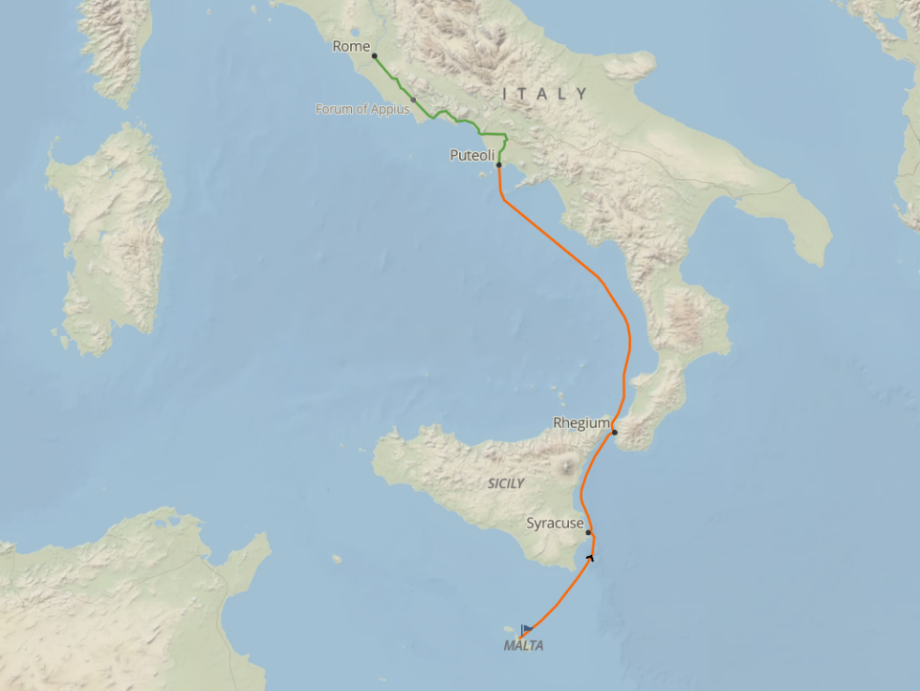
Notes:
Starting in ch 28 vs. 11, we read that “it was three months after the shipwreck that we set sail on another ship that had wintered at the island—an Alexandrian ship with the twin gods as its figurehead. 12 Our first stop was Syracuse, where we stayed three days. 13 From there we sailed across to Rhegium. A day later a south wind began blowing, so the following day we sailed up the coast to Puteoli
Once again, Luke provides us with plenty of details. He tells us where they were and how long they stayed. On the PowerPoint slide, you can see each of these places, where they started on the island of Malta, and the stops at Syracuse, Rhegium, and finally ending their sea voyage at PUTEOLI.

Slide 17
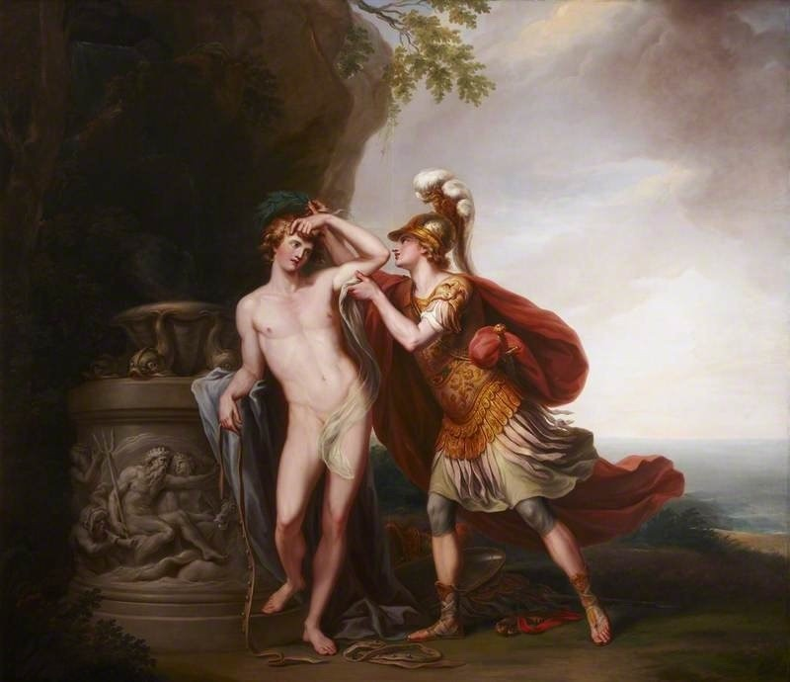
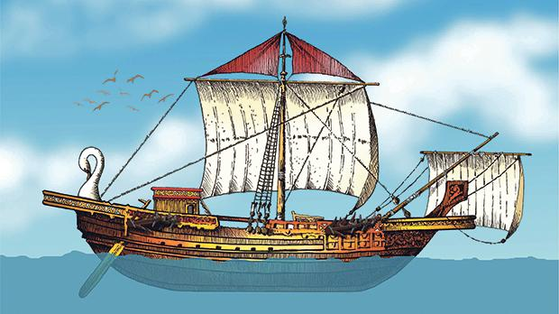
Castor & Pollux
Notes:
After being shipwrecked for 3 months, they can get passage on a large ALEXANDRIAN SHIP, which is basically a cargo ship to carry grain. And the ship had as its figurehead these two Roman gods.
I find this reference to Castor and Pollux interesting. Castor and Pollux are found in both Greek and Roman mythology. They were worshiped as the patron gods of sailors.
These sailors were putting their faith in these so-called gods to keep them safe on their travels. This is a basic truth seen throughout history. Man needs to put his faith in something! Unfortunately, all too often, the world relies on false gods.
In the past, it was mythology, gods of nature, seasons, weather. More recently, it has been science. Science tells us that with the big bang something came from nothing. Science tells us that with evolution the simple can become complex. Obviously science does not give us the answer. Real science tells us something does not come from nothing. Real science tells us that the simple does not become complex. Real science proves we shouldn’t exist. Therefore since we do exist, there must be a God who CREATED US.
Egyptian grain ship, by artist Victor Pulis.
https://timesofmalta.com/articles/view/St-Paul-s-voyage-and-shipwreck-the-ship-and-its-wise-captain.638728

Slide 18
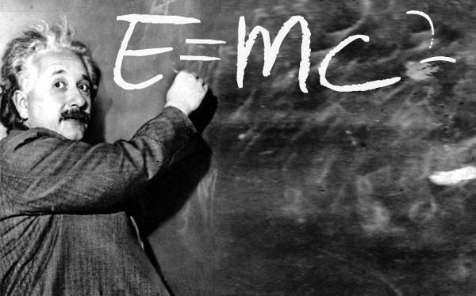
Notes:
People are starting to realize that science does not give the answers. But instead of turning to God, they turn even further away from science.
Most people are familiar with Albert Einstein and have at least heard of the Theory of Relativity, and the famous formula E = mc^2.
Just as science has proved that you need a cause to have an effect, just as science proves that something doesn’t come from nothing, and systems evolve from order to chaos, the science of relativity tells us something about space travel.
Last Tuesday, Jeff Bezos, the founder of Amazon, recently travelled into space for a few minutes. There are many science fiction books that talk about travelling to other planets.
But real science tells us that relativistic effects such as time dilation and increase in mass have been proven in the real world. This means there will not be travel between the different galaxies and solar systems. But what do people want TO BELIEVE?

Slide 19
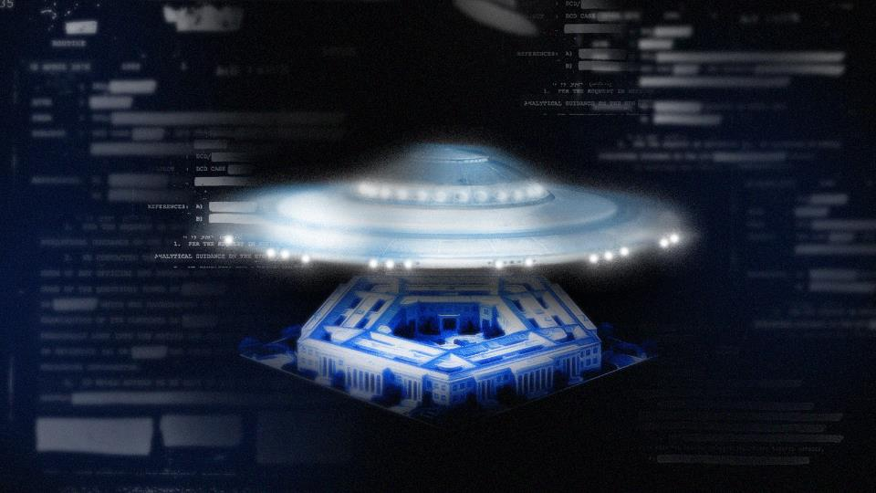
Notes:
UFOs! Last month, June 2021, the US government released a much-anticipated Pentagon UFO report. This is actual news, not science fiction. More and more people are willing to believe in the existence of UFOs.
How silly is that!
Actually, It's quite sad. People need to have faith in something. As Christians, like Paul, we place our faith in God. We put our faith in Jesus, the son of the living God, whose life, death, and resurrection gives us victory of sin, death, AND SATAN.
https://www.cnet.com/news/the-much-anticipated-pentagon-ufo-report-lands-today-what-to-know/

Slide 20
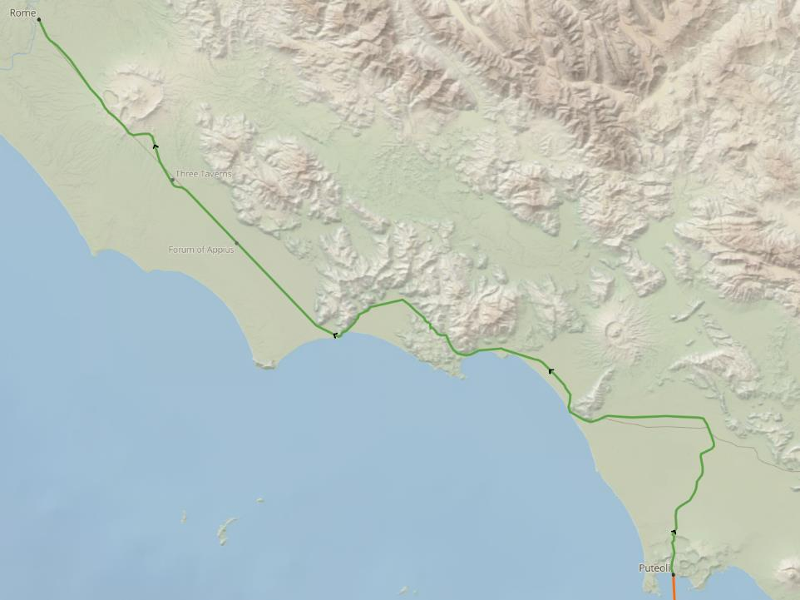
Rome
Three Taverns
Forum
Puteoil
Notes:
On this journey, Paul is not alone in placing his faith in God.
Continuing our reading in vs. 14, “There (speaking of Puteoli, where they finished the sea portion of their journey) we found some believers, who invited us to spend a week with them. And so we came to Rome.
15 The brothers and sisters in Rome had heard we were coming, and they came to meet us at the Forum on the Appian Way. Others joined us at The Three Taverns. When Paul saw them, he was encouraged and thanked God.
Don’t you find that amazing? Three different groups of believers met with Paul on his way up to Rome. They gave him encouragement. But that is what Christians do. Christians go out of their way to gather together. Even with all the COVID 19 restrictions you are here today, or you are joining us online. And when we gather together, It's VERY ENCOURAGING.

Slide 21
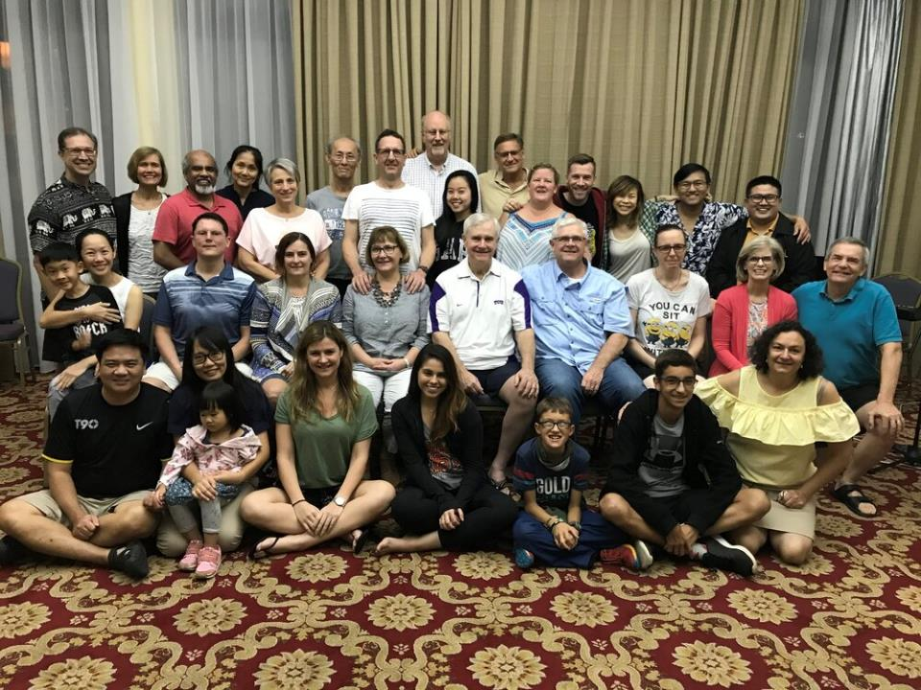
So encourage each other and build each other up, just as you are already doing (1 Thes 5:11 NLT)
Notes:
I think Paul needed the encouragement. Luke recorded that he thanked God.
Who knows, maybe that’s why Paul told Thessalonians to “therefore encourage one another and build each other up, just as in fact you are doing.”
Today I want to challenge you to go out of your way to encourage one another and build each other up.
We read Psalm 133 earlier in our service. How wonderful and pleasant it is when brothers live together in harmony. We are meant to gather together.
We sang, “we gather together to ask the Lord’s blessing.” In the US, that song is often sang around our Thanksgiving holiday, where we gather together with our families. As God’s people, we are meant to gather together.
So if it’s just having 2 people over for dinner, then invite two people over. Or even better, you and one other person visit a family who can’t go visit others but bring dinner along. Don’t place the burden on the large family to PREPARE FOOD.

Slide 22
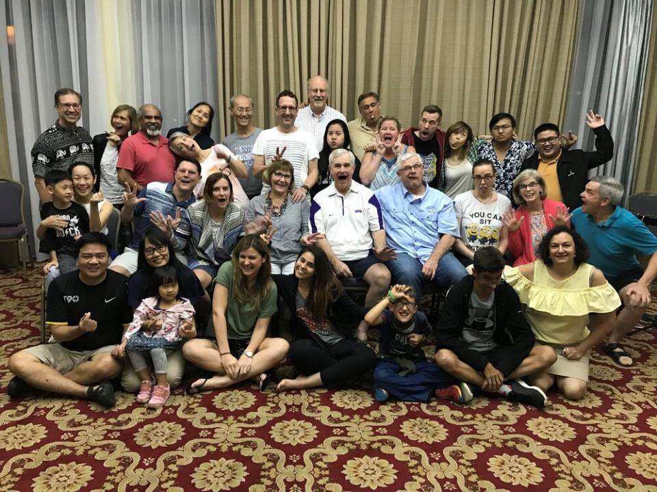
Notes:
With all the COVID 19 restrictions, it may be difficult to go out of your way to encourage one another and build each other up.
But when you really think about it, even after the COVID restrictions are eased, it will still be difficult to gather together and encourage one another. Our lives are so busy today. So many things get in the way. We may not have to walk 42 km like the believers in Paul’s day, in order to encourage one another, but we have our own difficulties to overcome.
But when you accept this challenge to encourage one another, you will see joy, like in this picture.
These two photos are from our last church retreat, back in 2019. Who knows, maybe we can gather together sometime later this year. A church retreat would be something to LOOK FORWARD TO.

Slide 23
Reaching Rome and then . . .
Notes:
Paul has been looking forward to reaching Rome. Now he is finally there.
Starting with vs. 16, we read that “When we arrived in Rome, Paul was permitted to have his own private lodging, though he was guarded by a soldier.”
It’s not really fair that Paul had to appeal his case to Caesar. He was innocent of all charges levied against him. He should have been set free. And now, he has to pay for his “house arrest.” But Paul does not make a big deal about it. He is BEING GRACIOUS.

Slide 24
Being Gracious
³² Don’t give offense to Jews or Gentiles or the church of God. ³³ I, too, try to please everyone in everything I do. I don’t just do what is best for me; I do what is best for others so that many may be saved (1 Cor 10:32-33 NLT).
Notes:
Not only is Paul gracious with his Roman hosts, he is gracious with his own people, the Jews who are in Rome. Even though the Jews in his home country were responsible for his current situation.
Starting with vs. 17, Three days after Paul’s arrival, he called together the local Jewish leaders. He said to them, “Brothers, I was arrested in Jerusalem and handed over to the Roman government, even though I had done nothing against our people or the customs of our ancestors. 18 The Romans tried me and wanted to release me, because they found no cause for the death sentence. 19 But when the Jewish leaders protested the decision, I felt it necessary to appeal to Caesar, even though I had no desire to press charges against my own people.
Paul doesn’t want to press charges. He doesn’t want to cause offense. That is an important point. We should try not to offend when giving an OFFENSIVE MESSAGE.
The NIV translates do not give offense as do not cause anyone to stumble. If we come across as rude, arrogant, and sarcastic, we will not be effective witnesses to GOD’S MESSAGE.

Slide 25
The message of the cross is foolish to those who are headed for destruction!
(1 Cor 1:18 NLT)!
Notes:
We are not to cause offense, but we do recognize that the gospel message is inherently offensive.
Paul writes that “The message of the cross is foolish to those who are headed for destruction!
Paul sets a great example. He could have been offensive and demanded justice against those trying to kill him, for they were definitely violating their own law. He could have demanded payment for his expenses. Yet, he bore those injustices for the sake of the gospel.
How can you be gracious like Paul today? In Singapore, you just need to follow the Maintenance of Religious Harmony Act (MRHA), which is based on the principle that Followers of different religions should exercise moderation and tolerance towards each other and their beliefs, and not instigate religious enmity or hatred.
I will still close my windows when someone drops a large amount of joss paper into the burn bins located around my flat. But I’m not going to call and complain about the smoke or asked for the bins to be moved away from my window.
I admit, trying to be gracious like Paul is difficult but It's WORTH DOING.
Photo by Issy Bailey on Unsplash
https://unsplash.com/photos/tEIHSmfwznM

Slide 26
The Hope of Israel
Notes:
We see the reason why we should be gracious or non-offensive when giving an offensive message in the next passage, starting at vs. 20, “I asked you to come here today so we could get acquainted and so I could explain to you that I am bound with this chain because I believe that the hope of Israel—the Messiah—has already come.”
Why are we gracious? Because we believe the hope of Israel, the Messiah, has already come.
If you recall from the many time Paul spoke and defended himself against the baseless accusations made against him, it all boiled down to “was Jesus the promised Messiah.” Paul’s answer was simply yes, he is. That is why Paul has hope.
Earlier we sang about Jesus’ death and resurrection.
There in the ground His body lay, Light of the world by darkness slain
Then bursting forth in glorious Day, Up from the grave He rose again.
That is Paul’s hope. Jesus the risen Messiah. So now Paul can say
And as He stands in victory, Sin's curse has lost its grip on me
For I am His and He is mine, Bought with the precious blood of Christ.
Paul was being gracious because he believes the hope of Israel, the Messiah, has ALREADY COME.
Photo by Zac Durant on Unsplash
https://unsplash.com/photos/_6HzPU9Hyfg

Slide 27
Religion
Good Works
Morality
Sinful
Humanity
Holy
God
Philosophy
Notes:
Why do we need hope? We know there is a God. Science tells us there has to be one.
We know from the Bible that we are a SINFUL HUMANITY, but he is a HOLY GOD. That presents a problem. Because of SIN, we are separated from the Holy God. We try many ways to overcome this separation from God.
RELIGION that doesn’t WORK
GOOD WORKS
MORALITY
Even PHILOSOPHY.
The only thing bridges the GAP

Slide 28
CHRIST
Religion
Good Works
Morality
Sinful
Humanity
Holy
God
Philosophy
Notes:
Is Christ.
Christ is the only thing that can bridge the gap between sinful humanity and a holy God.
Christian know that hope is fulfilled in Jesus. Christ is the hope of Israel.
That is the message of hope that Paul wanted to give to THE JEWS.

Slide 29
Sharing Hope
Notes:
Paul spends quite a bit of time sharing this message of hope with the Jews. Skipping ahead to vs 23 we see that
“a time was set, and on that day a large number of people came to Paul’s lodging. He explained and testified about the Kingdom of God and tried to persuade them about Jesus from the Scriptures. Using the law of Moses and the books of the prophets, he spoke to them from morning until evening.
We as Christians, just like Paul, need to be ready to share our hope with non-believers over and over and over and over and over and over and over again. I think the best way to do this is to live out the Great Commandment, found in Matthew ch 22 vs 37-40:
“‘You must love the Lord your God with all your heart, all your soul, and all your mind.’ 38 This is the first and greatest commandment. 39 A second is equally important: ‘Love your neighbor as yourself.’ 40 The entire law and all the demands of the prophets are based on these two commandments.”
When your focus is on loving God and Loving man, you will be an effective witness In Jerusalem, Judea and Samaria, and to the ends of THE EARTH.

Slide 30
Choose a Path
Notes:
Now the Jews have heard Paul’s message. His message that the hope of Israel is being fulfilled in the person of Jesus.
How do they respond? Starting at vs. 24, “Some were persuaded by the things he said, but others did not believe.”
This can be disheartening. When you know you have good news, such as your favorite team is the national champion you want everyone to celebrate with you.
But Paul is sharing something so much more important than a team winning a championship. Paul is sharing life, eternal life. But sadly, some don’t believe. Instead, some choose the wrong path.”
But Paul doesn’t get discouraged. Instead, he leans on scripture for ENCOURAGEMENT.
Photo by Beth Macdonald on Unsplash
https://unsplash.com/photos/P3rS8J1THi4

Slide 31
God’s word is Truth
Notes:
Paul has one final message for Jewish people. Starting at vs. 25 “after they had argued back and forth among themselves, they left with this final word from Paul: “The Holy Spirit was right when he said to your ancestors through Isaiah the prophet,
26 ‘Go and say to this people: When you hear what I say, you will not understand.
When you see what I do, you will not comprehend.
27 For the hearts of these people are hardened, and their ears cannot hear,
and they have closed their eyes—
so their eyes cannot see, and their ears cannot hear, and their hearts cannot understand,
and they cannot turn to me and let me heal them.’
God’s word is truth. Unfortunately some choose not to hear the truth. But that does not excuse us from being witnesses of the truth in Jerusalem, Judea and Samaria, or to the ends of THE EARTH.
Photo by Taylor Wilcox on Unsplash
https://unsplash.com/photos/ZHY7-YaGG2U

Slide 32
Boldly Proclaiming the Kingdom of God
Notes:
God’s truth is going to the ends of the earth and to everyone on the earth. So after Paul chastises the Jews for being blind, deaf, and hard-hearted, he finishes by saying, “so I want you to know that this salvation from God has also been offered to the Gentiles, and they will accept it.”
Luke concludes by telling us that “for the next two years, Paul lived in Rome at his own expense. He welcomed all who visited him, 31 boldly proclaiming the Kingdom of God and teaching about the Lord Jesus Christ. And no one tried to stop him.”
So what did Paul BOLDLY PROCLAIM?
Photo by The New York Public Library on Unsplash
https://unsplash.com/photos/yEauzeZU6xo

Slide 33
Main Idea
Our Hope is in Jesus,
the Promised Messiah, who brings Victory
(over Sin and Death)
for Jews and Gentiles
Notes:
Our hope is in Jesus, the Promised Messiah, who brings victory (over Sin and Death) for Jews and Gentiles
Jesus conquered death. He rose from the grave. So we, too, can conquer sin and death. And this victory is not just the hope of Israel, but It's also the hope of the Gentiles.
That is how the book of Acts concludes. Not with a big climactic scene, not with Paul being exonerated or executed, but by showing God continuing to work through THE CHURCH.

Slide 34
—in Jerusalem, throughout
Judea, in Samaria, and to the
ends of the earth."
(family)
“ends of the earth"
Samaria
Jerusalem
Judea
Notes:
Just as God was working through the church in the book of Acts, he is working through the church today.
God called the early church to be witnesses in Jerusalem. Most of the early church was from Jerusalem. That was their home. That is where their families were located.
Today, we can be witnesses in OUR HOMES, with our family. Our Jerusalem is our family.
It's tough witnessing to our own family. You need to be gracious, not condescending. It’s less about what you say and more about what you do. Paul stated, “all must repent of their sins and turn to God—and prove they have changed by the good things they do.” Let your family see the good things that you do. Let your actions and your attitude be your witness.
If Jerusalem is our home and family, where is our JUDEA AND SAMARIA?

Slide 35
—in Jerusalem, throughout
Judea, in Samaria, and to the
ends of the earth."
(family)
“ends of the earth"
(work)
Samaria
Jerusalem
Judea
Notes:
I think it would be our place of work, our school, where we go when we leave our home.
Once you leave your home, where do you spend the most time? At work or at school. We are called to be witnesses at our work or at our school. It’s easier for me since I am going to Singapore Bible College.
But I remember back when I was in the Navy, someone asked me why I wasn’t like the other officers on the ship. What I wasn’t stressing out over the next inspection. I said my hope was in Jesus, not my job. If you are not familiar with the US Navy, you move every 2 to 3 years. When you take over a new job, you are responsible, even if the problems are caused by your predecessor. I arrived in January and soon realized I would likely get fired. But instead of letting it bother me, I kept a good attitude and just tried my best. God did something amazing. He sent good people. We aced our inspections. And all the glory goes to God.
And finally, where are the ENDS OF THE EARTH?

Slide 36
—in Jerusalem, throughout
Judea, in Samaria, and to the
ends of the earth."
“ends of the earth"
Samaria
Jerusalem
Judea
Notes:
In Singapore, Changi, or Sembawang, or Tuas could be considered the ends of the earth, depending on WHERE YOU LIVE.

Slide 37
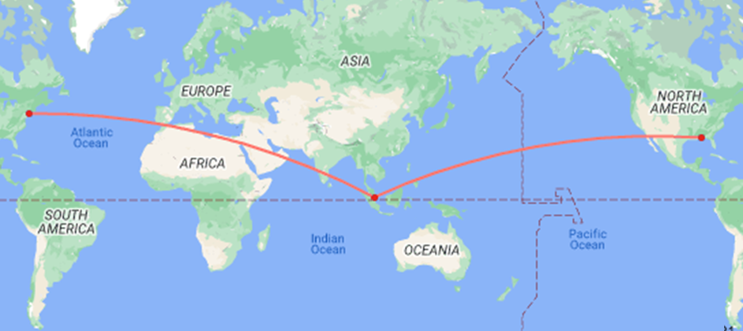
SIN to JFK
SIN to PNS
15,323 km
16,283 km
Notes:
I am from northwest Florida. A direct flight from Singapore to Pensacola Florida would be 16,283 km.
IF YOU GO the other direction, a direct flight to JFK in New York City is only 15,323 km.
I don’t consider myself to be at the ends of the earth. At Crosssroads, though, we are supporting missionaries pretty much to the ends of the earth, from Jordan, to India, to Pakistan, to Thailand, to Nepal, to Korea, and beyond.
Regardless of where you are or where God calls you, you are called to be a witness, telling people everywhere about Jesus. Tell people that your Hope is in Jesus, the Promised Messiah. Tell people that Jesus brings Victory over Sin and Death for JEWS AND GENTILES.

Slide 38
Progress Reports
End of the Earth
Key Verse: 1:8
2:47b
6:7
8:40
9:31
12:24
16:5
19:20
28:30-31
1:1–6:7
6:8–8:40
Acts 9–28
Adapted from Stanley D. Toussaint, BKC; Jeremy Chew, EAST
Notes:
And that is how Luke finishes the book of Acts, showing that Paul was in Rome, telling people that their Hope was in Jesus, the Promised Messiah. Telling people that Jesus brings Victory over Sin and Death for Jews and Gentiles.
Telling people a story (now its an old story)
How a Savior came from Glory.
How He gave His life on Calvary
To save a wretch like me
These are the words to the first stanza of the song Victory in Jesus, which we are going to sing for our closing, because our Hope is in Jesus, the promised Messiah, who brings victory over sin and death for Jews and Gentiles.
IF I HAD to assign a grade, I would have to give the early church an A+ when it comes to fulling the command to be my witnesses in Jerusalem, Judea and Samaria, and to the ends of the earth. But in reality, it’s God’s work through the early church; and today God is still working though us.
LET US PRAY.

Slide 39
Notes:
Gracious heavenly father, we thank you so much for these amazing stories of how you worked through the early church. We thank you for the good news, that Jesus is the Messiah, the son of the living God. We thank you because of what Jesus has done through his life, death, and resurrection, so that we can have victory of sin, death, and Satan.
Lord God, we ask that you give us the strength and courage to be your witnesses to our Jerusalem, our family and friends; be witnesses to our Judea and Samara, our work place or school, and even to our ends of the earth, whether that is Changi, Yishun, Tuas, Jordan, Korea, or wherever we are called. We pray all this in the name of your Son, Jesus. Amen.

