Slide 1
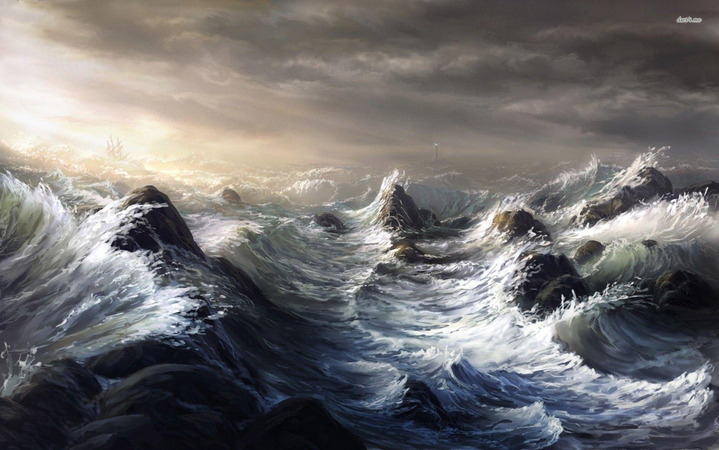
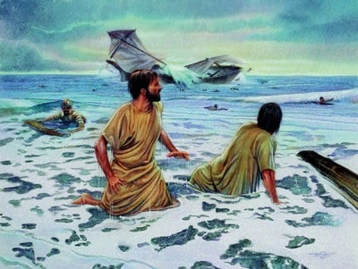
OF Storms & shipwrecks
Sermon at Crossroads International Church
Sunday, July 18th, 2021

Slide 2
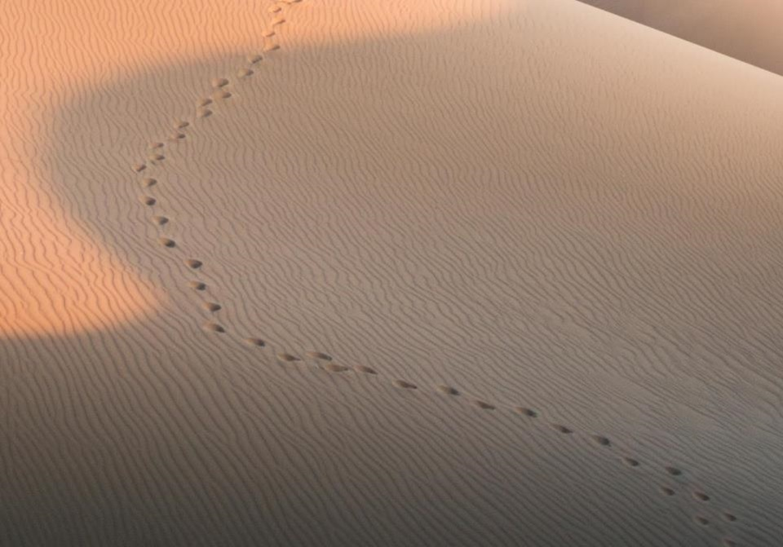
GOOD NE WS
ON THE MO VE
God’s work through the early church in
Acts
Notes:
We are continuing in our series called Good News on the Move, God’s work through the early church in Acts.
In the previous 19 sermons we have seen a lot of people on the move.
At the beginning of the book of Acts, we saw the church growing in Jerusalem, undergoing persecution, and spreading to Samaria.
As the book of Acts progressed, we are introduced to Saul, also known as Paul.

Slide 4
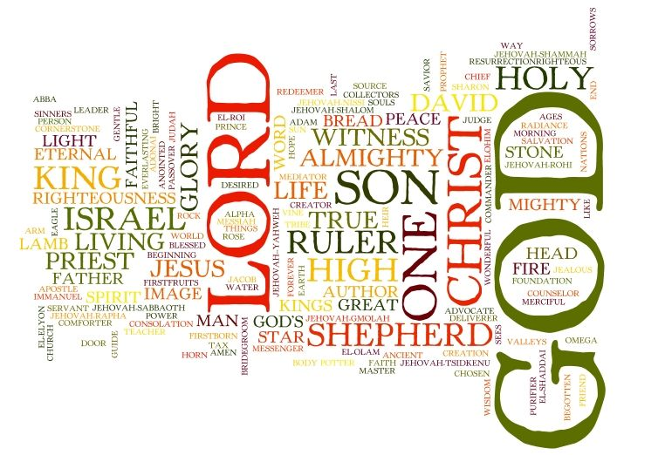

Slide 5
ACTS 27-28:10
Luke devotes 3 times more space for the journey to Rome than what happens when they get there.
God is faithful to bring Paul and his fellow-travellers safely to Rome.

Slide 6
ACTS 27:1-38
Paul is not alone – Luke and Aristarchus from Thessalonica is with him, as well as other prisoners.
Luke provides a detailed commentary on their journey.

Slide 7
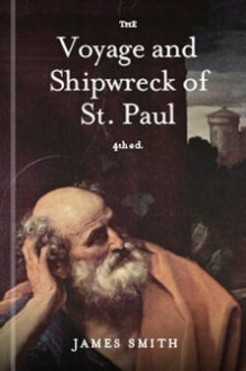
“…no man not a sailor could have written a narrative of a sea voyage so consistent in all its parts, unless from actual observation.”

Slide 8
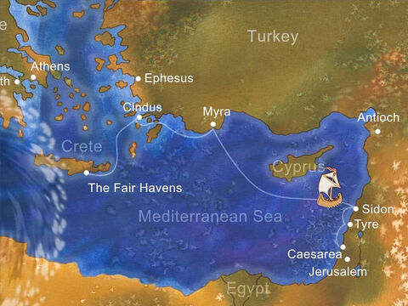

Slide 9
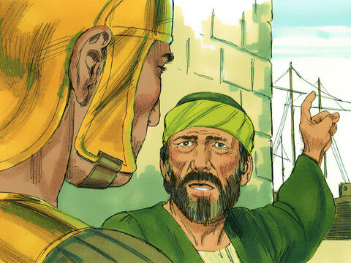

Slide 10
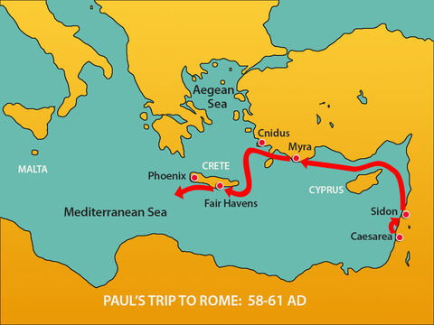

Slide 11
ACTS 27:1-38
Paul warned them not to go. He knew the dangers of the oceans (verse 9 – see 2 Cor 11:25-26).
Things soon took a turn for the worst (verses 14-20).

Slide 12
²⁰ When neither sun nor stars appeared for many days, and no small tempest lay on us, all hope of our being saved was at last abandoned.
²¹ Since they had been without food for a long time, Paul stood up among them and said, “Men, you should have listened to me and not have set sail from Crete and incurred this injury and loss. ²² Yet now I urge you to take heart, for there will be no loss of life among you, but only of the ship. ²³ For this very night there stood before me an angel of the God to whom I belong and whom I worship, ²⁴ and he said, ‘Do not be afraid, Paul; you must stand before Caesar. And behold, God has granted you all those who sail with you.’ ²⁵ So take heart, men, for I have faith in God that it will be exactly as I have been told. ²⁶ But we must run aground on some island.”

Slide 13
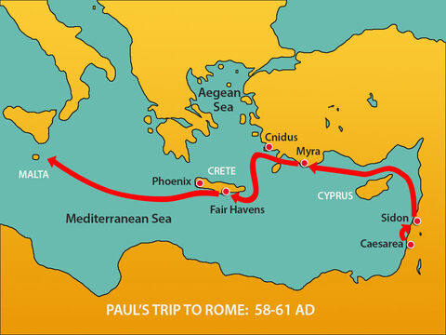

Slide 14
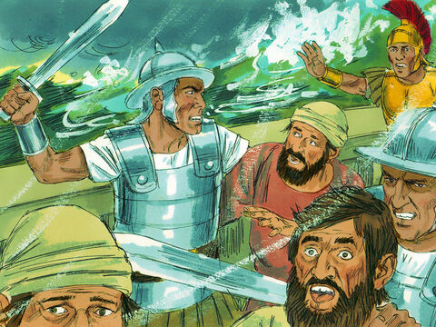

Slide 15
ACTS 27:39-28:10
God is sovereign.

Slide 16
“…here we see vividly illustrated the mysterious providence of God as he works out his purposes amidst the apparent misfortunes encountered while living in this fallen world.”
Ajith Fernando, NIV Application Commentary: Acts, Zondervan Academic: 1988

Slide 17
ACTS 27:39-28:10
God is sovereign.
God’s sovereignty is a sub-theme in Acts: 2:14-36; 3:12-26; 4:23-31; 12:5-18; 17:24-31; 28:16-31.

Slide 18
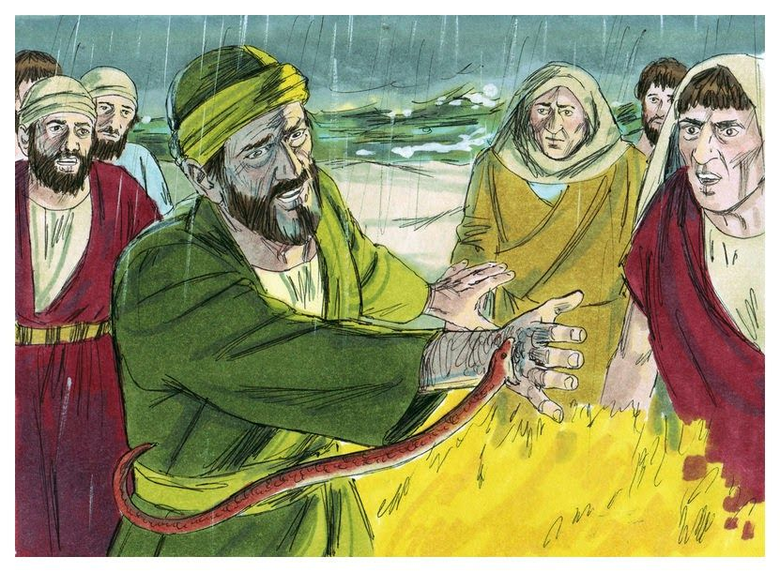

Slide 19
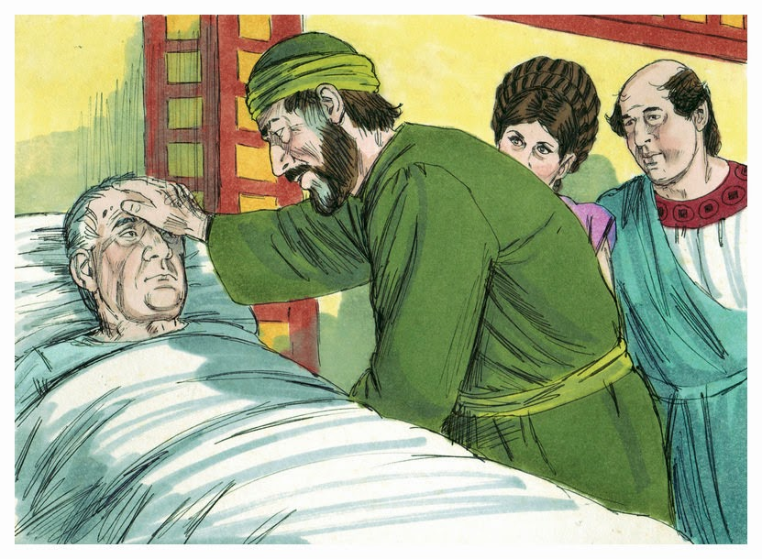

Slide 20
ACTS 27:39-28:10
God is sovereign.
God can use us, as he did Paul, in trying circumstances, to bring hope and healing to those who don’t know him.

Slide 21
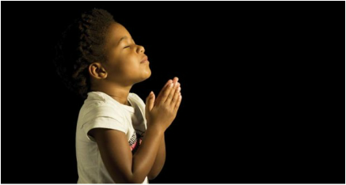
LET US PRAY

