Slide 1
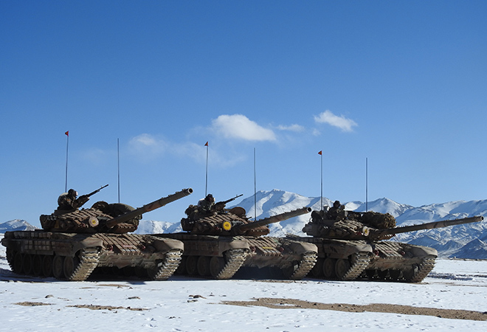
How Do I Defend Myself?
Standing strong in faith when persecuted for Christ
Acts 23:12-24:27

Slide 2
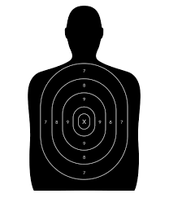
Recognize that you will receive unjust treatment because of your faith in Christ

Slide 3
Jesus
Paul
Prophesies his delivery by Jews to Gentiles when he enters Jerusalem
Receives prophecy of his delivery by Jews to Gentiles when he enters Jerusalem
Enters the temple to purify it
Enters the temple with vows of purity
Priests seek to kill him
Priests seek to kill him
New party has plot to kill him (Judas)
New party has plot to kill him
(40 vows)
Romans arrest him and try him
Romans arrest him and try him
Jews accuse him of disrupting peace
Jews accuse him of disrupting peace

Slide 4
Jesus
Paul
Romans find no guilt to priests’ charges
Romans find no guilt to priests’ charges
Roman officials try to please Jews
Roman officials try to please Jews
Send Jesus to death
Send Paul to Rome

Slide 5
1 Peter 4:12
“Beloved, do not be surprised at the fiery trial when it comes upon you to test you, as though something strange were happening to you.”

Slide 6
Recognize that you will receive unjust treatment because of your faith in Christ
Some opponents are emotionally convinced you are an enemy (23:12-14, 21)

Slide 7
“To make such an oath, they must have burned with intense hatred against the apostle, a hatred which must have been the accumulation of many years, in some cases probably going back to their reactions at the time of Paul’s conversion.”

Slide 8
Recognize that you will receive unjust treatment because of your faith in Christ
Some opponents are emotionally convinced you are an enemy (23:12-14, 21)
Some opponents make intricate plans for your demise (23:15)
Some opponents make false or exaggerated claims of your guilt (24:1-9)

Slide 9
Recognize that you will receive unjust treatment because of your faith in Christ
Rely on God to protect you
He protects us with unexpected advocates (23:16-22)
He protects us with government rules (23:23-30)
He protects us with human political ploys (24:22-23, 27)

Slide 10
Recognize that you will receive unjust treatment because of your faith in Christ
Rely on God to protect you
Ready yourself to explain your faith
Expose what is false (24:10-13, 17-20)
Explain what is true (24:14-16, 21, 24-26)

