Slide 1
O Church Arise
Keith Getty | Stuart Townend
(Performed by CIC Worship Band)
CCLI Song #4611992
© 2005 Thankyou Music
CIC CCLI License # 277507

Slide 2
O church arise
and put your armour on
Hear the call of Christ our Captain
For now the weak
can say that they are strong
In the strength that God has given
V1a

Slide 3
With shield of faith
and belt of truth
We'll stand against the devil's lies
An army bold
whose battle cry is Love
Reaching out to those in darkness
V1b

Slide 4
Our call to war
to love the captive soul
But to rage against the captor
And with the sword
that makes the wounded whole
We will fight with faith and valour
V2a

Slide 5
When faced with trials
on every side
We know the outcome is secure
And Christ will have
the prize for which He died
An inheritance of nations
V2b

Slide 6
Come see the cross
where love and mercy meet
As the Son of God is stricken
Then see His foes
lie crushed beneath His feet
For the Conqueror has risen
V3a

Slide 7
And as the stone
is rolled away
And Christ emerges from the grave
This victory march
continues till the day
Every eye and heart shall see Him
V3b

Slide 8
So Spirit come
put strength in every stride
Give grace for every hurdle
That we may run
with faith to win the prize
Of a servant good and faithful
V4a

Slide 9
As saints of old
still line the way
Retelling triumphs of His grace
We hear their calls
and hunger for the day
When with Christ we stand in glory
V4b (final)

Slide 10
Scripture Reading
John 15:18-16:4 (ESV)

Slide 11
Ch 15 ¹⁸ “If the world hates you, know that it has hated me before it hated you. ¹⁹ If you were of the world, the world would love you as its own; but because you are not of the world, but I chose you out of the world, therefore the world hates you. ²⁰ Remember the word that I said to you: ‘A servant is not greater than his master.’ If they persecuted me, they will also persecute you. If they kept my word, they will also keep yours.
John 15:18-16:4 (ESV)

Slide 12
²¹ But all these things they will do to you on account of my name, because they do not know him who sent me. ²² If I had not come and spoken to them, they would not have been guilty of sin, but now they have no excuse for their sin. ²³ Whoever hates me hates my Father also. ²⁴ If I had not done among them the works that no one else did, they would not be guilty of sin, but now they have seen and hated both me and my Father. ²⁵ But the word that is written in their Law must be fulfilled: ‘They hated me without a cause.’
John 15:18-16:4 (ESV)

Slide 13
²⁶ “But when the Helper comes, whom I will send to you from the Father, the Spirit of truth, who proceeds from the Father, he will bear witness about me. ²⁷ And you also will bear witness, because you have been with me from the beginning.
John 15:18-16:4 (ESV)

Slide 14
Ch 16 ¹ “I have said all these things to you to keep you from falling away. ² They will put you out of the synagogues. Indeed, the hour is coming when whoever kills you will think he is offering service to God. ³ And they will do these things because they have not known the Father, nor me. ⁴ But I have said these things to you, that when their hour comes you may remember that I told them to you.
John 15:18-16:4 (ESV)

Slide 15
Mighty To Save
Ben Fielding | Reuben Morgan
(Performed by CIC Worship Band)
CCLI Song #4591782
© 2006 Hillsong Music Publishing Australia
CIC CCLI License # 277507

Slide 16
Ev’ryone needs compassion
Love that's never failing
Let mercy fall on me
Ev’ryone needs forgiveness
The kindness of a Saviour
The hope of nations
V1

Slide 17
Saviour He can move the mountains
My God is mighty to save
He is mighty to save
Forever Author of salvation
He rose and conquered the grave
Jesus conquered the grave
C

Slide 18
So take me as You find me
All my fears and failures
Fill my life again
I give my life to follow
Ev’rything I believe in
Now I surrender
V2

Slide 19
Saviour He can move the mountains
My God is mighty to save
He is mighty to save
Forever Author of salvation
He rose and conquered the grave
Jesus conquered the grave
C

Slide 20
Shine your light and
let the whole world see
We're singing
For the glory of the risen King,
Jesus
Shine your light and
let the whole world see
We're singing
For the glory of the risen King
Bridge

Slide 21
Saviour He can move the mountains
My God is mighty to save
He is mighty to save
Forever Author of salvation
He rose and conquered the grave
Jesus conquered the grave
(repeat once)
C

Slide 22
Shine your light and
let the whole world see
We're singing
For the glory of the risen King,
Jesus
Shine your light and
let the whole world see
We're singing
For the glory of the risen King
Final

Slide 23
Message
Manik

Slide 24
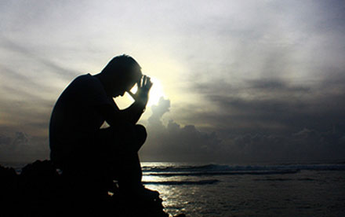
When trouble comes ACTS 21:17-23:11
Sermon at Crossroads International Church
Sunday, June 27th, 2021.

Slide 25
What are you most afraid of?

Slide 26
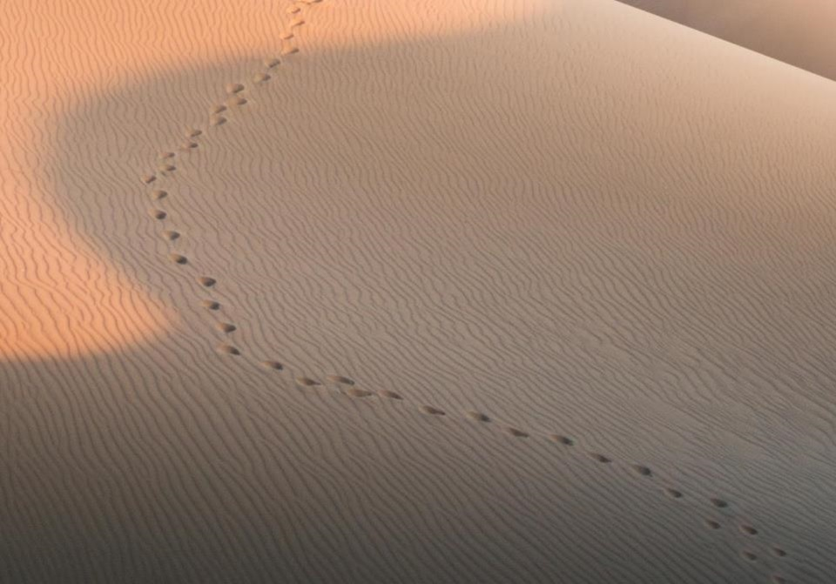
GOOD NE WS
ON THE MO VE
God’s work through the early church in
Acts
Notes:
We are continuing in our series called Good News on the Move, God’s work through the early church in Acts.
In the previous 19 sermons we have seen a lot of people on the move.
At the beginning of the book of Acts, we saw the church growing in Jerusalem, undergoing persecution, and spreading to Samaria.
As the book of Acts progressed, we are introduced to Saul, also known as Paul.

Slide 27
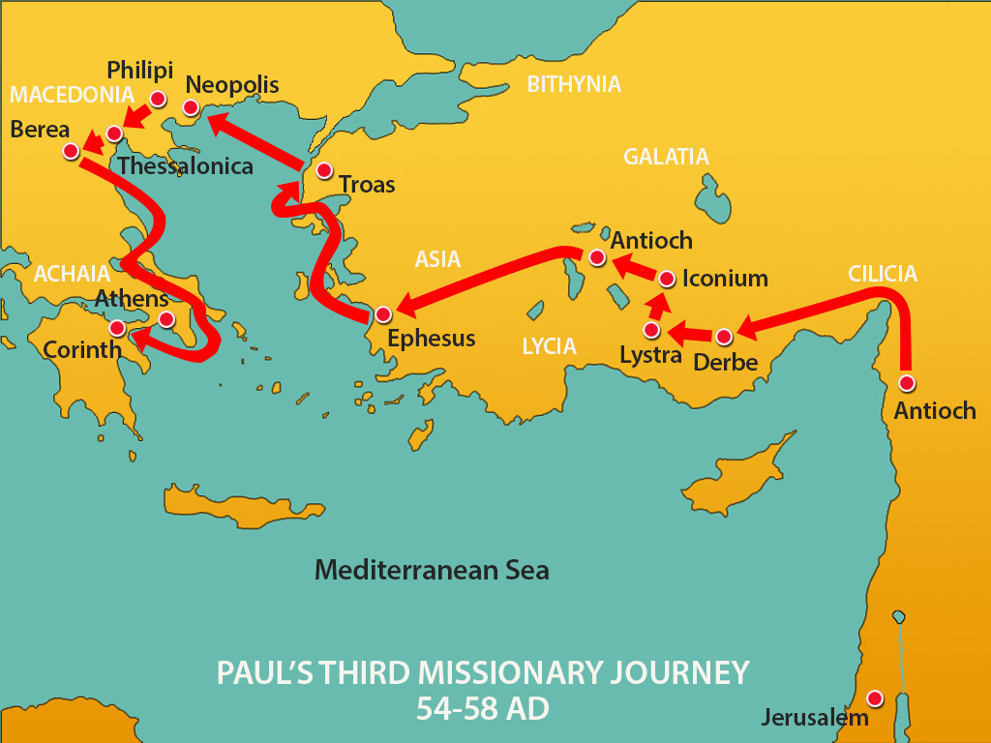

Slide 28
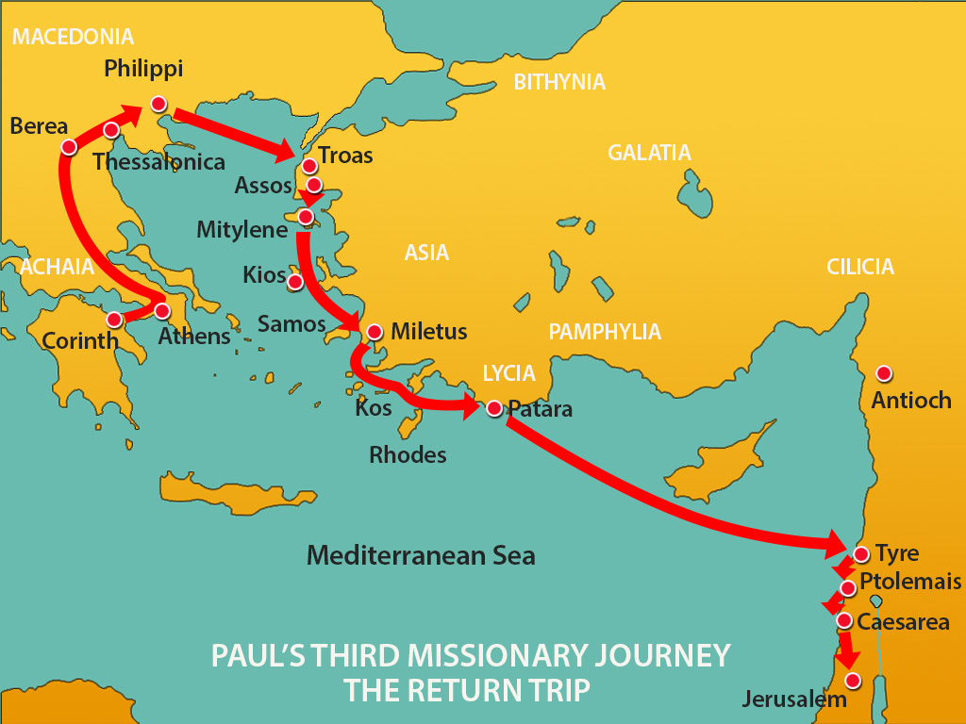

Slide 29
¹⁷ When we had come to Jerusalem, the brothers received us gladly. ¹⁸ On the following day Paul went in with us to James, and all the elders were present. ¹⁹ After greeting them, he related one by one the things that God had done among the Gentiles through his ministry. ²⁰ And when they heard it, they glorified God. And they said to him, “You see, brother, how many thousands there are among the Jews of those who have believed. They are all zealous for the law, ²¹ and they have been told about you that you teach all the Jews who are among the Gentiles to forsake Moses, telling them not to circumcise their children or walk according to our customs. ²² What then is to be done? They will certainly hear that you have come. ²³ Do therefore what we tell you. We have four men who are under a vow; ²⁴ take these men and purify yourself along with them and pay their expenses, so that they may shave their heads. Thus all will know that there is nothing in what they have been told about you, but that you yourself also live in observance of the law. ²⁵ But as for the Gentiles who have believed, we have sent a letter with our judgment that they should abstain from what has been sacrificed to idols, and from blood, and from what has been strangled, and from sexual immorality.” ²⁶ Then Paul took the men, and the next day he purified himself along with them and went into the temple, giving notice when the days of purification would be fulfilled and the offering presented for each one of them.

Slide 30
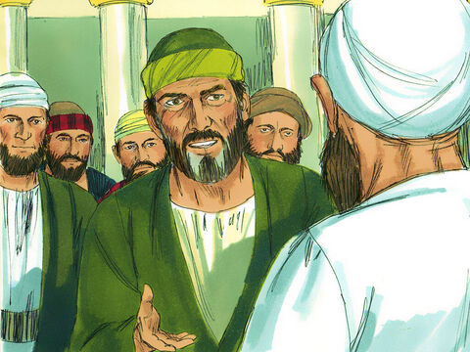
Nazirite Vow – a temporary vow to dedicate oneself to God by abstaining from meat and wine. Sacrifices are offered and one’s hair in cut at the end of the vow (Numbers 6:1-21). Paul himself followed this vow in Acts 18:18.

Slide 31
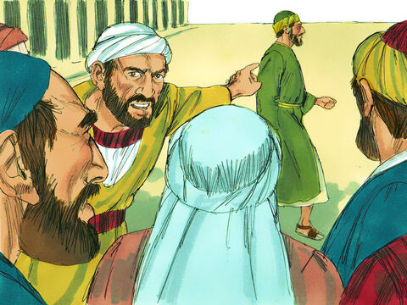

Slide 32
Mobs are stirred by prejudice and exclusivism, not by reason and just charges. Religious fervor is as dangerous as political hatred.
John L Ogilvie, The Preacher’s Commentary: Acts. (Nashville: Thomas Nelson, 2010).

Slide 33
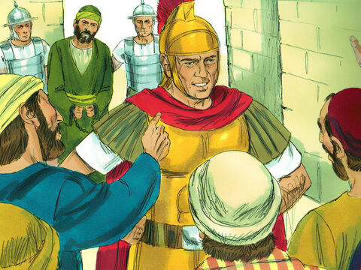

Slide 34
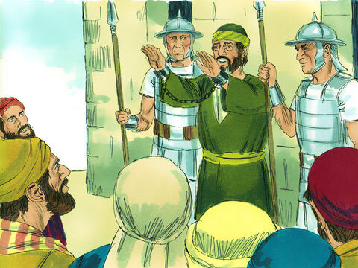
Paul makes his defence before the Jewish mob - Acts 21:27-22:21

Slide 36
PERSECUTION & WITNESS
Mark 13:9 – “… they will deliver you over to councils, and you will be beaten in synagogues….and you will stand before governors and kings for my sake, to bear witness to them.”
Paul witnesses boldly – Acts 22:-21 cf Acts 9:1-19 and Acts 26:12-23

Slide 37
“Brothers and fathers, hear the defense that I now make before you.”
² And when they heard that he was addressing them in the Hebrew language,^{[f]} they became even more quiet. And he said:
³ “I am a Jew, born in Tarsus in Cilicia, but brought up in this city, educated at the feet of Gamaliel according to the strict manner of the law of our fathers, being zealous for God as all of you are this day. ⁴ I persecuted this Way to the death, binding and delivering to prison both men and women, ⁵ as the high priest and the whole council of elders can bear me witness. From them I received letters to the brothers, and I journeyed toward Damascus to take those also who were there and bring them in bonds to Jerusalem to be punished.
⁶ “As I was on my way and drew near to Damascus, about noon a great light from heaven suddenly shone around me. ⁷ And I fell to the ground and heard a voice saying to me, ‘Saul, Saul, why are you persecuting me?’ ⁸ And I answered, ‘Who are you, Lord?’ And he said to me, ‘I am Jesus of Nazareth, whom you are persecuting.’ ⁹ Now those who were with me saw the light but did not understand the voice of the one who was speaking to me. ¹⁰ And I said, ‘What shall I do, Lord?’ And the Lord said to me, ‘Rise, and go into Damascus, and there you will be told all that is appointed for you to do.’ ¹¹ And since I could not see because of the brightness of that light, I was led by the hand by those who were with me, and came into Damascus.
¹² “And one Ananias, a devout man according to the law, well spoken of by all the Jews who lived there, ¹³ came to me, and standing by me said to me, ‘Brother Saul, receive your sight.’ And at that very hour I received my sight and saw him. ¹⁴ And he said, ‘The God of our fathers appointed you to know his will, to see the Righteous One and to hear a voice from his mouth; ¹⁵ for you will be a witness for him to everyone of what you have seen and heard. ¹⁶ And now why do you wait? Rise and be baptized and wash away your sins, calling on his name.’
¹⁷ “When I had returned to Jerusalem and was praying in the temple, I fell into a trance ¹⁸ and saw him saying to me, ‘Make haste and get out of Jerusalem quickly, because they will not accept your testimony about me.’ ¹⁹ And I said, ‘Lord, they themselves know that in one synagogue after another I imprisoned and beat those who believed in you. ²⁰ And when the blood of Stephen your witness was being shed, I myself was standing by and approving and watching over the garments of those who killed him.’ ²¹ And he said to me, ‘Go, for I will send you far away to the Gentiles.’”

Slide 38
²² Up to this word they listened to him. Then they raised their voices and said, “Away with such a fellow from the earth! For he should not be allowed to live.” ²³ And as they were shouting and throwing off their cloaks and flinging dust into the air, ²⁴ the tribune ordered him to be brought into the barracks, saying that he should be examined by flogging, to find out why they were shouting against him like this. ²⁵ But when they had stretched him out for the whips,^{[i]} Paul said to the centurion who was standing by, “Is it lawful for you to flog a man who is a Roman citizen and uncondemned?” ²⁶ When the centurion heard this, he went to the tribune and said to him, “What are you about to do? For this man is a Roman citizen.” ²⁷ So the tribune came and said to him, “Tell me, are you a Roman citizen?” And he said, “Yes.” ²⁸ The tribune answered, “I bought this citizenship for a large sum.” Paul said, “But I am a citizen by birth.” ²⁹ So those who were about to examine him withdrew from him immediately, and the tribune also was afraid, for he realized that Paul was a Roman citizen and that he had bound him.

Slide 39
Paul reveals his Roman citizenship - Acts 22:22-29

Slide 40
³⁰ But on the next day, desiring to know the real reason why he was being accused by the Jews, he unbound him and commanded the chief priests and all the council to meet, and he brought Paul down and set him before them.
23 And looking intently at the council, Paul said, “Brothers, I have lived my life before God in all good conscience up to this day.” ² And the high priest Ananias commanded those who stood by him to strike him on the mouth. ³ Then Paul said to him, “God is going to strike you, you whitewashed wall! Are you sitting to judge me according to the law, and yet contrary to the law you order me to be struck?” ⁴ Those who stood by said, “Would you revile God's high priest?” ⁵ And Paul said, “I did not know, brothers, that he was the high priest, for it is written, ‘You shall not speak evil of a ruler of your people.’”
⁶ Now when Paul perceived that one part were Sadducees and the other Pharisees, he cried out in the council, “Brothers, I am a Pharisee, a son of Pharisees. It is with respect to the hope and the resurrection of the dead that I am on trial.” ⁷ And when he had said this, a dissension arose between the Pharisees and the Sadducees, and the assembly was divided. ⁸ For the Sadducees say that there is no resurrection, nor angel, nor spirit, but the Pharisees acknowledge them all. ⁹ Then a great clamor arose, and some of the scribes of the Pharisees' party stood up and contended sharply, “We find nothing wrong in this man. What if a spirit or an angel spoke to him?” ¹⁰ And when the dissension became violent, the tribune, afraid that Paul would be torn to pieces by them, commanded the soldiers to go down and take him away from among them by force and bring him into the barracks.

Slide 41
TAKE COURAGE IN CHRIST
Acts 22:11 – The following night the Lord stood by him and said, “Take courage, for as you have testified to the facts about me in Jerusalem, so you must testify also in Rome.”
Hebrews 13:5 – “…for he has said, “I will never leave you nor forsake you.”

Slide 42
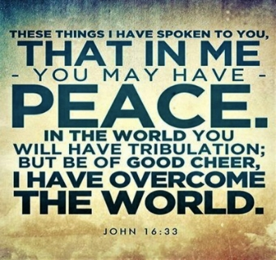

Slide 43
Video testimony John Monger

Slide 44
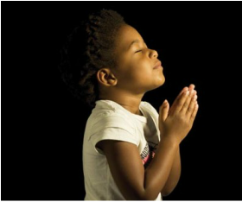
LET US PRAY

Slide 45
Be Thou My Vision
Eleanor Henrietta Hull | Mary Elizabeth Byrne
| Russell Mauldin
(Performed by CIC Worship Band)
CCLI Song #7056332
© Words and Music Public Domain
CIC CCLI License # 277507

Slide 46
Be Thou my Vision O Lord of my heart
Naught be all else to me save that Thou art
Thou my best thought by day or by night
Waking or sleeping Thy presence my light
V1

Slide 47
Be Thou my Wisdom
and Thou my true Word
I ever with Thee and Thou with me Lord
Thou my great Father I Thy true son
Thou in me dwelling and I with Thee one
V2

Slide 48
High King of heaven my victory won
May I reach heaven's joys
bright heaven's Sun
Heart of my own heart whatever befall
Still be my Vision O Ruler of all
V3 (final)

