Slide 1
How Firm a Foundation
Author: Unknown
Performed by:Sovereign Grace Music, Bob Kauflin
All rights reserved.
Used by permission. www.SovereignGraceMusic.org
CCLI Song #107816
© Words and Music: Public Domain
CIC CCLI License # 277507

Slide 3
Scripture Reading
Matthew 6:7-13 (NLT)

Slide 4
⁷ “When you pray, don’t babble on and on as the Gentiles do. They think their prayers are answered merely by repeating their words again and again. ⁸ Don’t be like them, for your Father knows exactly what you need even before you ask him! ⁹ Pray like this:
Matthew 6:7-13 (NLT)

Slide 5
Our Father in heaven,
may your name be kept holy.
¹⁰ May your Kingdom come soon.
May your will be done on earth,
as it is in heaven.
Matthew 6:7-13 (NLT)

Slide 6
¹¹ Give us today the food we need,
¹² and forgive us our sins,
as we have forgiven those who sin against us.
¹³ And don’t let us yield to temptation,
but rescue us from the evil one.
Matthew 6:7-13 (NLT)

Slide 7
He Leadeth Me
Joseph Henry Gilmore | Ken Barker | William Batchelder Bradbury | Word Music Group
Performed by:Sovereign Grace Music,
All rights reserved.
Used by permission. www.SovereignGraceMusic.org
CCLI Song #3272301
© Words and Music: Public Domain
CIC CCLI License # 277507

Slide 9
Message
Matt

Slide 10
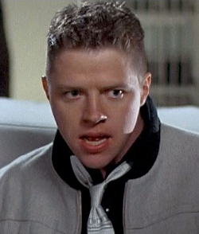
Notes:
If you knew the future, what would you do?
In the movie “Back to the Future Part 2” the bad guy, Biff Tannen, travels back in time to give his younger self a sports almanac. He tells his younger self that
This book tells the future.
This book tells the results of every major sports event till the end of this century

Slide 11
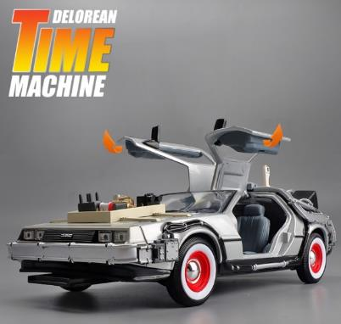
$37.19
Notes:
Is knowing the future only possible in the movies?
You can’t just go and buy a time machine can you?
Well, it is available on Shopee for just 37.19.

Slide 12
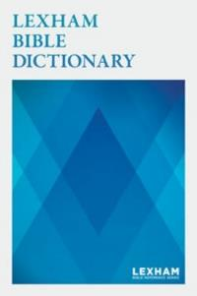
PROPHECY
A divine message mediated through an individual that is directed at a person or people group and intended to elicit a specific response.
Notes:
Today we are going to see that it is possible to know something about the future.
Today we are looking in Acts ch 21 and we will see that the Apostle Paul knows something about the future.
How does Paul know about the future when he does not have a DeLorean Time Machine?
The answer is through Prophecy! The Lexham Bible Dictionary defines prophecy as . .

Slide 13
A “Divine” Message
Deuteronomy
Gospels –
Acts 1
Genesis
12-50
1 Samuel
Leviticus
2 Samuel
Nehemiah
Numbers
1 Kings
2 Kings
Exodus
Joshua
Judges
Genesis 1-11
Ruth
Ezra
Esther
1990+
Max Anders, Dallas Theological Seminary
Notes:
Why does prophecy have to be a divine message? Because only a divine God is able to stand outside of time and see the beginning and the end at the same time.
Here is a Biblical timeline of history created by Max Anders. If you look in the notes, there are more details about each of the symbols. Basically, this timeline goes from the beginning (eternity) to the end (eternity).
You can take the historical books of the Old Testament and align them with the timeline.
The can also show the entire New Testament on the timeline. The gospels and Acts ch 1 are represented by the cross, when Christ was on the earth.

Slide 14
A “Divine” Message
Deuteronomy
Gospels –
Acts 1
Genesis
12-50
1 Samuel
Acts 2 –
Rev 3
Leviticus
2 Samuel
Nehemiah
Numbers
Rev 4-19
Exodus
Joshua
Judges
1 Kings
2 Kings
Rev 20-22
Genesis 1-11
Ruth
Ezra
Esther
You Are Here
1990+
Max Anders, Dallas Theological Seminary
Notes:
Acts ch 2 all the way through Revelation ch 3 are the 1,990+ years that the Church has been on the earth. That is where we are right now.
The next major event in Biblical history will be the rapture and 7 year tribulation period, which you can read about in Rev chapters 4-19.
This is followed by setting up Christ’s kingdom as shown in Rev 20-22.

Slide 15
A “Divine” Message
Deuteronomy
Gospels –
Acts 1
Genesis
12-50
1 Samuel
Acts 2 –
Rev 3
Leviticus
2 Samuel
Nehemiah
Numbers
Rev 4-19
Exodus
Joshua
Judges
1 Kings
2 Kings
Rev 20-22
Genesis 1-11
Ruth
Ezra
Esther
Daniel
(exiled in Babylon)
1990+
²⁴ “A period of 70 sets of 7 has been decreed . . .
²⁵ . . . 7 + 62 anointed one comes
Max Anders, Dallas Theological Seminary
Notes:
God, who stands outside of time, revealed prophecy to Daniel, when he was exiled in Babylon. This prophecy was for the entirety of God’s plan for history.
God also revealed to Daniel when the Messiah would come.
God, who stands outside of time, in the person of Jesus, referenced Daniel’s prophecy when answering the apostles questions about his return and the end of the world.
So you don’t need a time machine to know the future, you only need to have the God who stands outside of time, reveal His will, His plan.

Slide 16
PROPHECY
A divine message mediated through an individual that is directed at a person or people group and intended to elicit a specific response.
Notes:
When God chooses to reveal His plan or His will it is intended to elicit a specific response.

Slide 17
THE
FOR
NEED
PROPHECY
Acts 21:1-16
Matt Lyle • Crossroads International Church Singapore
CICFamily.org
Notes:
In acts 21:1-16 we will see various prophecies revealed through various people. As we study these passages we need to ask ourselves
Why did God reveal this prophecy?
What response did he intend to elicit?

Slide 18
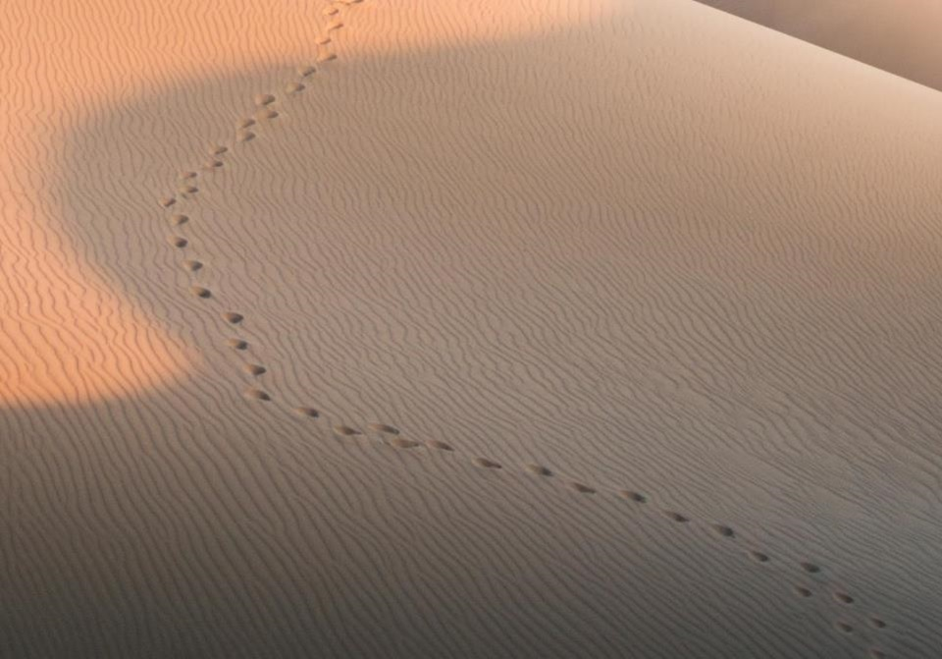
GOOD NE WS
ON THE MO VE
God’s work through the early church in
Acts
Notes:
We are continuing in our series called Good News on the Move, God’s work through the early church in Acts.
In the previous 19 sermons we have seen a lot of people on the move.
At the beginning of the book of Acts, we saw the church growing in Jerusalem, undergoing persecution, and spreading to Samaria.
As the book of Acts progressed, we are introduced to Saul, also known as Paul.

Slide 19
Timeline “Acts”
“To the remotest part of the earth” (Acts 1:8)
Acts 9 13 14 15 16 18 21 27 28
Apr 48- Sep 49
1 Galatia
Apr 50- Sep 52
2 Aegean
Spr 53- May 57
3 Asia
Summer 35- 37
Damascus Antioch
Fall 49
The
Council
Spring 68
Expansion of Church
35 48 49 50 52 53 57 60 62 67 68 95
Paul taught in Ephesus "for two years, so that all of Asia heard the word of the Lord" (Acts 19:10)
1234
Journeys
Notes:
This timeline shows the events in the second half of the book of Acts,
which is about God’s work spreading the Gospel through Paul.
Paul initially was persecuting the church. After encountering the Lord Jesus
on the road to Damascus, he became a follower of Christ,
and eventually a leader in a local church at Antioch.
The Holy Spirit led the elders at Antioch to
“Appoint Barnabas and Saul for the special work to which I have called them.”
This led to three missionary journeys which our teaching team has recently covered.
In his third Journey, Paul spent the last 2 years in 1 place, Ephesus.

Slide 20
²² “And now I am bound by the Spirit to go to Jerusalem. I don’t know what awaits me,
²³ except that the Holy Spirit tells me in city after city that jail and suffering lie ahead.
²⁴ But my life is worth nothing to me unless I use it for finishing the work assigned me by the Lord Jesus—the work of telling others the Good News about the wonderful grace of God.
(Acts 20:22-24 NLT)
Notes:
Two weeks ago, Pastor Rick, gave his final sermon at Crossroads, after spending 30 years in Singapore as he is moving on to Jordan. It is quite fitting that Pastor Rick’s final sermon covered Paul’s final interaction with the church at Ephesus.
These are key verses from that story that we need to keep in mind as we delve into chapter 21.
In these verses, Paul states that:

Slide 21
The Church at Tyre
“Having carefully investigated everything from the beginning, I also have decided to write an accurate account” (Luke 1:3 NLT)
Notes:
Looking at ch 21, we see that Luke mentions a lot of places in this section.
We know Luke “carefully investigated everything from the beginning,” (Luke 1:3 NLT). But Luke was not just an investigative reporter, he was part of the story. In several sections of the book of Acts, he is actually there with Paul.
Although he doesn’t call attention to this fact by naming himself, the grammar is clear by the use of the “we” We reached Rhodes. We boarded a ship. We sighted the island of Cyprus. Of course, when you see Luke writing “we” in the text, there tends to be a lot of geographic detail.

Slide 22
The Church at Tyre
Miletus
COS
Patara
Rhodes
Cyprus
Phoenicia
Tyre
Notes:
Starting in vs 1, Luke writes that “¹ After saying farewell to the Ephesian elders (we know that was in Miletus)
we sailed straight to the island of COS. The next day we reached Rhodes and then went to Patara. ² There we boarded a ship sailing for Phoenicia.
³ We sighted the island of Cyprus, passed it on our left, and landed at the harbor of Tyre, in Syria, where the ship was to unload its cargo.

Slide 23
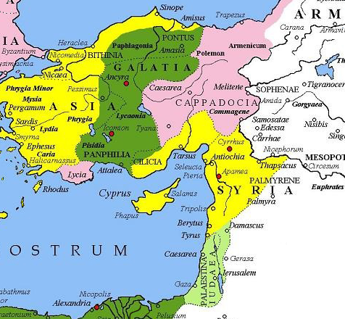
Roman
Provinces
Notes:
Luke uses Phoenicia and Syria interchangeably.
Generally, Phoenicia referred to the cities along the coast of what we now call Lebanon.
Syria was historically centered around Damascus.
However, the Roman Province of Syria included the cities of Phoenicia as well as Antioch (which would have been their ultimate destination as that is where they started their journeys.

Slide 24
These believers prophesied through the Holy Spirit that Paul should not go on to Jerusalem (NLT).
And through the Spirit they were telling Paul not to go on to Jerusalem (NIV).
Acts 21:4b
Notes:
As we continue reading, we see Paul receive his first specific warning to not go to Jerusalem.
⁴ We went ashore, found the local believers, and stayed with them a week. These believers prophesied through the Holy Spirit that Paul should not go on to Jerusalem. ⁵ When we returned to the ship at the end of the week, the entire congregation, including women and children, left the city and came down to the shore with us. There we knelt, prayed, ⁶ and said our farewells. Then we went aboard, and they returned home.
The ESV states that “through the Spirit they were telling Paul not to go on to Jerusalem.
Does this statement contradict Acts 20:22 where Paul stated “And now I am bound by the Spirit to go to Jerusalem. I don’t know what awaits me,
We know that Paul eventually goes to Jerusalem. Did Paul ignore or disregard the Holy Spirit?
It is not a contradictory statement and Paul does not ignore or disregard the Holy Spirit.

Slide 25
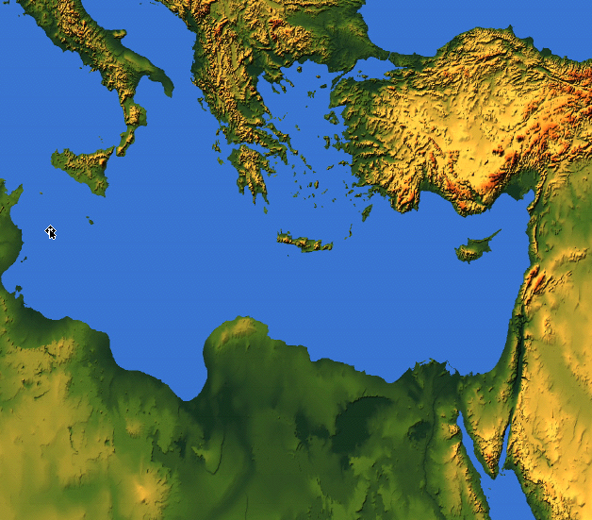
Macedonia
Bithynia
Troas
Asia
Antioch
Notes:
Let me explain my answer. First we know that Paul obeyed the Holy Spirit, he followed God’s will. Acts 16 Luke writes that
⁶ Next Paul and Silas traveled through the area of Phrygia and Galatia, because the Holy Spirit had prevented them from preaching the word in the province of Asia at that time.
⁷ Then coming to the borders of Mysia, they headed north for the province of Bithynia, but again the Spirit of Jesus did not allow them to go there.
We know he eventually goes to Macedonia.
This shows that Paul does not disregard or ignore the Holy Spirit.

Slide 26
Acts 20 ²² “And now I am bound by the Spirit to go to Jerusalem. I don’t know what awaits me,
²³ except that the Holy Spirit tells me in city after city that jail and suffering lie ahead.
Acts 21 ⁴ These believers prophesied through the Holy Spirit that Paul should not go on to Jerusalem
Notes:
Second, although Paul is bound to go to Jerusalem, he does not know what is going to happen. He knows that he is often thrown in jail, or beaten, but in other places he is granted safety.
In this case, God is revealing to Paul that there will not be peace when he returns to Jerusalem. The believers in Tyre understood, by the power of the Holy Spirit, that Paul would suffer when he returned to Jerusalem. That is why they did not want him to go.
The reason the Tyrian church prophesied that Paul should not go on to Jerusalem was to prepare him for what lies ahead.

Slide 27
How firm a foundation
When through the deep waters He calls thee to go
The rivers of grief shall not thee overflow
For He will be with thee in trouble to bless
And sanctify to thee thy deepest distress
When through fiery trials thy pathway shall lie
My grace all-sufficient shall be thy supply
The flames shall not hurt thee I only design
Thy dross to consume and thy gold to refine
Notes:
We hummed or lip-synced to the song How Firm a Foundation at the beginning of our service.
Paul does not know what awaits him in Jerusalem. But Paul does know that
when through the deep waters He calls thee to go
The rivers of grief shall not thee overflow
For He will be with thee in trouble to bless
And sanctify to thee thy deepest distress
Paul knows that
When through fiery trials thy pathway shall lie
My grace all-sufficient shall be thy supply
The flames shall not hurt thee I only design
Thy dross to consume and thy gold to refine

Slide 28
The Church at Caesarea
Tyre
Ptolemais
Caesarea
Stayed at the home of Philip the Evangelist
Philip’s daughters had gift of prophecy
Notes:
Continuing in verse 7 as Paul and his companion continue their journey
⁷ The next stop after leaving Tyre was Ptolemais, where we greeted the brothers and sisters and stayed for one day. ⁸ The next day we went on to Caesarea and stayed at the home of Philip the Evangelist, one of the seven men who had been chosen to distribute food. ⁹ He had four unmarried daughters who had the gift of prophecy.

Slide 29
Fill in the _ _ _ _ _
“One who prophesies strengthens others, encourages them, and comforts them. . . . one who speaks a word of prophecy strengthens the entire church” 1 Cor 14:3-4 (NLT) .
Notes:
Luke’s account leaves out what Phillip’s daughter’s were prophesying. Although we don’t know what they were prophesying, we can look at some of Paul’s other letters to see why they were prophesying.
According to Paul, the purpose of prophecy is the exhortation and building up of the church body.
In one of his letters to the Corinthians he writes “One who prophesies strengthens others, encourages them, and comforts them. . . . one who speaks a word of prophecy strengthens the entire church.”

Slide 30
Old vs New Testament Prophecy
 | OT | NT
Foretelling
Forthtelling
Notes:
Now lets compare Old Testament vs New Testament prophecy.
When I think of prophecy I generally think of telling the future, or prediction. This is known as foretelling. There are many Old Testament examples of foretelling in the Old Testament. The oracles against the nations in Isaiah, Jeremiah, Ezekiel, Amos. My favorite prophecies are about the end times, as seen in Daniel and Isaiah.
But the New Testament also has foretelling. Jesus’s Olivet discourse. The revelation given to the Apostle John. Both of these are clearly prediction, or foretelling about the future.
We’ve already shown that the other type of prophecy in the New Testament is exhortation and building up of the church body. This is also known as forthtelling.
In the Old Testament we also have forthtelling in the form of: divine messages of accusation and impending judgment due to the hearer’s rebelliousness
Or divine messages of comfort and exhortation that divine salvation is at hand

Slide 31
Is there prophecy today?
As for prophecies, they will pass away;
( 1 Cor 13:8 NIV)
For NOW we see in a mirror dimly, but THEN face to face
( 1 Cor 13:12 NIV)
Notes:
Some would say that there is no prophecy today because the canon, that is the Bible, is complete.
However, that is not what the Bible says. The Bible does that that prophecy will cease. In 1 Cor ch 13 Paul writes “As for prophecies, they will pass away.”
Paul even tells us when prophecy will cease. The second part of 1 Cor 13 is contrasting 2 periods of time. Now and Then. Prophecies will cease “Then”

Slide 32
When Prophecies Cease
Now
Then
we know in part and we prophesy in part
when the perfect comes
now we see in a mirror dimly
then face to face
All I know is partial, incomplete
then I will know everything completely
Notes:
Now is obviously when Paul was writing the letter. Then refers to some point in the future to Paul. It’s been almost 2,000 years, are we in the future to Paul. But are we in the “now” or are we in the “then” when it comes to prophecy?
When the perfect comes: one can make a weak argument that since we are made perfect or sinless through Christ’s shed blood on the cross we are at the “then”
I would submit that we do not know everything completely, therefore we are still in the “now” and we can still have prophecy, mostly in the form of forth telling, for exhortation and building up of the church body.

Slide 33
Agabus
Acts 11
²⁸ One of them named Agabus stood up in one of the meetings and predicted by the Spirit that a great famine was coming upon the entire Roman world. (This was fulfilled during the reign of Claudius.)
Notes:
Although we don’t know what Philip’s daughters prophesied about, we do know what the next prophet said.
Starting in vs 10: ¹⁰ Several days later a man named Agabus, who also had the gift of prophecy, arrived from Judea.
This is the same prophet who went to Antioch when Paul and Barnabas were preaching there and prophesied that there would be a great famine. That prophecy came true.

Slide 34
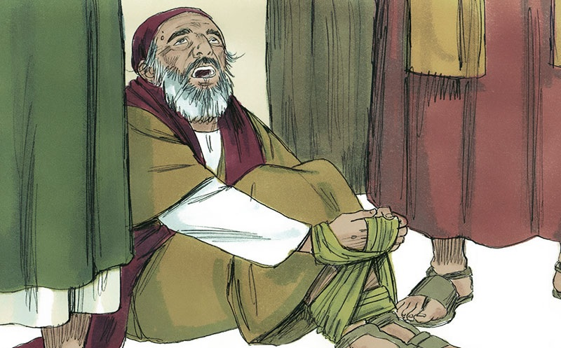
The Holy Spirit declares, ‘So shall the owner of this belt be bound by the Jewish leaders in Jerusalem and turned over to the Gentiles
Notes:
Now when we see Agabus,
¹¹ He came over, took Paul’s belt, and bound his own feet and hands with it. Then he said, “The Holy Spirit declares, ‘So shall the owner of this belt be bound by the Jewish leaders in Jerusalem and turned over to the Gentiles.’
This would be much harder today since not everyone wears a belt, and the belts we do wear would not work the same way. But using props is an effective teaching method. Agabus was not the only prophet to use a prop.

Slide 35
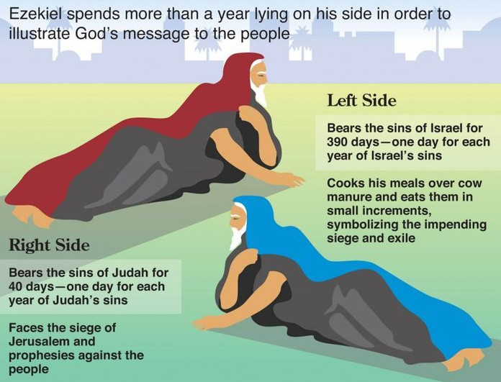
Notes:
The prophet Ezekiel spent more than a year lying on his side, first on his left side then the right side.

Slide 36
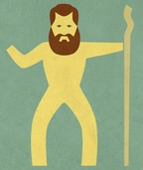
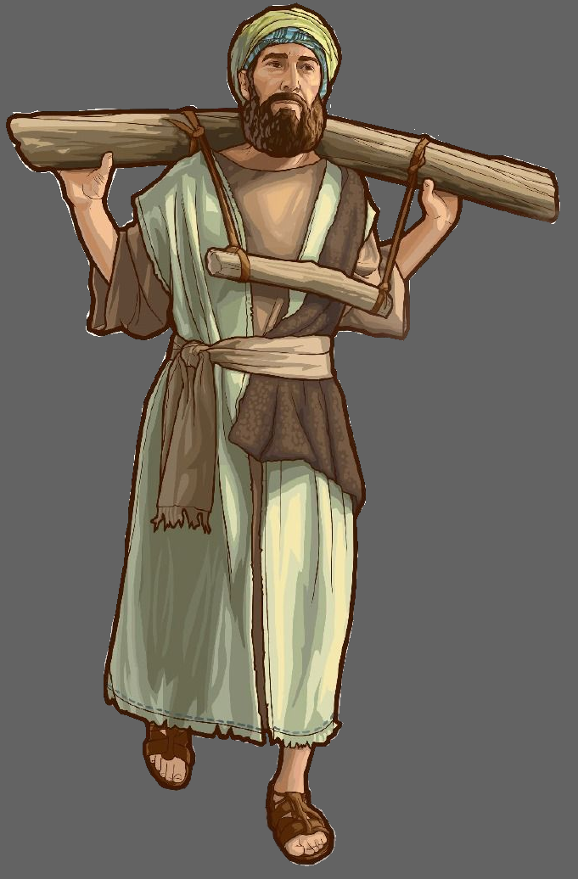
Micah
Jeremiah
Notes:
The prophet Micah lamented without wearing clothes to illustrate the severity of the destitution and captivity that was coming.
The prophet Jeremiah wore a yoke around his neck to demonstrate that Israel would be subject to Babylon.

Slide 37
Don’t Go to Jerusalem
Notes:
As you can imagine, this caused a strong reaction in the church. Luke writes that
When we heard this, we and the local believers all begged Paul not to go on to Jerusalem.
What was Paul’s response? Look at verse 13. ¹³ But he said, “Why all this weeping? You are breaking my heart! I am ready not only to be jailed at Jerusalem but even to die for the sake of the Lord Jesus.”

Slide 38
Key Verse
¹⁴ When it was clear that we couldn’t persuade him, we gave up and said,
“The Lord’s will be done.”
Acts Ch 21:14
Notes:
And now we get to what I think is the key verse in this section of scripture.
When it was clear that we couldn’t persuade him, we gave up and said, The Lord’s will be done.
When God’s plan is revealed to you, and it is not what you want or was expecting, how do you respond? Do you mope and complain? Do you turn the other way like Jonah? Do you drag your feet, saying, maybe next year I will .. . Do what ever it is that God has laid on your heart. Or do you say “the Lord’s will be done.”
Even though prophecy revealed Paul would suffer and be imprisoned, he submitted to the Lord’s will.
So what was the point of the prophecy? It prepared Paul for the suffering he would endure.

Slide 39
Suffering
Romans 8:17
¹⁷ And since we are his children, we are his heirs. In fact, together with Christ we are heirs of God’s glory. But if we are to share his glory, we must also share his suffering.
Notes:
In several of his letters, Paul writes about suffering. In Romans 8:17 he writes
And since we are his children, we are his heirs. In fact, together with Christ we are heirs of God’s glory. But if we are to share his glory, we must also share his suffering.
You might wonder when Paul wrote that statement in Romans.

Slide 40
NT Overview (Paul's Letters)
“To the remotest part of the earth” (Acts 1:8)
Acts 9 13 14 15 16 18 21 27 28
Apr 48- Sep 49
1 Galatia
Apr 50- Sep 52
2 Aegean
Spr 53- May 57
3 Asia
Summer 35- 37
Damascus Antioch
May 57- Aug 59
Trials
Fall 49
The
Council
Spring 68
Expansion of Church
35 48 49 50 52 53 57 60 62 67 68 95
Gal
1 Thess
1 Cor
2 Thess
2 Cor
Missionary
Romans
Pauline Epistles
1234
Journeys
Notes:
We saw this timeline earlier. Several of Paul’s letters were written during his mission trips. The letter to the Romans was written during his third missionary journey, before he returned to Jerusalem.

Slide 41
Suffering
Colossians 1:24
²⁴ I am glad when I suffer for you in my body, for I am participating in the sufferings of Christ that continue for his body, the church.
Philippians 1:29
²⁹ For you have been given not only the privilege of trusting in Christ but also the privilege of suffering for him.
Notes:
Here are a couple more statements on suffering.
Colossians 1:24 (NLT)
24 I am glad when I suffer for you in my body, for I am participating in the sufferings of Christ that continue for his body, the church.
Philippians 1:29 (NLT)
29 For you have been given not only the privilege of trusting in Christ but also the privilege of suffering for him.
Paul certainly never sought out difficulty. He had no martyr complex. On the other hand, he accepted suffering as a part of his witness which is why he alluded to suffering in his letters.

Slide 42
NT Overview (Paul's Letters)
“To the remotest part of the earth” (Acts 1:8)
Acts 9 13 14 15 16 18 21 27 28
Apr 48- Sep 49
1 Galatia
Apr 50- Sep 52
2 Aegean
Spr 53- May 57
3 Asia
Feb 60- Mar 62
1 Rome
Spr 62- Fall 67
4 Spain
Aut 67- Spr 68
2 Rome
Summer 35- 37
Damascus Antioch
May 57- Aug 59
Trials
Fall 49
The
Council
Spring 68
Expansion of Church
35 48 49 50 52 53 57 60 62 67 68 95
Gal
1 Thess
1 Cor
Eph
1 Tim
2 Tim
2 Thess
2 Cor
Col
Titus
Missionary
Pastoral
Romans
Philem
Phil
Pauline Epistles
1234
Journeys
Prison
Rome
Imprisonments
Notes:
Back to the timeline, Colossians and Philippians were written while he is in prison in Rome, which resulted from his returning to Jerusalem.
Can you imagine if Paul had listened to the churches at Tyre or Caesarea and not returned to Jerusalem?
Would he have ended up in Rome? Would he have written the prison letters? Would he have written the pastoral letters?
We don’t know. What do we know?

Slide 43
Assurance
Romans 8:28
²⁸ And we know that God causes everything to work together for the good of those who love God and are called according to his purpose for them.
Notes:
We know that God causes everything to work together for the good of those who love God and are called according to his purpose for them. (Rom 8:18 NLT)
We may suffer. We don’t need prophecy to tells us we are going to suffer.
But, we also have assurance. We must heed God’s calling in our lives. We must be in submission to his will, not our own.
When we do this, we have a blessed assurance.

Slide 44
Blessed Assurance
Fanny Jane Crosby | Phoebe Palmer Knapp
Performed by: Momo Kithan
CCLI Song #22324
© Words and Music: Public Domain
CIC CCLI License # 277507

Slide 45
Blessed assurance Jesus is mine
O what a foretaste of glory divine
Heir of salvation purchase of God
Born of His Spirit washed in His blood
This is my story this is my song
Praising my Savior all the day long
This is my story this is my song
Praising my Savior all the day long
V1

Slide 46
Perfect submission perfect delight
Visions of rapture now burst on my sight
Angels descending bring from above
Echoes of mercy whispers of love
This is my story this is my song
Praising my Savior all the day long
This is my story this is my song
Praising my Savior all the day long
V2

Slide 47
Perfect submission all is at rest
I in my Savior am happy and blest
Watching and waiting looking above
Filled with His goodness lost in His love
This is my story this is my song
Praising my Savior all the day long
This is my story this is my song
Praising my Savior all the day long
V3 (final)

