Slide 1
Is He Worthy?
Andrew Peterson | Ben Shive
CCLI Song #7108951
© 2018 Capitol CMG Genesis
CIC CCLI License # 277507

Slide 2
Do you feel the world is broken
We do
Do you feel the shadows deepen
We do
But do you know that all the dark
Won't stop the light from getting through
We do
Do you wish that you could
see it all made new
We do
V1

Slide 3
Is all creation groaning
It is
Is a new creation coming
It is
Is the glory of the Lord
To be the light within our midst
It is
Is it good that we remind ourselves of this
It is
V2

Slide 4
Is anyone worthy, is anyone whole
Is anyone able to break the seal
and open the scroll
The Lion of Judah
who conquered the grave
He is David's Root and the Lamb
who died to ransom the slave
Is He worthy? Is He worthy?
Of all blessing and honor and glory
Is He worthy of this? He is
V1

Slide 5
Does the Father truly love us
He does
Does the Spirit move among us
He does
And does Jesus our Messiah
Hold forever those He loves
He does
Does our God intend to dwell again with us
He does
V3

Slide 6
Is anyone worthy? Is anyone whole?
Is anyone able to break the seal
and open the scroll
The Lion of Judah
who conquered the grave
He is David's Root and the Lamb who died to ransom the slave
From ev'ry people and tribe
every nation and tongue
C2

Slide 7
He has made us a kingdom and priests
To God to reign with the Son
Is He worthy
Is He worthy
Of all blessing and honor and glory
Is He worthy
Is He worthy
Is He worthy of this
He is
C2-2

Slide 8
Is He worthy
Is He worthy
He is
He is worthy
He is worthy
He is
Final

Slide 9
Scripture Reading
Psalm 28:6-9 (ESV)

Slide 10
⁶ Blessed be the Lord!
For he has heard the voice of my pleas for mercy.
⁷ The Lord is my strength and my shield;
in him my heart trusts, and I am helped;
my heart exults,
and with my song I give thanks to him.
Psalm 28:6-9 (ESV)

Slide 11
⁸ The Lord is the strength of his people;
he is the saving refuge of his anointed.
⁹ Oh, save your people and bless your heritage!
Be their shepherd and carry them forever.
Psalm 28:6-9 (ESV)

Slide 12
The Perfect Wisdom
Keith Getty | Stuart Townend
CCLI Song #5933569
© 2011 Thankyou Music
CIC CCLI License # 277507

Slide 13
The perfect wisdom of our God
Revealed in all the universe
All things created by His hand
And held together at His command
He knows the myst'ries of the seas
The secrets of the stars are His
He guides the planets on their way
And turns the earth through another day
V1

Slide 14
The matchless wisdom of His ways
That mark the path of righteousness
His word a lamp unto my feet
His Spirit teaching and guiding me
And O the mystery of the cross
That God should suffer for the lost
So that the fool might shame the wise
And all the glory might go to Christ
V2

Slide 15
O grant me wisdom from above
To pray for peace and cling to love
And teach me humbly to receive
The sun and rain of Your sovereignty
Each strand of sorrow has a place
Within this tapestry of grace
So through the trials I choose to say
Your perfect will in Your perfect way
V3 (final)

Slide 16
Message
Jim

Slide 17
Where is God leading us?

Slide 18
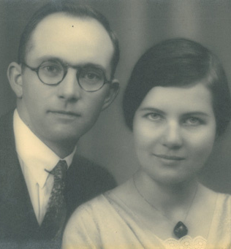
“The faithfulness of God is the only certain thing in the world today. We need not fear the result of trusting Him.”
John Stam

Slide 19
Recall our Joy

Slide 20
Acts 2:42
“And they devoted themselves to the apostles’ teaching and the fellowship, to the breaking of bread and the prayers.”
Teaching
Fellowship/Care
Ministry

Slide 21
Recall our Joy
Reaffirm our Foundation

Slide 22
2 Peter 1:13
¹² Therefore I intend always to remind you of these qualities, though you know them and are established in the truth that you have. ¹³ I think it right, as long as I am in this body, to stir you up by way of reminder”
Sound gospel theology
PIE Values

Slide 23
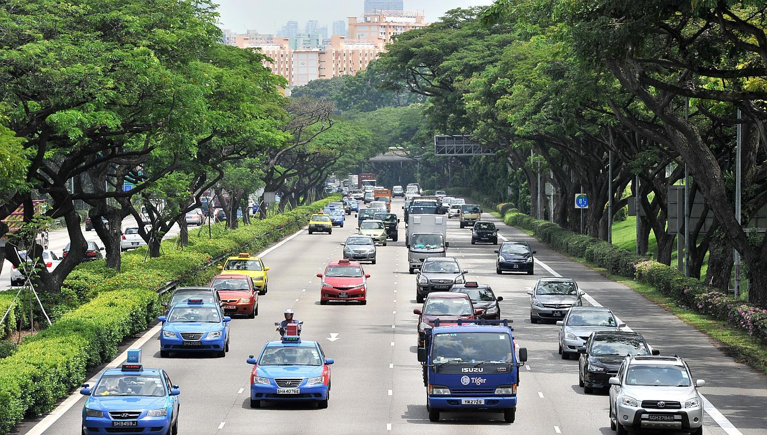
PIE
Passionate
International
Expository

Slide 24
Recall our Joy
Reaffirm our Foundation
Rise to our Challenge

Slide 25
Love God
Love the Church
Ministering
Create
Manage
Explore & Risk

Slide 26
Love God
Love the Church
Giving
Start
Increase

Slide 27
Love God
Love the Church
Loving
Family focus
Care Team

Slide 28
Philippians 1:9-11
⁹ And it is my prayer that your love may abound more and more, with knowledge and all discernment, ¹⁰ so that you may approve what is excellent, and so be pure and blameless for the day of Christ, ¹¹ filled with the fruit of righteousness that comes through Jesus Christ, to the glory and praise of God.

Slide 29
1 Thessalonians 3:12-13
¹² and may the Lord make you increase and abound in love for one another and for all, as we do for you, ¹³ so that he may establish your hearts blameless in holiness before our God and Father, at the coming of our Lord Jesus with all his saints.

Slide 30
Love God
Love the Church
Love the Nations
Deliberate discipleship
Hands on Missions

Slide 31
Where is God leading us?

Slide 32
Refiner's Fire
Brian Doerksen
CCLI Song #426298
© 1990 Mercy / Vineyard Publishing
CIC CCLI License # 277507

Slide 33
Purify my heart
Let me be as gold
And precious silver
Purify my heart
Let me be as gold
Pure gold
V1

Slide 34
Refiner's fire
My heart's one desire
Is to be holy
Set apart for You Lord
I choose to be holy
Set apart for You my Master
Ready to do Your will
C

Slide 35
Purify my heart
Cleanse me from within
And make me holy
Purify my heart
Cleanse me from my sin
Deep within
V2

Slide 36
Refiner's fire
My heart's one desire
Is to be holy
Set apart for You Lord
I choose to be holy
Set apart for You my Master
Ready to do Your will
(repeat once)
C (final)

