Slide 1
O Church Arise
Keith Getty | Stuart Townend
CCLI Song #4611992
© 2005 Thankyou Music
CIC CCLI License # 277507

Slide 2
O church arise and put your armour on
Hear the call of Christ our Captain
For now the weak can say that they are strong
In the strength that God has given
With shield of faith and belt of truth
We'll stand against the devil's lies
An army bold whose battle cry is Love
Reaching out to those in darkness
V1

Slide 3
Our call to war to love the captive soul
But to rage against the captor
And with the sword
that makes the wounded whole
We will fight with faith and valour
When faced with trials on every side
We know the outcome is secure
And Christ will have the prize for which He died
An inheritance of nations
V2

Slide 4
Come see the cross
where love and mercy meet
As the Son of God is stricken
Then see His foes lie crushed beneath His feet
For the Conqueror has risen
And as the stone is rolled away
And Christ emerges from the grave
This victory march continues till the day
Every eye and heart shall see Him
V3

Slide 5
So Spirit come put strength in every stride
Give grace for every hurdle
That we may run with faith to win the prize
Of a servant good and faithful
As saints of old still line the way
Retelling triumphs of His grace
We hear their calls and hunger for the day
When with Christ we stand in glory
V4 (final)

Slide 6
Shepherd Of My Soul
Martin Nystrom
CCLI Song #24054
© 1988 Universal Music
CIC CCLI License # 277507

Slide 7
Shepherd of my soul
I give You full control
Wherever You may lead
I will follow
I have made the choice
To listen for Your voice
Wherever You may lead
I will go
(repeat one)
V

Slide 8
Be it in a quiet pasture
Or by a gentle stream
The Shepherd of my soul
Is by my side
Should I face a mighty mountain
Or a valley dark and deep
The Shepherd of my soul
Will be my guide
C

Slide 9
Shepherd of my soul
I give You full control
Wherever You may lead
I will follow
I have made the choice
To listen for Your voice
Wherever You may lead
I will go
V

Slide 10
Be it in a quiet pasture
Or by a gentle stream
The Shepherd of my soul
Is by my side
Should I face a mighty mountain
Or a valley dark and deep
The Shepherd of my soul
Will be my guide
C

Slide 11
Shepherd of my soul
I give You full control
Wherever You may lead
I will follow
I have made the choice
To listen for Your voice
Wherever You may lead I will go
Wherever You may lead I will go
V (final)

Slide 12
Message
Rick

Slide 13
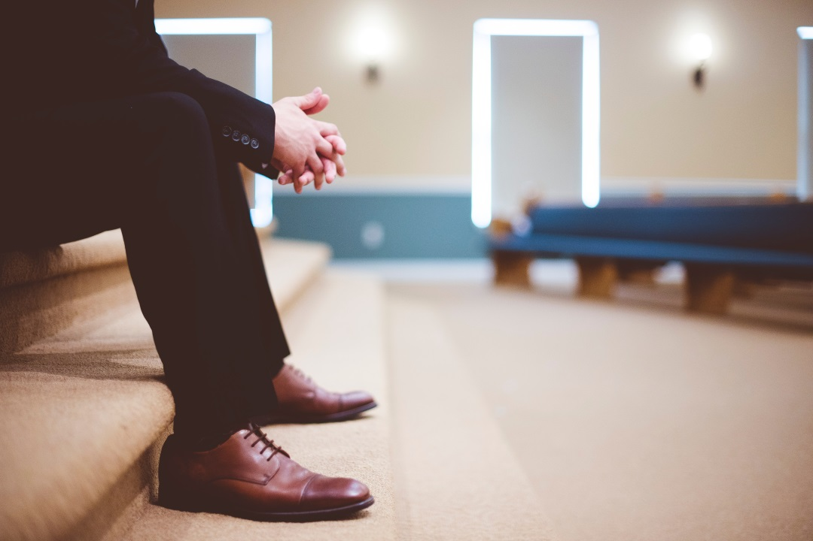
Elder Roles
Acts 20
Dr. Rick Griffith • Singapore Bible College • BibleStudyDownloads.org Crossroads International Church Singapore • CICFamily.com

Slide 14
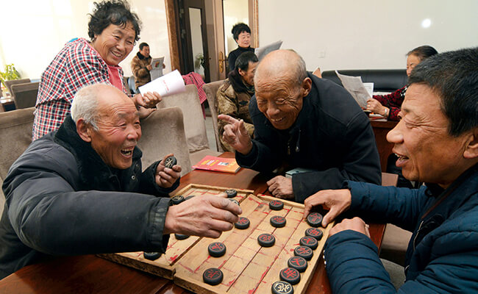
—Elders—
Notes:
Today we address elders. No—not the old folks who play games—

Slide 15
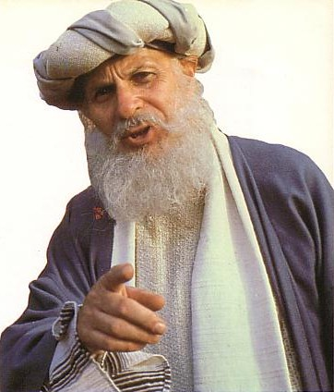
—Elders—
Notes:
—but the main leaders of the local church.

Slide 16
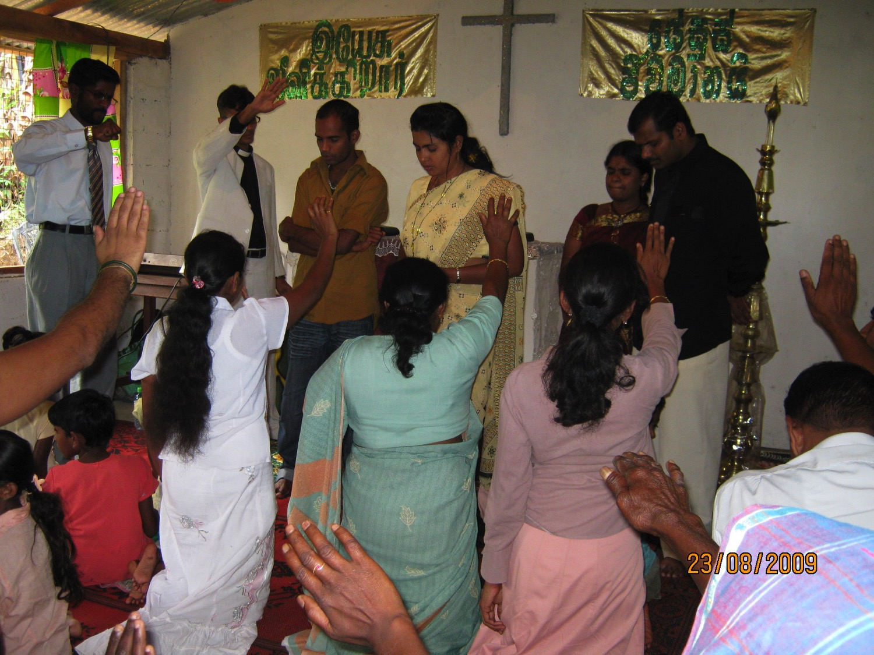
What are elders supposed to do?
Notes:
But Christians differ on what elders should do.
Some believe that all the elders do is serve communion.
Others think elders only carry on church traditions.
Elders sign papers and checks in the minds of others.
Some believe that elders function to give the impression to the congregation that the church isn't a "one-man show."

Slide 17
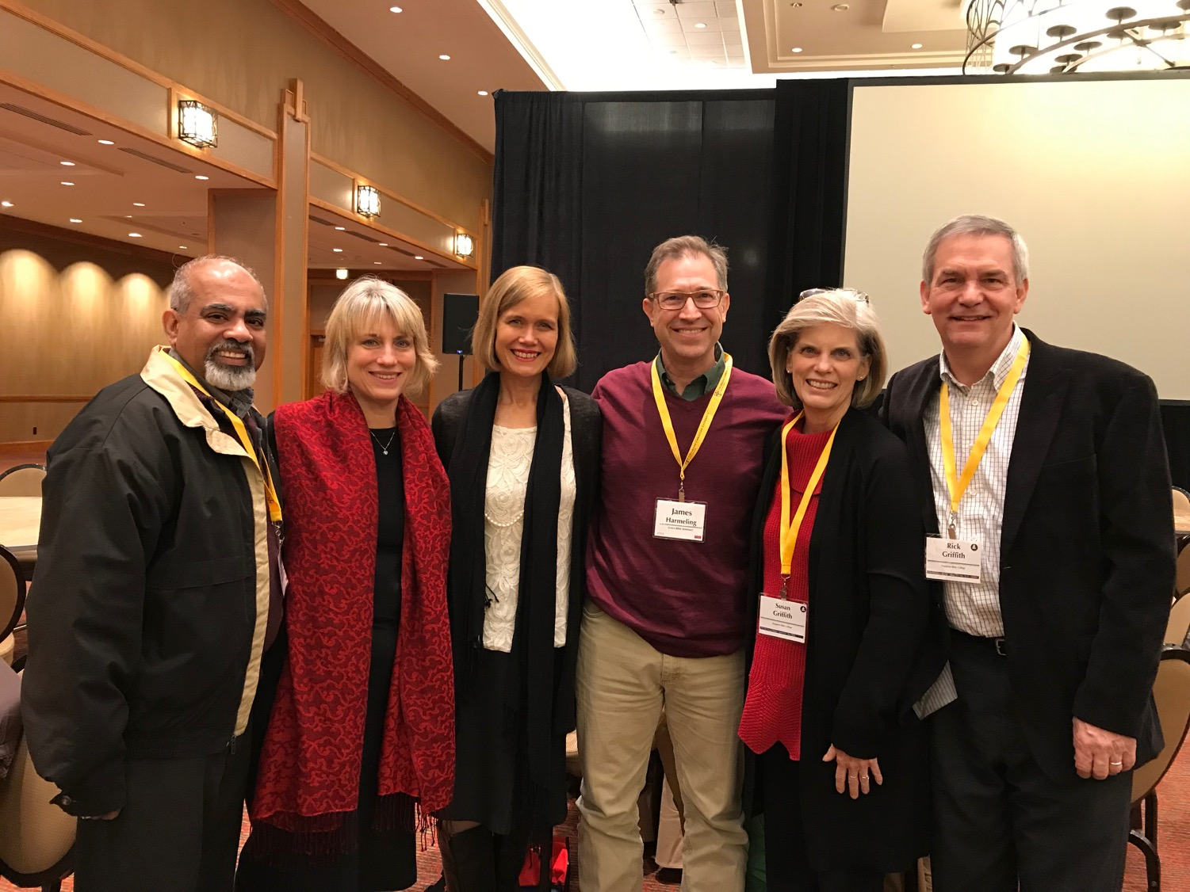
Our Church
2020 elders & wives
Notes:
Need: Here is the latest picture of our elders and their wives. Do you know what elders are supposed to do?
Can you name one Scripture on elder duties?
We have no excuse to be ignorant of elder roles since the NT addresses the issue many times.

Slide 18
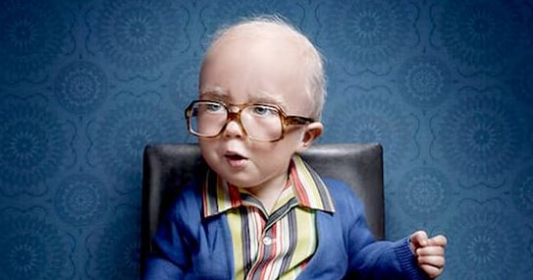
Who are you older than?
Notes:
But you say, “Nice that this message doesn’t apply to me! I can catch up on my sleep!” No, what we will see today does not only apply to elders. Each of us is older than someone else who looks up to us—so think of those who look to you, no matter how old you are. Let’s shepherd the flock we each have under our care—whether the whole church as elders, or our families, or friends.

Slide 19
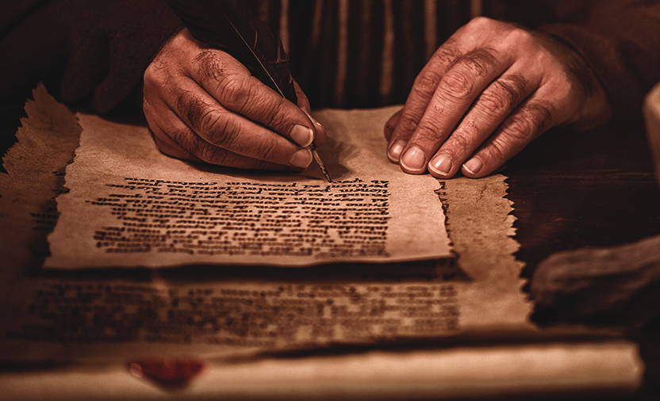
Background
What are elders supposed to do?
Notes:
Subject: So what are elders supposed to do?

Slide 20
The biblical pattern is church leadership by elders.
236a
Notes:
Elders Background: Elders have been around for millennia.

Slide 21
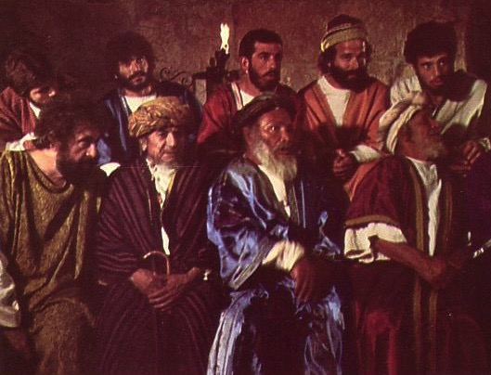
Elders led from the time of Moses
48
Elders led with Moses
1400 BC
“Go, assemble the elders of Israel and say to them…” (Exod. 3:16)
Notes:
Moses had elders in 1400 BC (Exodus 3:16).

Slide 22
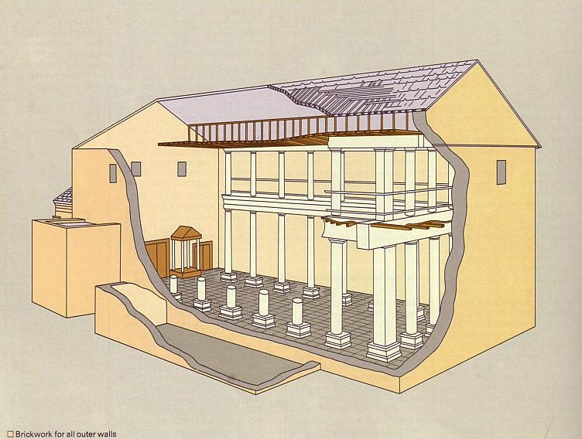
Who Led the Synagogue?
51
Elders led with Moses
1400 BC
Elders led Synagogues 600 BC
Notes:
Synagogues were led by elders from 600 BC to Jesus.

Slide 23
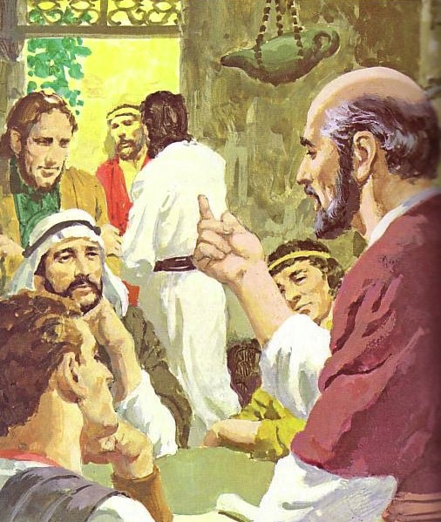
God has advocated group leadership through the ages
55
Elders led with Moses
1400 BC
Elders led Synagogues 600 BC
NT Elders
Notes:
Each NT church was led by elders.

Slide 24
Places Mentioning Elders
elders = overseers = bishops = pastors
55
Jerusalem (AD 47):
NIV Acts 11:30 This they did, sending their gift to the elders by Barnabas and Saul.
Ephesus (AD 57):
NIV Acts 20:17 From Miletus, Paul sent to Ephesus for the elders of the church.
Galatia (AD 48):
NIV Acts 14:23 Paul and Barnabas appointed elders {or Barnabas ordained elders; or Barnabas had elders elected} for them in each church
Crete (AD 66):
NIV Titus 1:5 The reason I left you in Crete was that you might straighten out what was left unfinished and appoint {or ordain} elders in every town, as I directed you.
Philippi (AD 62):
NIV Philippians 1:1 Paul and Timothy, servants of Christ Jesus, To all the saints in Christ Jesus at Philippi, together with the overseers and deacons:
Pontus, Galatia, Cappadocia, Asia & Bithynia (AD 64)
NIV 1 Peter 5:1 To the elders among you, I appeal as a fellow elder… (cf. 1:1)
Notes:
Every NT church had elder leadership—whether Jewish, Gentile, or mixed—whether in Israel or modern-day Turkey or Greece or the Mediterranean Island of Crete.

Slide 25
Acts Series
GOOD NE WS
ON THE MO VE
God’s work through the early church in
Acts
Notes:
Acts Background: Paul modeled the elder lifestyle before he preached it to others in Acts where the Good News was on the Move.

Slide 26
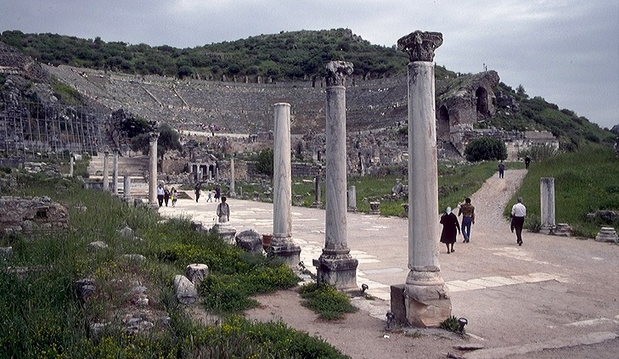
3."The Asian Thrust"
A.D. 53-57
ATLANTIC OCEAN
EUROPE
ANCIENT EPHESUS
ROME•
•Macedonia
ASIA
•Pisidian Antioch
•
•Ephesus
AFRICA
Athens
Acts 18-21
•Syrian Antioch
MEDITERRANEAN SEA
3.The Asian Thrust
•Jerusalem
Significance: extended time at the church in Ephesus; young man raised from the dead; important letters written; riot with Ephesian artisans at amphitheatre.
ARABIA
9.65.08.
45
4
© 2006 TBBMI
9.65.08.
Notes:
Paul had previously ministered in the Ephesian church for nearly three years (Acts 19; 20:31).
Then came Paul's ASIAN THRUST…recorded in Acts 18-21.
//// Again, this trip began overland from Syrian Antioch…revisited many of the earlier churches…made a horseshoe-shaped route around the Aegean, back down into Greece, retraced that route back around the horseshoe, remaining at Troas, then returning by sea to Syrian Antioch.
//// Paul spent a very long time living and ministering to the church in EPHESUS. Luke reports that Paul raised a young man from the dead in Ephesus. Many important letters –– our Epistles –– were written from Ephesus.
//// One of the most dramatic events recorded for us took place at the Ephesian AMPHITHEATRE where he confronted the souvenir makers of the city…those who manufactured small idols of the Goddess Diana, whose temple in Ephesus was one of the seven wonders of the ancient world.
//// LENGTH OF THIS TRIP: ALMOST FIVE YEARS BETWEEN A.D. 53 AND 57.

Slide 27
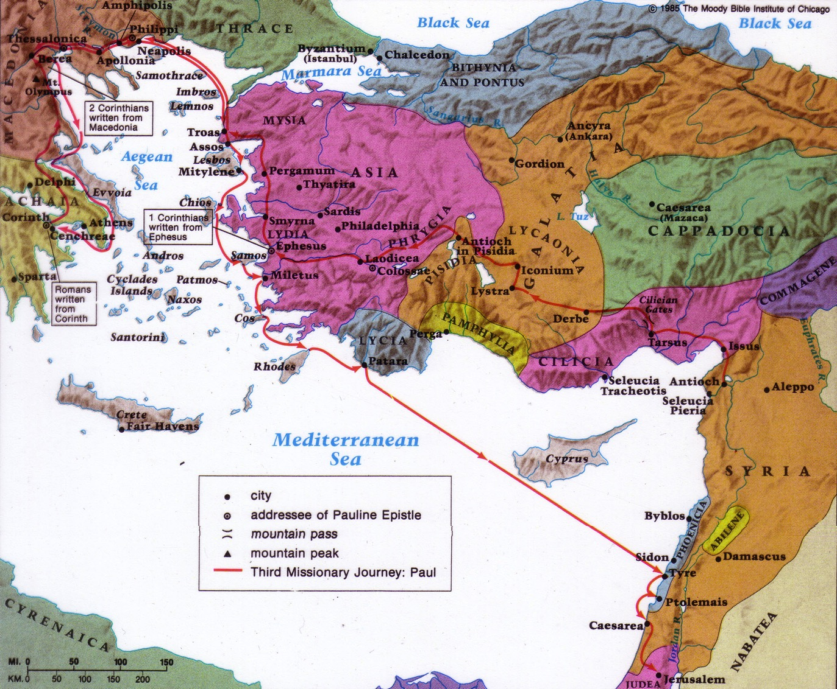
Paul's Third Missionary Journey
140
EPHESUS
Paul taught in Ephesus "for two years, so that all of Asia heard the word of the Lord" (Acts 19:10)
Notes:
He then ministered in Macedonia and Greece and Troas and coastal towns near Ephesus (20:1-15).
Paul stopped by the coastal town of Miletus while traveling to Jerusalem at the end of his third missionary journey (Acts 20:16,17a).
Knowing that he would soon die (20:25), Paul requested the Ephesian elders to come to him to hear his parting words (17b-18a).

Slide 28
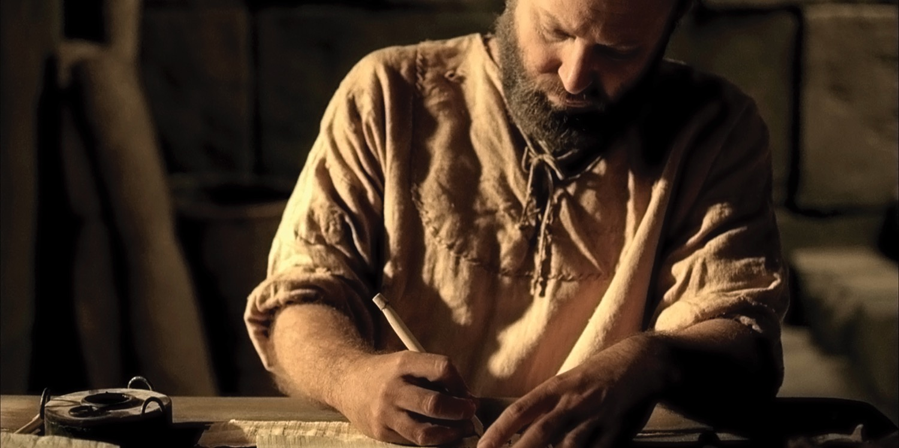
The Apostle Paul (Acts 20:18b-35)
Notes:
Preview: In our text today from Acts 20:18b-35, Paul shows first how he modeled being an elder and then what the elders were specifically supposed to do.
Text: Today we will observe Paul's example and instructions to elders concerning their job description found in Acts 20:18b-35.
(Paul knew that the success of the church at Ephesus would rest upon the faithfulness of the men who led the flock. But before charging the men with their responsibilities, Paul elaborated on his own life as an example.)

Slide 29
Paul modeled shepherding for the elders (Acts 20:18b-27).
Presence —where he was (18b)
Passion —what he felt (19)
Proclamation —what he preached (20-21)
Persecution —where he was going (22-23)
Priorities —what he valued (24-27)
Notes:
[He knew that more is caught than taught—so he set an example of care for them.]
A. Paul cared like an elder in his past ministry at Ephesus (18b-21).
1. Paul cared by his presence—where he was (18).
a) I once knew an elder who resigned due to the increased traveling responsibilities of his job. Through this he actually showed his commitment to the men.
b)As elders we must be available men.
2. Paul cared in his passion—what he felt (19).
a) He lived in brokenness.
b) He endured many trials that came with caring for people.
3. Paul cared in his proclamation—what he preached (20-21).
a) We must teach the basics: repentance towards God and faith in Christ.
b) Elders must not neglect evangelism.
B. Paul cared like an elder in his present situation (22-27).
1. Paul cared despite persecution—where he was going (22-23).
2. Paul cared by his priorities—what he valued (24-27).
(In light of Paul’s example, what specifically should elders do? He gives the Ephesian elders [and us] his charge in the following verses.)

Slide 30
My Only Aim
“But my life is worth nothing to me unless I use it for finishing the work assigned me by the Lord Jesus—the work of telling others the Good News about the wonderful grace of God”
(Acts 20:24 NLT).
Notes:
My only aim is within these verses!

Slide 31
Elders should follow Paul’s shepherding example (Acts 20:28-35).
236c1
Administration (Serve, care for & testify)
Teaching
1 Tim. 3:2; 5:17; Acts 20:28d
1 Tim. 3:1, 4-5; 5:17; Acts 20:28c
Pastor-Teacher
Episkopos =
Epi “over” +
skopos “look” =
“watch over”
Eph. 4:11
Pastoring (Protect & Lead)
1 Pet. 5:1-4
Acts 20:28a-b, 29, 35
1 Thess. 5:12
Notes:
They must lead the sheep like Paul cared for people.

Slide 32
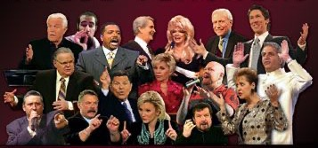
External False Teachers
Acts 20:29
Notes:
God hates false teaching, and we must hate what God hates.

Slide 33
Opposition
External
Notes:
God is truth—so whatever is not true cannot be allowed into the church.

Slide 34
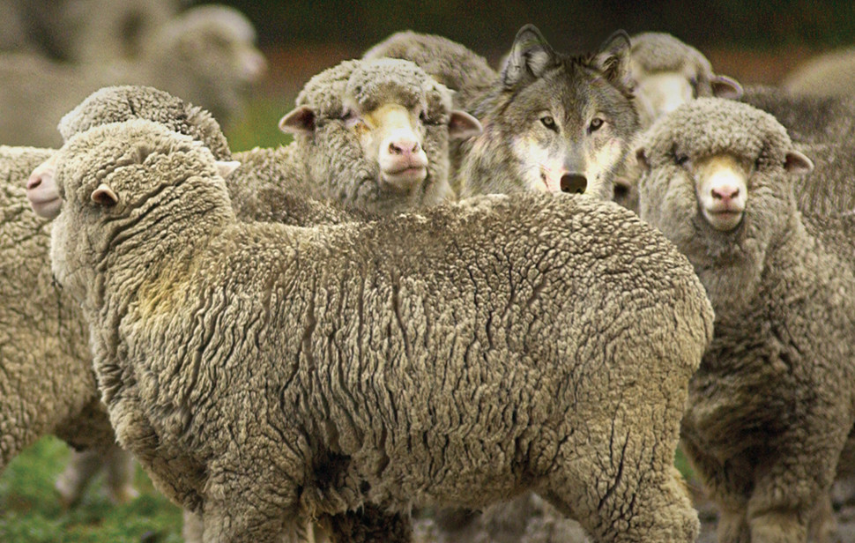
Internal False Teachers
Acts 20:30
Notes:
Sadly, too many churches have wolves right there among the sheep.

Slide 35
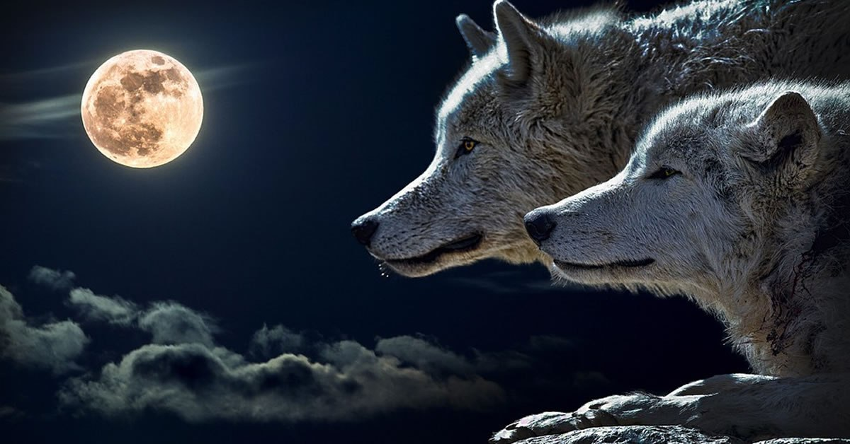
Black

Slide 36
Opposition
External
Internal
Notes:
Sadly, too many churches have wolves right there among the sheep.
Let's warn a factious (heretical) man only twice before we expel him from the body (Tit 3:10-11).

Slide 37
Elders must serve selflessly (Acts 20:32-35).
Founded on God’s grace and Word (32).
Based on hard work instead of greed (33-35).
Notes:
Be careful how others interpret the way we spend our money to avoid showing covetousness or greed (33-34a).
Set an example for the church in selfless giving (34b-38).

Slide 38
What are elders supposed to do?

Slide 39
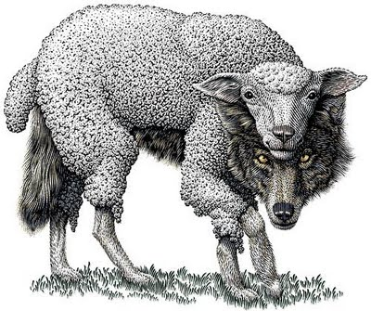
Main Idea of Acts 20
Elders should be selfless shepherds against false teachers

Slide 40
Watch Paul
Mimic Paul

Slide 41
What About You?
How can you better shepherd the flock under your care—whether the whole church as elders, or your family or friends?
Notes:
Acts 20 actually applies to us all.

Slide 42
Paul modeled shepherding for the elders (Acts 20:18b-27).
Presence —where he was (18b)
Passion —what he felt (19)
Proclamation —what he preached (20-21)
Persecution —where he was going (22-23)
Priorities —what he valued (24-27)
Notes:
[He knew that more is caught than taught—so he set an example of care for them.]
A. Paul cared like an elder in his past ministry at Ephesus (18b-21).
1. Paul cared by his presence—where he was (18).
a) I once knew an elder who resigned due to the increased traveling responsibilities of his job. Through this he actually showed his commitment to the men.
b)As elders we must be available men.
2. Paul cared in his passion—what he felt (19).
a) He lived in brokenness.
b) He endured many trials that came with caring for people.
3. Paul cared in his proclamation—what he preached (20-21).
a) We must teach the basics: repentance towards God and faith in Christ.
b) Elders must not neglect evangelism.
B. Paul cared like an elder in his present situation (22-27).
1. Paul cared despite persecution—where he was going (22-23).
2. Paul cared by his priorities—what he valued (24-27).
(In light of Paul’s example, what specifically should elders do? He gives the Ephesian elders [and us] his charge in the following verses.)

Slide 43
Elders should follow Paul’s shepherding example (Acts 20:28-35).
236c1
Administration (Serve, care for & testify)
Teaching
1 Tim. 3:2; 5:17; Acts 20:28d
1 Tim. 3:1, 4-5; 5:17; Acts 20;28c
Pastor-Teacher
Episkopos =
Epi “over” +
skopos “look” =
“watch over”
Eph. 4:11
Pastoring (Protect & Lead)
1 Pet. 5:1-4
Acts 20:28a-b, 29, 35
1 Thess. 5:12

Slide 44
Black

Slide 45
The Lord is My Shepherd
Mharmomo Kithan

Slide 47
The King is Coming
Charles Milhuff | Gloria Gaither | William J. Gaither
CCLI Song #3477
© 1970 William J. Gaither, Inc
CIC CCLI License # 277507

Slide 48
The market place is empty
No more traffic in the streets
All the builders' tools are silent
No more time to harvest wheat
Busy housewives cease their labors
In the courtroom no debate
Work on earth is all suspended
As the King comes thru the gate
V1

Slide 49
O the King is coming
The King is coming
I just heard the trumpets sounding
And now His face I see
O the King is coming
The King is coming
Praise God He's coming for me
C

Slide 50
Happy faces line the hallways
Those whose lives have been redeemed
Broken homes that He has mended
Those from prison He has freed
Little children and the aged
Hand in hand stand all aglow
Who were crippled broken ruined
Clad in garments white as snow
V2

Slide 51
O the King is coming
The King is coming
I just heard the trumpets sounding
And now His face I see
O the King is coming
The King is coming
Praise God He's coming for me
C

Slide 52
I can hear the chariots rumble
I can see the marching throng
The flurry of God's trumpets
Spells the end of sin and wrong
Regal robes are now unfolding
Heaven's grandstands all in place
Heaven's choir is now assembled
Start to sing Amazing Grace
V3

Slide 53
O the King is coming
The King is coming
I just heard the trumpets sounding
And now His face I see
O the King is coming
The King is coming
Praise God He's coming for me
C (final)

Slide 54
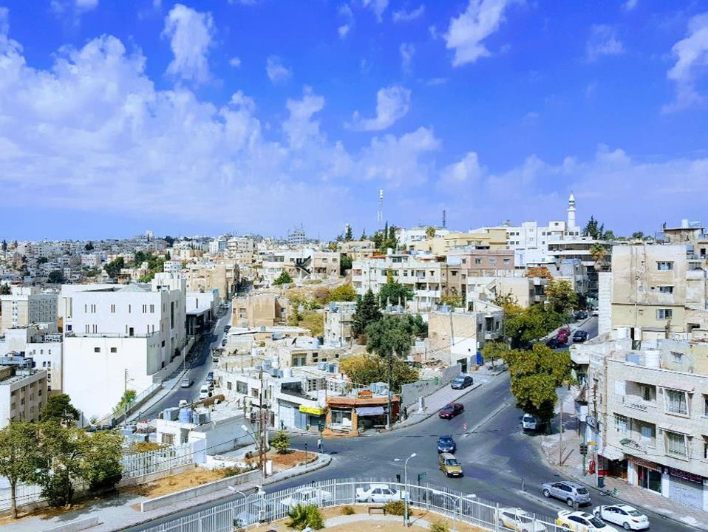
Prayer for the
Jordanian Arabs

