Slide 1

When Trials Come
Keith Getty | Kristyn Getty
  CCLI Song #4619523
  © © 2005 Thankyou Musi
  CIC CCLI License # 277507

Slide 2
When trials come no longer fear
For in the pain our God draws near
To fire a faith worth more than gold
And there His faithfulness is told
And there His faithfulness is told
V1

Slide 3
Within the night I know Your peace
The breath of God brings strength to me
And new each morning mercy flows
As treasures of the darkness grow
As treasures of the darkness grow
V2

Slide 4
I turn to wisdom not my own
For ev'ry battle You have known
My confidence will rest in You
Your love endures Your ways are good
Your love endures Your ways are good
V3

Slide 5
When I am weary with the cost
I see the triumph of the cross
So in its shadow I shall run
Till You complete the work begun
Till You complete the work begun
V4

Slide 6
One day all things will be made new
I'll see the hope You called me to
And in Your kingdom paved with gold
I'll praise Your faithfulness of old
I'll praise Your faithfulness of old
V5 (final)

Slide 7
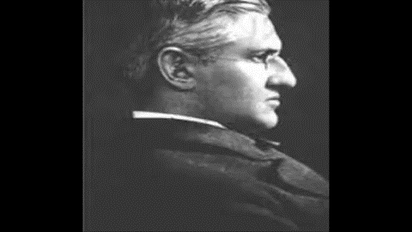
Horatio Spafford

Slide 8
It Is Well With My Soul
Horatio Gates Spafford | Philip Paul Bliss
  CCLI Song #25376
  © © Words and Music: Public Domain
  CIC CCLI License # 277507

Slide 9
When peace like a river
Attendeth my way
When sorrows like sea billows roll
Whatever my lot
Thou hast taught me to say
It is well, It is well
with my soul
It is well with my soul
It is well, It is well with my soul
V1

Slide 10
Tho' Satan should buffet
Tho' trials should come
Let this blest assurance control
That Christ hath regarded
My helpless estate
And hath shed His own blood
For my soul
It is well with my soul
It is well, It is well with my soul
V2

Slide 11
My sin O the bliss
Of this glorious tho't
My sin not in part but the whole
Is nailed to the cross
And I bear it no more
Praise the Lord
Praise the Lord O my soul
It is well with my soul
It is well, It is well with my soul
V3

Slide 12
And Lord haste the day
When the faith shall be sight
The clouds be rolled back as a scroll
The trump shall resound
And the Lord shall descend
Even so it is well
With my soul
It is well with my soul
It is well, It is well with my soul
V4 (final)

Slide 13
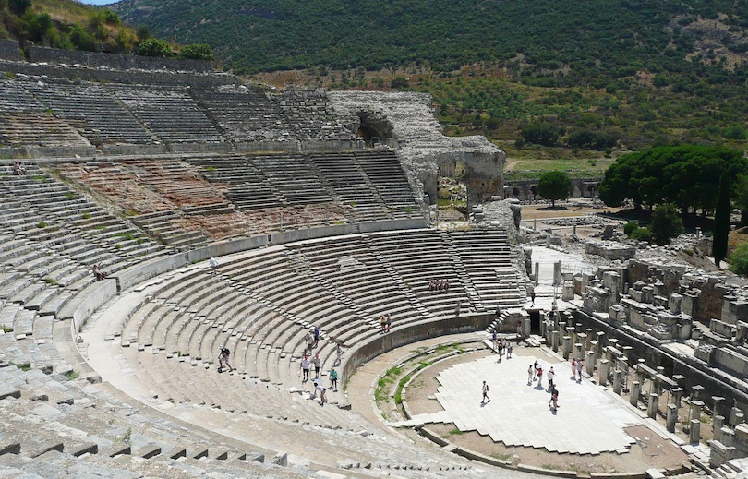
The Peaceful Riot
Acts 19:21-41
Dr. Rick Griffith • Crossroads International Church Singapore
CICFamily.com • BibleStudyDownloads.org

Slide 14
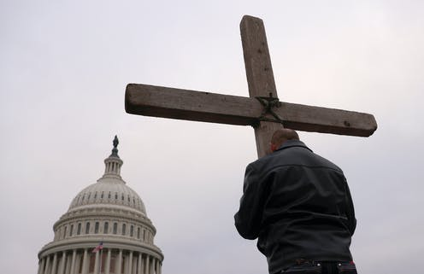
6 Jan 2021 Capitol Riot
Notes:
Christians are increasingly accused of disturbing the peace

Slide 15
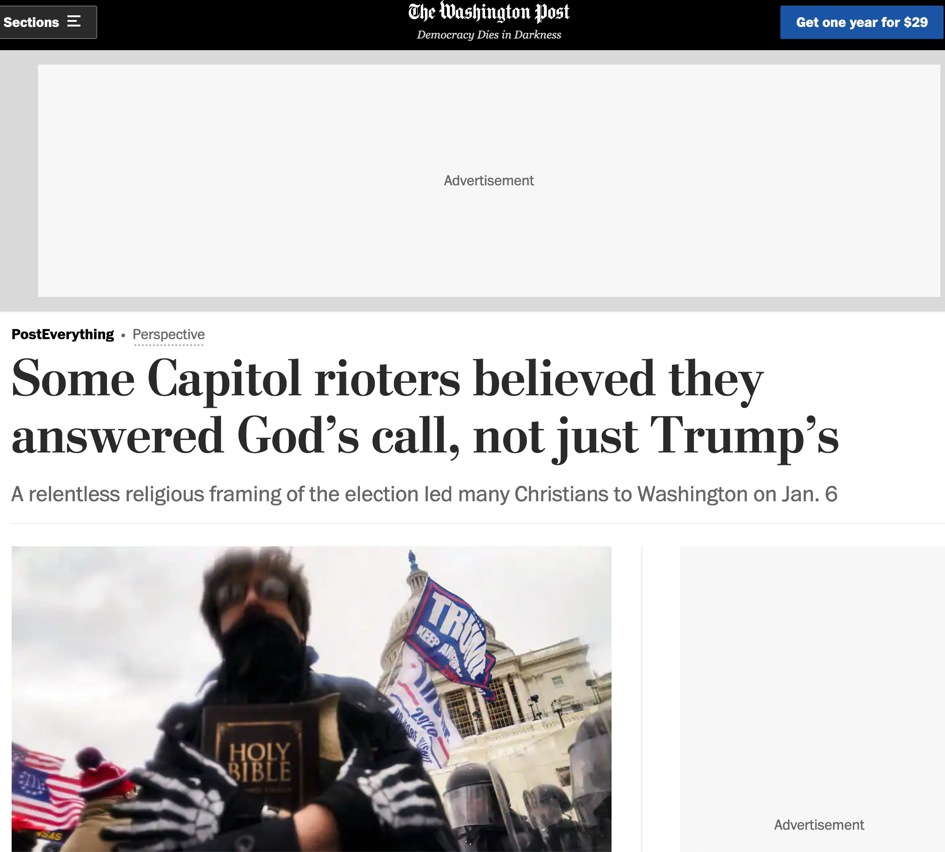
6 Jan 2021 Capitol Riot
Notes:
—such as in the January 6 US Capitol riot. And yet unbelievers rioted far worse.

Slide 16
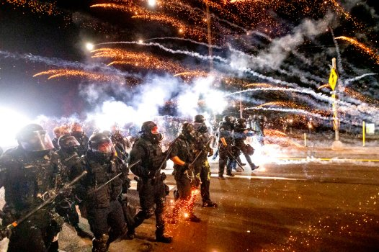
Portland 2021 Riots
Notes:
Portland had over 100 days of riots in 2020

Slide 17
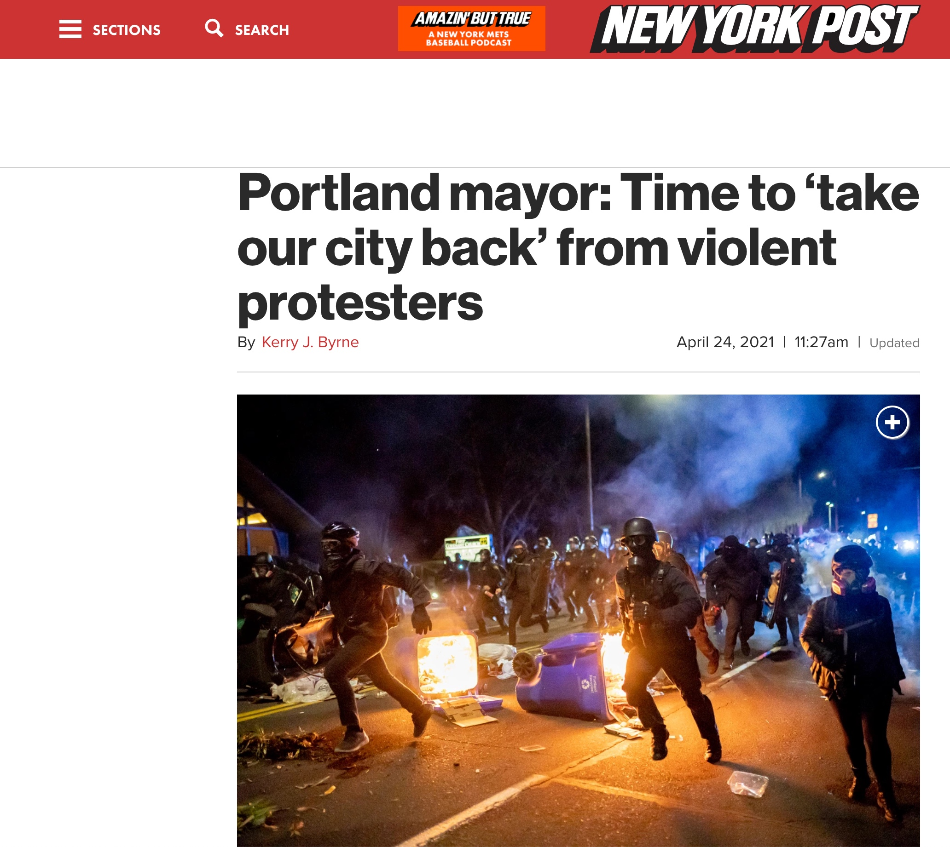
USA 2020 Riots
Notes:
that destroyed public buildings.

Slide 18

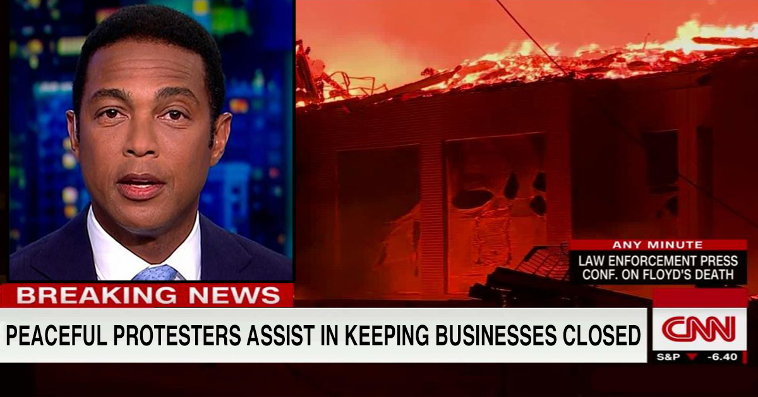
Minneapolis
Notes:
Milwaukie had rioting that destroyed 5 miles of buildings in 2020.
________
Here is a satire on the CNN report (not the real report but a depiction of how a riot can be peaceful!):
“It was a touching scene tonight in Minneapolis as thousands of peaceful protesters lent a helping hand in the effort to keep small businesses closed,” CNN’s Don Lemon cheerfully reported.
The protestors used the little-known technique of burning all the stores to the ground to accomplish this noble goal. Despite many Americans disagreeing with this method, experts are saying what they’ve done is, by far, the most scientifically proven way to prevent the owners from opening up their doors.
The folks at CNN also marveled at the environmentally mindful deeds from the protesters. “Would you look at that?” Chris Cuomo asked in amazement. “What they’re doing is choosing to not use the energy-guzzling streetlamps. But rather, they’ve found a way to light-up the city with fire—eerrr, with something more resourceful.”
Then minutes later, Lemon carefully squinted his eyes and pointed at the TV screen. “Zoom in on that guy!” he yelled to his producers. “He’s… he’s OPENING up his business!”
As it turned out, Lemon’s watchful eye was correct. It was, in fact, a local business owner entering his storefront. “THAT’S ILLEGAL BEHAVIOR!” Lemon screamed.
Update: Several vigilante-minded CNN cameramen apprehended the reckless man and opted to toss him into a nearby fire. “I’m glad you guys did that,” Lemon said on-air. “We cannot have the fabric of society crumble because unruly people act selfishly.”
______
https://thegloriousamerican.com/health/cnn-peaceful-protesters-lend-helping-hand-to-keep-small-businesses-closed/
Accessed 15 May 2021

Slide 19

“Blessed are the peacemakers.”
Are you a peacemaker?
Notes:
Do you know how to diffuse conflict?

Slide 20

Who brings peace in society more—believers or unbelievers in Jesus?
Notes:
Restatements: Who causes more trouble in our cultures—Christians or idolaters? Which is more harmful—idolatry or Christianity?

Slide 21
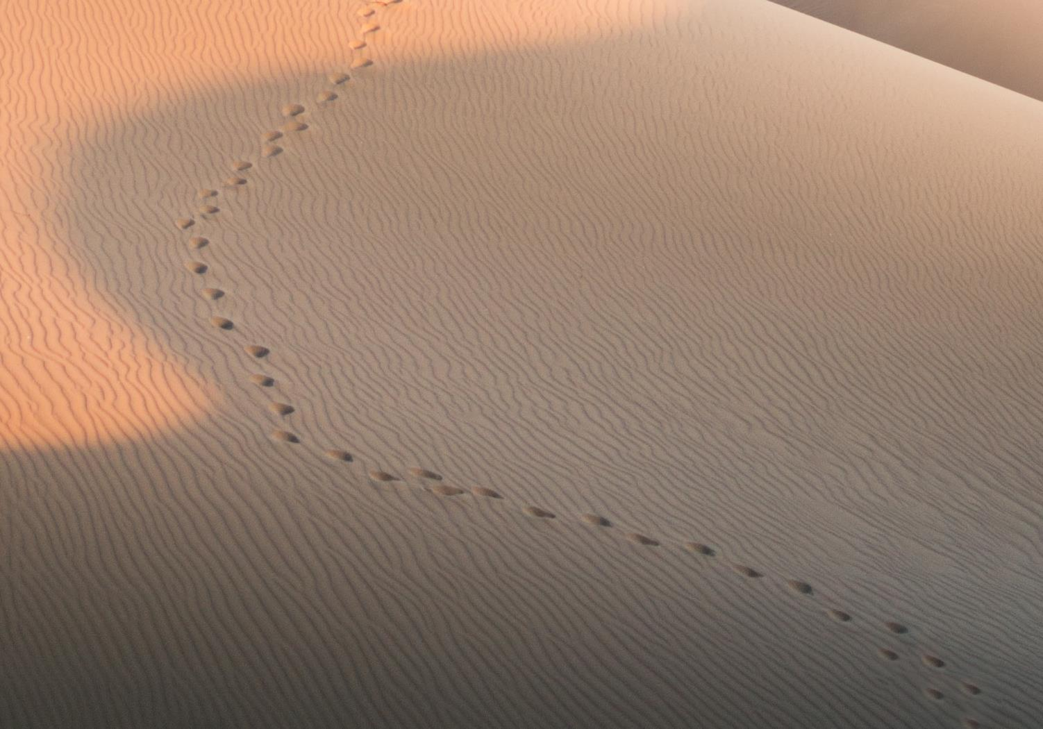
Acts Series
GOOD NE WS
ON THE MO VE
God’s work through the early church in
Acts
Notes:
Our series on Acts has emphasized that the Good News on the Move was God’s work.

Slide 22
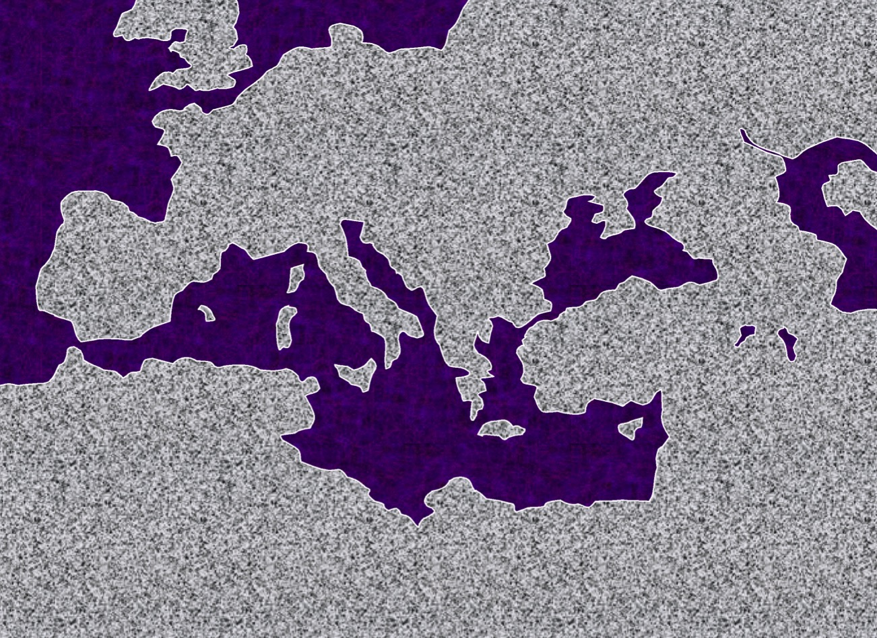
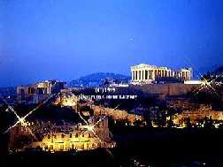
2. "The European Thrust"
ATLANTIC OCEAN
A.D.
49-52
EUROPE
ANCIENT ATHENS
ASIA
ROME•
•Macedonia
•Pisidian Antioch
•
•Ephesus
AFRICA
Athens
Acts 15-18
•Syrian Antioch
MEDITERRANEAN SEA
2."The European Thrust"
•Jerusalem
Significance: many church plants; call to Macedonia, on to Athens, "the unknown god"; Mars Hill; lengthy Corinthian stay.
ARABIA
44
5
©2006 TBBMI
9.65.08.
© 2006 TBBMI
Notes:
Paul then began to prepare for extended missionary trips.
//// Trip #2…THE EUROPEAN THRUST…is recalled in detail in Acts 15 through 18.
//// This second journey began overland from Syrian Antioch…all the way into Greece…then returning by sea to make his report to the church in Jerusalem…then back home to Syrian Antioch.
//// There were church plants along the way… They met in synagogues every Sabbath…speaking either Greek –– thanks to Alexander the Great –– or Hebrew or Latin. Paul spoke all those languages. This is the time of that famous call to "come over to MACEDONIA and help us." And then he took up a lengthy residence in the wild, seaside town of CORINTH, only a short journey from Athens.
//// On this trip he debated with the Athenian philosophers on Mars Hill, recognizing their statue to "the unknown God." He built a sermon around that!
//// LENGTH OF THIS TRIP: ESTIMATED AT ABOUT TWO AND A HALF YEARS BETWEEN A.D. 49 AND 52.

Slide 23
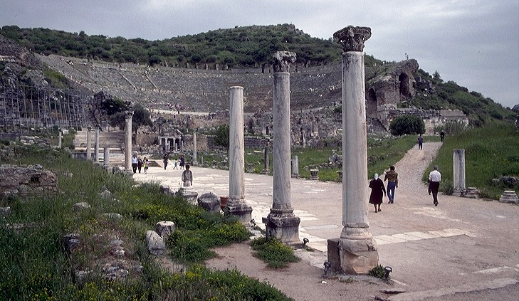
3."The Asian Thrust"
A.D.
53-57
ATLANTIC OCEAN
EUROPE
ANCIENT EPHESUS
ROME•
•Macedonia
ASIA
•Pisidian Antioch
•
•Ephesus
AFRICA
Athens
Acts 18-21
•Syrian Antioch
MEDITERRANEAN SEA
3.The Asian Thrust"
•Jerusalem
Significance: extended time at the church in Ephesus; young man raised from the dead; important letters written; riot with Ephesian artisans at amphitheatre.
ARABIA
9.65.08.
45
4
© 2006 TBBMI
9.65.08.
Notes:
Then came Paul's ASIAN THRUST…recorded in Acts 18-21.
//// Again, this trip began overland from Syrian Antioch…revisited many of the earlier churches…made a horseshoe-shaped route around the Aegean, back down into Greece, retraced that route back around the horseshoe, remaining at Troas, then returning by sea to Syrian Antioch.
//// Paul spent a very long time living and ministering to the church the EPHESUS. Luke reports that Paul raised a young man from the dead in Ephesus. Many important letters –– our Epistles –– were written from Ephesus.
//// One of the most dramatic events recorded for us took place at the Ephesian AMPHITHEATRE where he confronted the souvenir makers of the city…those who manufactured small idols of the Goddess Diana, whose temple in Ephesus was one of the seven wonders of the ancient world.
//// LENGTH OF THIS TRIP: ALMOST FIVE YEARS BETWEEN A.D. 53 AND 57.

Slide 24
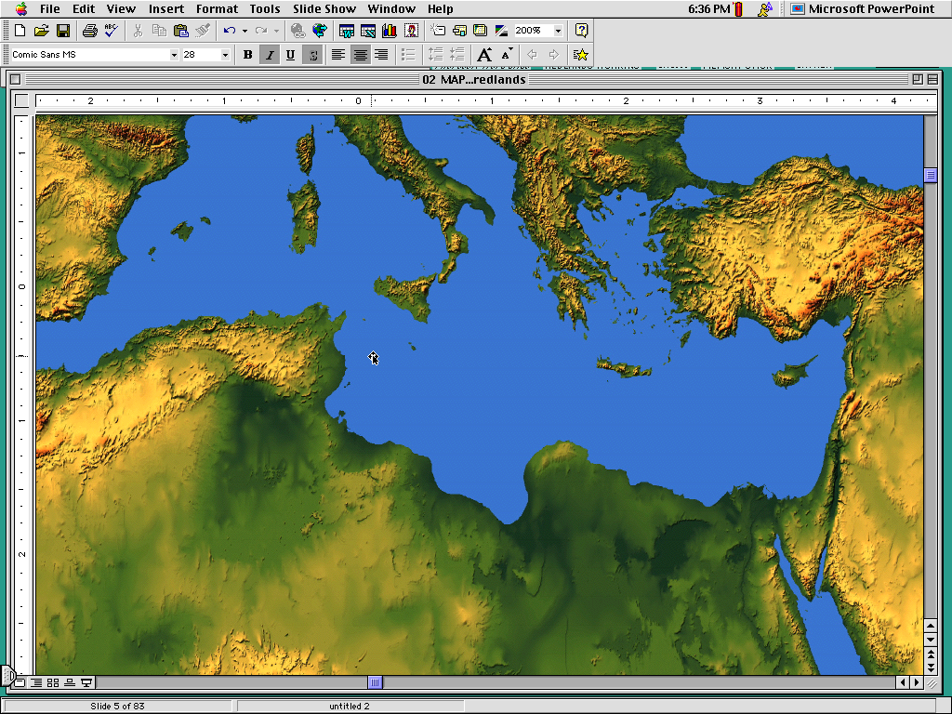
Apostles Opposed in Acts 16–19
Philippi
Notes:
Before the riot in Ephesus in Acts 19:23-41, Christianity had already shown itself peaceful a number of times.

Slide 25
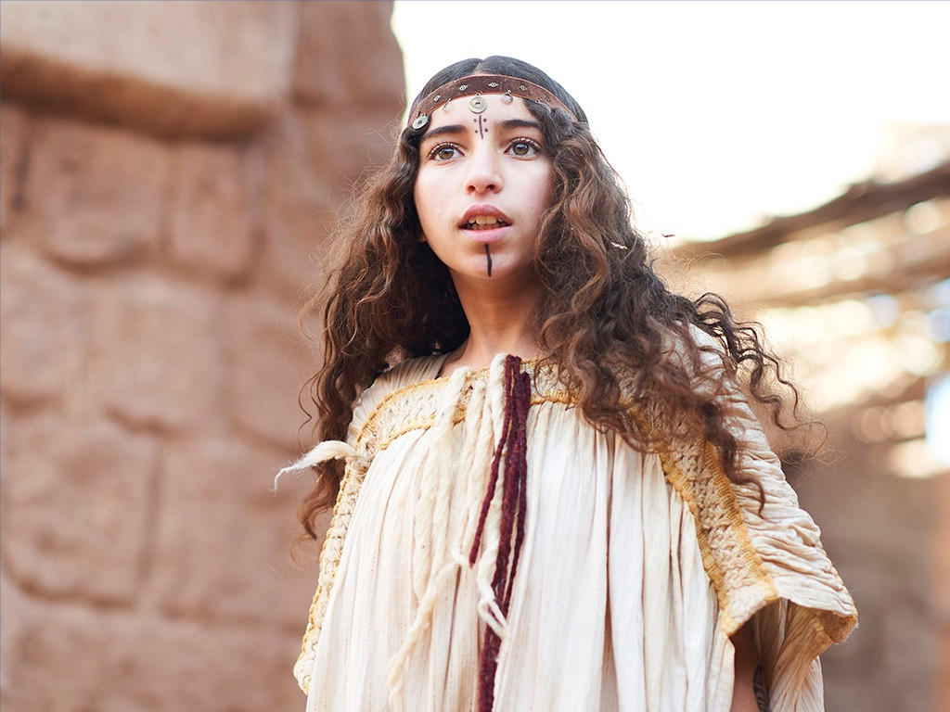
Slave Girl (Acts 16:16)
Notes:
Owners of a slave girl in Philippi whom Paul and Silas had released from a demon…

Slide 26
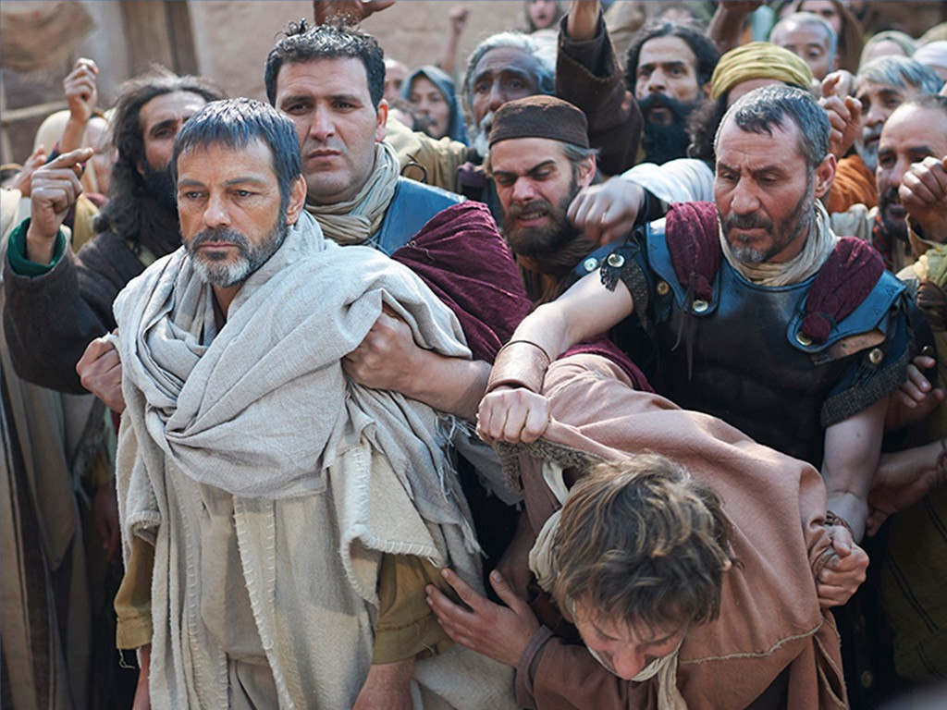
Beaten & Flogged
(Acts 16:22)
Notes:
…had them beaten, flogged, and imprisoned—but they prayed and sang in prison, which is not exactly rioting behavior (16:16-25). These men caused no riot—rather, they were the victims of the riot caused by others!

Slide 27
Apostles Opposed in Acts 16–19
Thessalonica
Philippi
Berea
Athens
Ephesus
Corinth
Notes:
Jews in Thessalonica jealous of Paul convincing some fellow Jews that Jesus was Messiah, accused Paul and Silas of causing trouble all over the world (17:6), recruited bad characters and caused a riot (17:2-5). These men caused no riot—rather, they were the victims of the riot caused by others!
• After kicking them out of Thessalonica, these Jews even traveled to Berea and agitated the crowds so the apostles got kicked out of Berea too (17:13-14). These men caused no riot—but they were victims of the riot caused by others!
• At Athens, Epicurean and Stoic philosophers ridiculed Paul publicly, but Paul gave a reasoned defense. Paul caused no riot—rather, he was the victim of the sneering of others (17:18, 32).
• In Corinth, Jews abused Paul (18:6), but Paul only shook out his clothes in response. Paul caused no abuse to them—rather, his friend Sosthenes was the victim of their abuse right in front of the government official (18:17).
At Ephesus, Jews publicly maligned Paul and expelled him from the synagogue (19:9). Paul healed people and caused no commotion, but a demon beat seven sons of a Jewish priest did (19:16)!

Slide 28
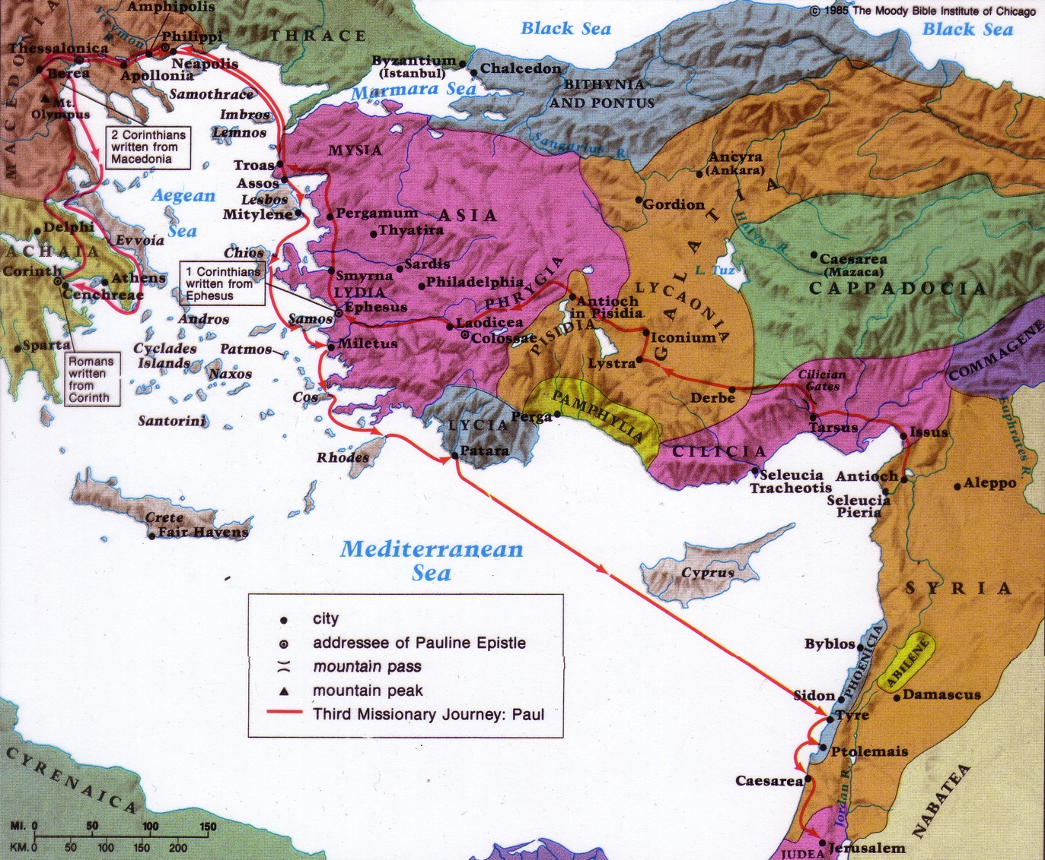
Paul's Third Missionary Journey
140
EPHESUS
Paul taught in Ephesus "for two years, so that all of Asia heard the word of the Lord" (Acts 19:10)
Notes:
In Acts 19:1-20, Paul had taught in Ephesus’s School of Tyrannus (19:9).

Slide 29
Paul's Third Missionary Journey
140
EPHESUS
“In this way the word of the Lord spread widely and grew in power” (Acts 19:20 NIV)
Notes:
The result was “the word of the Lord spread widely and grew in power” (19:20).

Slide 30

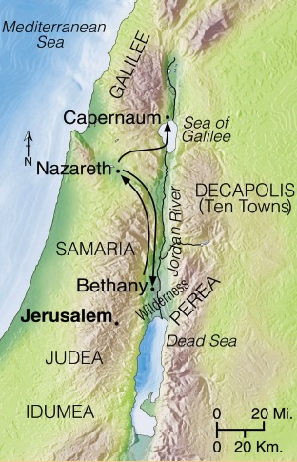
Progress Reports
125
End of the Earth
Key Verse: 1:8
2:47b
6:7
8:40
9:31
12:24
16:5
19:20
28:30-31
1:1–6:7
6:8–8:40
Acts 9–28
Why end this way?
Adapted from Stanley D. Toussaint, BKC; Jeremy Chew, EAST
Notes:
Here is Progress Report #7 in the book as the gospel advanced.

Slide 31
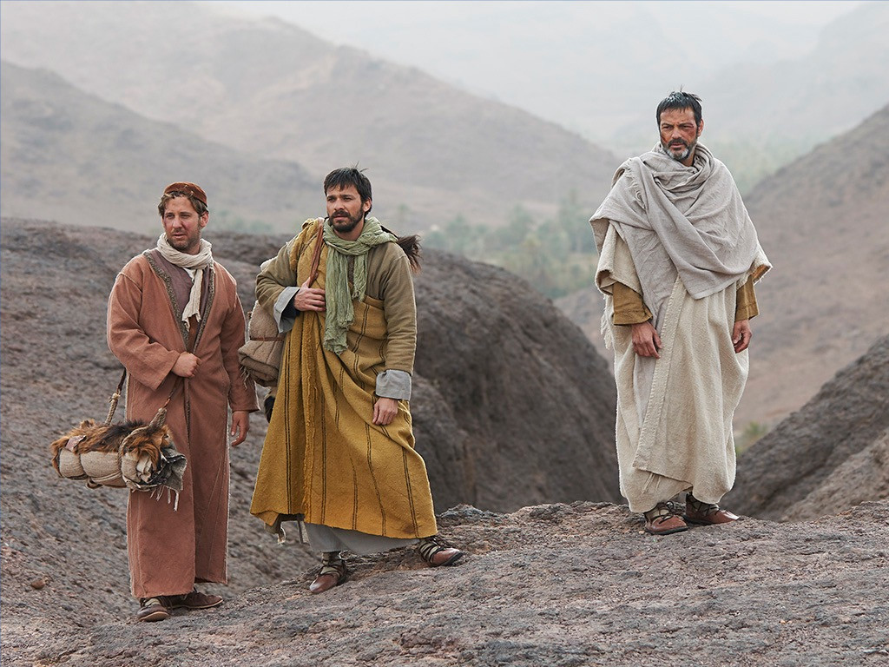
The Setting: Peace
Paul did not let the scroll burning lead to a riot but planned to leave for Rome (19:21-22).
Notes:
A demon had just beaten up men leading to the public burning of sorcery scrolls (21:21a; cf. verses 13-20).
Rather than let this lead to a riot, Paul planned to leave for Rome (21:21b-22).
Preview/Text: Let’s first see the real troublemaker in Acts 19:23-31 and then learn how not to be troublemakers today.

Slide 32

Artemis (Diana) Video (cf. Acts 19)
180c
Notes:
"In Roman mythology, Diana (lt. "heavenly" or "divine") was the goddess of the hunt and moon and birthing, being associated with wild animals and woodland, and having the power to talk to and control animals. She was equated with the Greek goddess Artemis, though she had an independent origin in Italy." (http://en.wikipedia.org/wiki/Diana_%28mythology%29)
Temple had 127 Marble pillars, Artemis (Gk), Diana (Latin)

Slide 33
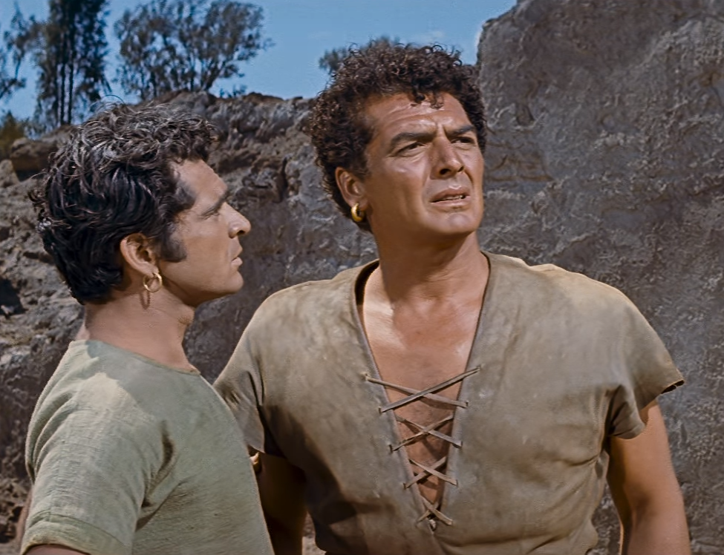
The idol maker Demetrius began the Ephesus riot—not the peaceful Paul (Acts 19:23-41).
Notes:
A financial motive of the craftsmen led to unrest—not Paul’s preaching.
The idolater Demetrius accused Paul of trouble-making and apostasy (19:23-27).

Slide 34
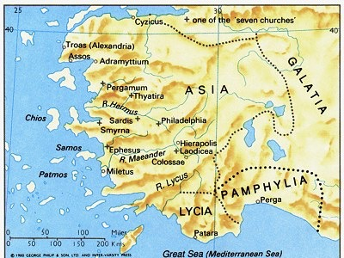
Ephesus was the capital of Asia
176
Notes:
Demetrius stirred up craftsmen against Paul cutting their profit from idols (19:23-27a).

Slide 35
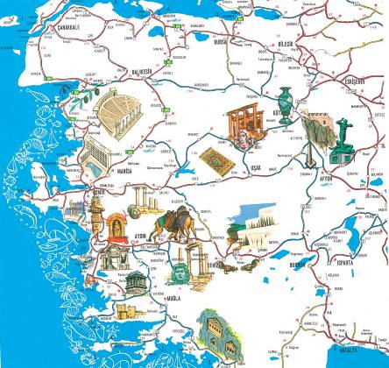
A Centre of Culture
Notes:
That he cared more about the money may be supported in that Demetrius noted their income first (19:25).

Slide 36
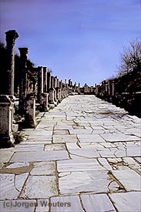
Marble Roads
Notes:
He also later repeated how important their trade would lose its good name (19:27a).
_________
Marble city, chariot ruts, speed humps, after earthquake columns put back up again.

Slide 37
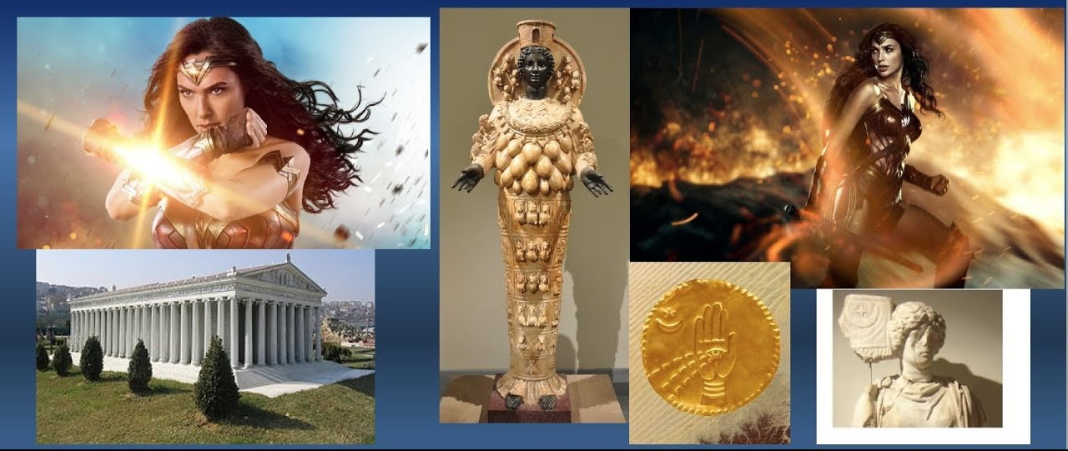
Artemis:
The Ancient Wonder Woman
Notes:
But Demetrius also said that he sought the honor of Artemis (19:27b).
Artemis was the key figure in Ephesus, Asia’s capital city.—essentially the Ancient Wonder Woman!

Slide 38
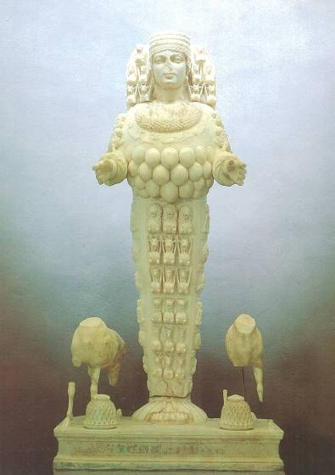
Artemis, Goddess of Fertility
Notes:
Artemis had many breasts to symbolize her ability to nourish the earth.
She was goddess of nature and fertility.
As one who fell from the sky, Artemis had miraculous powers to heal the sick and regulate the economy.
The Ephesians devoted one entire month each year to honor her. Businesses closed shop, people gathered for athletic games along with orgies, feasting, and carousing. Thousands attended, including many from other cities of Asia.

Slide 39
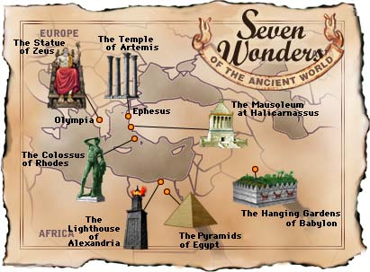
Seven Wonders of the Ancient World
Notes:
Why was the temple of Artemis so significant (24)?
It was one of the Seven Wonders of the Ancient World.

Slide 40

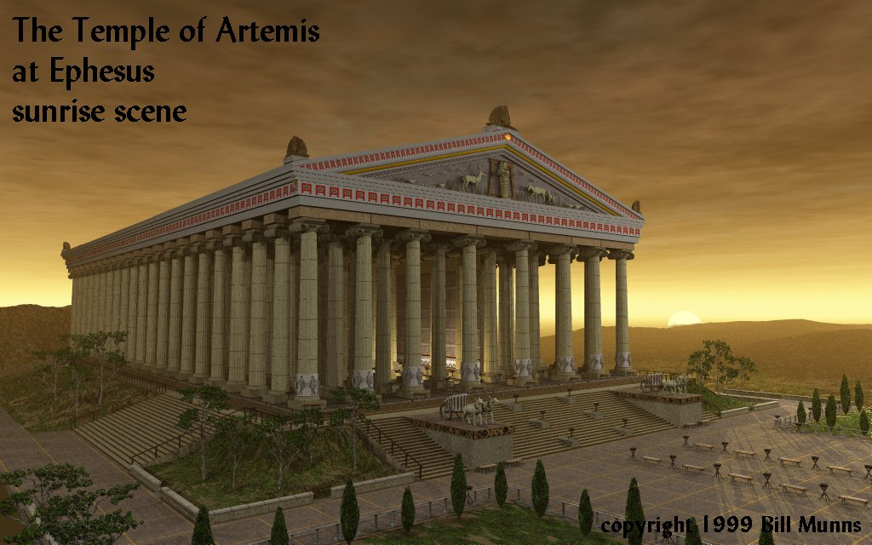
The Temple of Artemis at Ephesus
349
Notes:
An amazing 127 columns surrounded it, each beautifully sculptured at the base
The temple took 120 years to build, according to the historian Pliny the Elder (see below)!
______
Pliny the Elder, The Natural History 21.14
John Bostock, M.D., F.R.S., H.T. Riley, Esq., B.A., Ed.
http://www.perseus.tufts.edu/hopper/text?doc=Perseus%3Atext%3A1999.02.0137%3Abook%3D36%3Achapter%3D21
Accessed 17 May 2021
CHAP. 21. (14.)—THE TEMPLE OF DIANA AT EPHESUS.
The most wonderful monument of Græcian magnificence, and one that merits our genuine admiration, is the Temple of Diana at Ephesus, which took one hundred and twenty years in building, a work in which all Asia¹ joined. A marshy soil was selected for its site, in order that it might not suffer from earthquakes, or the chasms which they produce. On the other hand, again, that the foundations of so vast a pile might not have to rest upon a loose and shifting bed, layers of trodden charcoal were placed beneath, with fleeces² covered with wool upon the top of them. The entire length of the temple is four hundred and twenty-five feet, and the breadth two hundred and twenty-five. The columns are one hundred and twenty-seven in number, and sixty feet in height, each of them presented by a different king. Thirty-six of these columns are carved, and one of them by the hand of Scopas.³ Chersiphron⁴ was the architect who presided over the work. The great marvel in this building is, how such ponderous Architraves⁵ could possibly have been raised to so great a height. This, however, the architect effected by means of bags filled with sand, which he piled up upon an inclined plane until they reached beyond the capitals of the columns; then, as he gradually emptied the lower bags, the architraves⁶ insensibly settled in the places assigned them. But the greatest difficulty of all was found, in laying the lintel which he placed over the entrance-doors. It was an enormous mass of stone, and by no possibility could it be brought to lie level upon the jambs which formed its bed; in consequence of which, the architect was driven to such a state of anxiety and desperation as to contemplate suicide. Wearied and quite worn out by such thoughts as these, during the night, they say, he beheld in a dream the goddess in honour of whom the temple was being erected; who exhorted him to live on, for that she herself had placed the stone in its proper position. And such, in fact, next morning, was found to be the case, the stone apparently having come to the proper level by dint of its own weight. The other decorations of this work would suffice to fill many volumes, but they do not tend in any way to illustrate the works of Nature.

Slide 41
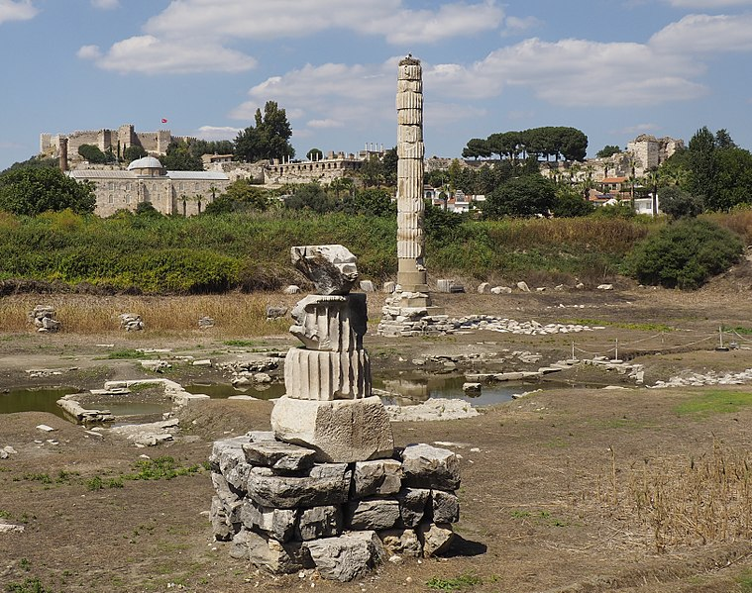
The Temple of Diana (Artemis) in 2017
349
Notes:
______
Picture: https://en.wikipedia.org/wiki/File:Templo-Artemisa-Efeso-2017.jpg
"In Roman mythology, Diana (lt. "heavenly" or "divine") was the goddess of the hunt and moon and birthing, being associated with wild animals and woodland, and having the power to talk to and control animals. She was equated with the Greek goddess Artemis, though she had an independent origin in Italy." (http://en.wikipedia.org/wiki/Diana_%28mythology%29)

Slide 42
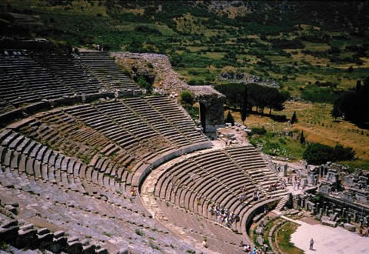
Theater Seats 25,000
theh'-at-ron
349
Acts 19:29
Notes:
Here is the place where the Ephesian clerk averted a riot in Acts 19:29.
Demetrius caused the riot—not Paul—whom the clerk defended (19:28-41).
The attack from Demetrius led to a two-hour riot in the theater (19:28-34).
Why was rushing into the theater significant (29)?
This was the largest gathering place in Ephesus.
It could hold 25,000 people!
Why would Paul want to enter an arena of hostile fanatics who would be in an uproar for two hours (30)?
Paul looked for every chance to share the gospel, even if his life was in danger.
Paul evidently supposed that God would enable him to give a reasonable defense of the gospel.
Why did some of provincial officials also prevent Paul from entering the theatre (31)?
These rulers “would not let him get caught in the riot. They were Asiarchs (lit., ‘rulers of Asia’), in charge of the community’s political and religious welfare. They would be on good terms with Rome and therefore would evidence Christianity’s good standing with the government”—Stanley D. Toussaint, “Acts,” in The Bible Knowledge Commentary: An Exposition of the Scriptures, ed. J. F. Walvoord and R. B. Zuck, vol. 2 (Wheaton, IL: Victor Books, 1985), 411–412.
If Paul entered there, a rumor may have started that said he caused the riot.

Slide 43
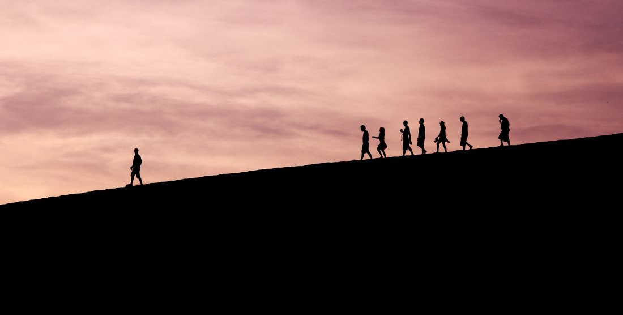
The City Clerk (Acts 19:35-41):
Enticed their pride (35-36)
Affirmed believers (37)
Encouraged legal charges (38-39)
Warned of Rome (40-41)
Notes:
The clerk wisely calmed the crowd by defending both Artemis and Paul (19:35-41).
• He enticed their pride, saying Ephesus guarded Artemis from heaven (19:35-36).
• He cleared Gaius and Aristarchus (and, in effect, Paul) of any crime (19:37).
• He encouraged legal charges, knowing the crowd wouldn’t do it (19:38-39).
• He warned that Rome might hear of their riot and punish the city (19:40-41).

Slide 44
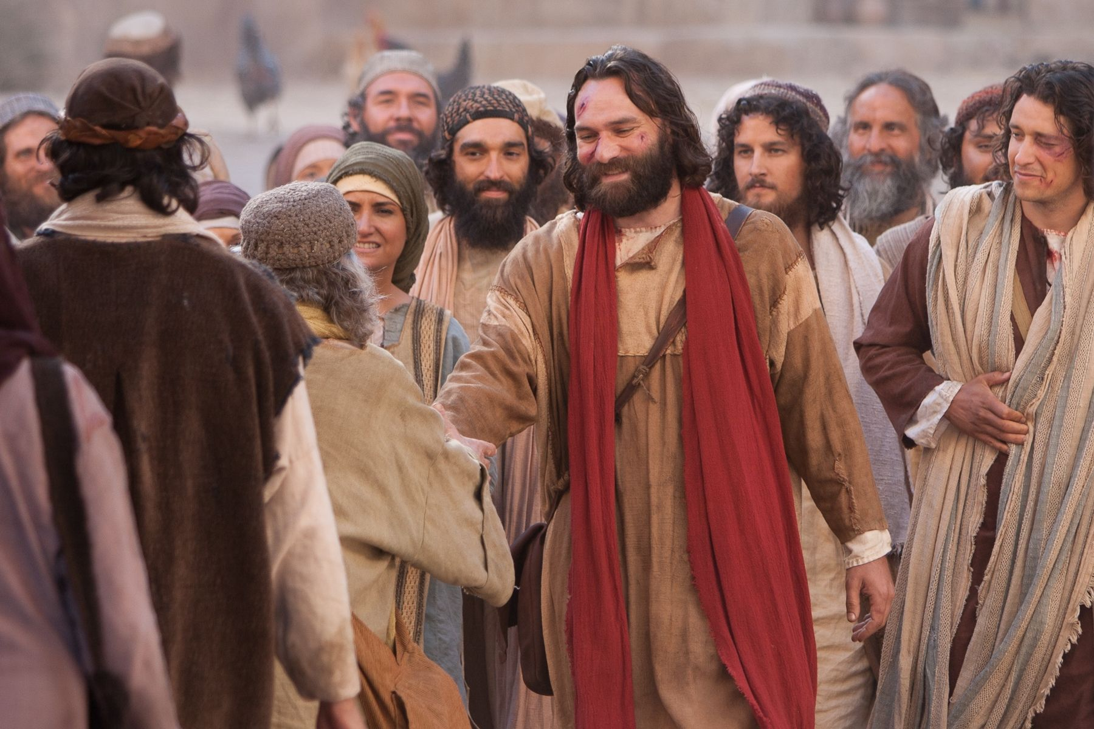
Christians = Riot Victims
—Not Riot Instigators
Notes:
(So Paul and the early Christians did not stir up trouble in Acts. But what about today?)

Slide 45

Believers bring peace in society.
Main Idea of Acts 19:21-41
Notes:
[Christians are the best ones to bring harmony in society.]

Slide 46
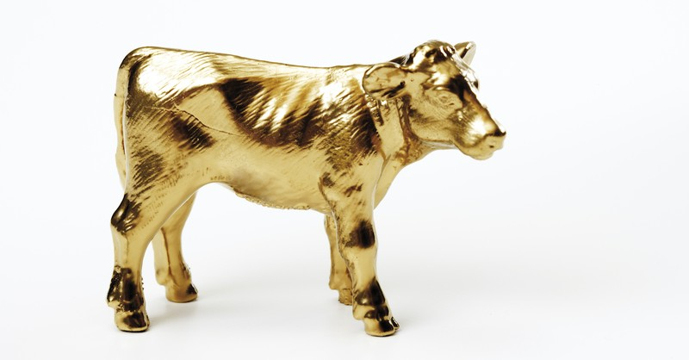
Idolatry leads to trouble.

Slide 47
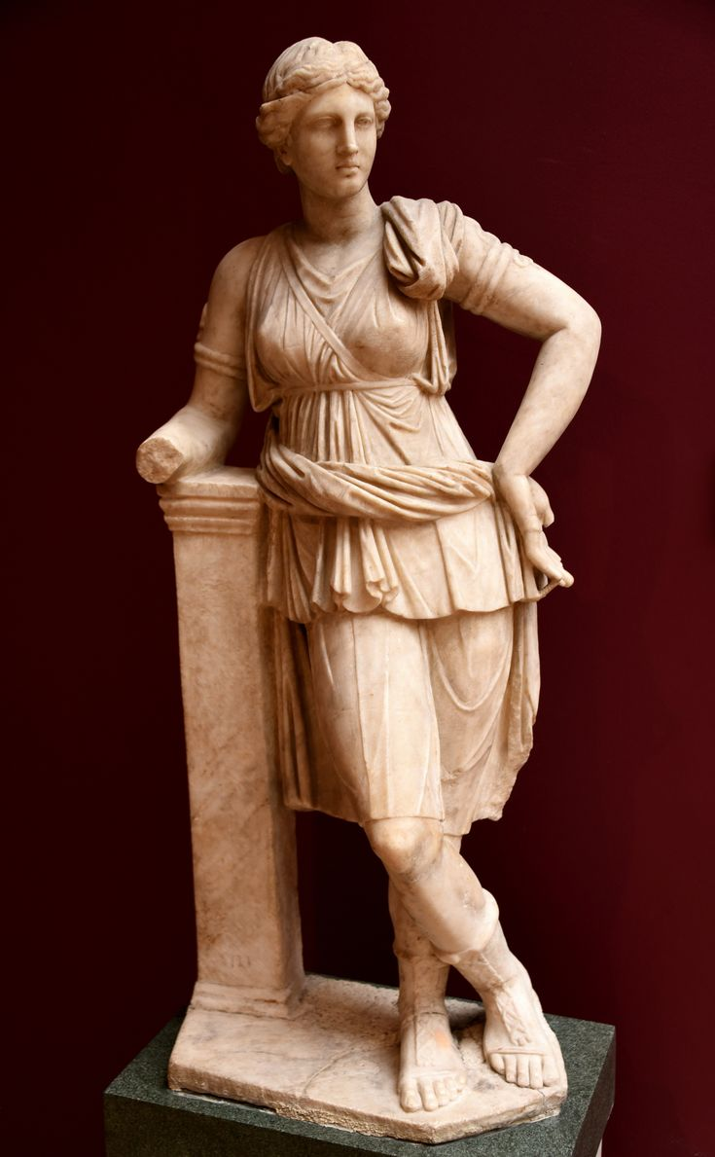
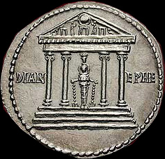
Diana (Artemis) of Ephesus
Notes:
The uproar at Ephesus proved Christianity innocent of wrongdoing but idolatry useless.

Slide 48


How can you be faithful to God in a world of idols?
Money
Power
Sex
Food
Pleasure
Entertainment
Drinking
Science
Pride
IDOLS
of the
HEART
Ezekiel 14:3-6 NLT
Notes:
“Son of man, these leaders have set up idols in their hearts. They have embraced things that will make them fall into sin. Why should I listen to their requests? ⁴ Tell them, ‘This is what the Sovereign LORD says: The people of Israel have set up idols in their hearts and fallen into sin, and then they go to a prophet asking for a message. So I, the LORD, will give them the kind of answer their great idolatry deserves. ⁵ I will do this to capture the minds and hearts of all my people who have turned from me to worship their detestable idols.’” (Ezekiel 14:3-6 NLT).
Money can take first place in our hearts. The millionaire “Aristotle Onassis once said, ‘All that matters in this life is money. It is the people with money who are the royalty in our generation.’ Ultimately he discovered that he had leaned the ladder of his life against the wrong wall. When he died, the only person at his side was his daughter; his money brought no comfort.”
—George and Donald Sweeting, The Acts of God: Reflections from the Book of Acts (Chicago: Moody, 1986), 159.

Slide 49
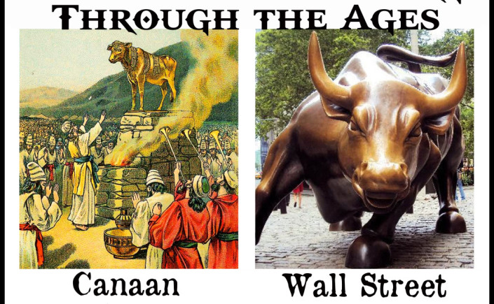
Not much has changed…
Notes:
Israel’s idol was a bull—our idol is a bull market!

Slide 50
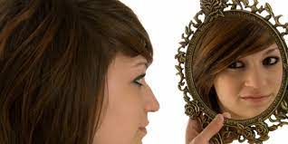
Idolatry actually worships self.
Notes:
Idols are dumb objects that we need to care for—which in reality is self-worship.

Slide 51
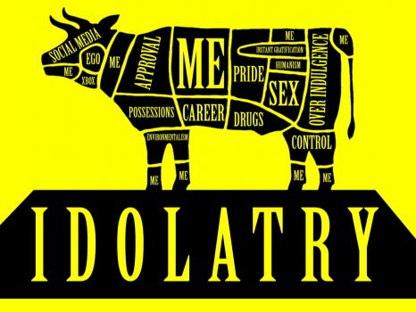
Idolatry actually worships self.
Notes:
Our bull idol takes different forms—social media, ego, Xbox, approval, possession, career, experimentalism, drugs, pride, sex, instant gratification, humanism, overindulgence, control—all permeated with generous chunks of me, me, me, me, me, me…

Slide 52

The gospel leads to peace.
Notes:
In contrast…
The gospel leads to peace.
Idolatry brings turmoil; Christianity brings peace.
Unbelievers in the Roman Empire often leveled unfair attacks against Christians, accusing them of causing riots and even being guilty of incest and cannibalism.
Luke never mentions these objections directly in Acts—but he does show what they did do when they peacefully presented the gospel.

Slide 53

Let’s continue the peaceful proclamation of the gospel that characterized the early church
Notes:
This narrative gives another account of unbelievers accusing believers of the very violence that they themselves foment.
This reminds us to continue the peaceful proclamation of the gospel that characterized the early church.

Slide 54

Can we reconcile these?
“I will bring a sword”
—Jesus
“Peace I leave with you”
—Jesus
Notes:
Belief in Jesus divides families but also brings harmony today.
“I will bring a sword”—Jesus
“Peace I leave with you”—Jesus
But that sword is not ours to wield—it is a sword others use against us!

Slide 55
Who brings peace in society more—believers or unbelievers in Jesus?
Notes:
Restatements: Who causes more trouble in our cultures—Christians or idolaters? Which is more harmful—idolatry or Christianity?

Slide 56
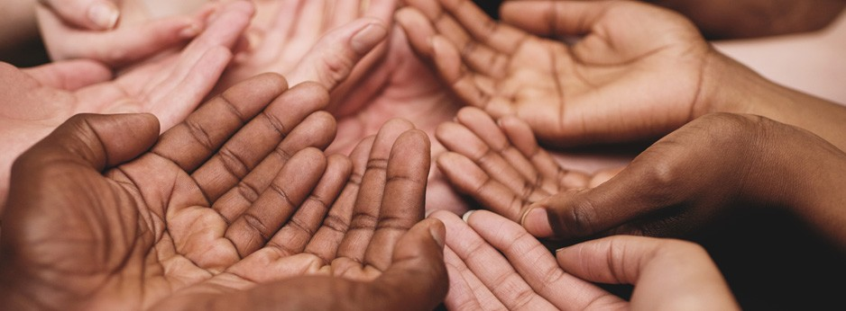
Main Idea
Believers bring peace in society.
Notes:
Look around the world and you will see that it is the Christians that produce harmony, but the violence that comes has them as the objects, not the perpetrators.

Slide 57
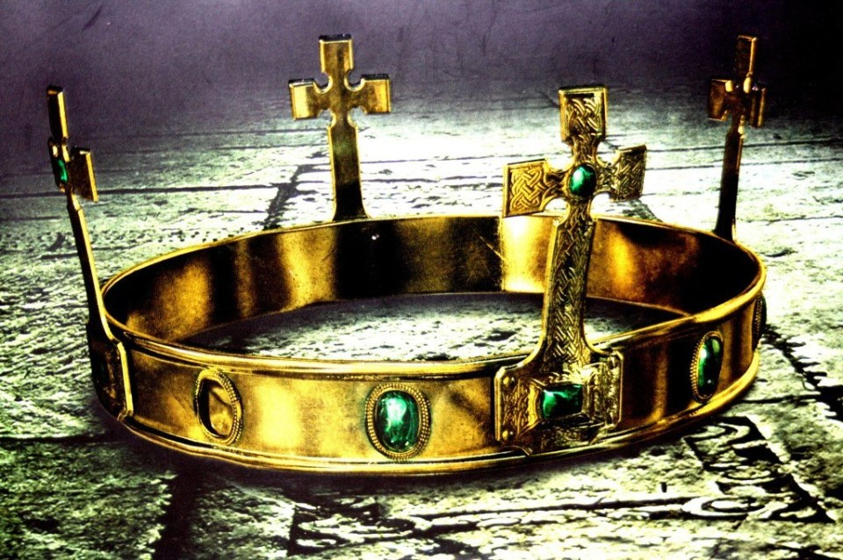
Prince of Peace (Isa 9:6)
Notes:
This is because our leader is the Prince of Peace.

Slide 58
The idol maker Demetrius began the Ephesus riot—not the peaceful Paul (Acts 19:23-41).

Slide 59
The gospel leads to peace.

Slide 60

Peace Painting Contest
Notes:
Years ago judges conducted a peace painting contest.

Slide 61
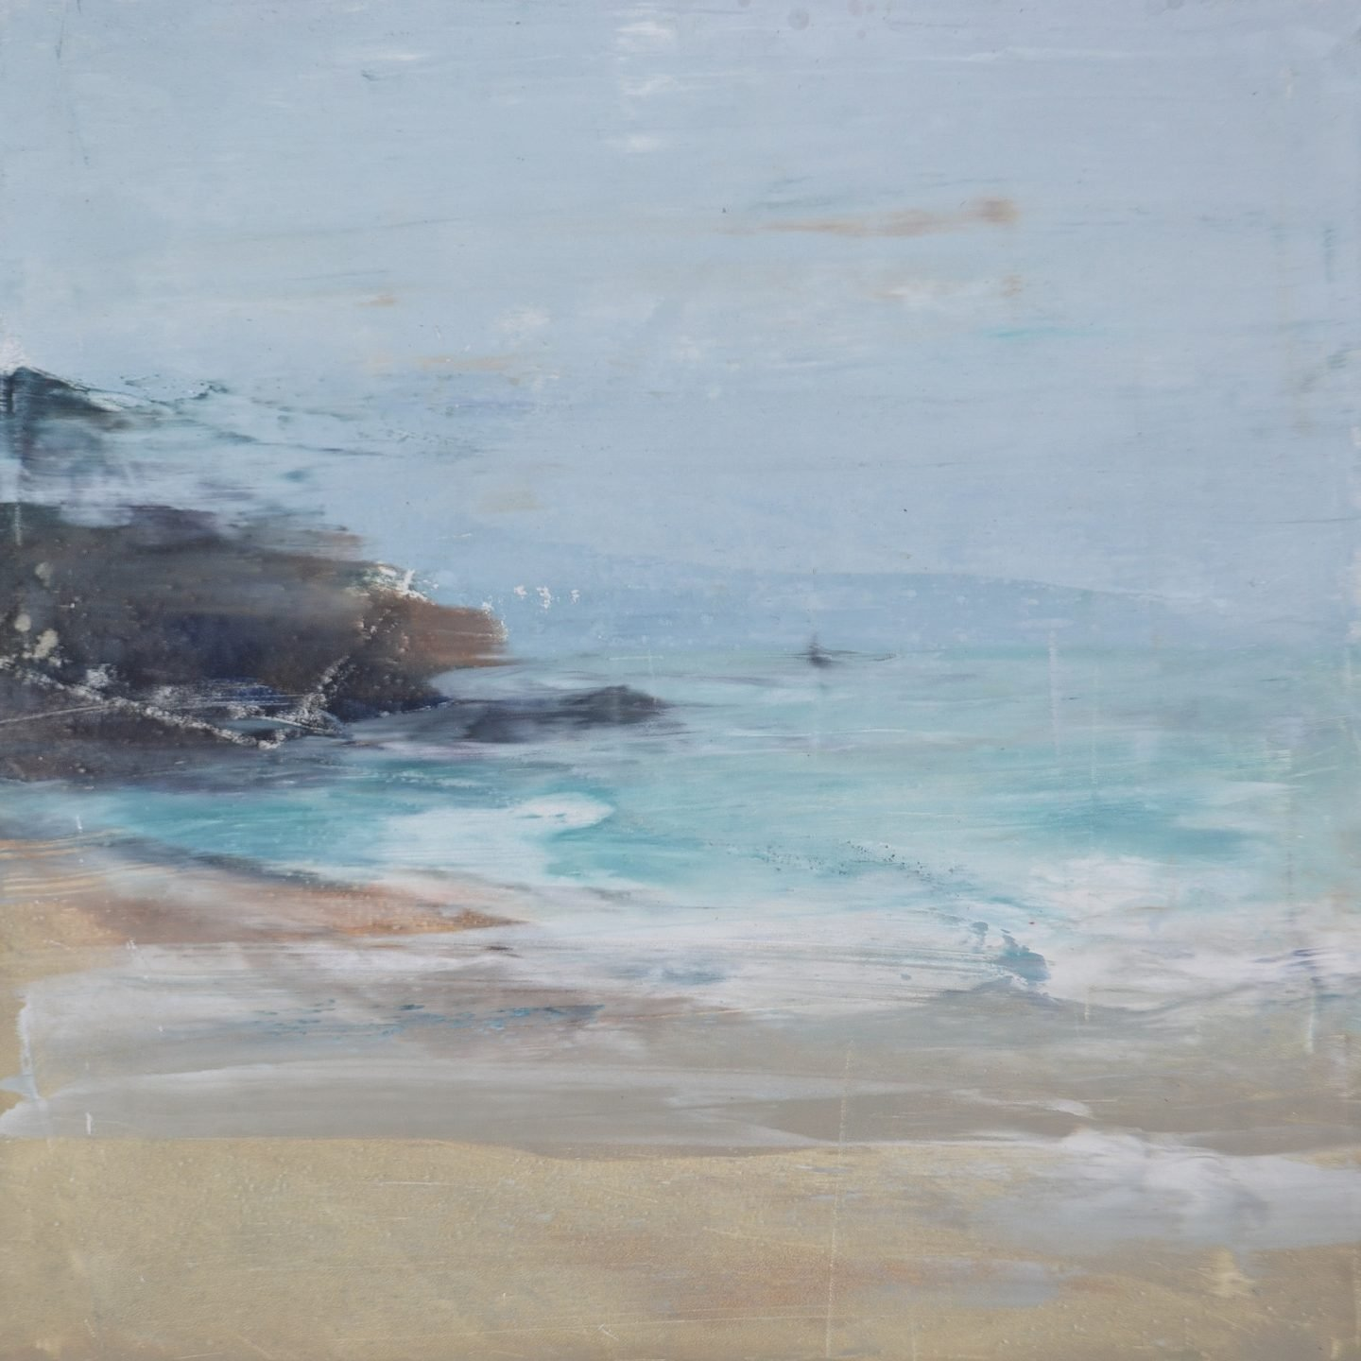
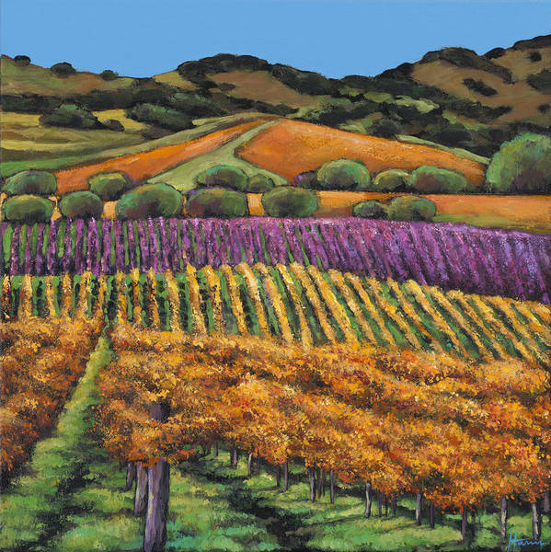
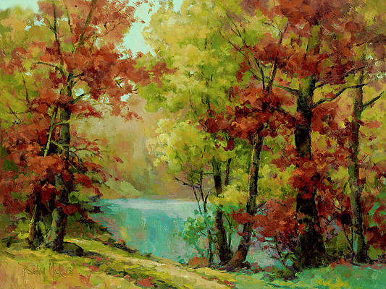
Peace Picture Contest
Notes:
Contestants submitted paintings of peaceful nature scenes of orchards
• or seascapes
• or forests and lakes.

Slide 62
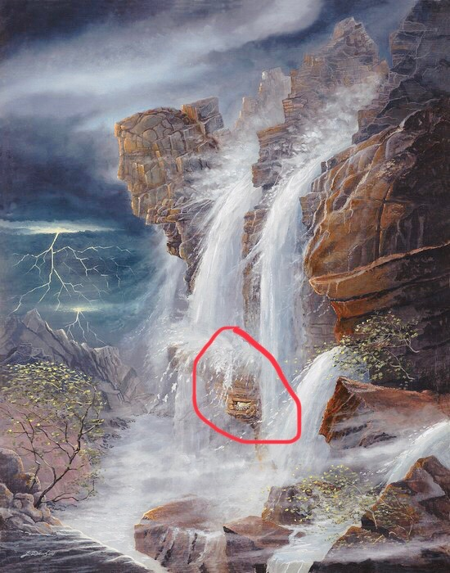
The Winner
Notes:
But the winner was actually a chaotic painting of lightning and a rushing waterfall.
• And if you look closely, amidst all that turbulence in the midst of the violent water was a mother bird sitting in her nest with her chicks.
Peace doesn’t come because our surroundings don’t have challenges. It comes from resting in Christ amidst those trials.

Slide 63
How can you exchange idols for peace?
Strengthen your family.
Use your money for peace.
Don’t enflame passions.
Notes:
We typically consider idols as man-made statues of gold, silver, or wood—but do you have any of those idols of the heart?
In what ways do you promote peace in society?
• Strengthen the family—
I seek to do this by supporting Family Research Council.
Work on your marriage.
Do not support the slaughter of the most defenseless in society, the unborn.
• Money: Invest your money not where it will bring the highest profit, but where it will bless values-based organizations.
• In what ways do you disturb peace in society?
Facebook posts can often enflame passions—so, as a general rule, I don’t make political pronouncements on FB.
Do not spread fake news. I quoted a so-called article this month but had to follow up with an apology when I discovered that it did not exist.

Slide 64
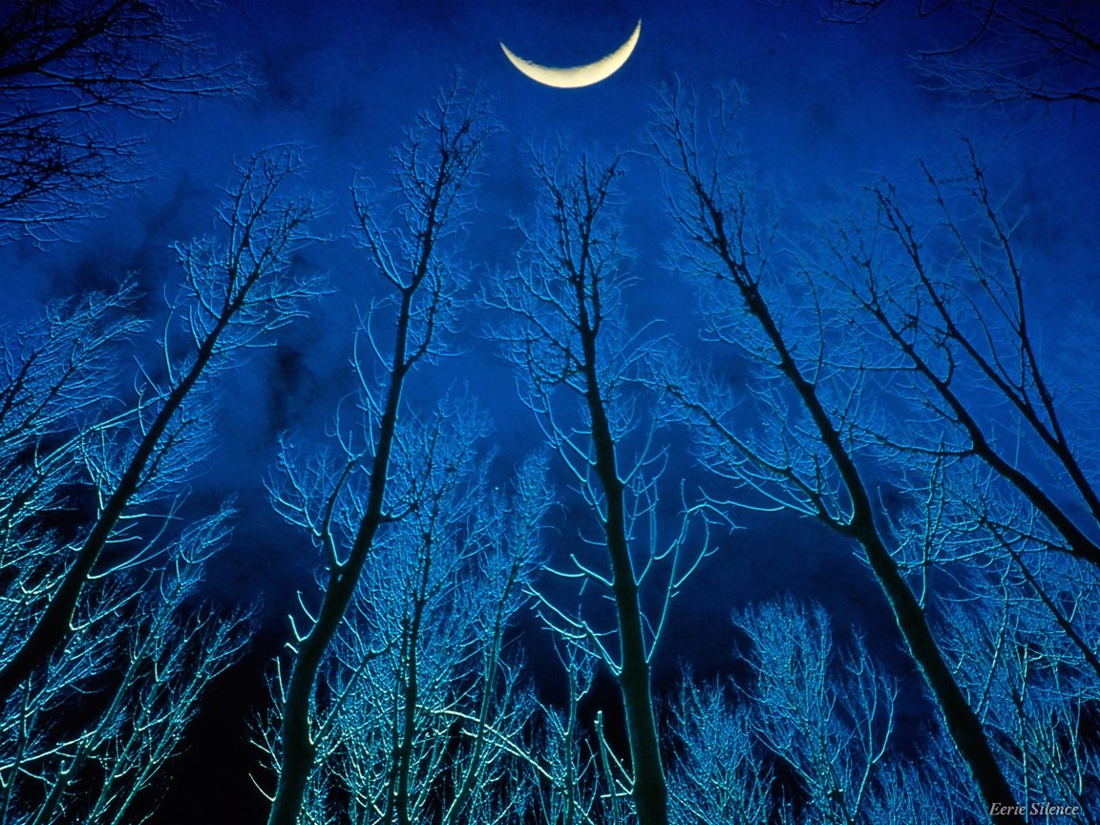
He Is Our Peace
Kandela Groves
CCLI Song # 28737
© 1975 CCCM Music (Admin. by Brentwood-Benson Music Publishing, Inc.)
Universal Music - Brentwood Benson Publishing (Admin. by Brentwood-Benson Music Publishing, Inc.)
For use solely with the SongSelect®
Notes:
The chorus “He is Our Peace” written in 1975…

Slide 65
He Is Our Peace
He is our peace, who has broken down every wall.
He is our peace,
He is our peace.
(repeat)
He Is Our Peace 1 of 2
Notes:
…tells us that Jesus has broken down every wall…

Slide 66
He is Our Peace
Cast all your cares on Him,
For He cares for you.
He is our peace,
He is our peace.
(repeat)
He Is Our Peace 2 of 2
Notes:
…so we can cast our cares on him. Let’s do it as we sing together.

Slide 67
Black

Slide 68


NT Preaching link at BibleStudyDownloads.org
Get this presentation and script for free!

Slide 69
He Is Our Peace
Kandela Groves
  CCLI Song #28737
  © 111
  CIC CCLI License # 277507

Slide 70
He is our peace
Who has broken down ev'ry wall
He is our peace He is our peace
Cast all your cares on Him
For He cares for you
He is our peace He is our peace
V / C (final)

