Slide 1
Open The Eyes Of My Heart
Paul Baloche
CCLI Song #2298355
© 1997 Integrity's Hosanna! Music
CIC CCLI License # 277507

Slide 2
Open the eyes of my heart Lord
Open the eyes of my heart
I want to see You
I want to see You
(2x)
C

Slide 3
To see You high and lifted up
Shining in the light of Your glory
Pour out Your power and love
As we sing holy holy holy
V

Slide 4
Open the eyes of my heart Lord
Open the eyes of my heart
I want to see You
I want to see You
(2x)
C

Slide 5
To see You high and lifted up
Shining in the light of Your glory
Pour out Your power and love
As we sing holy holy holy
V

Slide 6
Holy holy holy
Holy holy holy
Holy holy holy
I want to see You
(3x)
B

Slide 7
Open the eyes of my heart Lord
Open the eyes of my heart
I want to see You
I want to see You
(repeat once)
C (final)

Slide 8
Scripture Reading
Acts 17:22-31 (NLT)

Slide 9
²² So Paul, standing before the council, addressed them as follows: “Men of Athens, I notice that you are very religious in every way, ²³ for as I was walking along I saw your many shrines. And one of your altars had this inscription on it: ‘To an Unknown God.’ This God, whom you worship without knowing, is the one I’m telling you about.
Acts 17:22-31 (NLT)

Slide 10
²⁴ “He is the God who made the world and everything in it. Since he is Lord of heaven and earth, he doesn’t live in man-made temples, ²⁵ and human hands can’t serve his needs—for he has no needs. He himself gives life and breath to everything, and he satisfies every need. ²⁶ From one man he created all the nations throughout the whole earth. He decided beforehand when they should rise and fall, and he determined their boundaries.

Slide 11
²⁷ “His purpose was for the nations to seek after God and perhaps feel their way toward him and find him—though he is not far from any one of us. ²⁸ For in him we live and move and exist. As some of your own poets have said, ‘We are his offspring.’ ²⁹ And since this is true, we shouldn’t think of God as an idol designed by craftsmen from gold or silver or stone.
Acts 17:22-31 (NLT)

Slide 12
³⁰ “God overlooked people’s ignorance about these things in earlier times, but now he commands everyone everywhere to repent of their sins and turn to him. ³¹ For he has set a day for judging the world with justice by the man he has appointed, and he proved to everyone who this is by raising him from the dead.”
Acts 17:22-31 (NLT)

Slide 13
This I Believe (The Creed)
Ben Fielding | Matt Crocker
CCLI Song #7018338
© 2014 Hillsong Music Publishing Australia
CIC CCLI License # 277507

Slide 14
Our Father everlasting
The all creating One
God Almighty
Through Your Holy Spirit
Conceiving Christ the Son
Jesus our Saviour
V1

Slide 15
I believe in God our Father
I believe in Christ the Son
I believe in the Holy Spirit
Our God is three in One
I believe in the resurrection
That we will rise again
For I believe in the Name of Jesus
C1

Slide 16
Our judge and our defender
Suffered and crucified
Forgiveness is in You
Descended into darkness
You rose in glorious life
Forever seated high
V2

Slide 17
I believe in God our Father
I believe in Christ the Son
I believe in the Holy Spirit
Our God is three in One
I believe in the resurrection
That we will rise again
For I believe in the Name of Jesus
C1

Slide 18
I believe in You
I believe You rose again
I believe that Jesus Christ is Lord
(repeat once)
B

Slide 19
I believe in God our Father
I believe in Christ the Son
I believe in the Holy Spirit
Our God is three in One
I believe in the resurrection
That we will rise again
For I believe in the Name of Jesus
For I believe in the Name of Jesus
For I believe in the Name of Jesus
C1

Slide 20
I believe in life eternal
I believe in the virgin birth
I believe in the saints' communion
And in Your holy Church
I believe in the resurrection
When Jesus comes again
For I believe in the Name of Jesus
C2

Slide 21
I believe in God our Father
I believe in Christ the Son
I believe in the Holy Spirit
Our God is three in One
I believe in the resurrection
That we will rise again
For I believe in the Name of Jesus
(repeat once)
C1 (final)

Slide 22
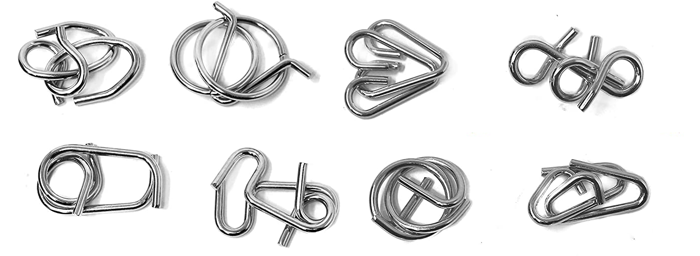

Slide 23
God is more complex than a metal puzzle

Slide 24
Mission in Macedonia
Acts 16:11 – 18:22

Slide 25
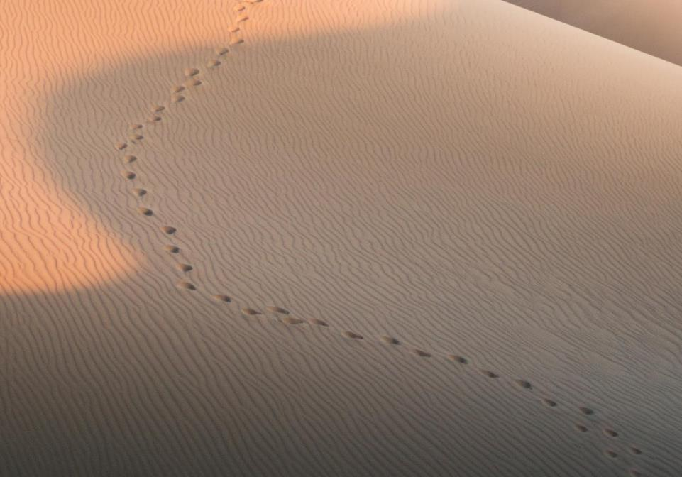
GOOD NE WS
ON THE MO VE
God’s work through the early church in
Acts

Slide 26
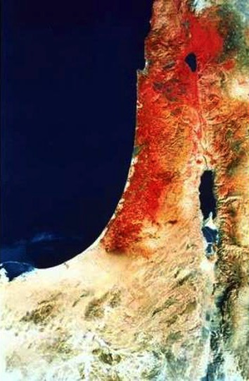
“ends of the earth"
Acts 1:8 NLT
"But you will receive power when the Holy Spirit comes upon you. And you will be my witnesses, telling people about me everywhere
Samaria
Jerusalem
Judea
—in Jerusalem
throughout Judea,
in Samaria,
and to the
ends of the earth.”

Slide 27
Church Growth
Persecution

Slide 28
Antioch
Jerusalem

Slide 29
Church Growth
Persecution
Missions

Slide 30
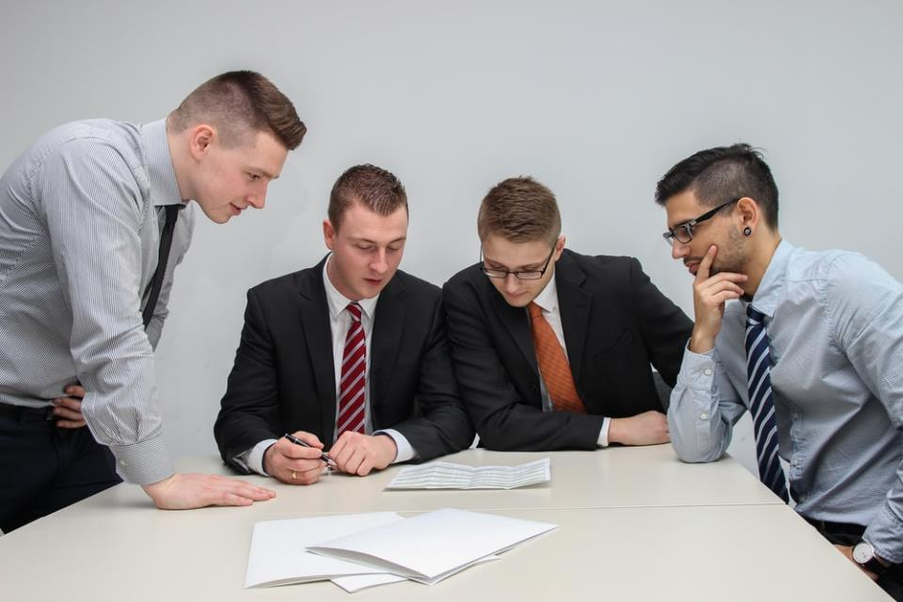
God who Reveals
One day as these men were worshiping the Lord and fasting,

Slide 31
Antioch
Jerusalem
1st Missionary Journey
Acts 13 – 14

Slide 32
Paul & Silas
Antioch
Barnabas & Mark
Disagreement leading to separation may be God's way to expand his work
Jerusalem
2nd Missionary Journey
Part 1: Disagreement
(Acts 15:39b – 16:10)

Slide 33
Macedonia
Bithynia
Troas
Paul & Silas
Asia
Antioch
Jerusalem
2nd Missionary Journey
Part 2: Macedonian Mission
(Acts 16:11 – 18:22)

Slide 34
Philippi
Thessalonica
Berea
Troas
Athens
Corinth

Slide 35
Philippi
People
Paul / Silas / Timothy
Luke
1. ???
2. ???
3. ???
Places
Samothrace
Neapolis
Philippi
Macedonia

Slide 36
Philippi
¹³ On the Sabbath we went a little way outside the city to a riverbank,
where we thought people would be meeting for prayer,

Slide 37
Lydia
from Thyatira
a merchant of expensive purple cloth
worshiped God
we sat down to speak with some women who had gathered there.

Slide 38
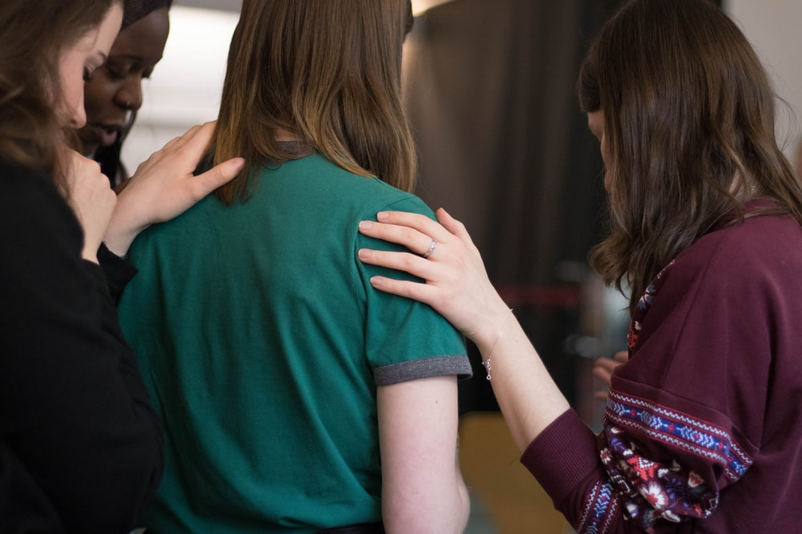
What was Lydia and her group praying for?

Slide 39
Open the eyes of my heart Lord
Open the eyes of my heart
I want to see You
I want to see You

Slide 40
God who Reveals
As she listened to us, the Lord opened her heart, and she accepted what Paul was saying

Slide 41
She and her household were baptized

Slide 42
God reveals himself
(through Paul and others)
to those who seek and worship him

Slide 43
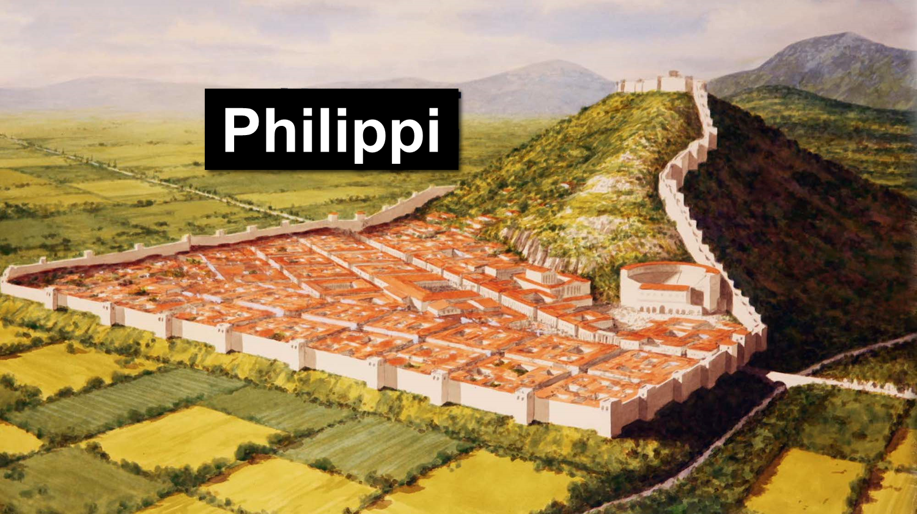
Philippi
“These men are servants of the Most High God, and they have come to tell you how to be saved.”

Slide 44
God reveals himself
(not through testimony of demons)
to those who seek
and worship him

Slide 45
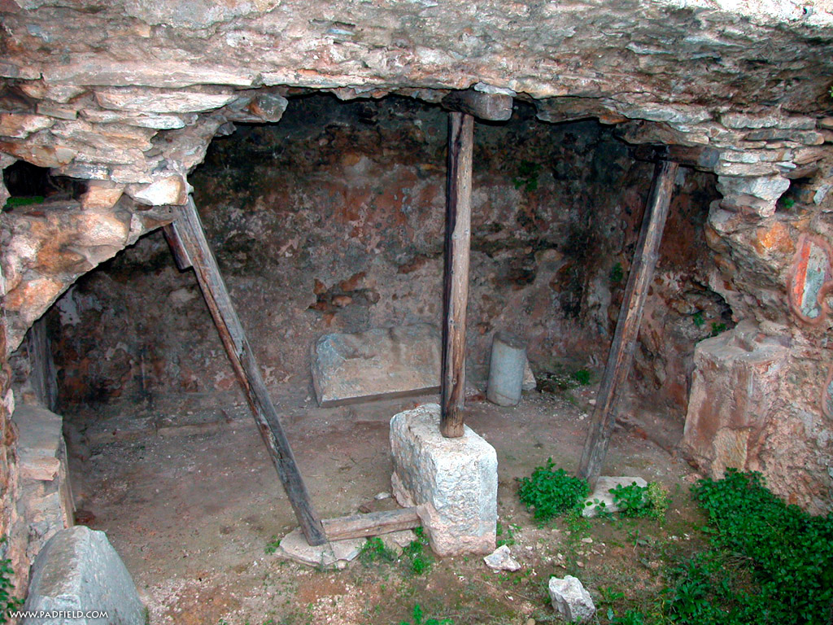
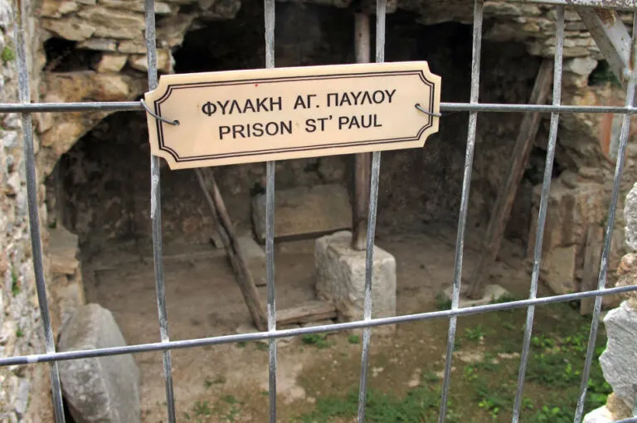
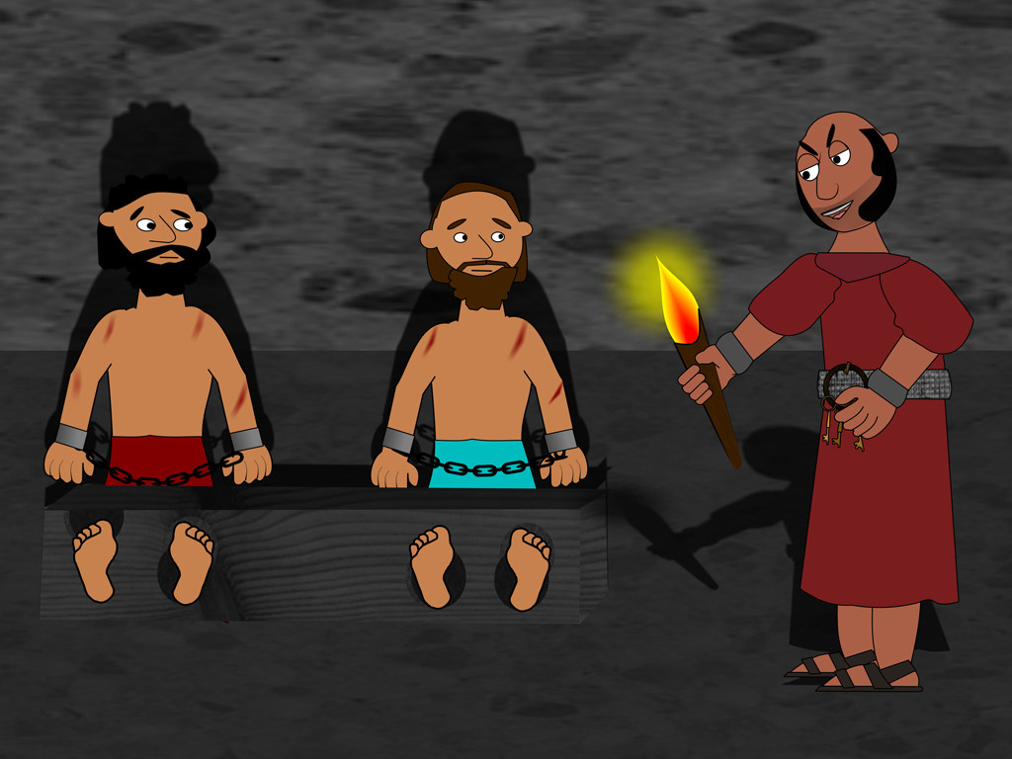
Jail in Philippi
Sue Bentley / FreeBibleimages.org

Slide 46
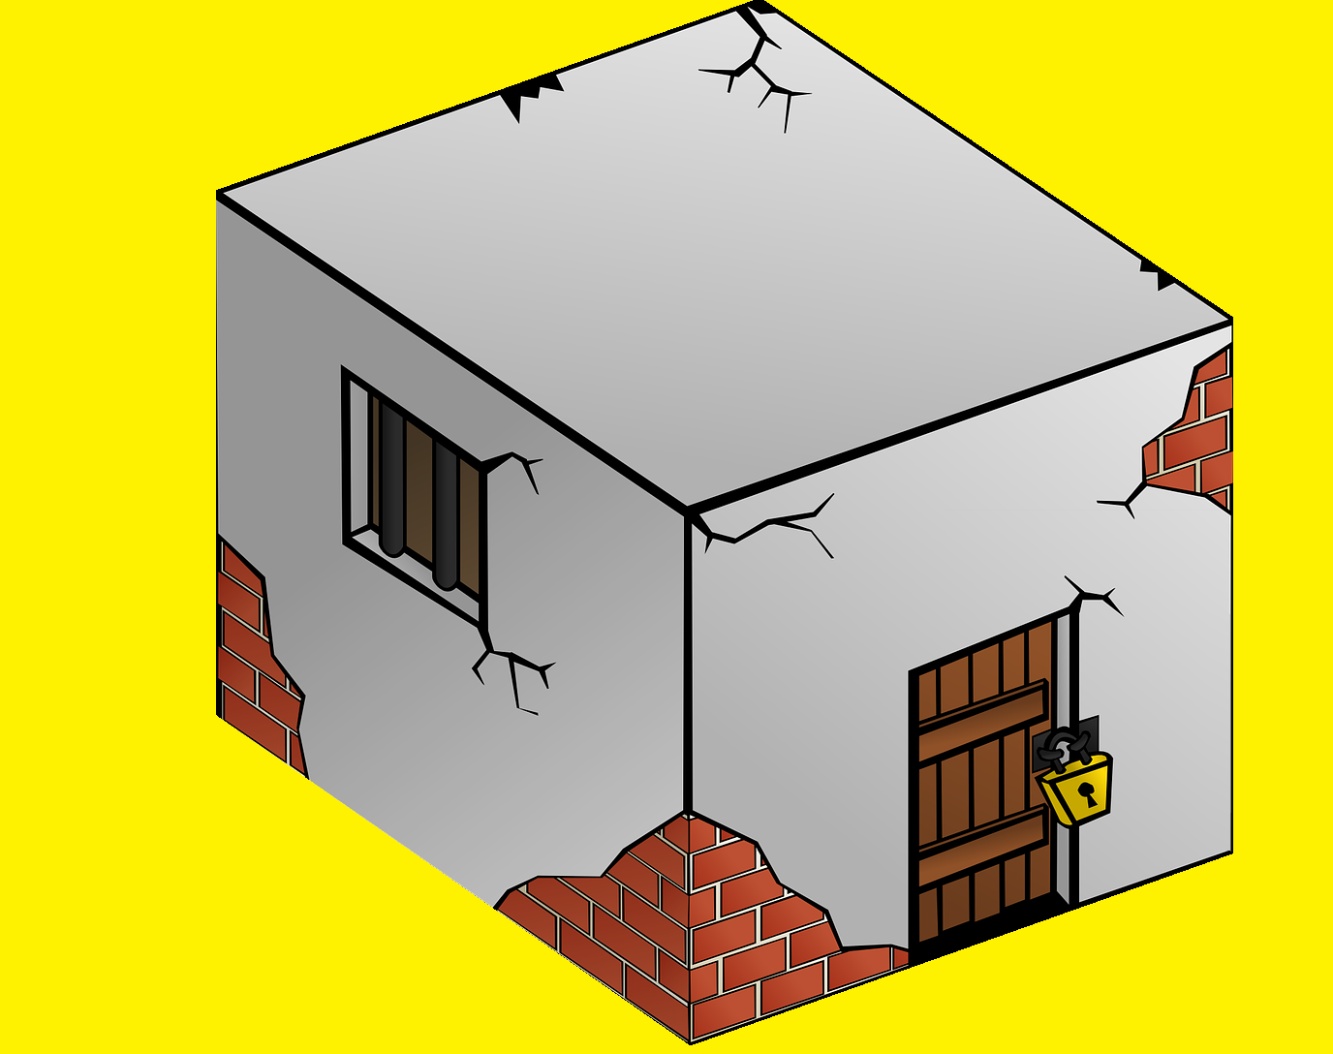
In and Out of Jail
Inner dungeon & stocks
Acts 16
Chained to soldiers
Acts 12
locked room
guards outside
Acts 5
Jerusalem
Arrested
Acts 4
Ends of the Earth

Slide 47
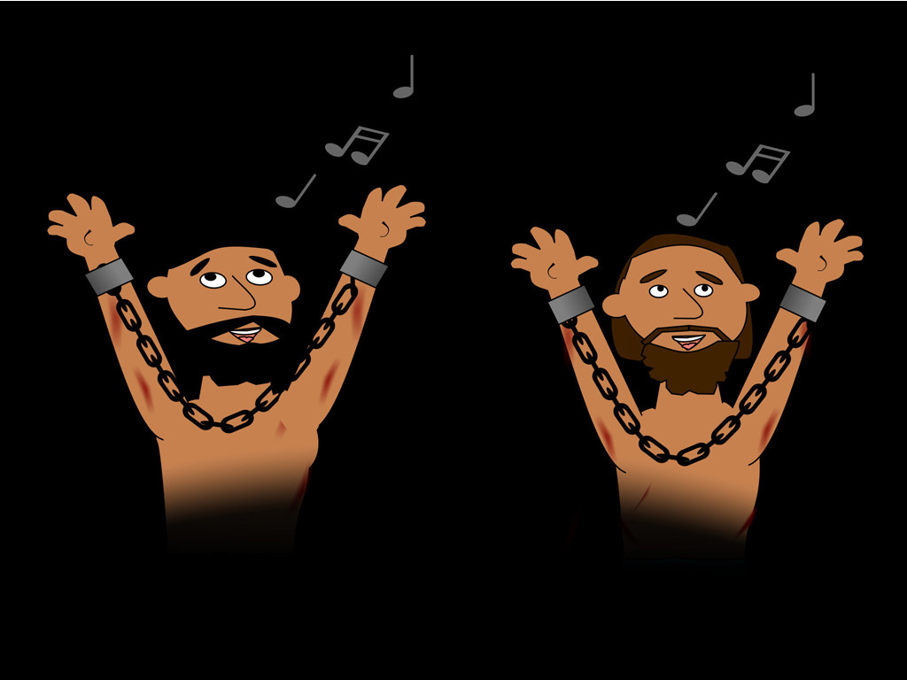
In and Out of Jail
²⁵ Around midnight Paul and Silas were praying and singing hymns to God, and the other prisoners were listening.
Sue Bentley / FreeBibleimages.org

Slide 48
I believe in God our Father
I believe in Christ the Son
I believe in the Holy Spirit
Our God is three in One
I believe in the resurrection
That we will rise again
For I believe in the Name of Jesus

Slide 49
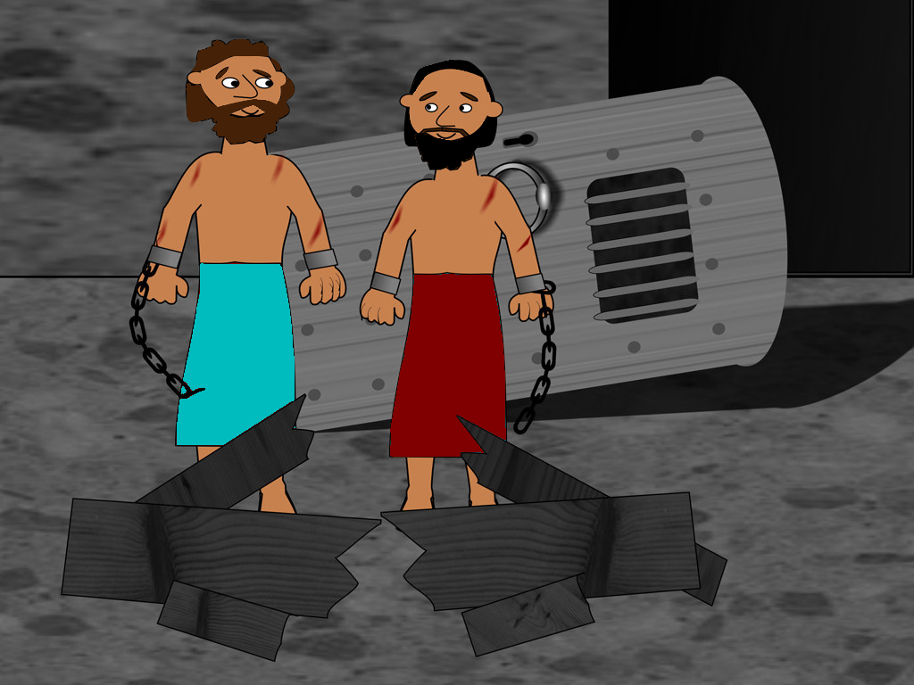
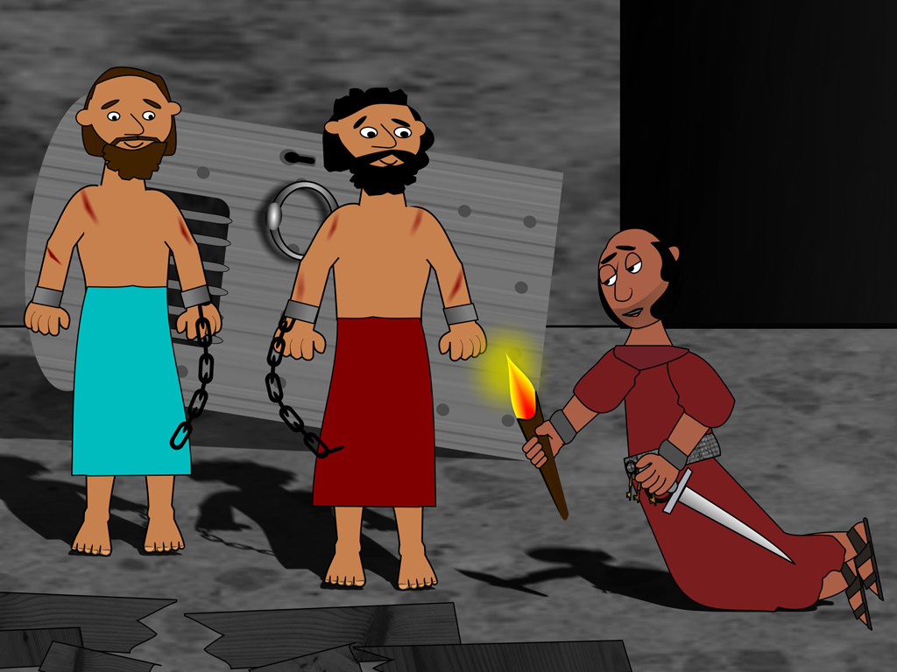
In and Out of Jail
Sue Bentley / FreeBibleimages.org

Slide 50
What was jailer afraid of?
²⁷ The jailer woke up to see the prison doors wide open. He assumed the prisoners had escaped, so he drew his sword to kill himself.
Authorities

Slide 51
What was jailer afraid of?
²⁸ But Paul shouted to him, “Stop! Don’t kill yourself! We are all here!”
²⁹ The jailer called for lights and ran to the dungeon and fell down trembling before Paul and Silas.
GOD
What must I do to be saved?

Slide 52
God reveals himself
(through actions of his disciples)
to those who seek
and worship him

Slide 53
What must I do?
³¹ . . . “Believe in the Lord Jesus and you will be saved, along with everyone in your household.”
Acts 8: 36 Why can’t I be baptized?
³⁷ “You can,” Philip answered, “if you believe with all your heart.” And the eunuch replied, “I believe that Jesus Christ is the Son of God.”

Slide 54
God reveals himself
to those who seek
and worship him
Lydia
Slave Girl
Jailer
through Paul and others called to minister
not through testimony of demons
through actions of his disciples

Slide 55
Turn the Other Cheek
³⁵ The next morning the city officials sent the police to tell the jailer, “Let those men go!” ³⁶ So the jailer told Paul, “The city officials have said you and Silas are free to leave. Go in peace.”

Slide 56
Turn the Other Cheek
Matt 5:39 But I say, do not resist an evil person! If someone slaps you on the right cheek, offer the other cheek also.

Slide 57
Thessalonica
Short period of time (3 weeks)
Preached in Synagogue (resurrection)
Some Jews / Many devout (God-fearing) Greek men believed
Opposed by Jews

Slide 58
Berea
Short period of time
Preached in Synagogue
Many Jews / Many prominent Greek men and women believed
Opposed by Jews from Thessalonica

Slide 59
Thessalonica Berea
Some Jews Believed
Many Jews Believed
¹¹ And the people of Berea were more open-minded than those in Thessalonica, and they listened eagerly to Paul’s message. They searched the Scriptures day after day to see if Paul and Silas were teaching the truth.

Slide 60
God reveals himself
(through his word)
to those who seek
and worship him

Slide 61
Philippi
Thessalonica
Berea
Troas
Athens
Corinth

Slide 62
Athens
Short Period of Time
Preached in Synagogue
Troubled by all the idols
Debated philosophers
Sermon for Gentiles

Slide 63
Sermon for Gentiles
22-23
Gentiles are seeking God
24-26
Who God is
27-29
What God is doing
30-31
God’s Expectations

Slide 64
God reveals himself
(even to gentiles)
to those who seek
and worship him

Slide 65
Prince of Peace

Slide 66
Corinth
Preached in Synagogue
How many believed?
Opposed by Jews
Preached to Gentiles
Who was first convert?
God gave Guidance via a dream

Slide 67
When God reveals his plans for you
Expect him to fulfill those plans

Slide 68
The Return Trip
Athens
Ephesus
Corinth
Antioch
Caesarea
Jerusalem
Why did Paul go to Jerusalem?

Slide 69
CIC is an independent church body that shall not be accountable to any other ecclesiastical or denominational body.
The elders are a group of biblically qualified men who are charged with leading the church under the leadership of Christ Jesus.
The congregation shall have highest authority in the life of the church.

Slide 70
God reveals himself
to those who seek
and worship him
through Paul and others called to minister
not through testimony of demons
through actions of his disciples
through his word
even to gentiles

Slide 72
Mighty To Save
Ben Fielding | Reuben Morgan
CCLI Song #4591782
© 2006 Hillsong Music Publishing Australia
CIC CCLI License # 277507

Slide 73
Ev’ryone needs compassion
Love that's never failing
Let mercy fall on me
Ev’ryone needs forgiveness
The kindness of a Saviour
The hope of nations
V1

Slide 74
Saviour He can move the mountains
My God is mighty to save
He is mighty to save
Forever Author of salvation
He rose and conquered the grave
Jesus conquered the grave
C

Slide 75
So take me as You find me
All my fears and failures
Fill my life again
I give my life to follow
Ev’rything I believe in
Now I surrender
V2

Slide 76
Saviour He can move the mountains
My God is mighty to save
He is mighty to save
Forever Author of salvation
He rose and conquered the grave
Jesus conquered the grave
C

Slide 77
Shine your light and
let the whole world see
We're singing
For the glory of the risen King
Jesus
Shine your light and
let the whole world see
We're singing
For the glory of the risen King
B

Slide 78
Saviour He can move the mountains
My God is mighty to save
He is mighty to save
Forever Author of salvation
He rose and conquered the grave
Jesus conquered the grave
(repeat once)
C

Slide 79
Shine your light and
let the whole world see
We're singing
For the glory of the risen King
Jesus
Shine your light and
let the whole world see
We're singing
For the glory of the risen King
B (final)

