Slide 1
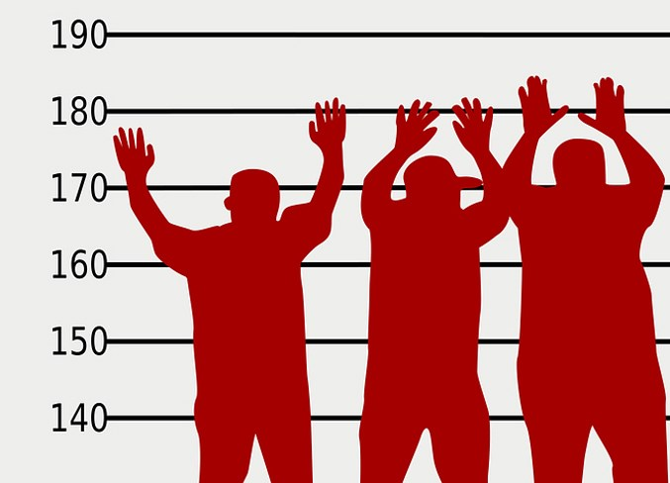
Don’t Be Law Abiding
Acts 15:1-35
Dr. Rick Griffith • Crossroads International Church Singapore CICFamily.com • BibleStudyDownloads.org

Slide 2
A Key Question
How do we get right with God?

Slide 3
Our Problem:
Sin Separates Us from God
Sinful
Humanity
Holy
God
Notes:
God is holy and we are sinful—so we are separated from God

Slide 4
Our Efforts
Our Problem:
Sin Separates Us from God
Religion
Sinful
Humanity
Holy
God
Good Works
Morality
Philosophy
Notes:
So how do we bridge that gap? Religion won’t do it—nor good work, nor morality, nor the right philosophy .

Slide 5
Which is the Most Accurate?
174d
Salvation by…
Faith + Works
Faith Alone
Faith + Works
OT
Works
Faith Alone
Faith Alone
Faith + Works
NT
Faith
cf. OTS 121e
Notes:
Maybe seeing how people were save in the OT might help—so which of these four views is the most accurate?
Works in the OT but faith in the NT?
Faith + Works in the OT but now faith alone?
Or Faith Alone in both the OT and NT?
Or Faith + Works in both testaments?
What color are you? Tell the person next to you!

Slide 6
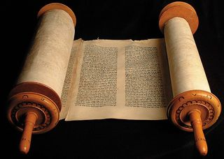
The Christian's Relationship to the Law
Notes:
What is the Christian’s relationship to the Law? Should we be law abiding?
Do you know how to relate the OT and NT for Christians?
I was confused how the law of Moses applied to me even after my ThM degree. So I wrote a 424-page PhD dissertation on the Sabbath!

Slide 7
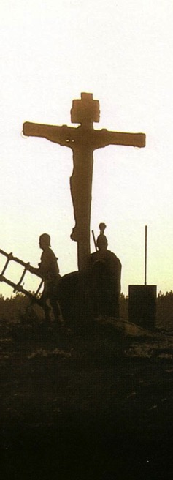
Salvation in All Ages:
The Centrality of the Cross
B.C.
Looked forward to the Cross of Christ
A.D.
Look back at the Cross of Christ
Notes:
It helped me see the centrality of the cross—how people before Jesus believed by looking toward the cross while those of us after Jesus look back at the cross. In other words…

Slide 8
In Other Words…
153
Salvation has ALWAYS been by grace through faith!
Notes:
So I think the blue is right.

Slide 9
How can we affirm grace?
Notes:
In what ways can we support salvation by faith?

Slide 10
Acts Series
GOOD NE WS
ON THE MO VE
God’s work through the early church in
Acts
Notes:
Our series on Acts has emphasized that the Good News on the Move was God’s work.

Slide 11
NT Overview (Paul's Letters)
38 124 39-41
"To the remotest part of the earth" (Acts 1:8)
Acts 9 13 14 15 16 18 21 27 28
Apr 48- Sep 49
1 Galatia
Apr 50- Sep 52
2 Aegean
Spr 53- May 57
3 Asia
Feb 60- Mar 62
1 Rome
Spr 62- Fall 67
4 Spain
Aut 67- Spr 68
2 Rome
Summer 35- 37
Damascus Antioch
May 57- Aug 59
Trials
Fall 49
The
Council
Spring 68
Expansion of Church
35 48 49 50 52 53 57 60 62 67 68 95
Matt
Luke
Acts
Mark
John
Gal
Gospels & Acts
Pauline Epistles
1234
Journeys
Rome
Imprisonments
Pauline
Notes:
We have studied our way up through Acts 13–14 that Matt covered last week. That’s why I put “Matt” here—because Matthew likely wrote his gospel at this time.

Slide 12
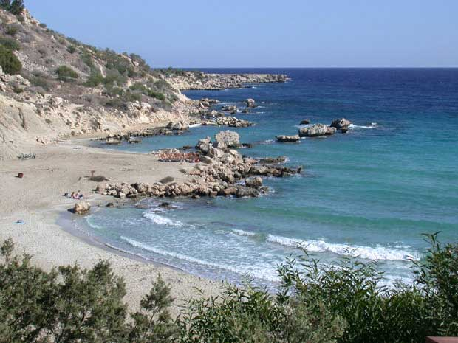
#1."The Hook: A Laboratory"
STUDY HELP #24
PAUL'S JOURNEYS …AT A GLANCE
ATLANTIC OCEAN
AD 48-49
EUROPE
A BEACH ON CYPRUS
ASIA
ROME•
Macedonia
•
•Pisidian Antioch
AFRICA
Athens
•Ephesus
Acts 13-14
•Syrian Antioch
MEDITERRANEAN SEA
•Jerusalem
Significance: Worshipped as gods; did miracles; Paul stoned; difficult work; churches planted; return by same route.
ARABIA
42
14
© 2006 TBBMI
9.65.08.
Notes:
With these ideas in mind…and with Study Help #24…let's go with Paul on his JOURNEYS AT A GLANCE. First…the main locations of the dramatic action facing Paul and his little party…
//// Here is Jerusalem…
//// SYRIAN Antioch…
//// PISIDIAN Antioch…(there were many ancient Antiochs!)…
//// Ephesus…
//// Macedonia…(Remember Alexander's birthplace?)…
//// Athens…
//// and the capital city of the world of his day…ROME, at the center of Empire.
//// So…Trip #1: Call it the HOOK…or A LABORATORY on Study Help #24…
//// Recounted in some detail in Acts 13 and 14.
//// Here's a Cyprian beach typical of those Paul and his party would have moved across.
//// On your map trace out his route similar to A HOOK SHAPE that moves from SYRIAN ANTIOCH through the island of Cyprus and on into central Turkey.
//// Significance of this trip: IT WAS A LEARNING LABORATORY! No one had done this before. Along the way they were worshipped as GODS…because the people had never seen anything like this…these strangers were going about working miracles. But in spite of those good works, Paul was STONED and almost died. The party must have quickly recognized that mission would become a very difficult work indeed. But along the way many new churches were planted. What kept them going? Faith in all they had seen and experienced in the development of their own Christian spirit and intellect. Their travel route began at Syrian Antioch – follow your hook – into today's central Turkey…
//// …then they turned around and returned to Syrian Antioch by the same route, there to report the results of their journey to the church.
//// LENGTH OF THIS TRIP: PROBABLY ABOUT 1.5 YEARS
IN THE LAST HALF OF THE A.D. 40s.

Slide 13
Now make sure that you stay free, and don’t get tied up again in slavery to the law
So Christ has truly set us free.
Galatians 5:1 NLT
Notes:
So Paul wrote the letter to the Galatians, where he told them clearly that circumcision was like the yoke one puts on oxen—“So Christ has truly set us free. Now make sure that you stay free, and don’t get tied up in slavery to the law.”
But after this came a very important event before the second journey that clarified grace for the early church—so we will study this today in Acts 15.

Slide 14
How can we affirm grace?
Three ways…
Notes:
Here we’ll see three ways to affirm grace.
Acts 15:1-35 records how God used conflict over grace to turn division into unity.

Slide 15
How can we affirm grace?
Acts 15
Expect attacks (1-5)
Notes:
(What is the first way to affirm grace?)
• Expect attacks against grace!
Many oppose the truth of simple trust giving us a right relationship with God.

Slide 16
I. Expect attacks against grace (Acts 15:1-5).
Notes:
Many oppose the truth of simple trust giving us a right relationship with God.

Slide 17
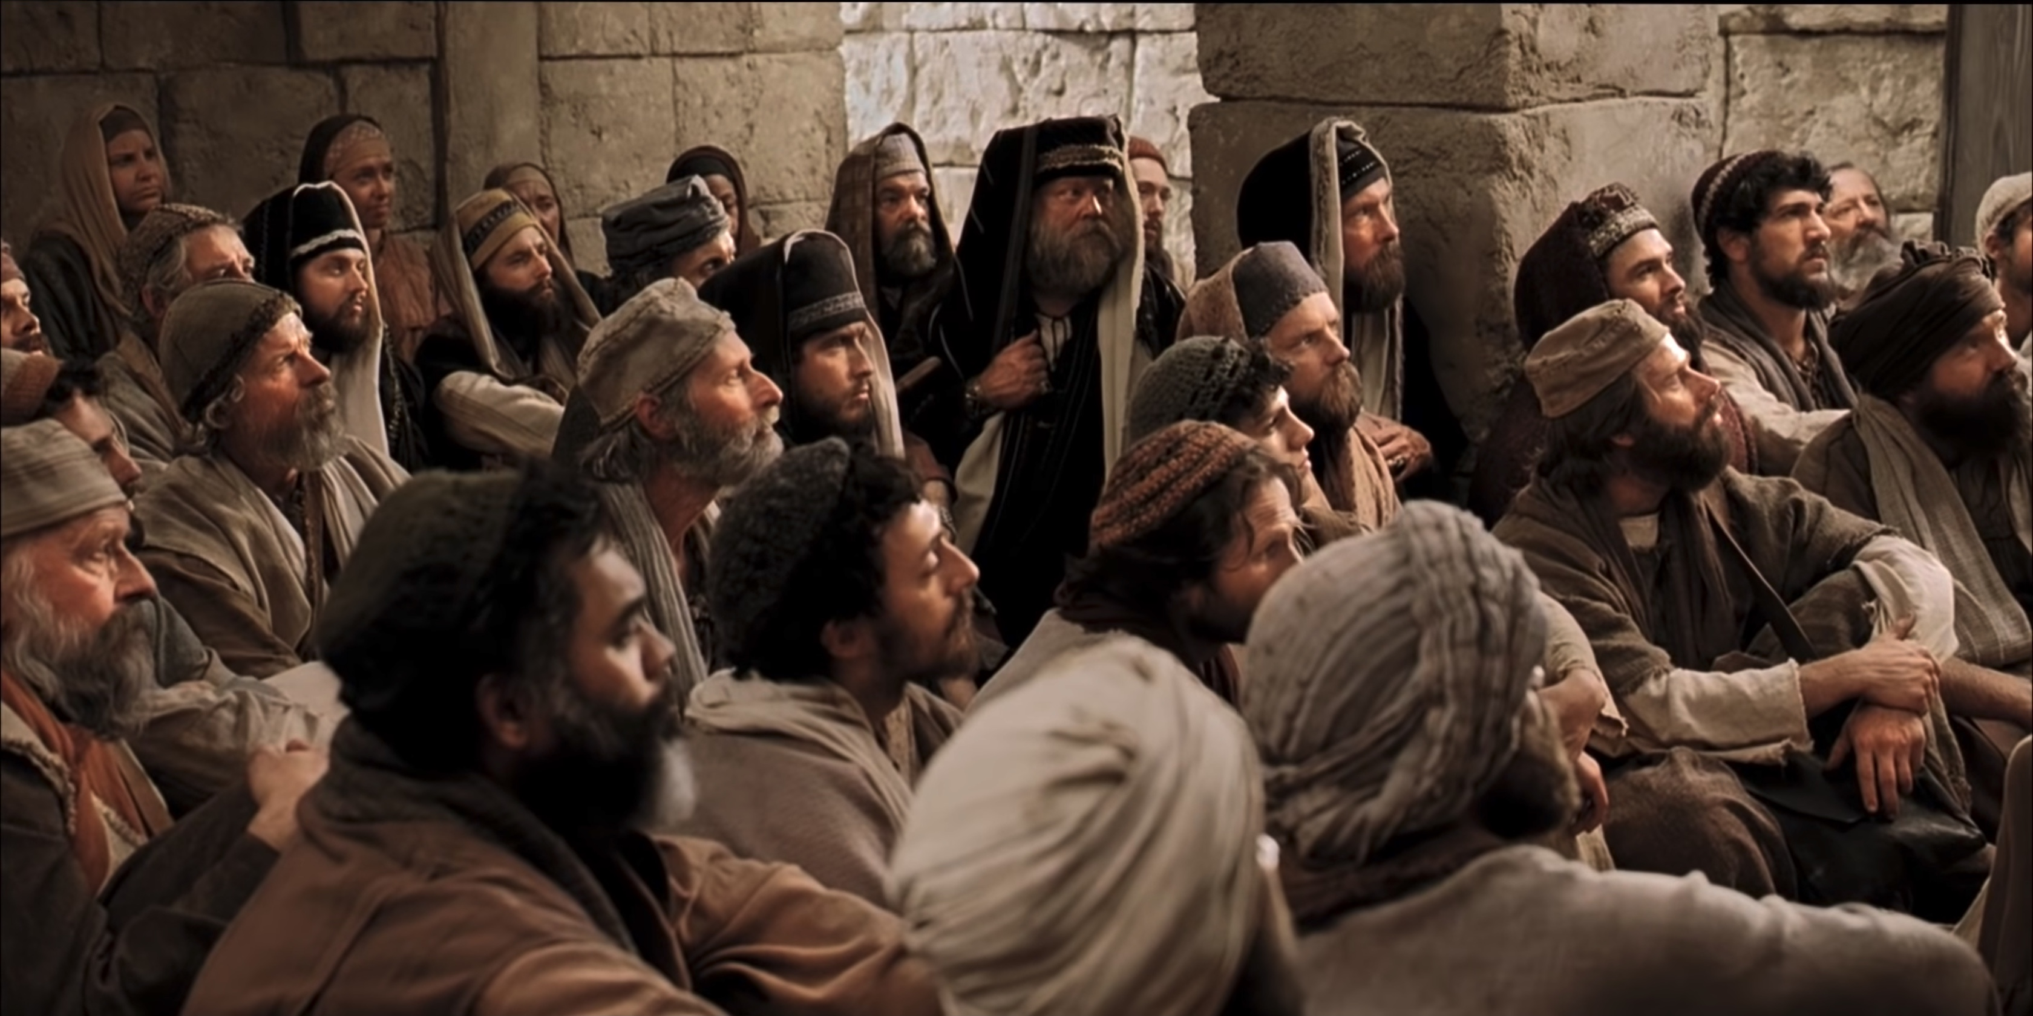
Gentile believers in Antioch became confused whether they must obey the law of Moses to be saved (Acts 15:1-5).
Notes:
Let’s read verses 1-5…

Slide 18
1(--)2"The Jerusalem Council"
A.D.49
Acts 15:1—Must a Gentile become a Jew, and accept his laws and ceremonies, before he can become a Christian?
ATLANTIC OCEAN
EUROPE
ASIA
ROME•
•Macedonia
•Pisidian Antioch
Athens
•Ephesus
AFRICA
•Syrian Antioch
Acts 15
MEDITERRANEAN SEA
•Jerusalem
ARABIA
© 2006 TBBMI
9.65.08.
43
4
Notes:
Paul apparently had little time to rest up.
//// In Fall A.D. 49 he made that special SHORT trip between the BIG TRIPS #1 and #2…for the famous JERUSALEM COUNCIL.
This was a 500-mile journey from Syrian Antioch, south to the city of the mother church…to Jerusalem.
//// The issue here –– told to us in Acts 15 –– was the simple question:
"Must a Gentile become a Jew, and accept his laws and ceremonies, before he can become a Christian?" It must have been a heated argument!
//// Finally the issue was permanently settled: one becomes a Christian through GRACE…not LAW. However, if following the law makes one comfortable, fine. Accepting Christ as Lord and Savior is a matter of belief and relinquishment –– that is the only requirement! GRACE AND GRACE ONLY!
//// Then Paul and his party returned north to Syrian Antioch. Our BASIC BELIEFS of today date firmly from that Jerusalem meeting of Acts 15. Later reformers of the church also anchored their Christian tenets right there – dating from the Jerusalem Council.

Slide 19
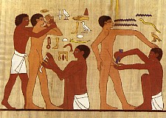
"So Christ has truly set us free. Now make sure that you stay free, and don’t get tied up again in slavery to the law" (Gal. 5:1 NLT).
"Listen! I, Paul, tell you this: If you are counting on circumcision to make you right with God, then Christ will be of no benefit to you. ³I’ll say it again. If you are trying to find favor with God by being circumcised, you must obey every regulation in the whole law of Moses. ⁴For if you are trying to make yourselves right with God by keeping the law, you have been cut off from Christ! You have fallen away from God’s grace" (5:2-4 NLT).
Notes:
Paul had already opposed circumcision for salvation to the Galatians (5:1-4). But this letter was not known yet to the churches of Jerusalem and Antioch.

Slide 20
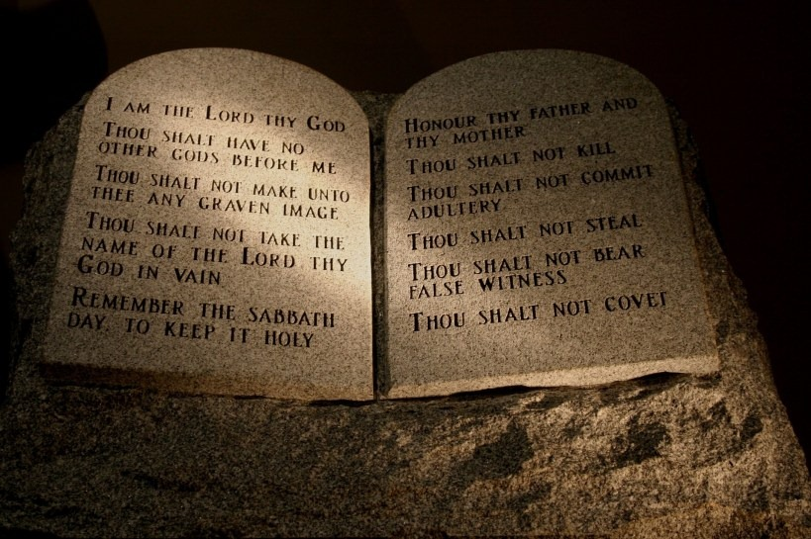
Many people oppose grace today

Slide 21
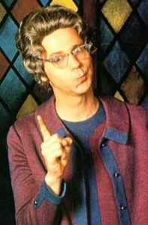
Christian Legalists
Notes:
Some churches add to faith and thus ruin it.

Slide 22
True Jesus Church, Adam Road
200
Notes:
The TJC ruins the gospel by adding legalistic requirements to the pure gospel.

Slide 23
What Does the True Jesus Church Believe?
Identification with TJC
200
+
Baptism in TJC (Head Bowed)
+
Footwashing by TJC Minister
+
Communion (Transubstantiation)
+
Reception of the Holy Spirit
+
Speaking in Tongues
+
(Faith in Christ? No!)
=
Salvation ! ? ! ?
Notes:
This is the complicated and unbiblical formula for salvation taught by the TJC. The church is definitely misnamed!

Slide 24
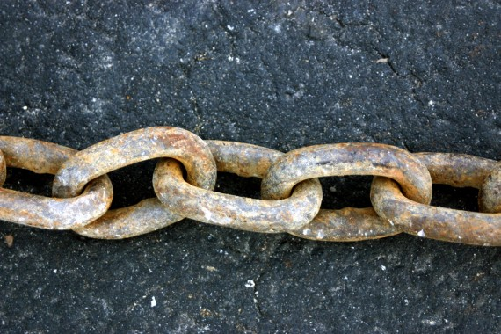
Why do people like legalism?

Slide 25
Why do people like legalism?
It gives us a tangible measure of where we stand.
It puts confidence into our hands so we can get credit for our deeds.
It makes decision-making easier with nearly everything being right or wrong.
Notes:
People like legalism as a tangible measure where we get credit and have easy decisions.

Slide 26
Why do people like legalism?
PRIDE
Notes:
I become the focal point in legalism—what I do, what I accomplish, what I can take glory for, what I should be rewarded for.

Slide 27
I. Expect attacks against grace (Acts 15:1-5).
Notes:
Many oppose the truth of simple trust giving us a right relationship with God.
(So expect attacks against grace, OK?
But what is the second way to affirm grace?)

Slide 28
How can we affirm grace?
Acts 15
Expect attacks (1-5)
Uphold equally (6-18)
Notes:
Jews and Gentiles have identical way to be saved—belief in Jesus.

Slide 29
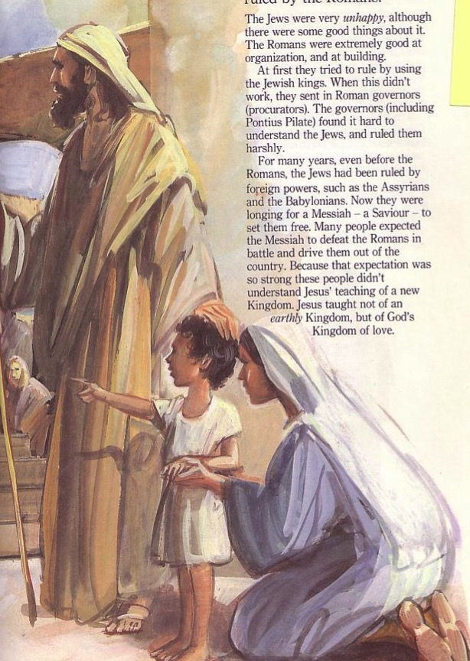
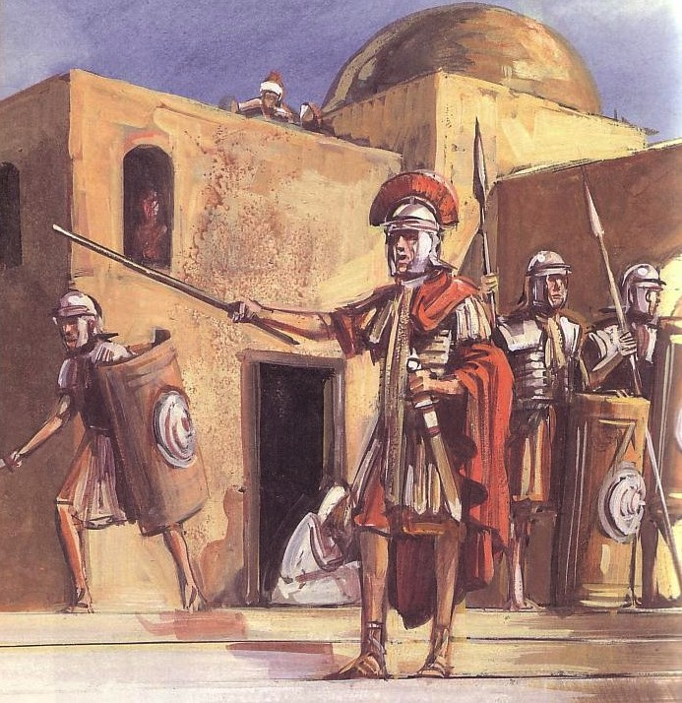
II. Uphold grace equally (Acts 15:6-18).
Jews
Gentiles
One God
Many taboos
Many Gods
Few taboos
Notes:
Jews and Gentiles have identical way to be saved—belief in Jesus.

Slide 30
The Jerusalem Council affirmed salvation by faith for Jew and Gentile alike (Acts 15:6-18).
“He made no distinction between us and them, for he purified their hearts by faith” (9).
“…it is through the grace of our Lord Jesus that we are saved, just as they are” (11).
Notes:
Peter asserted that Jews and Gentiles are saved by grace through faith (15:6-11).
Paul and Barnabas shared how God miraculously confirmed Gentile salvation (15:12).
James taught Gentile salvation now by their future millennial salvation (15:13-18).

Slide 31
All believers have the same way to Jesus—by simple trust in him.
Jew-Gentile Unity
Gentiles
One God
Love over Taboos
One God
Love over Taboos
There is neither Jew nor Greek, there is neither slave nor free, there is neither male nor female, for you are all one in Christ Jesus.
Galatians 3:28 ESV
Notes:
Galatians 3:28 affirms no difference in the way of salvation.

Slide 32
Do you abide by the law?

Slide 33
What do you think?
Are we living under law?
Can I eat pork?
Should I obey the Sabbath?
LAW
Should you be a law abiding Christian?
Should you worship idols?
Does God require me to tithe?
Notes:
How much should you follow the OT today?
Can you eat pork?
Must you follow the Sabbath? (Here’s a hint—today is Sunday!)
Should you worship idols? (OK, that one is easy.)
Must Christians tithe?
Should you be a law abiding Christian?

Slide 34
Leviticus 19:28 "Do not cut your bodies for the dead, and do not mark your skin with tattoos. I am the LORD."
Notes:
Can Christians today have tattoos even though they’re prohibited by the OT Law?
What if they are tattoos about Jesus?!

Slide 35
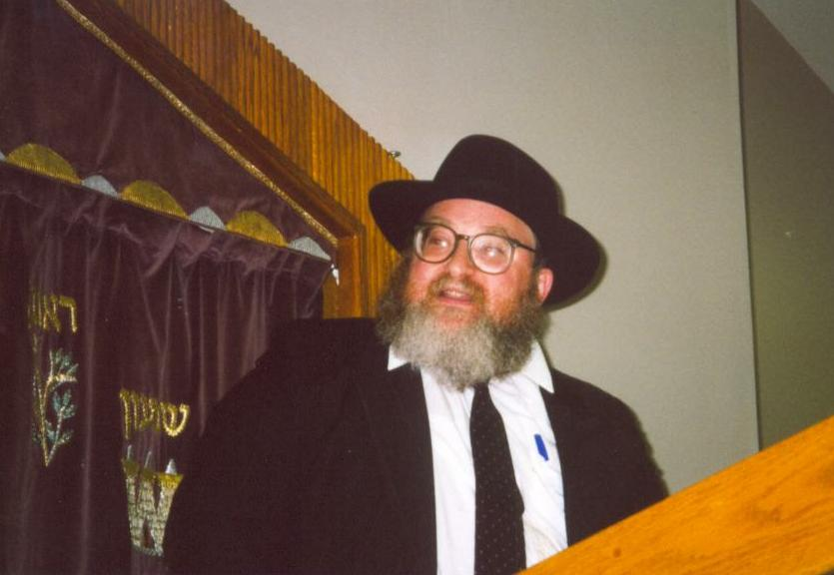
To Clip or Not to Clip?
Lev. 19:27– "Do not cut the hair at the sides of your head or clip off the edges of your beard."
Notes:
Can you men clip the edge of your beard?

Slide 36
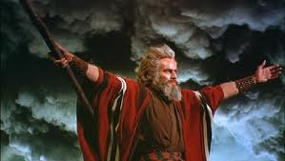
TRADITIONAL VIEW ON LAW
Ex. 25-31
112a
7
A Godly Education In Three Parts:
MORAL: The Ten Commandments; a basis for our current legal system.
CIVIL: How the people are to live with each other in the new social structure.
CEREMONIAL: How to worship God in the new social structure.
BUT ARE THE BIG 10 MORAL LAW?
MOSES
Exodus
Sinai
M - C - C
40
Handbook pg. 26-29
13
Notes:
The key issue of debate concerns the Ten Commandments.
But are the Ten Commandments moral law?

Slide 37
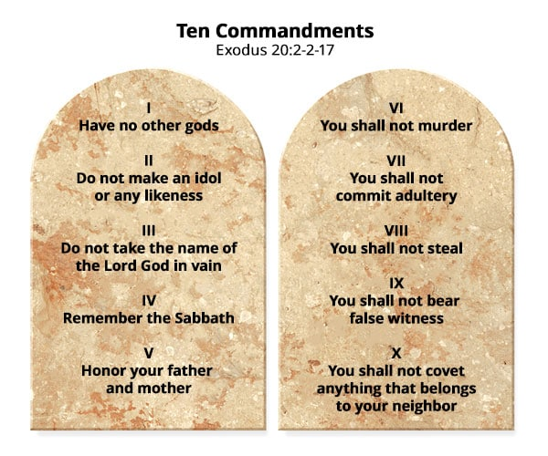
Ten Commandments
???
Notes:
Here they are as a refresher.
• But do you follow the Sabbath?

Slide 38
Moral law means God's rules that apply to…
Every time period
Every culture
Every place
Every people
Notes:
Moral laws are universal
________
BS-28-Law of Moses-07
OS-02-Exodus-252
OS-05-Deut-111
NS-06-Rom5-8-slide79
SA-08-Mosaic Law-31

Slide 39
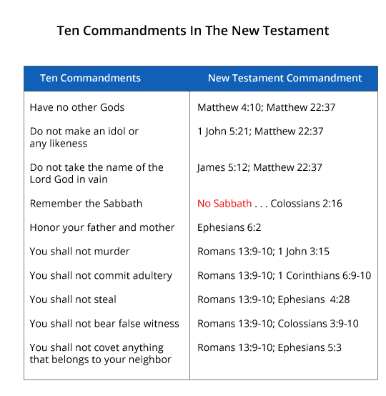
Ten Commandments in the NT
Notes:
Nine of the ten commandments are repeated in the NT—all but the Sabbath.
____________
Do we have to keep the Ten Commandments given in the Old Testament?
NeverThirsty.com
https://www.neverthirsty.org/bible-qa/qa-archives/question/do-we-have-to-keep-the-commandments-and-laws-given-in-the-old-testament/
Accessed 28 April 2021

Slide 40
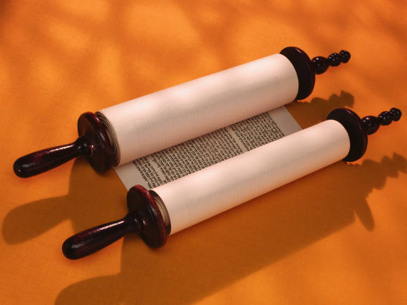
Jewish: The Law is Good
but…

Slide 41
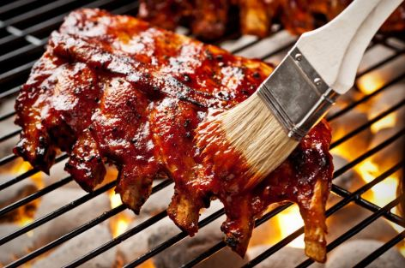
No Legalism!
"So don't let anyone condemn you for what you eat or drink, or for not celebrating certain holy days or new moon ceremonies or Sabbaths. ¹⁷For these rules are only shadows of the reality yet to come. And Christ himself is that reality" (Col. 2:16-17 NLT)
Notes:
But the law of Moses is a shadow of what we have in Jesus.

Slide 42
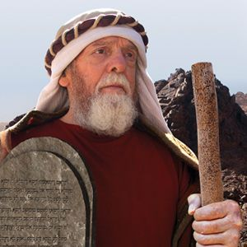
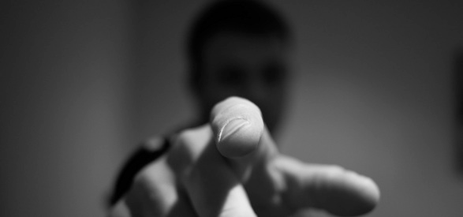
No Legalism!
Notes:
So don’t be a legalist!

Slide 43
The Law
Notes:
We don’t need to abide by the law of Moses.
Jesus was the end of the law (Rom 10:4).
Jesus nailed the law to the cross (Col 2:14).
Jesus abolished “in his flesh the law with its commandments and regulations” (Eph 2:15 NIV).

Slide 44
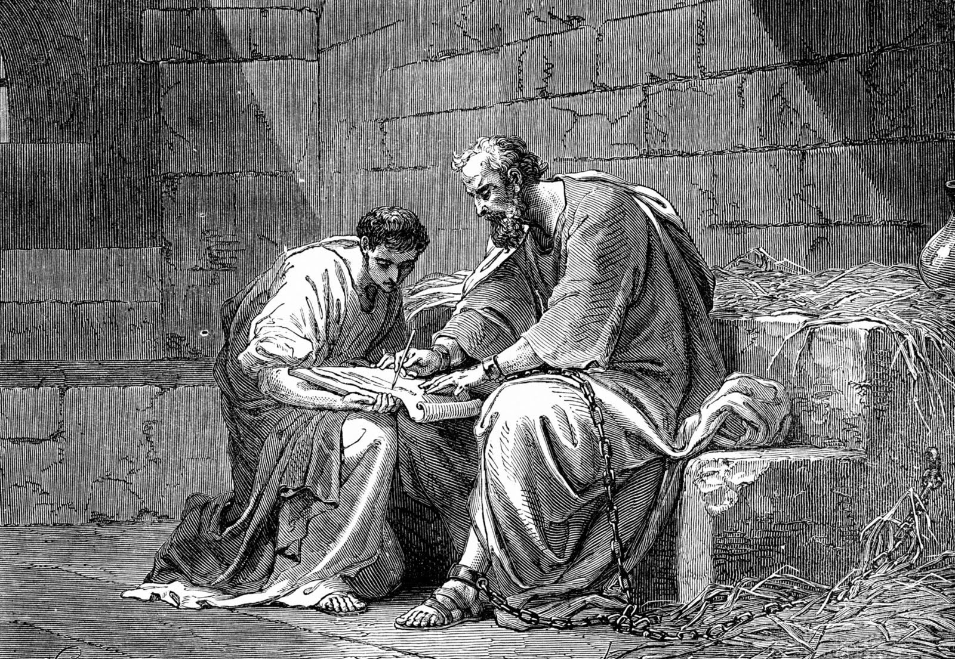
Paul was not under the Law
“When I was with the Jews, I lived like a Jew to bring the Jews to Christ. When I was with those who follow the Jewish law, I too lived under that law. Even though I am not subject to the law, I did this so I could bring to Christ those who are under the law”
1 Corinthians 9:20 NLT
Notes:
Paul said he was not subject to the law (1 Cor 9:20).

Slide 45
How can we affirm grace?
Acts 15
Expect attacks (1-5)
Uphold morality (19-35)
Uphold equally (6-18)
Notes:
(What is the third and final way to affirm grace?)

Slide 46
Freedom to go the wrong way?
Notes:
Freedom is good—but it must be used responsibly just as we free to drive anywhere we want as long as we stay on the correct side of the road!

Slide 47
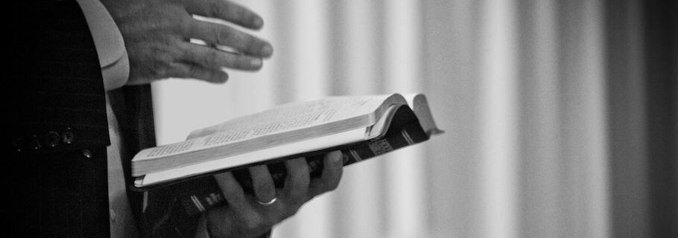
III. Uphold morality for unity (Acts 15:19-35).
Notes:
Believing in Christ should lead us to ethical living that brings harmony.

Slide 48
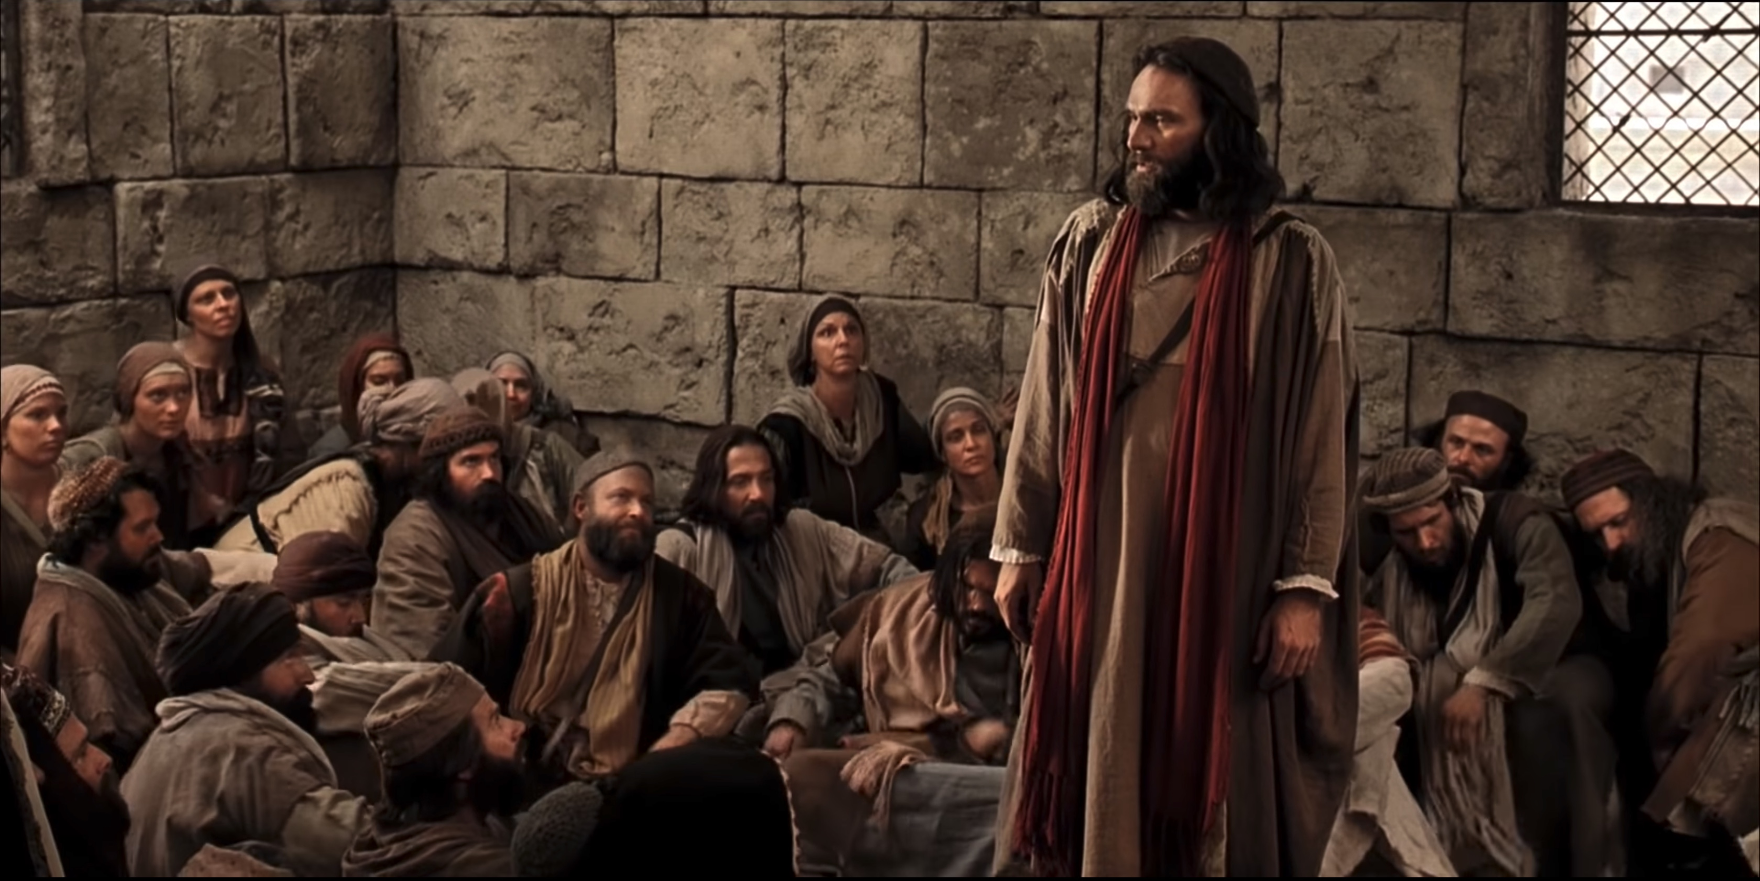
Jerusalem’s leaders preserved a unified church by prohibiting Gentiles from idolatry, eating blood, and immorality (Acts 15:19-35).
Notes:
James proposed to prohibit Gentiles from idolatry, eating blood, and immorality (15:19-21).
The Council wrote the Gentile believers to obey these three moral obligations (15:22-29).
The result was a unified and encouraged church of both Jews and Gentiles (15:30-35).

Slide 49
Where grace shows up…
IDOLATRY
BLOOD
IMMORALITY
Notes:
These practices show our salvation with moral living that unifies.
Doing more than this would make it difficult for Gentiles who trust Christ (15:19).
Doing less than this would make it difficult for Jewish believers to accept the new Gentile believers (15:21).
These three requirements are moral commands applicable to all people in all ages—universal prohibitions.
Idolatry is wrong as we must worship the one, true God.
Blood is our life (Lev 17)—so we don’t eat blood.
Sex since Eden has been reserved for marriage.

Slide 50
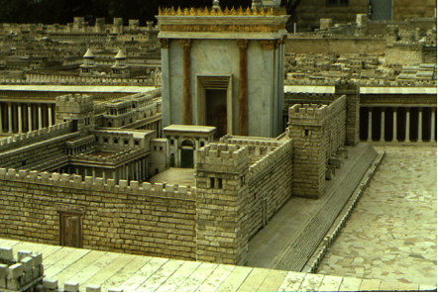
1(--)2"The Jerusalem Council"
A.D.49
Acts 15:1—Must a Gentile become a Jew, and accept his laws and ceremonies, before he can become a Christian?
ATLANTIC OCEAN
EUROPE
GRACE ONLY!
ASIA
ROME•
•Macedonia
•Pisidian Antioch
Athens
•Ephesus
AFRICA
Acts 15
•Syrian Antioch
MEDITERRANEAN SEA
1(--)2 "The Jerusalem Council"
•Jerusalem
The issue was permanently settled: GRACE, not LAW!
ARABIA
© 2006 TBBMI
9.65.08.
43
4
Notes:
Paul apparently had little time to rest up.
//// In Fall A.D. 49 he made that special SHORT trip between the BIG TRIPS #1 and #2…for the famous JERUSALEM COUNCIL.
This was a 500-mile journey from Syrian Antioch, south to the city of the mother church…to Jerusalem.
//// The issue here –– told to us in Acts 15 –– was the simple question:
"Must a Gentile become a Jew, and accept his laws and ceremonies, before he can become a Christian?" It must have been a heated argument!
//// Finally the issue was permanently settled: one becomes a Christian through GRACE…not LAW. However, if following the law makes one comfortable, fine. Accepting Christ as Lord and Savior is a matter of belief and relinquishment –– that is the only requirement! GRACE AND GRACE ONLY!
//// Then Paul and his party returned north to Syrian Antioch. Our BASIC BELIEFS of today date firmly from that Jerusalem meeting of Acts 15. Later reformers of the church also anchored their Christian tenets right there – dating from the Jerusalem Council.

Slide 51
Where grace shows up…
IDOLATRY
BLOOD
IMMORALITY
Notes:
These practices show our salvation with moral living that unifies.
Doing more than this would make it difficult for Gentiles who trust Christ (15:19).
Doing less than this would make it difficult for Jewish believers to accept the new Gentile believers (15:21).
These three requirements are moral commands applicable to all people in all ages—universal prohibitions.
Idolatry is wrong as we must worship the one, true God.
Blood is our life (Lev 17)—so we don’t eat blood.
Sex since Eden has been reserved for marriage.

Slide 52
How can we affirm grace?
Notes:
(So what have we learned about grace? The issue was permanently settled: GRACE, not LAW! How can we affirm grace instead of obeying the law of Moses?)

Slide 53
Main Idea of Acts 15:1-35
Don’t be law abiding— trust Christ by grace through faith for unity.
Notes:
Make sure you don’t feel obligated to follow any OT law not repeated in the NT.
Instead, believe in Jesus as the one who accepts you apart from any good work.
This will put all believers on the same page in theology and practice.

Slide 54
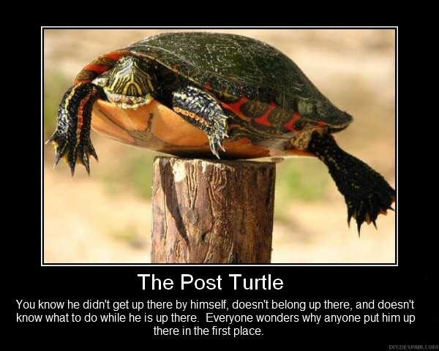
Turtle on a Fencepost
You didn’t get grace by your own efforts
Notes:
You are like a turtle on a fencepost—it didn’t get there by itself, and you didn’t get grace by your own efforts.

Slide 55
How can YOU affirm grace?
Three ways…
Notes:
Where does this show up in your own life?

Slide 56
I. Expect attacks against grace (Acts 15:1-5).
How are you attacking grace with legalism?
Notes:
Many oppose the truth of simple trust giving us a right relationship with God—don’t be one of them!

Slide 57
II. Uphold grace equally (Acts 15:6-18).
Jews
Gentiles
From whom are you withholding grace?
Notes:
Jews and Gentiles have identical way to be saved—belief in Jesus.
Do you think anyone is too far from God to ever turn around?

Slide 58
III. Uphold morality for unity (Acts 15:19-35).
How can you better show grace in moral living?
Notes:
Believing in Christ should lead us to ethical living that brings harmony.
Idolatry is wrong as we must worship the one, true God.
Blood is our life (Lev 17)—so we don’t eat blood.
Sex since Eden has been reserved for marriage.

Slide 59
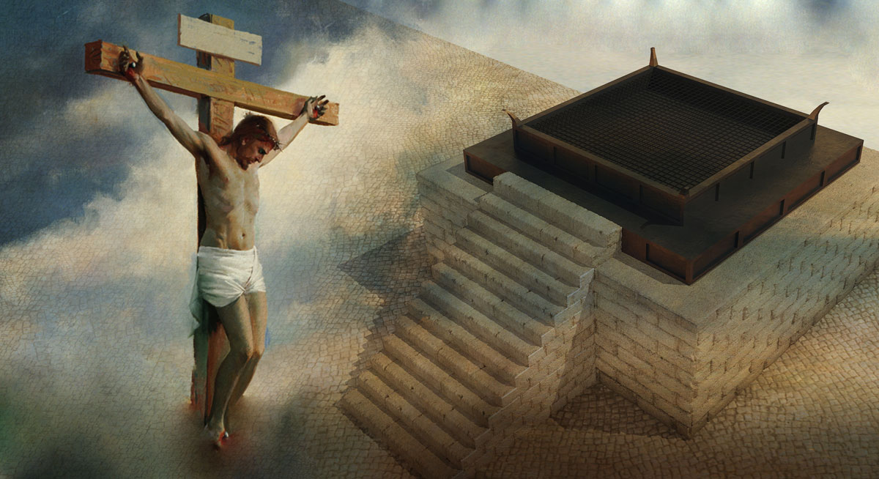
Jesus is the final sacrifice pointed to by the law of Moses.
Notes:
Let’s remember this when we approach the Lord’s table.

Slide 60
Black

Slide 61
NT Preaching link at BibleStudyDownloads.org
Get this presentation and script for free!

