Slide 1
Notes:
Who wants to take a trip?
Suppose you want to cross the causeway and have dinner in JB
Suppose you want to take a ferry to Bintan or Batam
Suppose you want to go to Changi airport, hop on a flight to Australia, Bali, Bangkok, wherever.
But taking a journey right now seems impossible.

Slide 2
Going on a
Journey
Acts 12:25 – 14:28
Notes:
Today we are going to look at another impossible journey.
We will start with the last verse in Acts ch 12 and go all the way through the end of Acts chapter 14. This section is about about Paul’s first missionary journey.
Go ahead and turn in your Bible or apps to Acts ch 12 vs 25 while I give a little background.

Slide 3
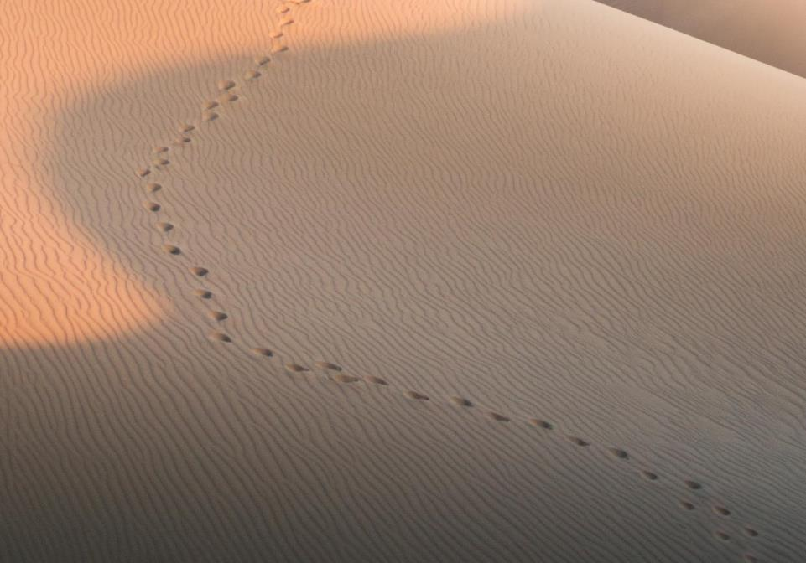
GOOD NE WS
ON THE MO VE
God’s work through the early church in
Acts
Notes:
This is the 13th sermon in our series on the Book of Acts which we are calling “Good News on the Move.
Now this is a story about many different people doing many different things in many different places. We’re going to read about many different places today.
But what you need to realize is that even though there are many different people, places, and things, this is God’s story about His church which is led by His Son, Jesus.

Slide 4
Church Growth
Increasing in Number
Acts 6:1
Persecution
5000
Acts 4:4
Pentecost
3000
Acts 2
Notes:
We see this story about God’s church being born in Acts chapter 2. This is the with the story of Pentecost, and that is when the disciples received the Holy Spirit. The church grew by 3,000 that day.
We see this story about God’s church growing by another 5,000 in Acts chapter 4, and again in Acts chapter 6 the church is “increasing in number”

Slide 5
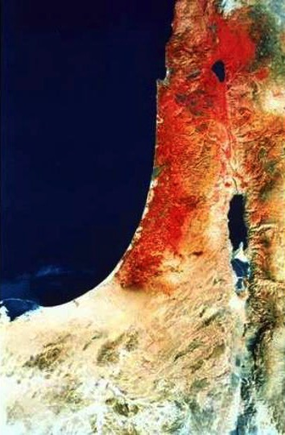
Now those who were scattered went about preaching the word.
Acts 8:4
Samaria
Jerusalem
they believed Philip as he preached good news about the kingdom of God and the name of Jesus Christ
Acts 8:12
Judea
Notes:
Up to this point church, the church has been centered around the city of Jerusalem, in Judea.
But with the persecution by Saul, the believers scattered, but those who were scattered went about preaching the word.
One person who went to Samaria proclaiming the Gospel was Philip. Many people heard the good news about the kingdom of God and the name of Jesus Christ.
One such person was Simon the Magician, who believed and was then baptized.
Another person was the Ethiopian Eunuch who after hearing the Gospel asked “What prevents me from being baptized”

Slide 6
Church Growth
Gentiles
Acts 8, 10-12
Increasing in Number
Acts 6:1
Persecution
5000
Acts 4:4
Pentecost
3000
Acts 2
Notes:
In chapters 10 through 12, the Church continues to grow, and now includes gentiles.
The Ethiopian Eunuch asked “What prevents me from being baptized”
The Apostle Peter asks something very similar, “Can anyone withhold water for baptizing these Gentiles, who have received the Holy Spirit just as we have?

Slide 7
Opposition
External
Acts 4 - Arrested
Acts 5 - Arrested
Acts 7 - Stoned
Acts 8 - Persecution (Jews – Saul)
Acts 12 - Persecution (Jews – Herod)
Notes:
But with growth comes opposition. This opposition comes from both external and internal sources.
We see external opposition to the gospel in the early part of Acts with the apostles being arrested. Opposition continued now led by Saul, and eventually resulted in Stephen’s stoning and the believers scattering.
After Saul’s conversion, the Jews apparently decided to use a political leader rather than a religious leader to persecute the church through Herod.

Slide 8
Despite Opposition the Church Grew
Opposition
External
Internal
Acts 4 - Arrested
Acts 5 - Arrested
Acts 7 - Stoned
Acts 8 - Persecution (Jews – Saul)
Acts 12 - Persecution (Jews – Herod)
Acts 5 - Ananias/Sapphira
Acts 6 - Food Distribution
Acts 8 - Simon the Magician
Notes:
Opposition to church growth also comes from within.
Ananias and Sapphira withheld their offerings, and lied about it.
There were issues about food distribution between the Greek and Hebrew speaking widows.
And in ch 8, we could have had internal opposition with Simon the magician. He was a new believer so he does not understand everything about the Gospel. So when he saw the Holy Spirit being given through the laying on of the apostles' hands, he wanted to pay money so he could do the same thing. He was rebuked by Peter.
Despite opposition, the church Grew

Slide 9
Background
Despite Opposition
God Grows the Church
POSSIBLE
IM
Notes:
That is our background.
Despite this external and internal opposition, we see that God uses various people and circumstances to make the church grew.
We see the impossible become the possible.

Slide 10
“ends of the earth"
Acts 1:8 NLT
"But you will receive power when the Holy Spirit comes upon you. And you will be my witnesses, telling people about me everywhere—in Jerusalem, throughout Judea, in Samaria, and to the ends of the earth.”
Samaria
Jerusalem
Judea
IMPOSSIBLE
Notes:
How will the church continue to grow in fulfilment of Acts 1:8?
Acts 1:8 is where Jesus tells the Apostles they will be his witnesses, telling people everywhere about him, in Jerusalem, throughout Judea, in Samaria, and to the ends of the earth.
And we have seen God is already making that happen. So should the church leaders just sit back and let God continue to work or should they seek out and participate in God’s will?
How can you contribute to God’s plan of growing the church? How do you do the impossible? Today I will show you two things you need to do the impossible.

Slide 11
Seek Counsel from the Holy Spirit
Notes:
The first thing you need to do the impossible is to seek counsel from the Holy Spirit. We have already seen this in action with the early church.

Slide 12
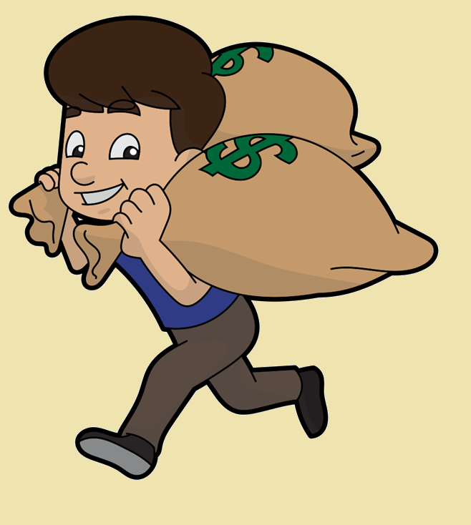
Acts ch 11 ²⁸ And one of them named Agabus stood up and foretold by the Spirit that there would be a great famine over all the world (this took place in the days of Claudius). ²⁹ So the disciples determined, every one according to his ability, to send relief to the brothers living in Judea. ³⁰ And they did so, sending it to the elders by the hand of
Barnabas and Saul.
Famine Relief
Notes:
At the end of Acts ch 11, we see that the great famine during the reign of Claudius was predicted by the prophet Agabus by the power of the Holy Spirit.
Barnabas and Saul were the ones who delivered the gifts from Antioch to Jerusalem.

Slide 13
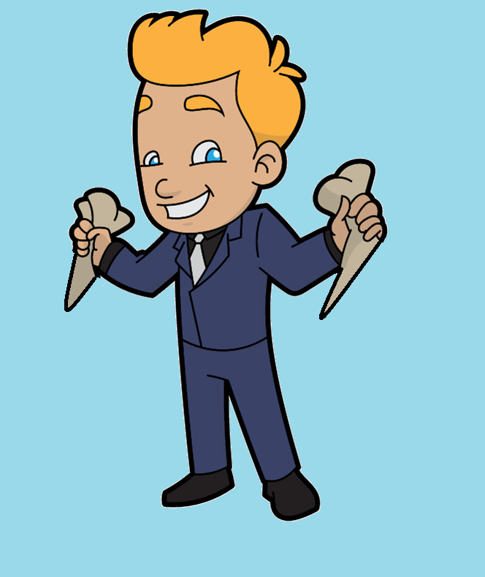
Acts ch 12 ²⁵ And Barnabas and Saul returned from Jerusalem when they had completed their service,
bringing with them John, whose other name was Mark.
Famine Relief
Notes:
Some point later, Barnabas and Saul returned to Antioch.
They also brought with them John Mark. You can just call him Mark. This is the same Mark who wrote the Gospel of Mark.
John Mark is also the cousin of Barnabas (see Col 4:10). That is why they look alike on the slide.

Slide 14
Church Leadership
Barnabas
Simeon
Lucius
Manaen
Saul
Notes:
Moving into chapter 13, we see the leaders at the church at Antioch meeting together.
This is an interesting group. Barnabas is the leader.
Simeon is a Jewish name, who is likely from modern day Nigeria.
Lucius is a Roman name.
Manaen was a childhood friend of King Herod Antipas, the Herod that killed John the Baptist and was part of Jesus’ trial.
And of course Saul, who formerly persecuted the Christians.

Slide 15
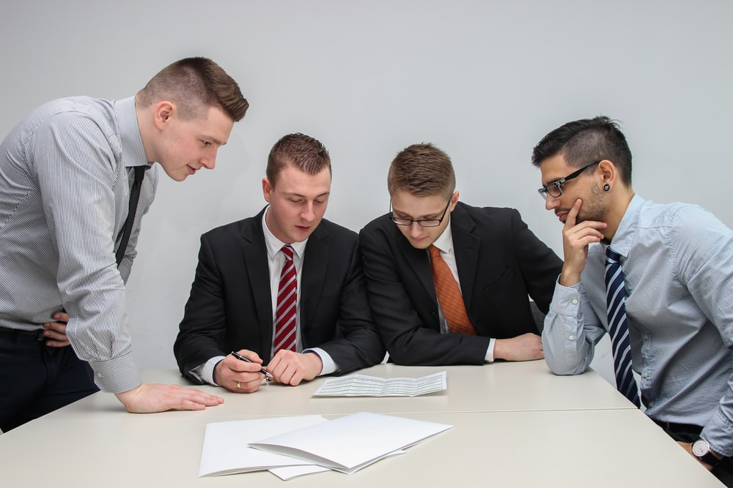
One day as these men were worshiping the Lord and fasting,
Notes:
What was this group doing? Were they busy planning the next famine relief drive? No, they were worshiping the Lord, they were praying, they were fasting.
It says they were worshipping, how do we know they were praying?
Because the next verse tells us that after more fasting and prayer, the men laid their hands on them and sent them on their way.

Slide 16
Timeline in Acts
AD 33
Resurrection
Pentecost
AD 35
Death of Stephen
Saul’s Conversion
AD 48
First Missionary Journey
Notes:
At first glance when reading the Book of Acts, it can seem as if everything is happening very rapidly. But when you take a closer look you realize that Paul waited over 12 years after his conversion to begin his missionary journeys.
When you seek God’s guidance and direction, he will show you his perfect timing.

Slide 17
View from Bethany Ministries
Cheung Chau Island, Hong Kong
Notes:
ILL: Isn’t it interesting how God gives guidance and direction to our lives? But if you are not seeking God’s guidance and direction, how will you know when he gives it.
Two years ago, I was contemplating quitting my job, and becoming a missionary. My wife and I heard about this organization in Hong Kong that provides a place for missionaries to rest and relax, a place of respite. They are located on top of a hill on a small island that has no cars.
They stated they needed volunteers to help run the facility. I thought I can do that. So Karla and I visited and interviewed with the organization. I hadn’t really prayed about it, I was just looking at what I could do, not what God could do with me.
During the interview the director was asking Karla about her counseling degree and whether she would be content basically sequestered on top of this mountain 6 days a week. At that point, I began to realize that I would not be content.
We got back to Singapore and began to pray more earnestly about where God’s was leading us. It seemed as if the answer was to stay in Singapore. But I remember saying it would be impossible to stay in Singapore. We can’t afford it. We can’t get a visa for both of us.
We continued praying, and here I am today, just about to finish my first year of a three year program at Singapore Bible College.
What do you need to do the impossible?

Slide 18
Seek Counsel from the Holy Spirit
Notes:
The first thing you need to do the impossible is to seek counsel from the Holy Spirit.
But seeking counsel of the Holy Spirit is half the equation. What is the other half?

Slide 19
Seek Counsel from the Holy Spirit
Follow the Holy Spirit
Notes:
You must follow the Holy Spirit
When you seek and follow the Holy Spirit, you can do the impossible.
Lets take a look at an impossible Journey and see how it was enabled by the Holy Spirit.

Slide 20
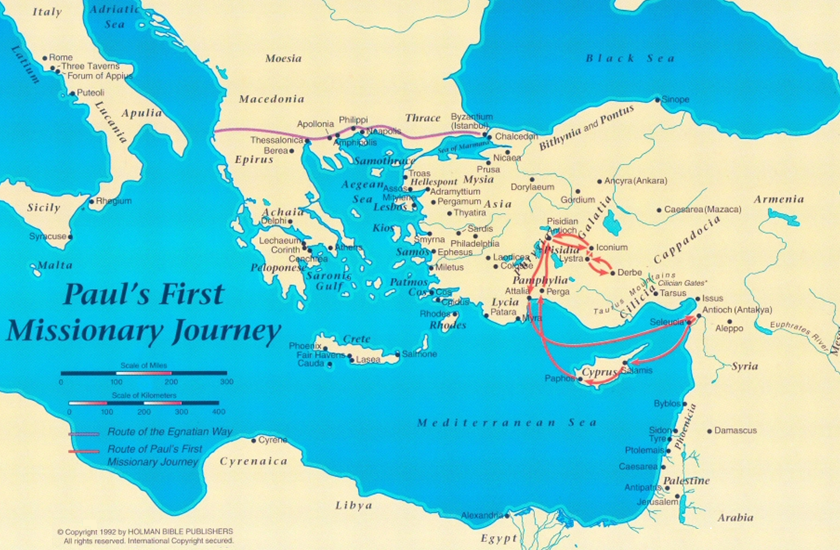
Notes:
Paul’s journey is not amazing simply because of how far he travelled. What is amazing is what happened during his journey.

Slide 21
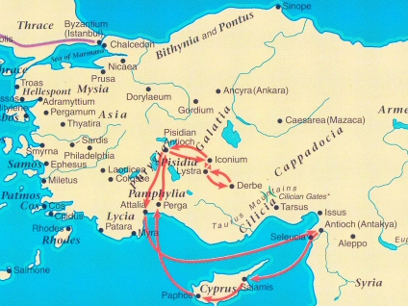
Iconium
Lystra
Salamis
Paphos
Perga
Antioch (Pisidia)
Iconium
Lystra
Derbe
Perga => Attalia
Antioch (Pisidia)
Antioch (Syria)
Antioch (Syria)
Notes:
Here is a closer look of where he travelled.
Started in Antioch – Salamis – Paphos – Perga – Anitoch of Pisidia – Iconium – Lystra – Derbe, then back the same way, stopping by Attalia and skipping the Island of Cyprus.
We are not going to look at each of these individual stops.

Slide 22
Salamis
Paphos
Perga
Antioch (Pisidia)
Iconium
Lystra
Derbe
Salamis
Perga
Antioch (Syria)
Notes:
Salamis and Perga are not included in the notes but are important as they set the stage for John Mark being a disappointment for Paul. We will see this more in a later sermon.

Slide 23
Salamis
Paphos
Perga
Antioch (Pisidia)
Iconium
Lystra
Derbe
Antioch (Syria)
Notes:
We will take a close look at Paphos.

Slide 24
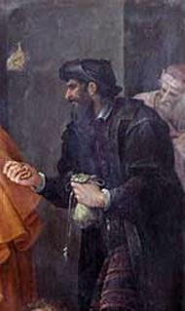
Paphos (13:4-12)
Simon the Magician
Elymas the Magician
Believed
Baptized
Opposed
Blinded
vs
Acts 8
Acts 13

Slide 25
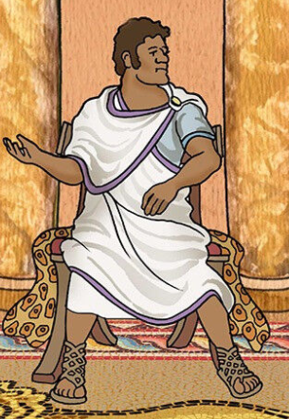
Paphos (13:4-12)
Sergius Paulus
Elymas the Magician
Believed
Opposed
Blinded
vs
Acts 13
Acts 13

Slide 26
Paphos (13:4-12)
Sergius Paulus
When the governor saw what had happened, he became a believer, for he was astonished at the teaching about the Lord.
Acts 13:12

Slide 27
Iconium
Lystra
Derbe
Salamis
Paphos
Perga
Antioch (Pisidia)
Antioch (Syria)
Notes:
Here is a closer look.

Slide 28
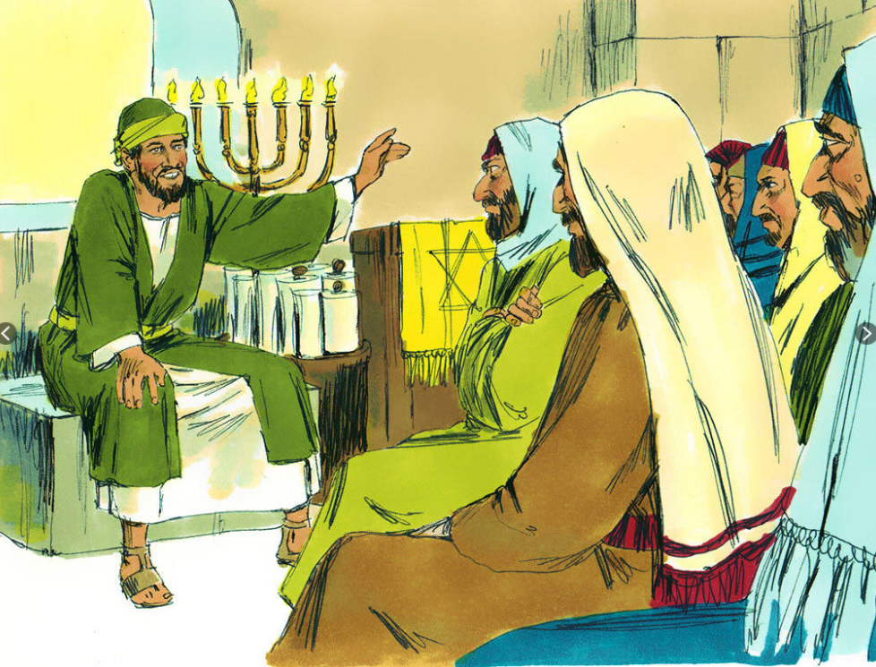
Antioch of Pisidia (13:13-52)
³² And now we are here to bring you this Good News. The promise was made to our ancestors, ³³ and God has now fulfilled it for us, their descendants, by raising Jesus.
³⁸ “Brothers, listen! We are here to proclaim that through this man Jesus there is forgiveness for your sins. ³⁹ Everyone who believes in him is made right in God’s sight—something the law of Moses could never do.

Slide 29
Antioch of Pisidia (13:13-52)
⁴⁶ Then Paul and Barnabas spoke out boldly and declared, “It was necessary that we first preach the word of God to you Jews. But since you have rejected it and judged yourselves unworthy of eternal life, we will offer it to the Gentiles. ⁴⁷ For the Lord gave us this command when he said,
‘I have made you a light to the Gentiles, to bring salvation to the farthest corners of the earth.’”

Slide 30
Iconium
Lystra
Derbe
Salamis
Paphos
Perga
Antioch (Pisidia)
Antioch (Syria)
Notes:
Here is a closer look.

Slide 31
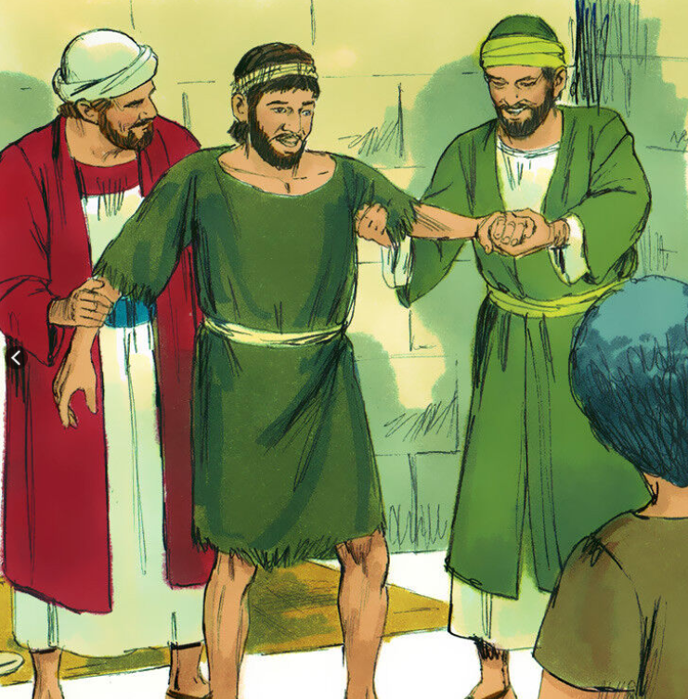
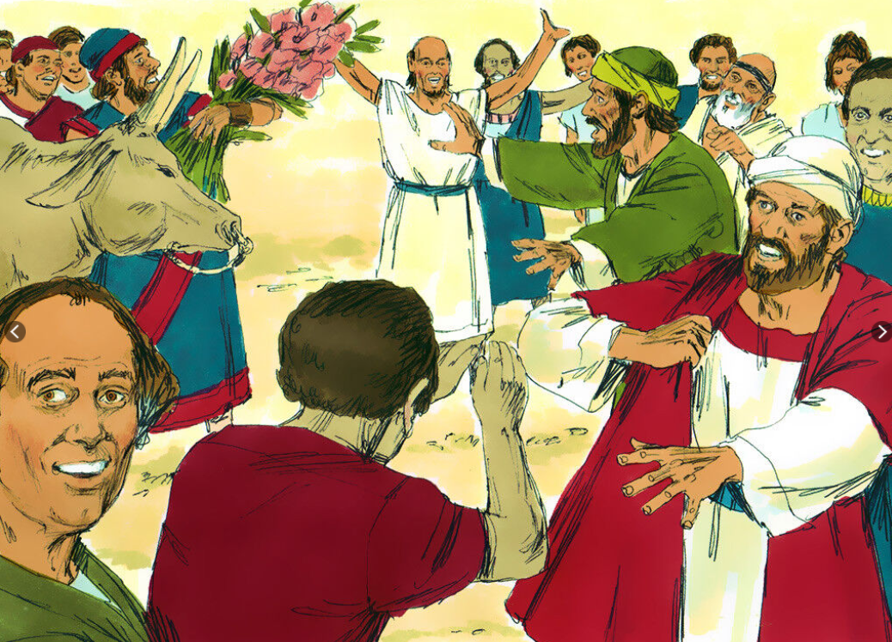
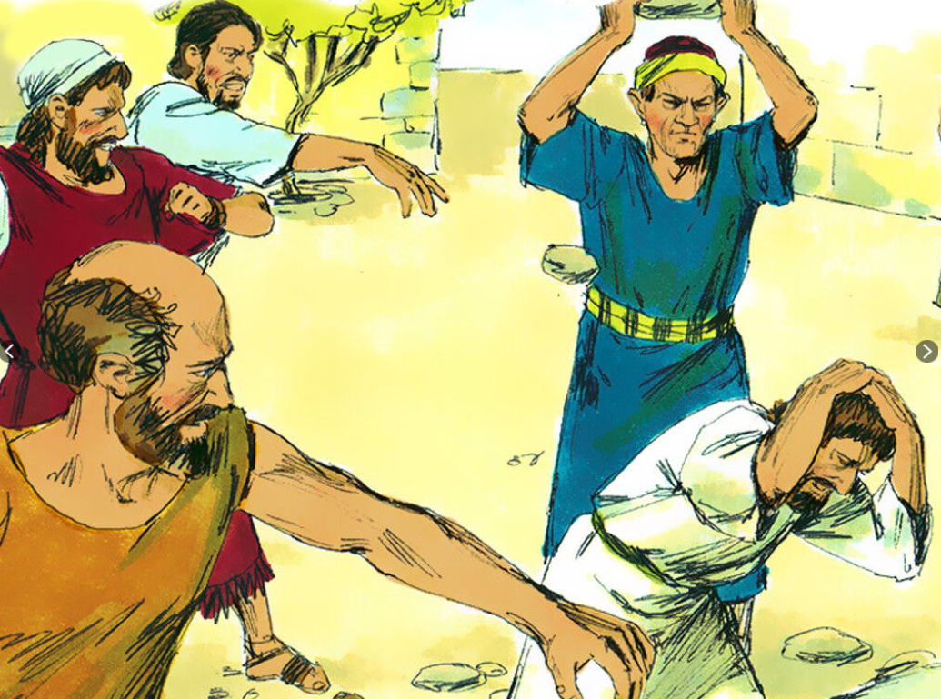
Lystra
Stoned
Healing
Idolized

Slide 32
Eric Liddell
Notes:
The story of Eric Liddell is about someone who sought after and followed the Holy Spirit and he achieved the impossible.

Slide 33
1924 Olympic Games

Slide 34
Return to China
Teacher
Husband / Father
Ordained Minister
1925 - 1943

Slide 35
Japanese Internment
I never heard him say a bad word about anybody"
"the best thing he gave me was his baton of forgiveness. He taught me to love my enemies, the Japanese, and to pray for them."
1943 - 1945

Slide 36
The Return Trip
They encouraged them to continue in the faith, reminding them that we must suffer many hardships to enter the Kingdom of God.
Notes:
We also see the impossible being made possible on the return trip. The churches Paul and Barnabas planted are growing.
Any mission organization today will tell you the goal of church planting is to have churches that are governing, self supporting, and self-propagating.
Paul does give some advice that is still applicable today.
We know this is not hard, this is not impossible, because . . .
Later Paul would write all who desire to live a godly life will suffer persecution. It seems like it would be impossible to be a Christian if you must suffer many hardships, if you must endure persecution. But that the main point of this section of scripture.

Slide 37
Nothing is Impossible when you Seek out and Follow the Holy Spirit
Notes:
Nothing is Impossible when you Seek out and Follow the Holy Spirit.
Most of us are not going on a missionary journey to a strange new place. But this can still apply to you.
Are there areas in your life where you need to seek the Holy Spirit? Just like Paul and the leaders at the church in Antioch sought after the Holy Spirit so should you to. What areas of your life do you need to seek the Holy Spirit? That is easy: All areas.
Maybe the Holy Spirit is already calling you for something. Maybe to volunteer at you local church. Maybe he is calling you to stop watching so much TV for worrying about the future. Obey, follow the Holy Spirit.
Nothing is Impossible when you seek out and follow the Holy Spirit.

Slide 38
The Holy Spirit
Achieving the
Impossible
Since AD 33
Notes:
The Holy Spirit, helping the church achieve the impossible since AD 33.
Let us pray. . .

