Slide 1
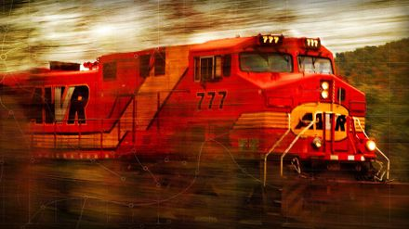
Our Unstoppable God
Acts 12:1-24
Dr. Rick Griffith • Crossroads International Church Singapore CICFamily.com • BibleStudyDownloads.org

Slide 2
The Book of Acts in 3 Minutes (TheChurchatBrookHills.mp4)
131e

Slide 3
Jewish Opposition in Acts
Herod & Jews
12:1
Saul
9:1-2, 29
Stephen
6:11–8:3
Peter & Apostles
5:17-40
Peter & John
4:29
Notes:
“The Persecution of the Church at Jerusalem (12:1–24): The purpose of this section of Acts is to confirm Israel’s rejection of the Messiah. Luke has skillfully woven this theme throughout the entire book and it can be seen up to this point in 4:1–30 (esp. 4:29); 5:17–40; 6:11–8:3; 9:1–2, 29. This animosity of Israel set the stage for the first missionary journey.”
—Stanley D. Toussaint, “Acts,” in The Bible Knowledge Commentary: An Exposition of the Scriptures, ed. J. F. Walvoord and R. B. Zuck, vol. 2 (Wheaton, IL: Victor Books, 1985), 384.

Slide 4
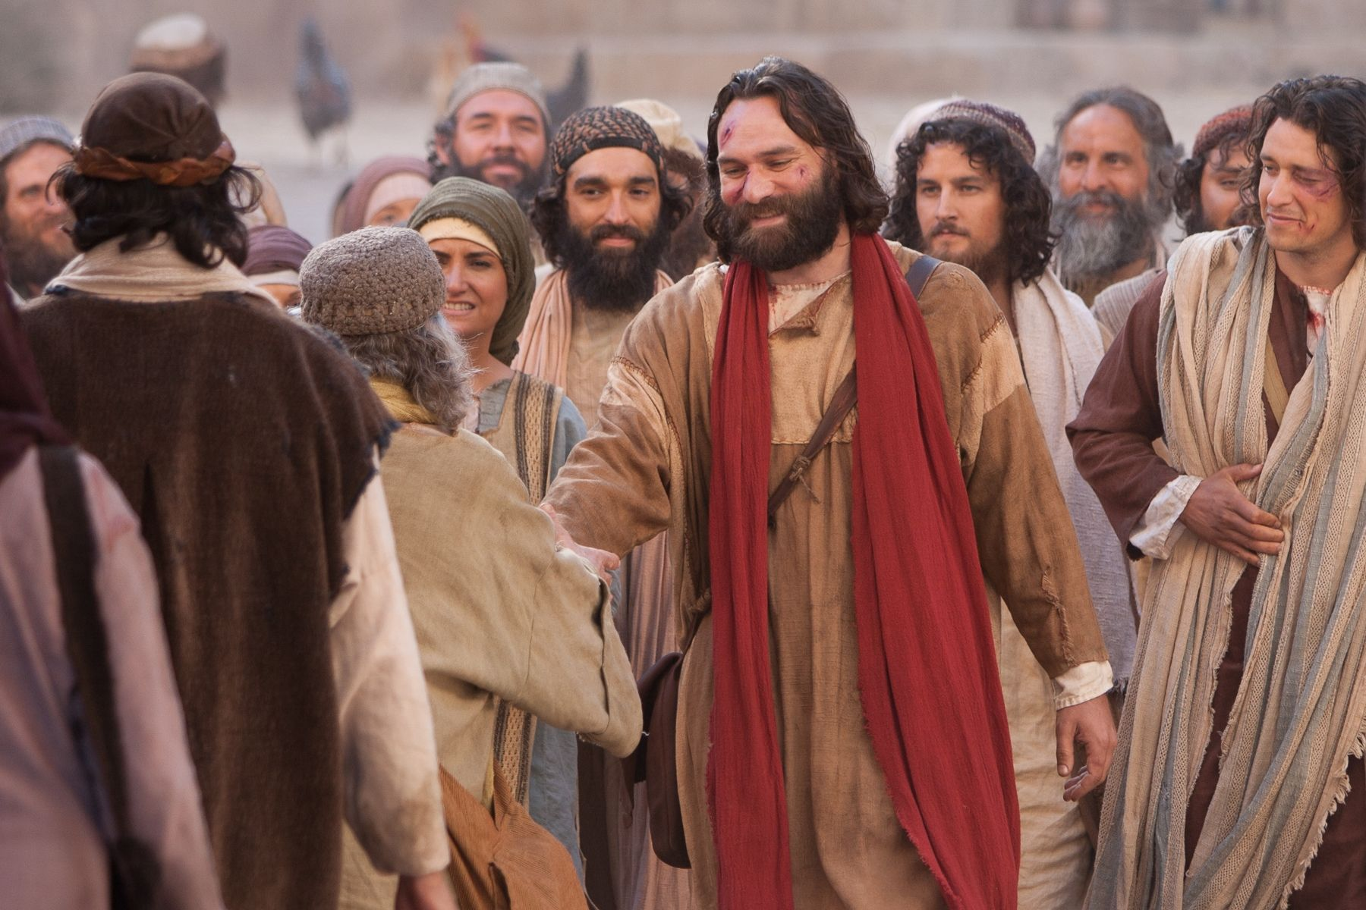
Jewish Opposition in Acts
Barnabas & Saul
Famine Gift
11:30
Barnabas & Saul
Famine Gift
12:25
Acts 12:1-24
Notes:
“The martyrdom of James (12:1–2)… Artfully, Luke contrasted the love of the church at Antioch for the saints at Jerusalem with the coldhearted enmity of Herod and the Jews for the church. The Herod mentioned here is Agrippa I, a ruler popular with the Jews for he was partly Jewish, being of Hasmonean descent. His kingdom covered basically the same area as that of his grandfather Herod the Great. He was known for doing everything possible to curry the favor of the Jews, so he found it politically expedient to arrest Christians and to execute James, the brother of John. Herod Agrippa I died in AD 44.”
—Stanley D. Toussaint, “Acts,” in The Bible Knowledge Commentary: An Exposition of the Scriptures, ed. J. F. Walvoord and R. B. Zuck, vol. 2 (Wheaton, IL: Victor Books, 1985), 384.

Slide 5
Can God’s plan be stopped?

Slide 6
Need

Slide 7
Are you unstoppable?

Slide 8
Christian Versions

Slide 9
How did the Jews continue to reject the gospel?
Acts 12:1-24

Slide 10
Patterns: Acts 12 & Today
RESULT
REJECTION

Slide 11
Our
GOD

Slide 12
GOOD NE WS
ON THE MO VE
God’s work through the early church in
Acts

Slide 13
Jerusalem Church Challenges in AD 44
Herod opposed Christ (Acts 12:1-22)
James
Murdered
1-2
Notes:
Herod murdered James (12:1-2).
Herod imprisoned Peter unsuccessfully (12:3-19a).
Herod accepted worship that only God deserves (12:19b-22).

Slide 14
Jewish Opposition in Acts
Jerusalem Herod & Jews
Hatred
12:1
Antioch Gentiles
Love
11:30
Notes:
“The martyrdom of James (12:1–2)… Artfully, Luke contrasted the love of the church at Antioch for the saints at Jerusalem with the coldhearted enmity of Herod and the Jews for the church. The Herod mentioned here is Agrippa I, a ruler popular with the Jews for he was partly Jewish, being of Hasmonean descent. His kingdom covered basically the same area as that of his grandfather Herod the Great. He was known for doing everything possible to curry the favor of the Jews, so he found it politically expedient to arrest Christians and to execute James, the brother of John. Herod Agrippa I died in AD 44.”
—Stanley D. Toussaint, “Acts,” in The Bible Knowledge Commentary: An Exposition of the Scriptures, ed. J. F. Walvoord and R. B. Zuck, vol. 2 (Wheaton, IL: Victor Books, 1985), 384.

Slide 15
Jerusalem Church Challenges in AD 44
Herod opposed Christ (Acts 12:1-22)
James
Murdered
1-2
Peter
Imprisoned
3-19a
Herod Worshipped
19b-22
Notes:
Herod murdered James (12:1-2).
Herod imprisoned Peter unsuccessfully (12:3-19a).
Herod accepted worship that only God deserves (12:19b-22).

Slide 16
God judged Herod but prospered the church
Oppressors
Judged
23
Church
Expanded
24
James
Murdered
1-2
Peter
Imprisoned
3-19a
Herod Worshipped
19b-22
Notes:
Herod died by being eaten by worms (12:23).
The church grew both in numbers and geographically (12:24).

Slide 17
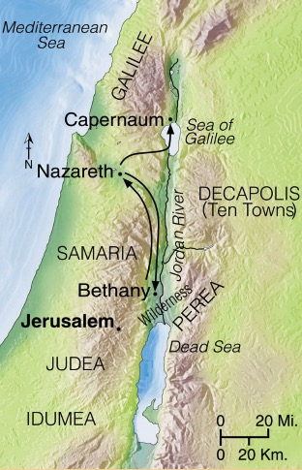
Progress Reports
125
End of the Earth
Key Verse: 1:8
2:47b
6:7
8:40
9:31
12:24
16:5
19:20
28:30-31
1:1–6:7
6:8–8:40
Acts 9–28
Why end this way?
Adapted from Stanley D. Toussaint, BKC; Jeremy Chew, EAST

Slide 18
Main Idea of Acts 12:1-24
God judges oppressors
while expanding his church

Slide 19
Psalm 31
Love the Lord,
all you godly ones!
For the Lord protects those who are loyal to him,
but he harshly punishes the arrogant.
²⁴ So be strong and courageous,
all you who put your hope in the Lord!
(Ps 31:23–24 NLT)

Slide 20
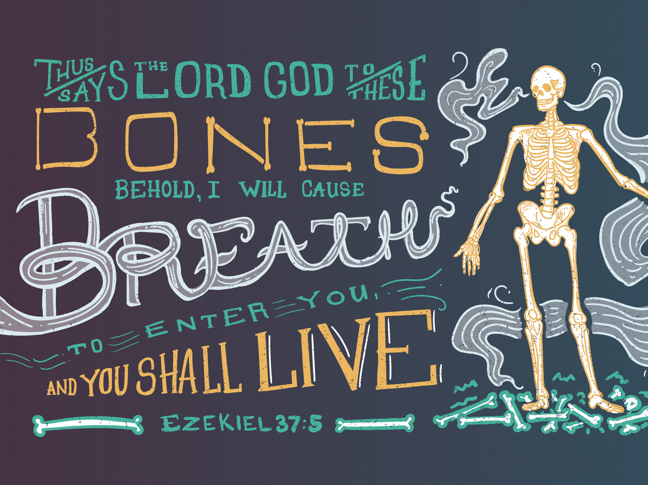
Ezekiel 37:5
* Don't try that on the final exam

Slide 21
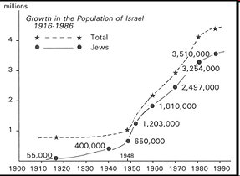
Jews Return in the 20th Century
195b
www.bibleweb.org/ MEastStudies/Sem3.htm
millions
Growth in the Population of Israel
1916-1986
Total
Jews
Notes:
www.bibleweb.org/ MEastStudies/Sem3.htm

Slide 22
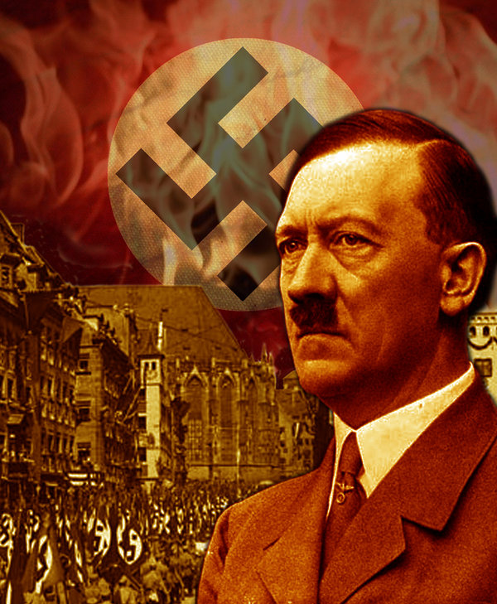
Hitler motivated the Jews to go to their homeland!

Slide 23
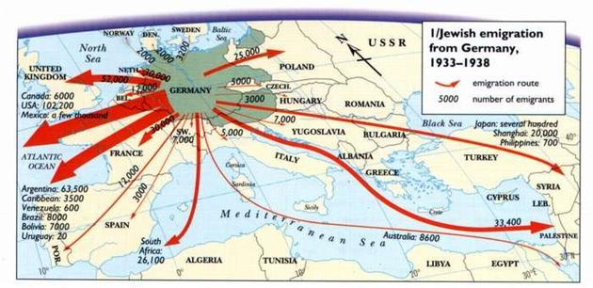
Hitler motivated the Jews to go to their homeland!
Notes:
Hitler sought to eradicate the Jews, but God sought to eradicate Hitler. He committed suicide in 1945 and three years later the Jews established their homeland in Israel!

Slide 24
Paul’s Thorn in the Flesh
My grace is sufficient for you,
for my power is made perfect in weakness
—Jesus (2 Cor 12:9)

Slide 25
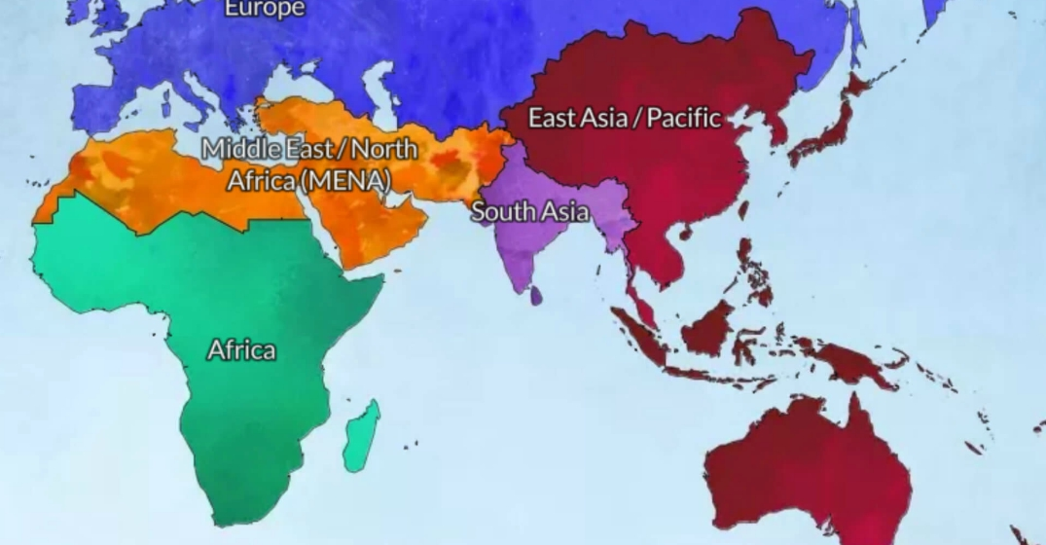
God is leading us from Asia to MENA
Jordan
Singapore

Slide 26
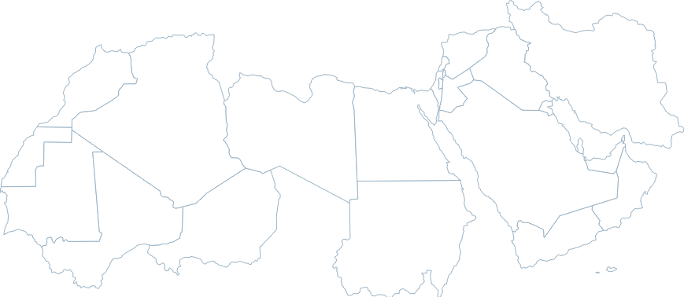
Do you know the countries of MENA?
Iran
Jordan
MENA = Middle East/ North Africa

Slide 27
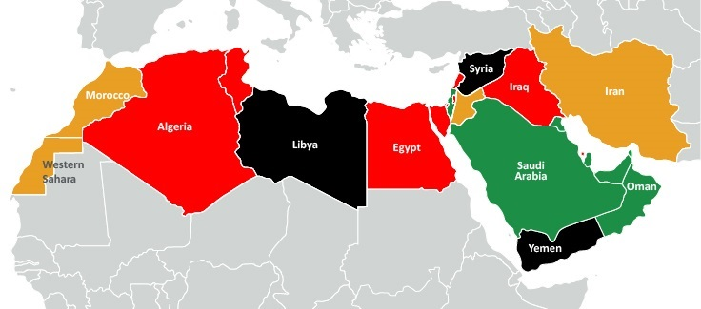
Do you know the countries of MENA?
Jordan
MENA = Middle East/ North Africa

Slide 28
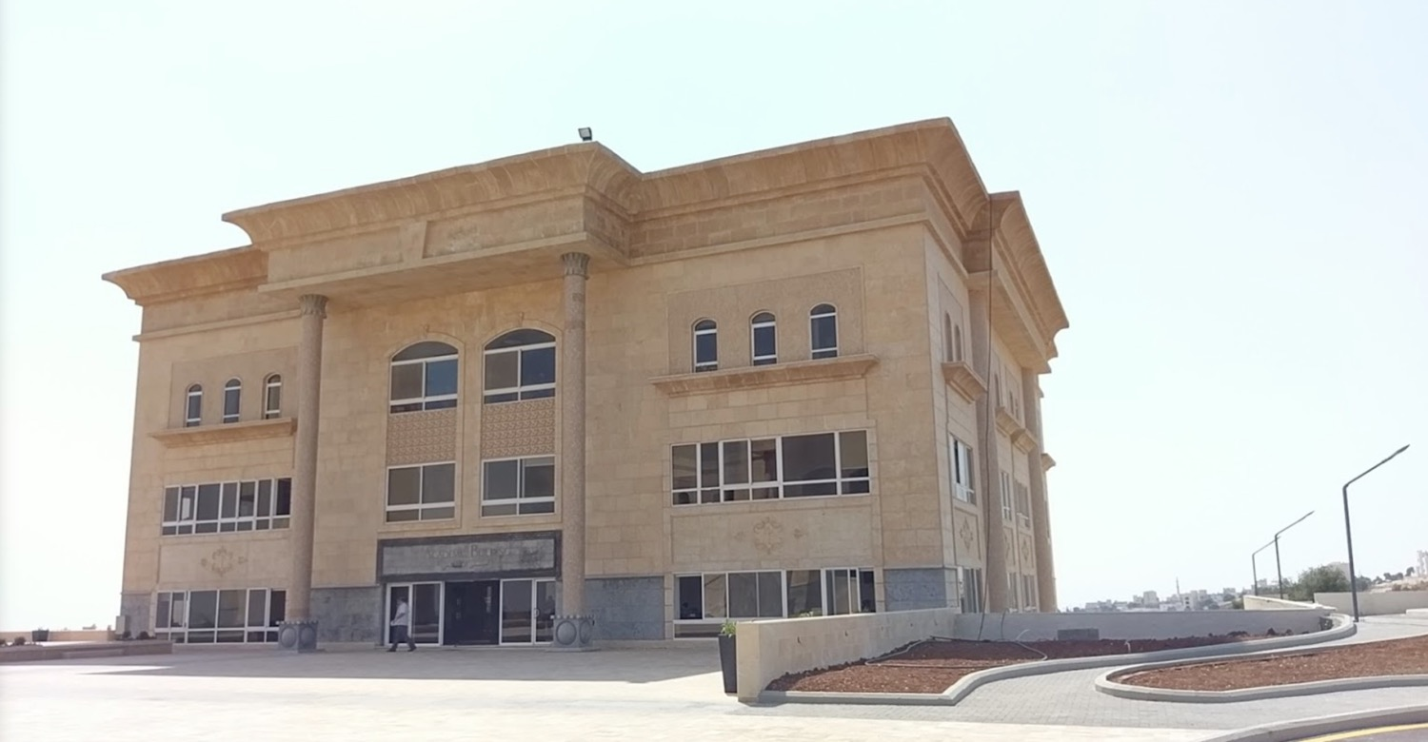
Jordan Evangelical Theological Seminary (JETS)
Notes:
to teach Bible and theology through translation into Arabic.

Slide 29
Main Idea of Acts 12:1-24
God judges oppressors
while expanding his church

Slide 30
What about you?
How will you trust in God’s timing and way to deal with those who reject him?
Are you suffering for Jesus right now?
How can your difficulties propel you to greater growth?
Will you let God deal with his opposers as he wishes?

Slide 31
Black

Slide 32
NT Preaching link at BibleStudyDownloads.org
Get this presentation and script for free!

