Slide 1
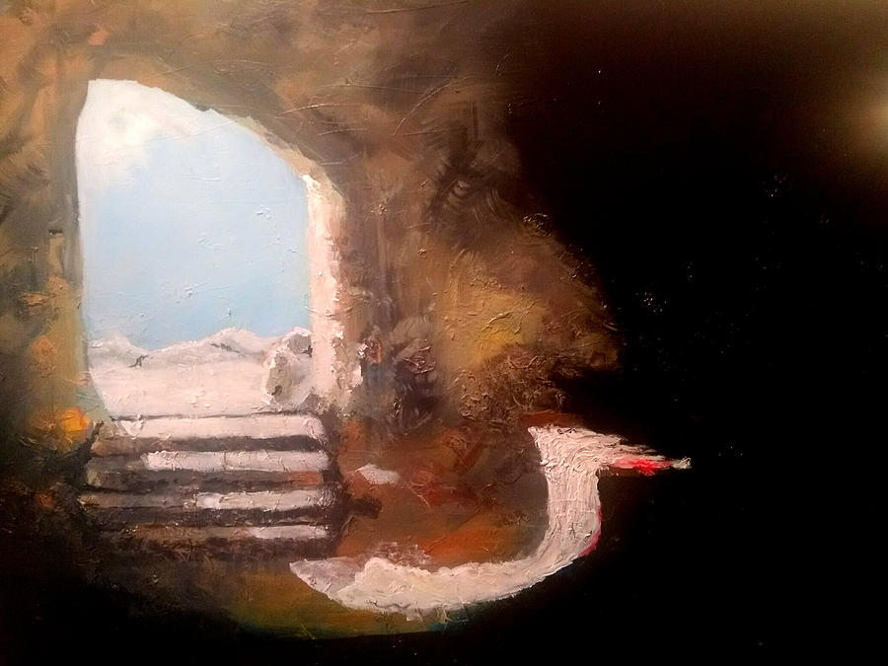
The Powerful Work of God
Raising the Lame, Dead, and Defiled
Acts 9:32-11:18

Slide 2
Acts 2:24
“God raised him up, loosing the pangs of death, because it was not possible for him to be held by it.”

Slide 3
Scene 1: Healing Aeneas at Lydda (9:32-35)
Scene 2: Physically raising Dorcas at Joppa (9:36-43)
Scene 3: Spiritually raising Cornelius at Caesarea (10:1-48)
Scene 4: Believing spiritual resurrection at Jerusalem (11:1-18)

Slide 4
God is not limited to do powerful works in only one place or manner
God develops the minister while performing powerful works
God controls His powerful works to point people to His Son

Slide 5
Jesus in Luke’s gospel
Jesus healed a paralytic (Luke 5:17-26)
Jesus raised a boy and girl from the dead (Luke 7:11-17; 8:49-56)
Jesus observed a Roman centurion’s faith (Luke 7:1-5)

Slide 6
God’s Control in Conversion
God sets up the meeting of men (10:1-23)
God makes conversion happen (10:24-48)
God receives the credit (11:1-18)

