Slide 1
Sit!
Stay!
Attack!

Slide 2
Exodus 17:6
Behold, I will stand before you there on the rock at Horeb, and you shall strike the rock, and water shall come out of it, and the people will drink.” And Moses did so, in the sight of the elders of Israel.
Luke 19:38-40
³⁸ saying, “Blessed is the King who comes in the name of the Lord! Peace in heaven and glory in the highest!” ³⁹ And some of the Pharisees in the crowd said to him, “Teacher, rebuke your disciples.” ⁴⁰ He answered, “I tell you, if these were silent, the very stones would cry out.”

Slide 3
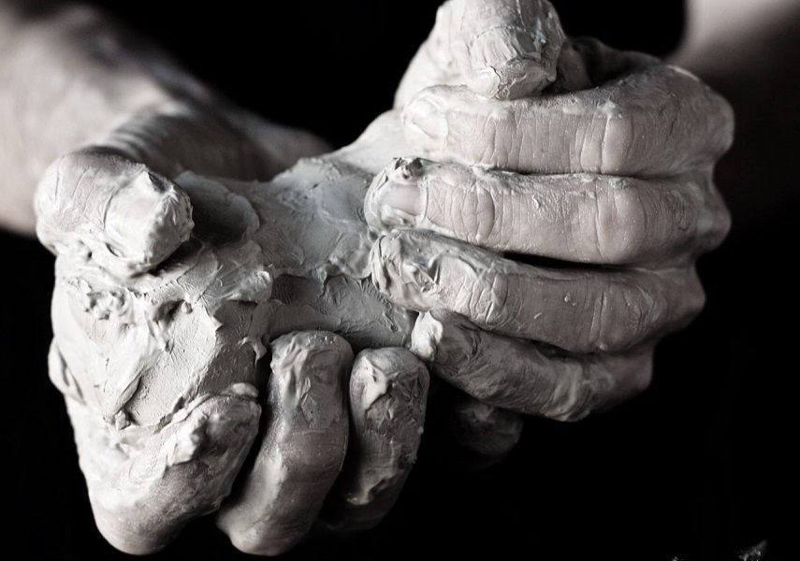
The Way to God
Transforming Dead Souls into Living Witnesses for Christ
Acts 9:1-31

Slide 4
Understand God’s Intention
Samaria
Simon
Insincere seeking
Judea
Ethiopian eunuch
Sincere seeking
end of the earth
Saul
Persecuting

Slide 5
Understand God’s Intention
Genesis 12:1-3
¹ Now the Lord said to Abram, “Go from your country and your kindred and your father's house to the land that I will show you. ² And I will make of you a great nation, and I will bless you and make your name great, so that you will be a blessing. ³ I will bless those who bless you, and him who dishonors you I will curse, and in you all the families of the earth shall be blessed.”

Slide 6
Understand God’s Intention
Luke 24:45-47
⁴⁵ Then he opened their minds to understand the Scriptures, ⁴⁶ and said to them, “Thus it is written, that the Christ should suffer and on the third day rise from the dead, ⁴⁷ and that repentance for the forgiveness of sins should be proclaimed in his name to all nations, beginning from Jerusalem.

Slide 7
Understand God’s Intention
Acts 1:8
But you will receive power when the Holy Spirit has come upon you, and you will be my witnesses in Jerusalem and in all Judea and Samaria, and to the end of the earth.”

Slide 8
Observe the pattern of transformation
Resistance (9:1-2)
Illumination (9:3-9)
Connection (9:10-19)
Ministry & Witness (9:20-22, 26-28)
Suffering (9:23-25, 29-31)

Slide 9
2 Corinthians 12:7-10
⁷ So to keep me from becoming conceited because of the surpassing greatness of the revelations, a thorn was given me in the flesh, a messenger of Satan to harass me, to keep me from becoming conceited. ⁸ Three times I pleaded with the Lord about this, that it should leave me. ⁹ But he said to me, “My grace is sufficient for you, for my power is made perfect in weakness.” Therefore I will boast all the more gladly of my weaknesses, so that the power of Christ may rest upon me. ¹⁰ For the sake of Christ, then, I am content with weaknesses, insults, hardships, persecutions, and calamities. For when I am weak, then I am strong.

