Slide 1
Best Laid Plans
Notes:
The phrase “The best-laid plans of mice and men often go awry” is found in a poem written in 1785.
John Steinbeck took the title of his 1937 novel Of Mice and Men from this poem.

Slide 2
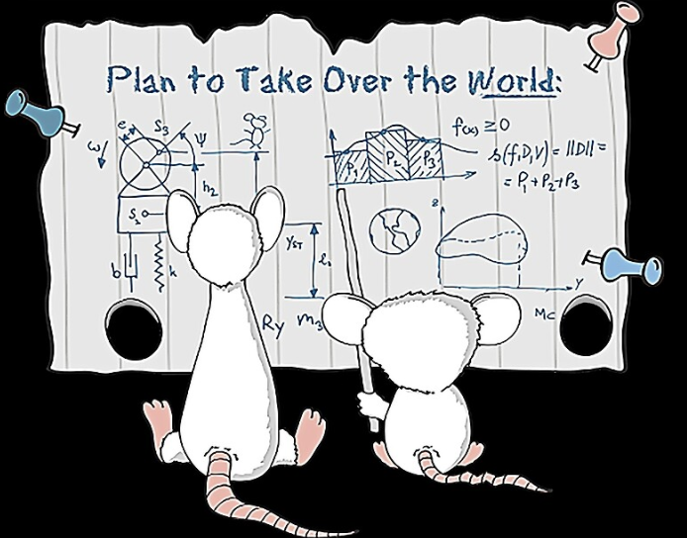
Notes:
Stephen Spielberg, in the mid 90’s produced an animated television series called Pinky and the Brain.
The TV show is about two mice. In each episode, Brain, the smart one, devises an elaborate plan to take over the world which ultimately ends in failure. However at the end of the each episode Pinky asks, Why, Brain? What are we going to do tomorrow night?
Brain answers “The same thing we do every night, - try to take over the world!
Brain always had best laid plans, they just never seemed to work out.

Slide 3

GOOD NE WS
ON THE MO VE
God’s work through the early church in
Acts
Notes:
As we are moving through our series on the Book of Acts called Good News on the Move, we have seen God’s Plan for growing the church.

Slide 4

Jerusalem Church Growth
Disciples
Increasing
Acts 6:1
Persecution
5000
Acts 4:4
Pentecost
3000
Acts 2:41
Notes:
In Acts chapter 2, we see God’s plan for growing the church following Peter’s speech at Pentecost, where about 3,000 believed, were baptized, and added to the church that day.
In Acts chapter 4, we see God’s plan for growing the church after Peter and John were arrested, where the number of just men alone was about 5,000.
In Acts chapter 6, we see God’s plan for growing the church with the believers rapidly multiplying. Thus making it necessary to choose additional leaders to help the apostles.

Slide 5

Opposition
External
Internal
Acts 4 - Arrested
Acts 5 - Arrested
Acts 7 - Stoned
Acts 8 - Persecution
Notes:
But with church growth comes opposition.
God’s plan is for the church to grow. The enemies’ plans involve both external and internal opposition to the church and gospel message.
In Acts chapter 4, we see external opposition to the church when Peter and John are arrested . . . for proclaiming the Gospel.
In Acts chapter 5, we see external opposition to the church when Peter and John are arrested again . . . for continuing to proclaim the Gospel.
In Acts chapter 7, we see external opposition to the church when Stephen is brought before the council and eventually stoned . . . For proclaiming the Gospel.
And at the beginning of Acts chapter 8, where we finished up last week, we saw external opposition to the church in the form of intense persecution, being lead by Saul

Slide 6
Opposition
External
Internal
Acts 4 - Arrested
Acts 5 - Ananias/Sapphira
Acts 5 - Arrested
Acts 7 - Stoned
Acts 6 - Greek / Hebrew
widows
Acts 8 - Persecution
Notes:
The enemies’ plans not only involve external opposition. The enemy stirs up internal disputes within the church
In Acts ch 5, the enemy stirred Ananias and Sapphira to not commit to fully serving God and then to lie about it.
In Acts ch 6, the enemy stirred up strife between the Greek speaking and Hebrew speaking widows.
The enemy is always looking for a foothold to stir up strife within the church.

Slide 7
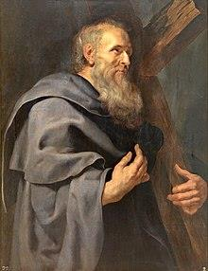
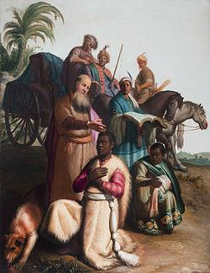

Acts 8:4-40
Philip the Apostle
Philip the Evangelist
Notes:
Today we are in Acts chapter 8. We looked at verses 1-3 last week. This week we will look at the remaining verses in chapter 8, vs 4-40.
So go ahead and open up your Bibles, or go to your apps, and turn to or click on Acts ch 8.
The story we are going to read today is about Philip. Not Philip, one of the 12 apostles, but Philip the Evangelist.

Slide 8
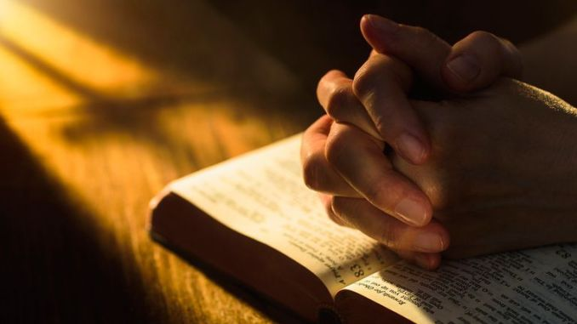
Acts ch 6
Acts ch 8
Philip the Evangelist
Stephen
Philip
Procorus
Nicanor
Timon
Parmenas
Nicolas from Antioch, a convert to Judaism
. . . seven men who are well respected and are full of the Spirit and wisdom. (Acts 6:3)
Notes:
Philip the Evangelist, the Philip in Acts ch 8, was one of the seven men who were selected in Acts ch 6 because they were well respected and full of the Spirit and wisdom.
They were needed because the church was growing and there was conflict between the Hebrew and Greek believers.
Last week we read about Stephen, the first on the list of seven. Today we are going to read 2 stories about Philip the Evangelist, the second person on the list from chapter 6.
Although we are reading a story about Philip the Evangelist, the overall theme of the text is fulfillment of God’s plan. So pay close attention to the people we read about today and see how they participated in God’s plan.

Slide 9
Opposition Overcome
⁴ But the believers who were scattered preached the Good News about Jesus wherever they went.
⁵ Philip, for example, went to the city of Samaria
Notes:
The first group of people we see participating in God’s plan are “the believers” Verse 4 tells us Read vs 4
Even though the church was facing external opposition in the form of Saul and his persecution, this opposition was overcome because the believers participated in God’s plan.
Verse 4 is the introduction to the story, now we focus on one particular believer, Philip. We read in verse 5 that Read vs 5
I have 2 key points to make about Philip going to Samaria.

Slide 10
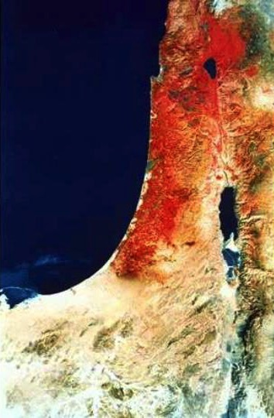
“ends of the earth"
Acts 1:8 NLT
"But you will receive power when the Holy Spirit comes upon you. And you will be my witnesses, telling people about me everywhere—in Jerusalem, throughout Judea, in Samaria, and to the ends of the earth.”
Samaria
Jerusalem
Judea
Notes:
First key point takes us back to Acts 1:8.
Jesus told his disciples that “they will receive power when the Holy Spirit comes upon them. And they will be his witnesses, and they will tell people about Jesus everywhere—in Jerusalem, throughout Judea, in Samaria, and to the ends of the earth.”
Luke, the author of acts is making a point that the disciples are fulfilling the statement of Acts 1:8. Because up until now, the gospel pretty much remained in Jerusalem.
It took Saul’s persecution in Acts 8:1 to cause the disciples and the church to participate in God’s plan given in Acts 1:8

Slide 11
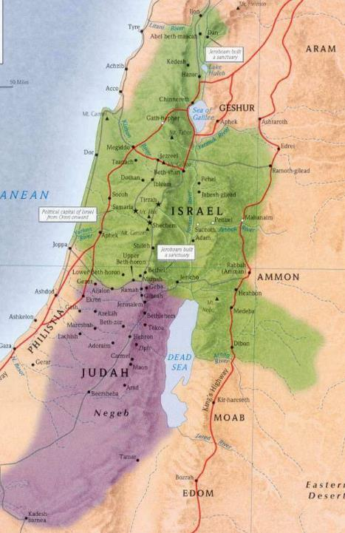
1 Kings 12
Samaria
Jerusalem
Judea
During Roman Empire
1 Kings 12
Notes:
The second key point goes a bit further back, about 900 years. There was animosity between the Jews and the Samaritans. Its roots can be traced back to 1 Kings ch 12.
The Kingdom has been split.
Samaria is associated with the Northern Kingdom, called Israel, whereas Judea is associated with Southern Kingdom, called Judah.

Slide 12
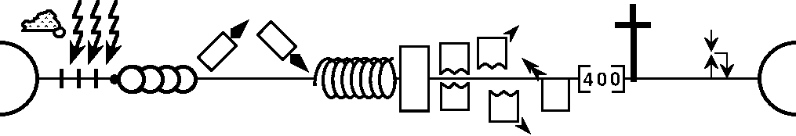
Timeline of History
J (B) & I (A)
J (R) & I (J)
S • D • S
Z • E • N
United Kingdom
Divided Kingdom
Restoration
Max Anders, Dallas Theological Seminary
Notes:
This diagram shows a timeline of the entire history of the world from creation in Genesis ch 1 to the new heavens and new earth in Revelation ch 22 from a Biblical perspective.
It is helpful when reading Old Testament stories, or New Testament references to the Old Testament to be able to put them into a historical context. This simple timeline helps with that.
The Reason for animosity between the Jews and the Samaritans goes back to the period following the United Kingdom under Saul, then David, and finally Solomon.
Upon Solomon’s death, the Kingdom split, with Solomon’s son, Rehoboam ruling in Judah, the southern Kingdom, and Jeroboam ruling in Israel, the Northern Kingdom.
Because of disobedience to God’s word, both Kingdoms were eventually exiled from the land, first Israel, the Northern, Kingdom was exiled by the Assyrians, then Judah, the Southern Kingdom was exiled by the Babylonians. The Babylonians were defeated by the Persians, and King Cyrus decreed the return of the exiled Jews from Babylon. This is the restoration and was led first by Zerubbabel, then Ezra, then Nehemiah.
During the exile, the land was not empty. Not everyone was taken away. And some non Jewish people moved in, but mostly in the northern Kingdom. There was intermarriage between the Jews and the non-Jewish people that moved in, and these eventually became the Samaritans.
So when the Jews returned from exile, they looked down upon those who had intermarried.

Slide 13
³ So he left Judea and returned to Galilee.
⁴ He had to go through Samaria on the way.
John 4:3-4 (NLT)
Samaria
Jerusalem
Notes:
That animosity between the Jews and Samaritans was present during Jesus’ time.
Jesus spent quite a bit of time around the Sea of Galilee. John 4 tells us that when he returned to Galilee he went through Samaria.
Many commentaries will tell you that was not the preferred route. Instead most Jews would cross over to the Jordan river valley, and then go up, which took a bit longer, but avoided going through Samaria.

Slide 14
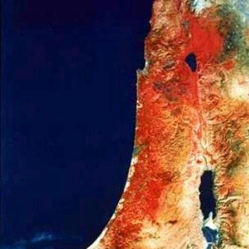
²⁵ a woman . . . begged him to cast out the demon from her daughter.
²⁷ Jesus told her, “First I should feed the children—my own family, the Jews. It isn’t right to take food from the children and throw it to the dogs.”
Samaria
²⁸ She replied, “That’s true, Lord, but even the dogs under the table are allowed to eat the scraps from the children’s plates.”
Mark 7:25-30
Notes:
There is a story in Mark chapter 7 / Matthew ch 15, about Jesus when he was near Tyre and Sidon, which is in Samaria
I am not going to explain this passage, but just want to show you the animosity between Jews and Samaritans.
Jesus made a play on words, the woman even acknowledged this play on words. In the end her faith was acknowledged and daughter was healed,

Slide 15
Philip the Evangelist
Samaria
Samaria
Jerusalem
Acts 8:6-8
Crowds listened
=> Hear message
=> See Miraculous Signs
Notes:
This is the background from which Philip the Evangelist heeded God’s call and went to Samaria.
What happened when he went? Read vs 6-8
Crowds listened. They wanted to hear his message. They wanted to see miraculous signs.

Slide 16
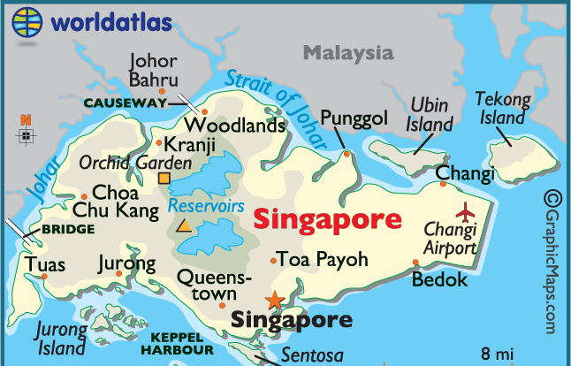
Crowds listened
People will listen
=> Hear message
=> See Miraculous Signs
=> Hear your story
=> See a Changed Life
Notes:
Just like Philip, you too can participate in God’s plan.
Jesus told his disciples to go to the ends of the earth. Well, if you are flying from the East Coast of the United States, Singapore is considered the ends of the earth. You can fly east or west, it takes about the same amount of time to get here.
Now that you are here in Singapore, people will listen. Just tell them your story. Your testimony. What had God done in your life. What were you like before you knew Jesus as your personal savior. What is your life like now.
Instead of miraculous signs, let people see a changed life in you. Nothing is more powerful of a testimony that that of a changed life. Let people see you participating in God’s plan.

Slide 17
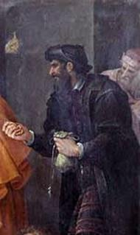
Simon Magus
Sorcerer
Astounded people with his magic
People listened to him
Acts 8:9-11
Notes:
A new character is introduced in vs 9 to 11. His name is Simon. The text tells us that Read vs 9-11
So this new character is a sorcerer, he astounded people with his magic, the people listened to him. Is Simon going to be a problem? Will the enemy use Simon to mount some external opposition to the church?

Slide 18
Simon the Sorcerer
Philip the Evangelist
vs
Acts 8:12-13
Notes:
Vs 12 tells us that Read vs 12
The people are no longer listening to Simon, instead they listen to Philip.
But guess what, Read vs 13

Slide 19

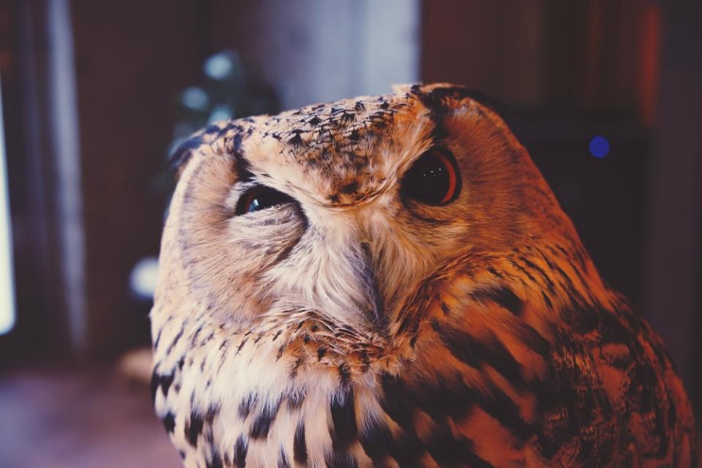
CURIOSITY
Acts 8:14-17
Notes:
The overall theme of our text today is seeing the fulfillment of God’s plan.
Participating in God’s plan, Phillip went to Samaria, the crowds listened, they believed and were baptized. The apostles were curious. Read vs 14-17
Why had the Holy Spirit not come upon the Samaritans?

Slide 20

CURIOSITY
Jews (Acts 2) | Samaritans (Acts 8)
Repented | Believed
Were baptized | Were baptized
 | Apostles prayed for / laid hands on
Received the Holy Spirit | Received the Holy Spirit
Prevent Internal Opposition
Notes:
In acts chapter 2, the Jews who repented were baptized and then received the Holy Spirit.
However, in Acts ch 8, after the Samaritans believed and were baptized, it was not until the Apostles, Peter and John came, that they received the Holy Spirit.
In both cases they were saved in the same way, by faith in the Lord Jesus Christ.
The reason for this one time unique event because it was part of God’s plan to prevent internal opposition with in the church.
As we already discussed, Jewish believers were likely to have animosity towards the Samaritans. By having Peter and John witness the Samaritans receiving the Holy Spirit, no one could doubt the truthfulness of their conversion.

Slide 21
4-8: Believers / Philip preaching
  9-11: Simon background
    12: Samaritans Believed
      13: Simon amazed by signs
        14-17: Samaritans received Holy Spirit
      18-19: Simon wants power
    20-23: Simon Rebuked
  24: Simon Repent
25: Apostles preaching
Notes:
A chiastic structure can often be used to help understand narrative or stories within the Bible. Usually the center of the chiasm is the climax of the story, or the main point.
So the center of this first story is the Samaritan’s receiving the Holy Spirit. God’s plan in action prevented the enemy from using the animosity between the Jewish believers and the Samaritans believers from causing internal opposition to the growth of the church.
The application is to simply participate in God’s plan. We see the Philip and the other believers participating by preaching the good news. You too can participate in God’s plan.
But what about Simon? Is Simon going to participate in God’s plan?

Slide 22

Simon the Sorcerer
13: Simon amazed by signs
  14-17: Samaritans received Holy Spirit
18-19: Simon wants power
Acts 8:18-19
Notes:
Reading vs 18-19 it appears Simon is not interested in God’s plan but only in Simon’s plan. For Read vs 18-19
We can understand Simon’s motive by simply going back to vs 13, where it says Simon was amazed by the signs and great miracles he saw.
Simon saw the miracles, but did he hear the message? Did he hear the message about Jesus who came to die for our sins and make a way for us to be righteous before a Holy God? Did Simon know Jesus as his Savior?
Take this as a warning. How many people have a spiritual experience but never really hear the gospel message and never really know who Jesus is?
You want to know who Jesus is? Simply read the Bible.

Slide 23
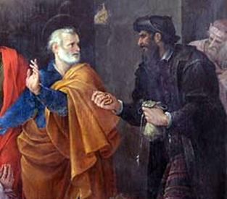
Peter's conflict with Simon Magus
Avanzino Nucci, 1620
Acts 8:20-23
Notes:
This painting by Avanzino Nucci shows us Peter’s response to Simon’s request: Read vs 20-23

Slide 24
Simon the Sorcerer
Did Simon Repent?
Lessons from Simon
Avoid worldly desires
Acknowledge Sin
Pray
Acts 8:24
Notes:
So how did Simon respond? Vs 24 tells us Read vs 24
You may be thinking, did Simon really repent? Did he mean what he said?
Most commentators say no. The artist also thinks no, which is why he is wearing black. But the more important takeaway is that Believers can be tempted with worldly desires. The apostle John calls them lust of the eyes, lust of the flesh and pride of life.
You can learn lessons from Simon. You need to avoid the worldly desires. But when you succumb to them, acknowledge your sin and pray.

Slide 25
4-8: Believers / Philip preaching
  9-11: Simon background
    12: Samaritans Believed
      13: Simon amazed by signs
        14-17: Samaritans received Holy Spirit
      18-19: Simon wants power
    20-23: Simon Rebuked
  24: Simon Repent
25: Apostles preaching
Acts 8:25
Notes:
This first story ends the way it began. Read vs 25
Believers, including Peter, and John are participating in God’s plan by preaching the word of God.

Slide 26
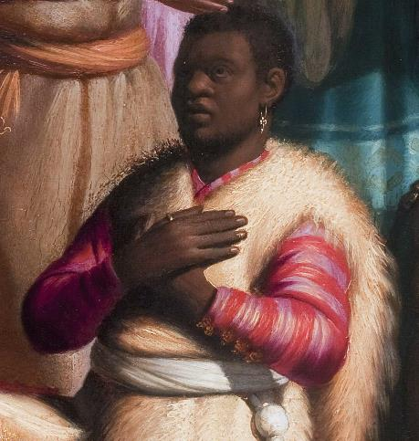
Acts ch 8
vs 25-40
Ethiopian eunuch
Notes:
the overall theme of the second story found in vs 25 to 40 is also the fulfillment of God’s plans.
This story involves Philip and an Ethiopian Eunuch.

Slide 27

Philip
Spirit says go => Philip went
Ethiopian
Prominent position / carriage
Seeking God / Reading
Excluded from temple (Deut 23:1)
Acts 8:26-28
Notes:
Read vs 26-28 A lot of information is packed into these 2 verses.
For Philip it shows him participating in God’s plan. The Spirit said go, so Philip went.
More information is given about the Ethiopian. He is of a prominent position, the treasurer for the queen. And he is travelling in a carriage.
He was seeking God. He had travelled over 2,400 km to worship at the temple. He was reading scriptures.
He was excluded from temple worship because he was a Eunuch. He could not fully participate. Deuteronomy 23:1 (. . . may not be admitted to the assembly of the Lord)

Slide 28
Strategies to first rate reading
Read Thoughtfully
Read Repeatedly
Read Patiently
Read Prayerfully
Read Purposefully
Entire Book
Start at beginning
Different Translation
Listen
Read out loud
Hendricks H. & Hendricks W., Living by the Book
Notes:
Please note that the Ethiopian Eunuch was reading the scriptures aloud.
In our small group we have been reviewing lessons on how to study the Bible.
In the section on reading Repeatedly, we are told to read an entire book of scripture, start at the beginning, use different translations, listen to an audio version, and finally to read out loud.
The Ethiopian Eunuch is employing the strategy of reading out loud to assist in his study of the word.

Slide 29
How can I understand?
Acts 8:29-31
Notes:
Looking at vs 29-31 we see that Read vs 29-31
Here is another picture of obedience, of Philip participating in God’s plan. The Holy spirit says go over and by that carriage, so Philip goes and walk by the carriage.
Imagine his surprise when he hears this foreigner reading from the Prophet Isaiah. So he asks do you understand and the Ethiopian responds “How can I understand”
How can I understand is a fair question for the Ethiopian Eunuch to ask. Today we may ask the same question. How do I understand a difficult passage?

Slide 30
The Bible is a unified story that leads to
JESUS
Acts 8:32-33
Notes:
One thing to remember is that the Bible is a unified story that leads to Jesus. This is especially true of the passage from Isaiah. Read vs 32-34

Slide 31
Philip and Eunuch
Asked questions
=> Heard Good News
If someone asks about your hope as a believer, always be ready to explain it. (1 Peter 3:15 NLT)
Acts 8:34-35
Notes:
That is a difficult passage to understand. One method of Bible study is to ask questions of the text. That is what the Ethiopian does. Read vs 34-35
Philip answers rightly that the text in question is about Jesus and then shares the gospel message with the Ethiopian Eunuch.
We mentioned earlier that Philip was one of seven men commissioned in Acts ch 6 because they were well respected and full of the Spirit and wisdom.
But 1 Peter 3:15 shows us that we don’t need to be specially commissioned like Philip and Stephen, to explain our hope as a believer. Peter writes that if …

Slide 32
Philip and Samaritans
Philip and Eunuch
Crowds listened
Asked questions
=> Hear message
=> See Miraculous Signs
=> Believed
=> Were Baptized
=> Heard Good News
=> Why can’t I . . .
=> Was Baptized
Acts 8:36-38
Notes:
So now the Ethiopian Eunuch heard the Good News, what was his response? Is he going to participate in God’s plan? Read vs 36-38
Now lets compare the Ethiopian Eunuch with the Samaritans.
The Samaritan crowd listened, the Ethiopian not only listened but was asking questions.
They both heard the good news. But the Ethiopian did not need to see miraculous signs.
The Samaritans believed and were baptized. The Ethiopian was also baptized. But why did he ask the question “why can’t I get baptized?
Remember, he was not allowed to enter and participate in temple worship. He was ceremonially impure. But he understood the good news that because of Jesus, everyone can become pure, everyone can participate in Baptism.
What do you have to believe in order to get baptized?

Slide 33
Footnote
Some manuscripts add verse 37, “You can,” Philip answered, “if you believe with all your heart.” And the eunuch replied, “I believe that Jesus Christ is the Son of God.”
Acts 8:37
Notes:
The answer can be found in vs 37.

Slide 34
4-8: Believers / Philip preaching
  9-11: Simon background
    12: Samaritans Believed
      13: Simon amazed by signs
        14-17: Samaritans received Holy Spirit
      18-19: Simon wants power
    20-23: Simon Rebuked
  24: Simon Repent
25: Apostles preaching
40: Philip Preaching
Acts 8:25
Notes:
This second story also ends the same way the first story began and ended. Read vs 39-40.
The overall theme of these 2 stories is fulfillment of God’s plan. You can also call it God’s plan in action.

Slide 35

Acts ch 8
vs 4-40
Ethiopian eunuch
Simon the Sorcerer
vs
Notes:
We see God’s plan in action when we comparing the Ethiopian Eunuch with Simon the Sorcerer
The diligence with which the eunuch pursued his reading,
the earnestness with which he inquired of Philip,
and the promptness with which he asked for baptism –
all testify to the lofty nature of his character and demonstrate God’s plan in action.

Slide 36

God’s Providence
Notes:
God’s plan in action can also be called God’s Providence.
John Piper has a podcast about God’s providence, in which concludes that a good summary of God’s providence: wise and purposeful sovereignty.
But the wonderful news is that you can be a part of God’s providence. You can participate in God’s plan.
If you are not yet a believer, follow the example of the Ethiopian Eunuch, simply believe with all your heart that Jesus Christ is the Son of God. If you have done that, ask to follow through with Baptism.
If you are already a believer, follow the example of Philip. Avoid the temptations that Simon the sorcerer gave into. Philip followed the guidance of the Holy Spirit. When we follow the guidance of the Holy Spirit, we can avoid the worldly temptations, the lust of the eyes, lust of the flesh, and pride of life.

