Slide 1
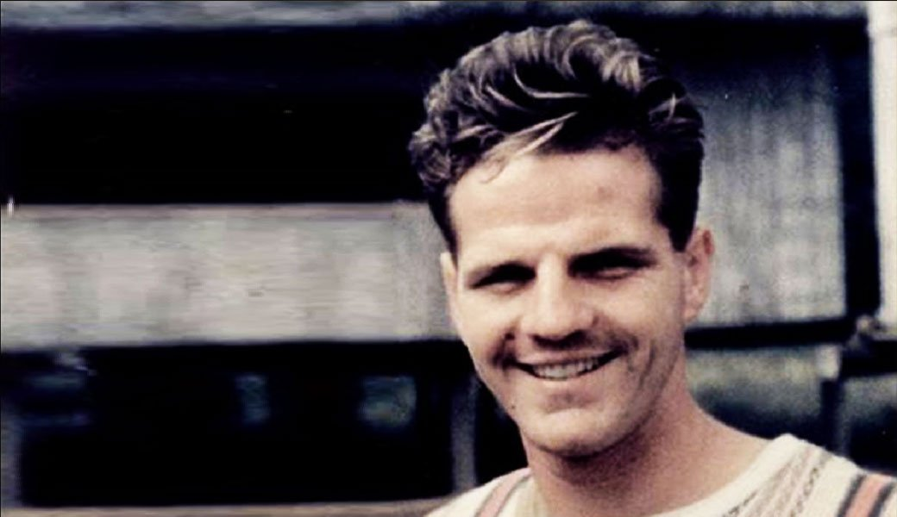
Jim Elliot

Slide 2
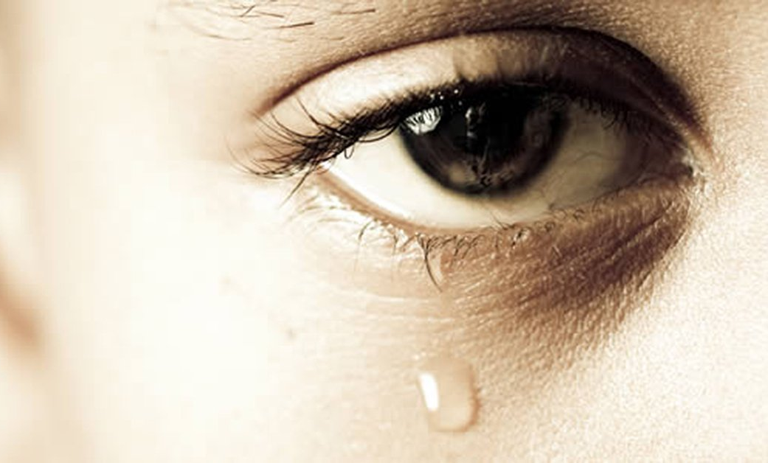
The Sovereignty of God in Suffering
Acts 6:8-8:3

Slide 3
GOOD NE WS
ON THE MO VE
God’s work through the early church in
Acts

Slide 4
Opposition & Response
External
Internal

Slide 5
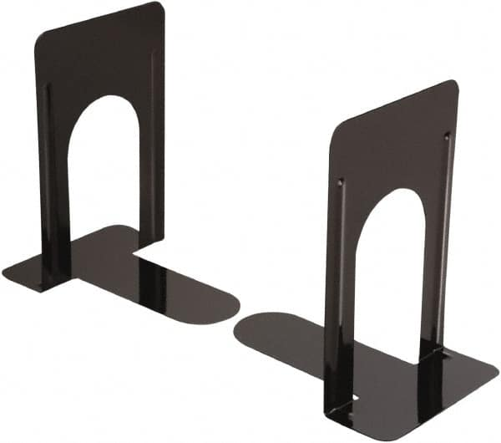
Stephen
Saul

Slide 6
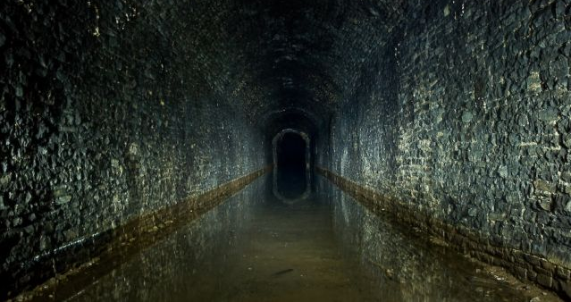
The Suffering
(Acts 6:9-7:60)

Slide 7
John 15:20
Remember the word that I said to you: ‘A servant is not greater than his master.’ If they persecuted me, they will also persecute you. . .
2 Timothy 3:12
Indeed, all who desire to live a godly life in Christ Jesus will be persecuted,

Slide 8
Level 1 suffering: Disputes about the Bible (6:9-10)
Level 2 suffering: Public false accusation (6:8-7:1)
Level 3 suffering: Rejection of confrontation of sin (7:2-53)
Abraham obeyed God (vs. 2-8)
Jacob and Joseph obeyed God (vs. 9-16)
Moses obeyed God but was rejected (vs. 17-44)
Joshua, David, & Solomon obeyed God (vs. 45-50)
Jewish leaders do not obey God (vs. 51-53)

Slide 9
“stiff-necked”
(Exod 32:9; 33:3, 5; 34:9; Deut 9:6, 13)
“uncircumcised in heart and ears”
(Lev 26:41; Jer 4:4; 6:10; 9:26; Ezek 44:7,9)
“resist the Holy Spirit”
(Isa 63:10)

Slide 10
Comparison
Exodus 1-20 = action & divine deliverance
Exodus 21-31, 34-40 = instruction in the Law & God’s presence
Exodus 32-34 = rebellion against Moses & God’s presence
Acts 1-6 = action & divine deliverance
Acts 7 = instruction in the Law & God’s presence
Acts 7-8 = rebellion against Moses & God’s presence

Slide 11
Comparison
Jesus = judged by Jewish religious leaders; predicts being seated by God’s right hand; sentenced to die; offers forgiveness; commits spirit into God’s hand
Stephen = judged by Jewish religious leaders; sees Jesus seated by God’s right hand; sentenced to die; offers forgiveness; commits spirit into God’s hand

Slide 12
Level 1 suffering: Disputes about the Bible (6:9-10)
Level 2 suffering: Public false accusation (6:8-7:1)
Level 3 suffering: Rejection of confrontation of sin (7:2-53)
Level 4 suffering: Physical assault (7:54-60)

Slide 13
The Sovereignty of God
(Acts 8:1-3)

