Slide 1
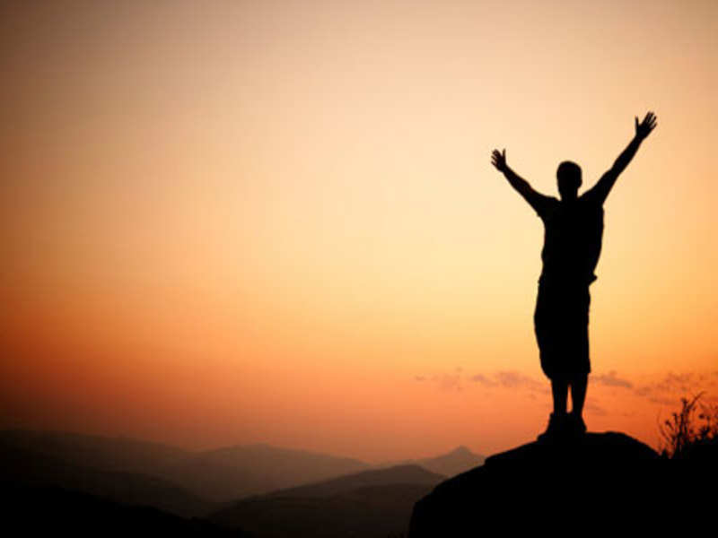
Why God Does Amazing Things
Acts 3
Dr. Rick Griffith • Crossroads International Church Singapore CICFamily.com • BibleStudyDownloads.org

Slide 2
Acts 3:1-10 Video

Slide 3
What’s the point of this story?
• How to heal?
• Be kind?
• Identify with the beggar?

Slide 4
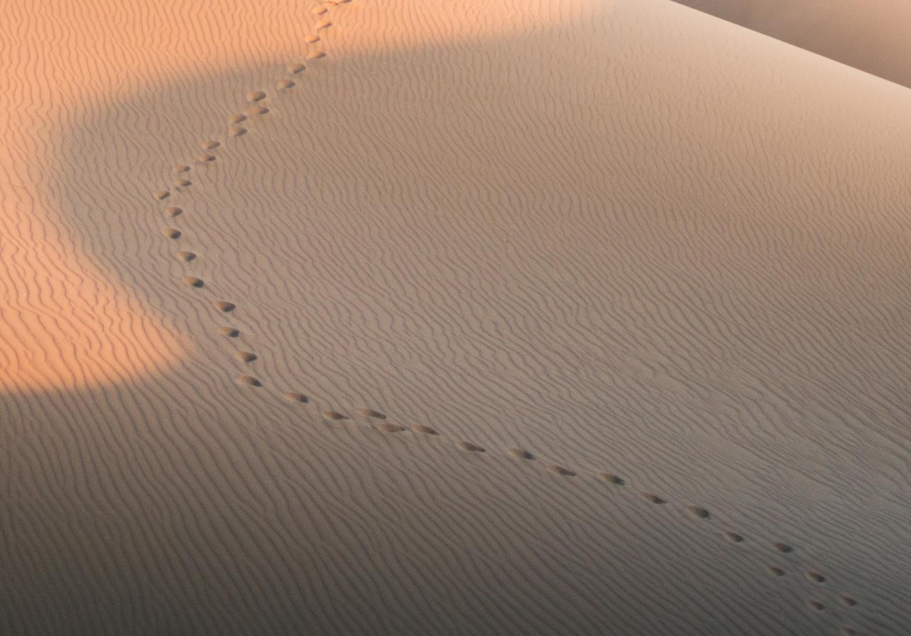
GOOD NE WS
ON THE MO VE
God’s work through the early church in
Acts

Slide 5
What’s the point of this story?
Notes:
What is the point of God doing this healing miracle—or any miracle?
What is the purpose for the account of the cripple?

Slide 6
Why does God do amazing things?

Slide 7
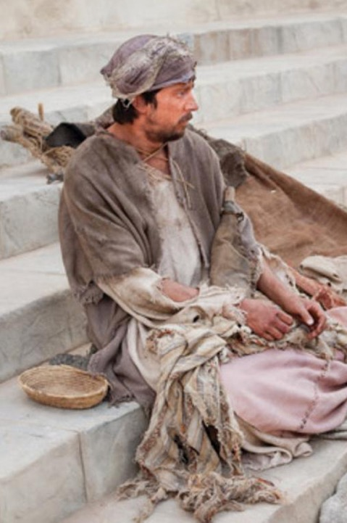
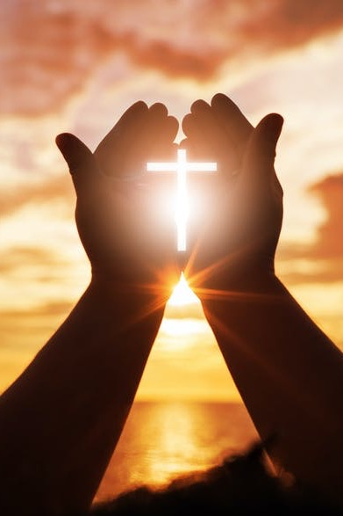
Where we’re headed in Acts 3…
Lame Man
Us

Slide 8
The name of Jesus

Slide 9
Herod’s Temple
Holy Place
Priest Courtyard
Women's Courtyard
Gentile Courtyard
Gentile Courtyard
Notes:
Copyright 2017 Faithlife / Logos Bible Software
Logos User

Slide 10
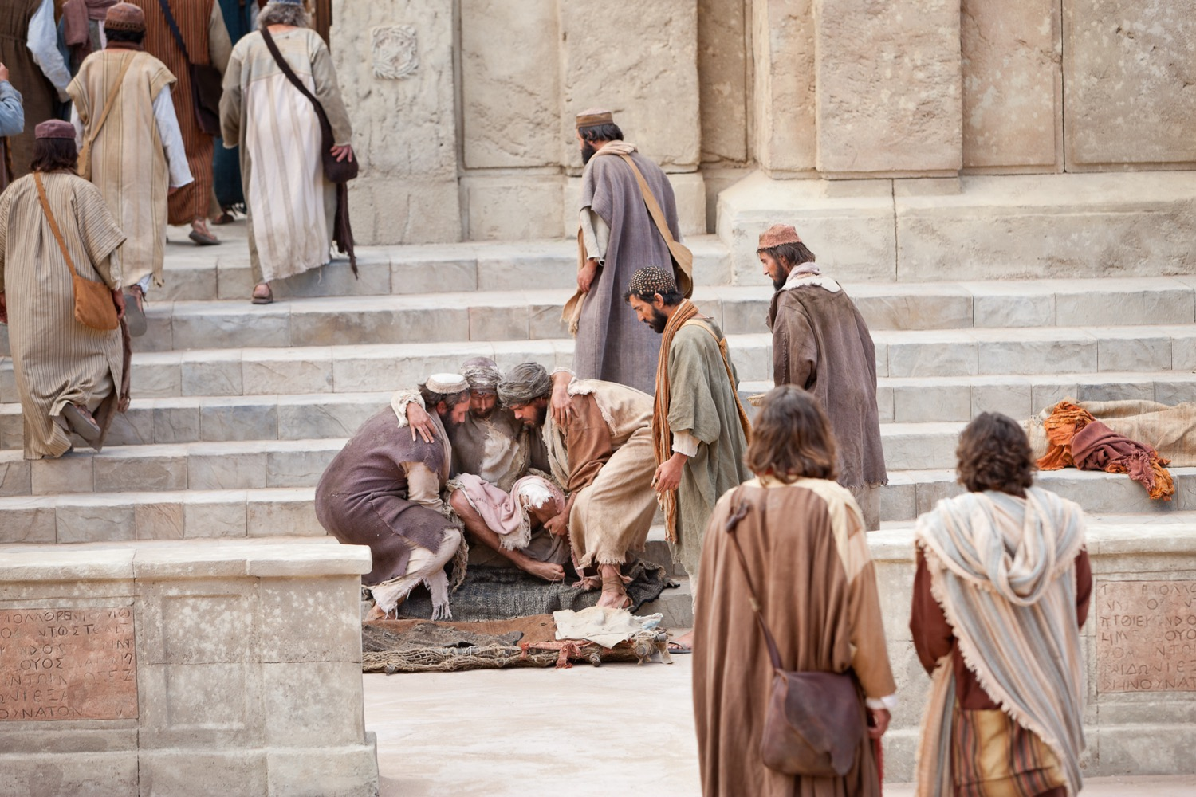
"As they approached the Temple, a man lame from birth was being carried in. Each day he was put beside the Temple gate, the one called the Beautiful Gate, so he could beg from the people going into the Temple" (Acts 3:2 NLT).

Slide 11
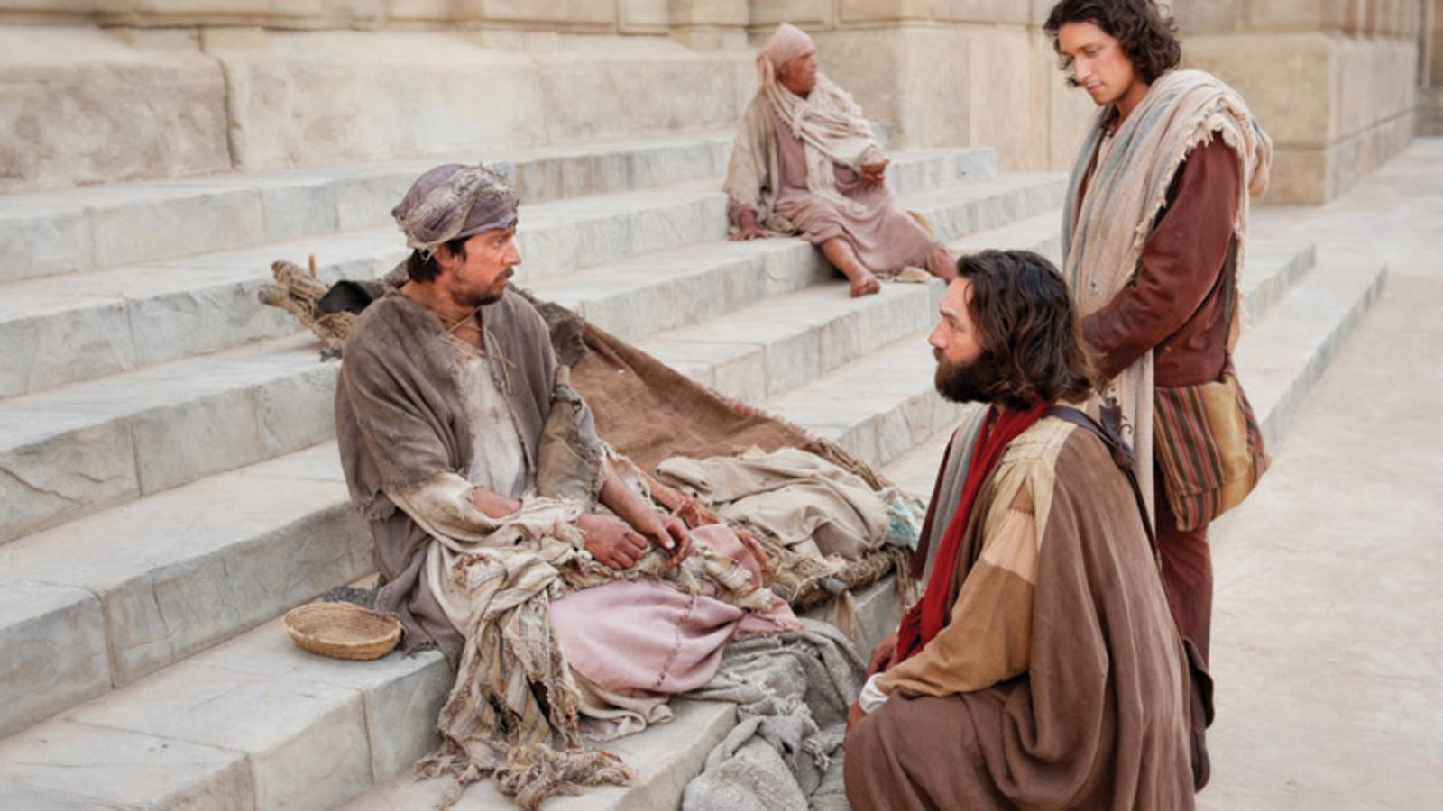
"Peter and John looked at him intently, and Peter said, ‘Look at us!’ ⁵ The lame man looked at them eagerly, expecting some money. ⁶ But Peter said, ‘I don’t have any silver or gold for you. But I’ll give you what I have. In the name of Jesus Christ the Nazarene, get up and walk!’" (Acts 3:4–6 NLT).

Slide 12
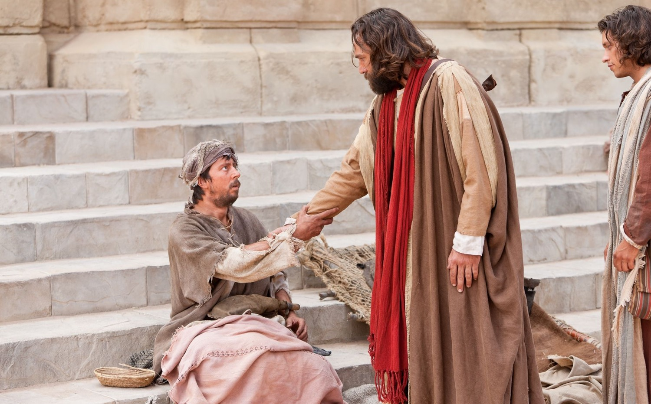
"Then Peter took the lame man by the right hand and helped him up" (Acts 3:7a NLT).

Slide 13
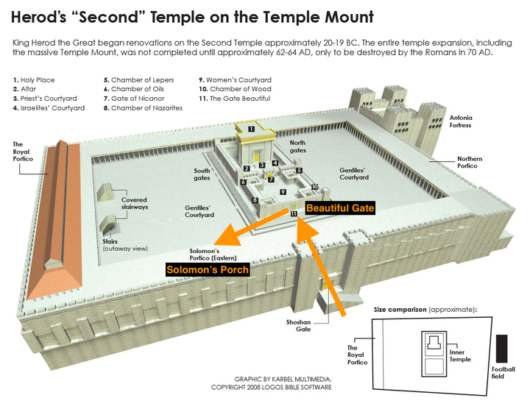
Herod’s Temple Complex
Beautiful Gate
(Acts 3:2, 10)
Solomon’s Colonnade
(Acts 3:11)
Notes:
Copyright 2017 Faithlife / Logos Bible Software
Logos User

Slide 14
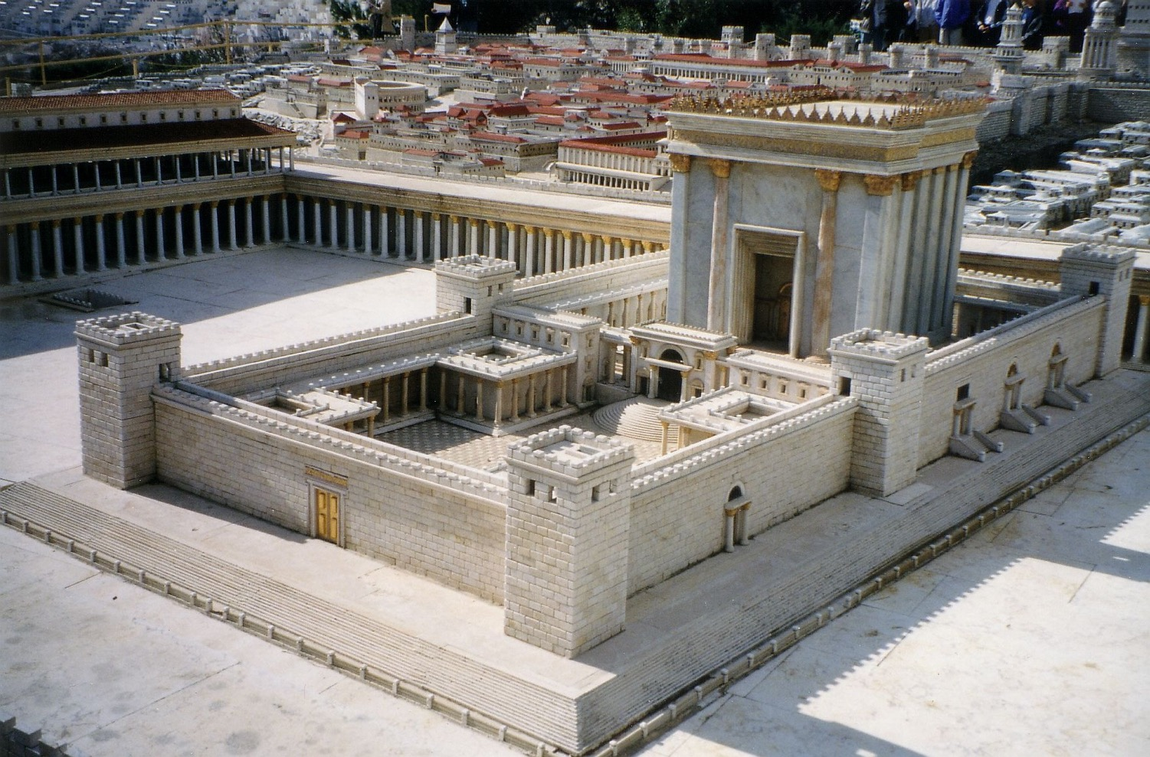
The Gate Beautiful
Notes:
Source: https://commons.wikimedia.org/wiki/File:Jerus-n4i.jpg
Juan R. Cuadra
Juan R. Cuadra (own work) / Public Domain
Public Domain

Slide 15
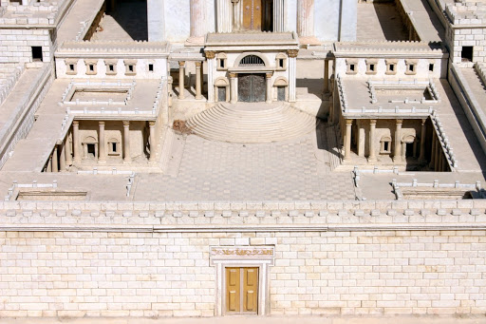
The Gate Beautiful
Notes:
Holy Land Photos

Slide 16
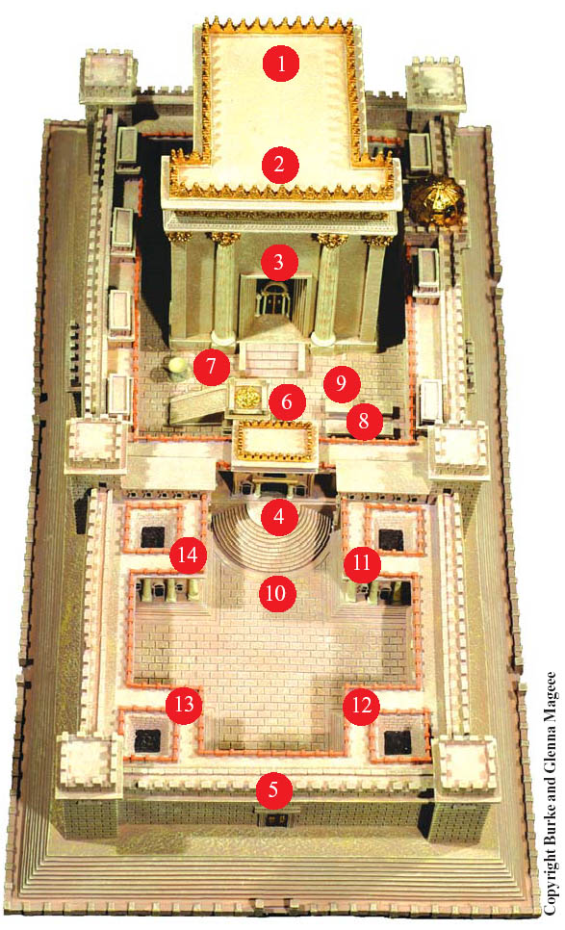
Temple Gates
Nicanor
Beautiful
Notes:
Copyright 2017 Faithlife / Logos Bible Software
Logos User

Slide 17
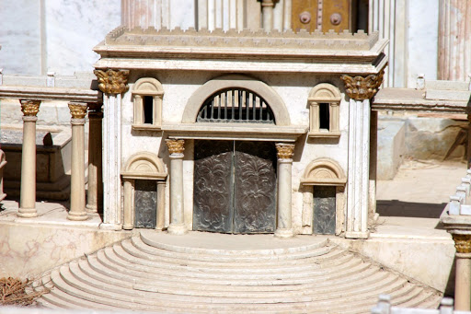
Nicanor Gate

Slide 18
Herod’s Temple Complex
Beautiful Gate
(Acts 3:2, 10)
Solomon’s Colonnade
(Acts 3:11)
Notes:
Copyright 2017 Faithlife / Logos Bible Software
Logos User

Slide 19
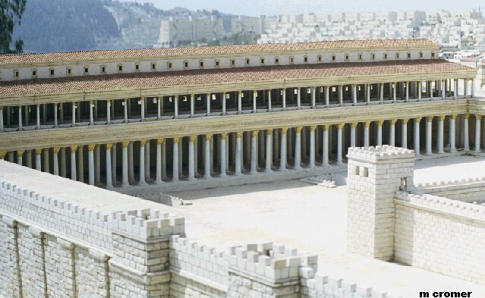
Solomon’s Colonnade (Acts 3:11)

Slide 20
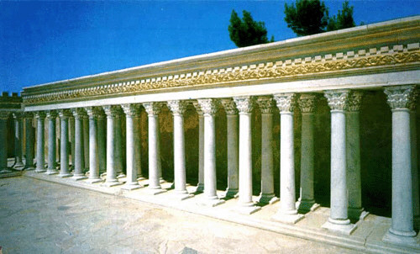
Solomon’s Colonnade (Acts 3:11)

Slide 21
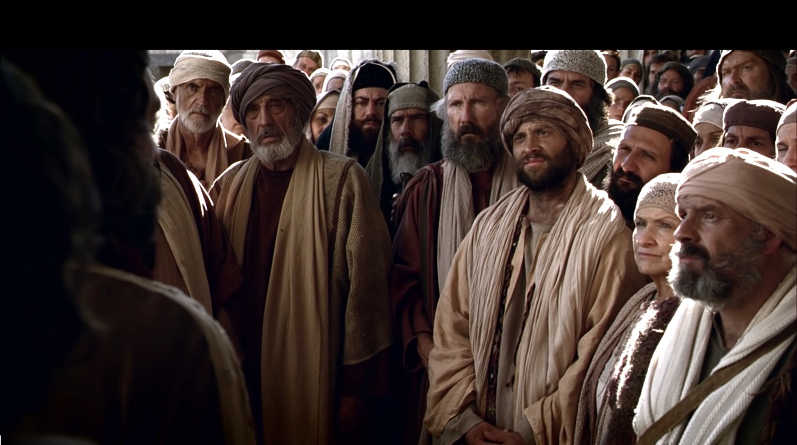
"When they realized he was the lame beggar they had seen so often at the Beautiful Gate, they were absolutely astounded!" (Acts 3:10 NLT).
The healing comprises only 10 verses

Slide 22
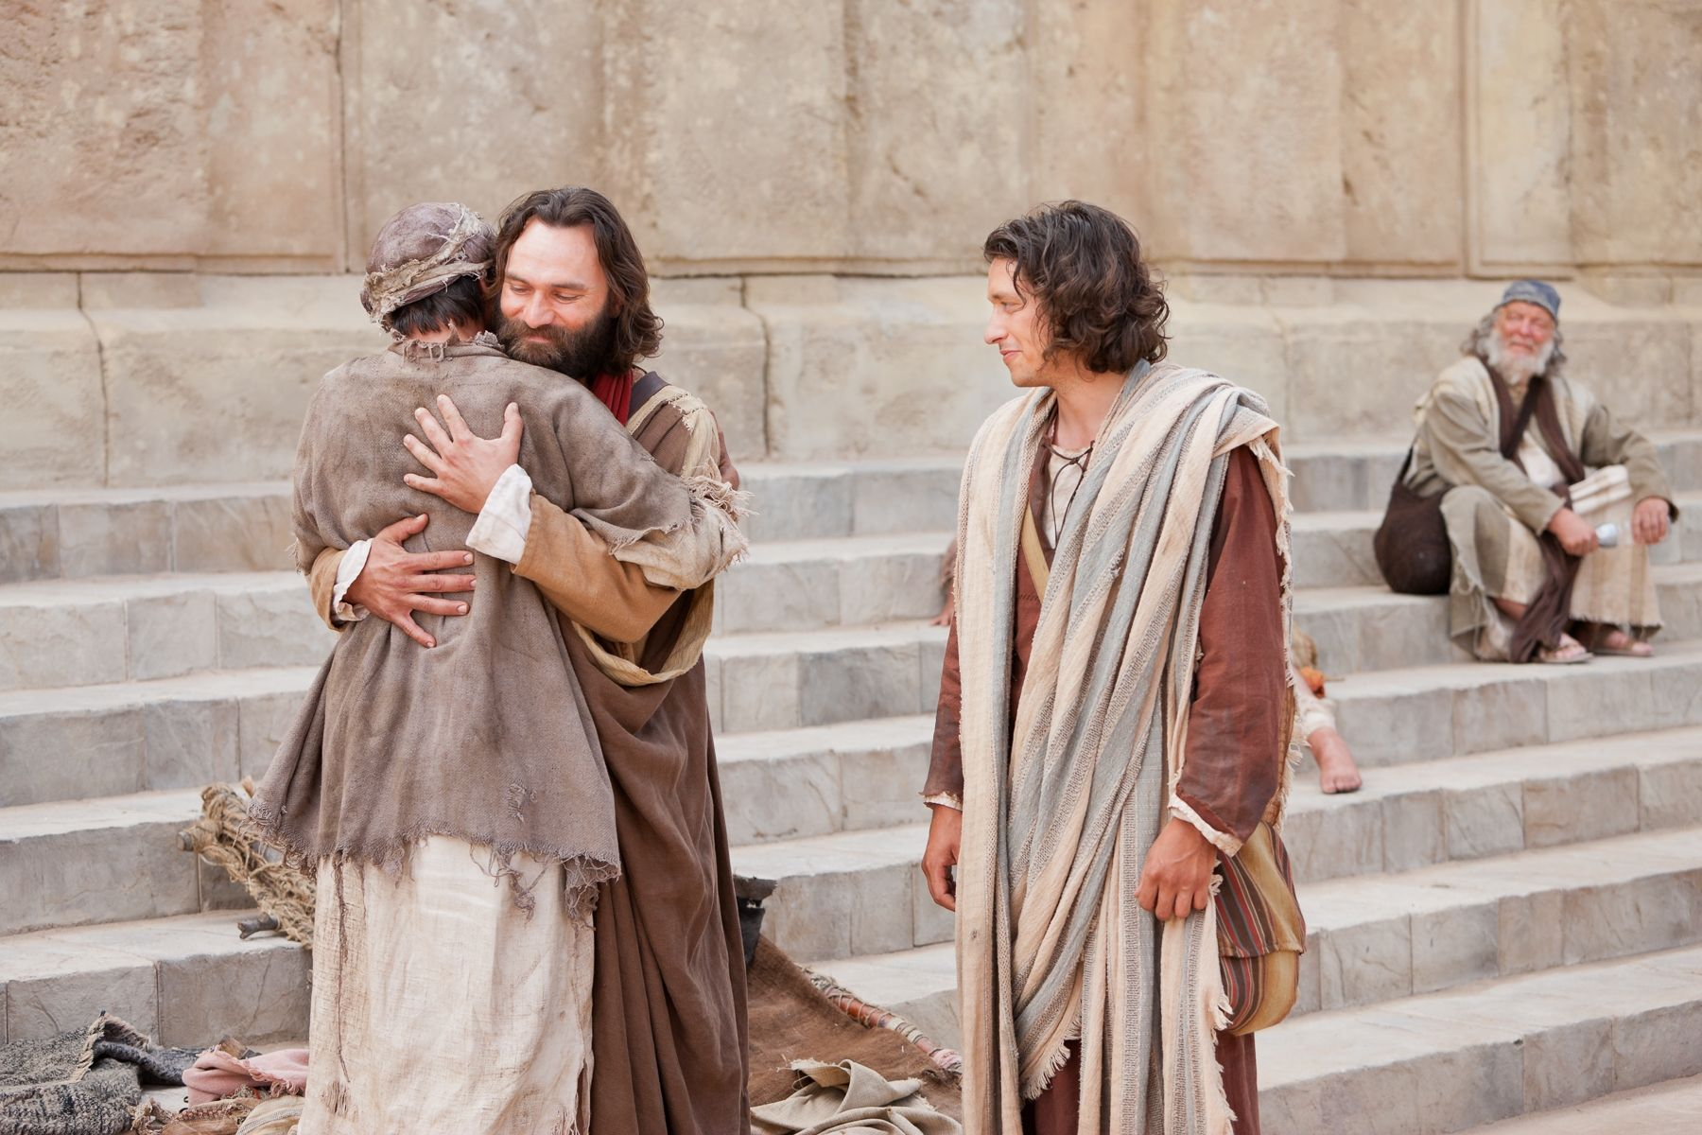
"They all rushed out in amazement to Solomon’s Colonnade, where the man was holding tightly to Peter and John" (Acts 3:11 NLT).

Slide 23
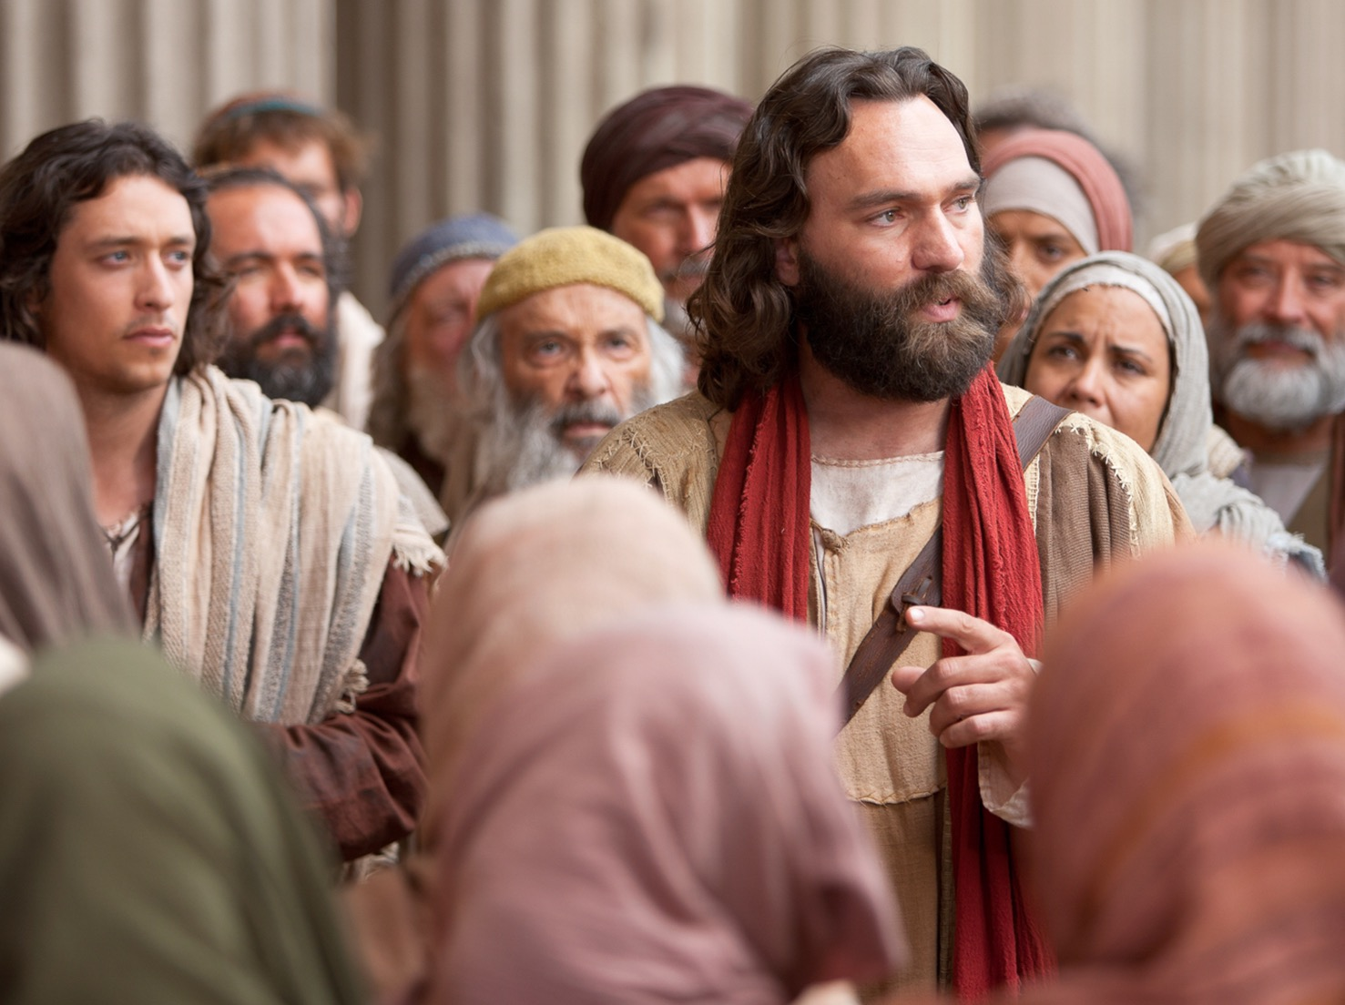
"Peter saw his opportunity and addressed the crowd. ‘People of Israel,’ he said, ‘what is so surprising about this? And why stare at us as though we had made this man walk by our own power or godliness?’" (Acts 3:12 NLT).

Slide 24
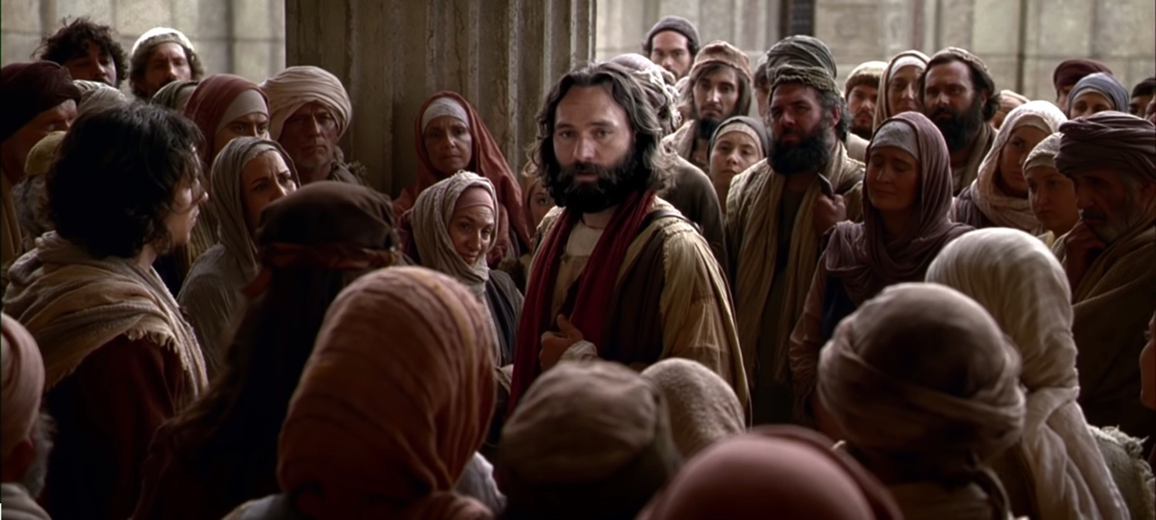
"For it is the God of Abraham, Isaac, and Jacob—the God of all our ancestors—who has brought glory to his servant Jesus by doing this. This is the same Jesus whom you handed over and rejected before Pilate, despite Pilate’s decision to release him" (Acts 3:13 NLT).

Slide 25
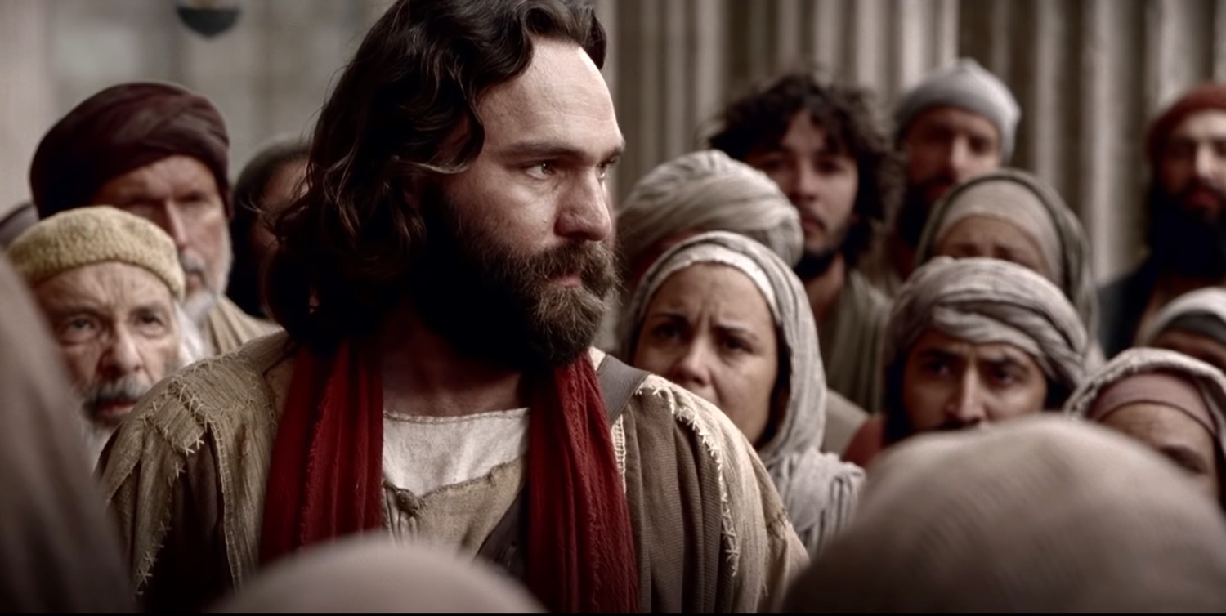
"You rejected this holy, righteous one and instead demanded the release of a murderer. ¹⁵ You killed the author of life, but God raised him from the dead. And we are witnesses of this fact!" (Acts 3:14-15 NLT).

Slide 26
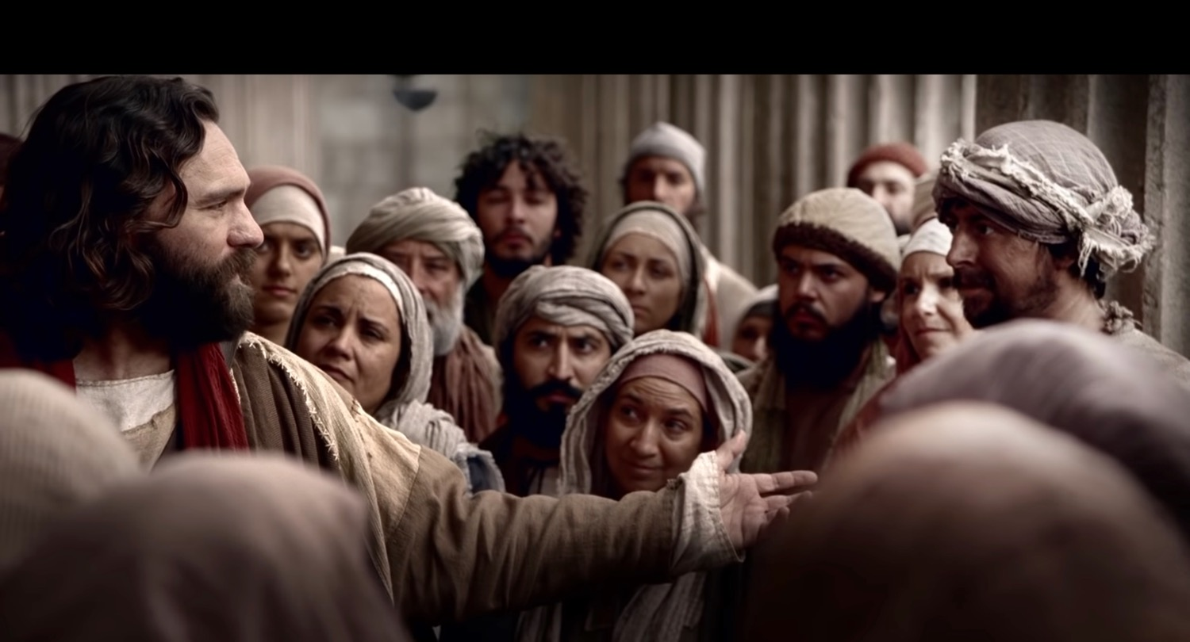
"Through faith in the name of Jesus, this man was healed—and you know how crippled he was before. Faith in Jesus’ name has healed him before your very eyes" (Acts 3:16 NLT).
Notes:
Does Peter mean that the beggar trusted Christ—or was the faith that of Peter (16)?
“The crippled man’s healing came because of his faith in the name of Jesus. Faith was also evident in many of those whom Jesus healed (e.g., Mark 5:34; 10:52; Luke 17:19).” (Toussaint, BKC, 2:361).

Slide 27
The name of Jesus
Israel
sanctuary
Notes:
“In Bible times a person’s name represented him and his characteristics. In Acts, Luke spoke of “the name” (of Jesus) at least 33 times (cf. Acts 2:21, 38; 3:6, 16; 4:7, 10, 12, 17–18; 5:28, 40–41; etc.).”
———————
Stanley D. Toussaint, “Acts,” in The Bible Knowledge Commentary: An Exposition of the Scriptures, ed. J. F. Walvoord and R. B. Zuck, vol. 2 (Wheaton, IL: Victor Books, 1985), 361.

Slide 28
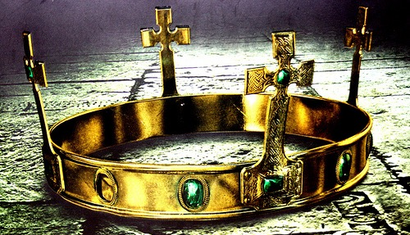
The people should accept Jesus as Israel’s promised king (Christ = Messiah) who will return to restore the kingdom after the nation believes (3:17-26).

Slide 29
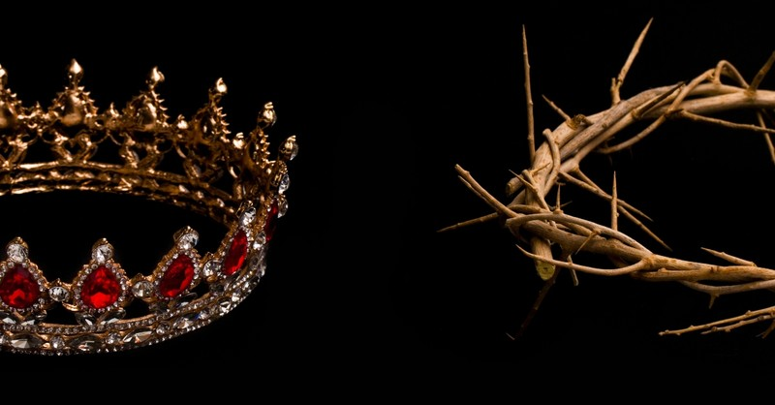
"Friends, I realize that what you and your leaders did to Jesus was done in ignorance. ¹⁸ But God was fulfilling what all the prophets had foretold about the Messiah—that he must suffer these things" (Acts 3:17-18 NLT).

Slide 30
"Now repent of your sins and turn to God, so that your sins may be wiped away. ²⁰ Then times of refreshment will come from the presence of the Lord, and he will again send you Jesus, your appointed Messiah" (Acts 3:19-20 NLT).
Notes:
What is the distinction between repenting and turning to God (19a)?
“First of all, they had to repent of their sins (see Acts 2:38; 5:31; 17:30), which means to have a change of mind about themselves, their sin, and Jesus Christ…True repentance is admitting that what God says is true, and because it is true, to change our mind about our sins and about the Saviour.”
“Second, they had to be converted, “to turn again” and exercise saving faith in Jesus Christ. The biblical message is “repentance toward God, and faith toward our Lord Jesus Christ” (Acts 20:21), and the two go together. Unless we turn from our sins, we cannot put saving faith in Jesus Christ.”
————————
Warren W. Wiersbe, The Bible Exposition Commentary, vol. 1 (Wheaton, IL: Victor Books, 1996), 413.

Slide 31
"Now repent of your sins and turn to God, so that your sins may be wiped away. ²⁰ Then times of refreshment will come from the presence of the Lord, and he will again send you Jesus, your appointed Messiah" (Acts 3:19-20 NLT).
"For he must remain in heaven until the time for the final restoration of all things, as God promised long ago through his holy prophets" (Acts 3:21 NLT).
Notes:
What are the “times of refreshing” that Peter promised would come when the nation repented and turned to God (19b)?
“There was a promise for the individual (sins forgiven) and a promise for the nation (times of spiritual refreshing). Peter was actually calling for national repentance, for the nation through its leaders had denied its Messiah and condemned Him to die. The declaration is that, if the nation repented and believed, the Messiah would return and establish the promised kingdom.”
“The nation did not repent—and certainly God knew this would happen—so the message eventually moved from the Jews to the Samaritans (Acts 8) and to the Gentiles (Acts 10).”
————————
Warren W. Wiersbe, The Bible Exposition Commentary, vol. 1 (Wheaton, IL: Victor Books, 1996), 414.

Slide 32
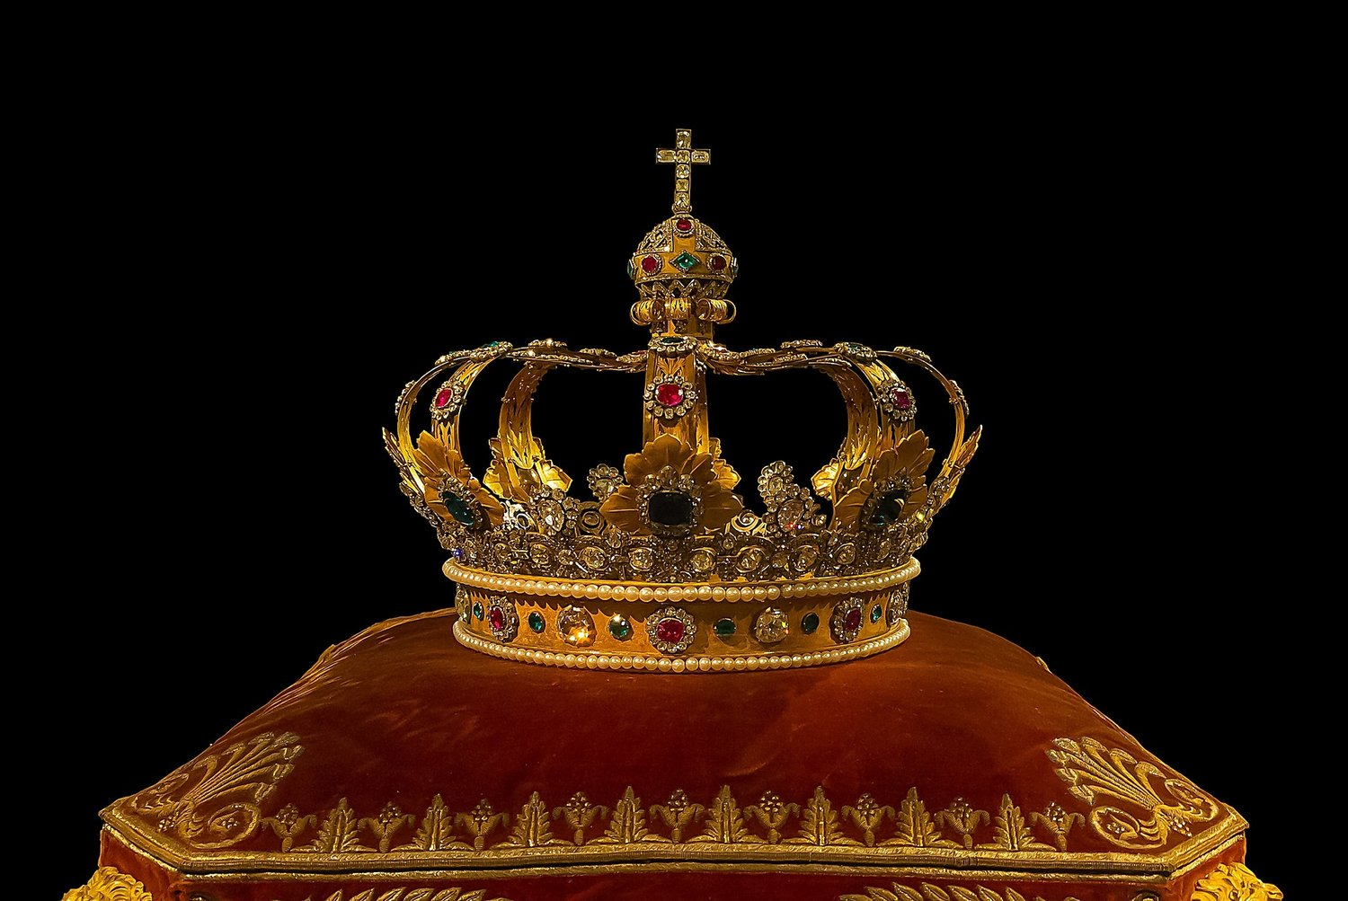
Is Peter saying that their repentance would have brought the kingdom?
Yes!

Slide 33
Is Peter saying that their repentance would have brought the kingdom?
Regeneration = Restoration
“The concept of restoration parallels regeneration when it is used of the kingdom (cf. Isa. 65:17; 66:22; Matt. 19:28; Rom. 8:20–22).”
—Toussaint, BKC, 2:361
Notes:
Stanley D. Toussaint, “Acts,” in The Bible Knowledge Commentary: An Exposition of the Scriptures, ed. J. F. Walvoord and R. B. Zuck, vol. 2 (Wheaton, IL: Victor Books, 1985), 361.

Slide 34
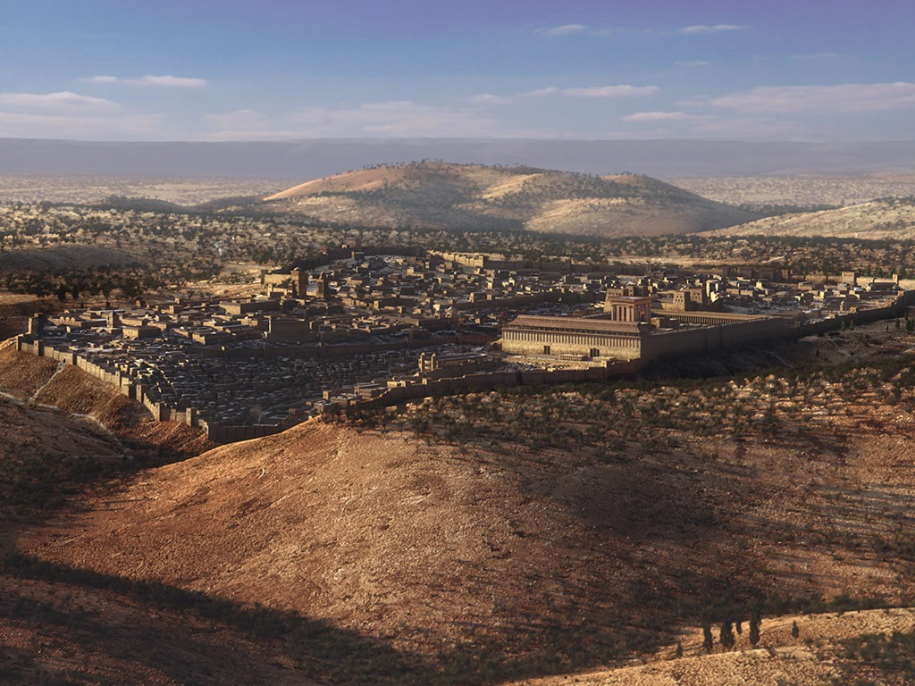
A Great Question (Acts 1:6)
So when they met together, they asked him, “Lord, are you at this time going to restore the kingdom to Israel?”
Notes:
We should witness to everyone until Israel is restored (1:6-8).

Slide 35
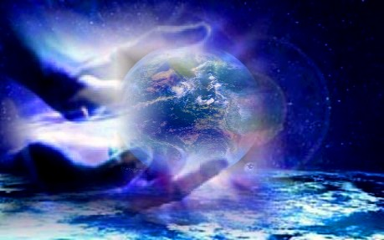
Isaiah 65:17-18a (NLT)
"Look! I am creating new heavens and a new earth, and no one will even think about the old ones anymore. ¹⁸Be glad; rejoice forever in my creation!"
Notes:
35

Slide 36
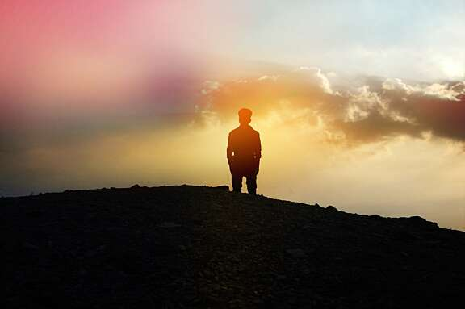
Isaiah 66:22 (NLT)
"'As surely as my new heavens and earth will remain, so will you always be my people, with a name that will never disappear,' says the LORD."
Notes:
36

Slide 37
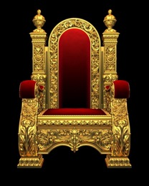
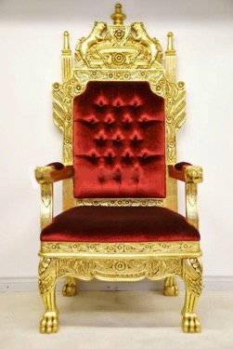
Jesus will Reign Over a Literal, Political Kingdom
"Jesus replied, 'I assure you that when the world is made new and the Son of Man sits upon his glorious throne, you who have been my followers will also sit on twelve thrones, judging the twelve tribes of Israel'" (Matt. 19:28 NLT)
Notes:
It will be ruled by Messiah where Israel will have prominence over the entire world that will follow the Lord.

Slide 38
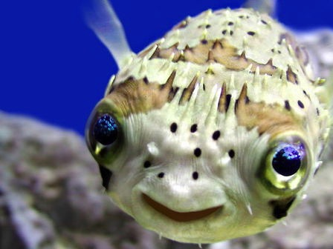
Romans 8:19-21
"The creation waits in eager expectation for the sons of God to be revealed. . . The creation itself will be liberated from its bondage to decay and brought into the glorious freedom of the children of God."
Notes:
38

Slide 39
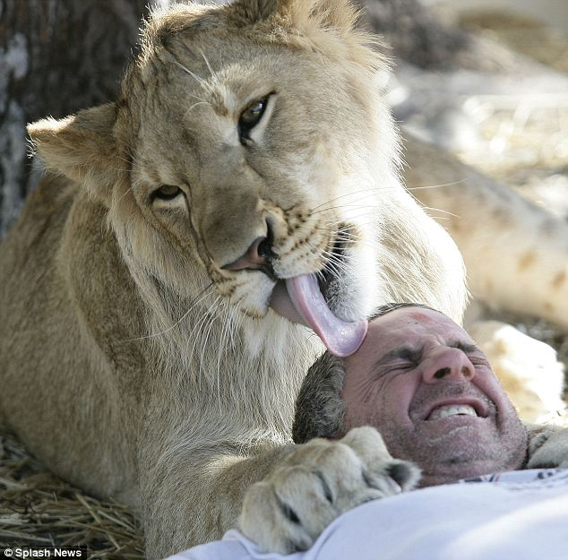
Romans 8:19-21
"The creation waits in eager expectation for the sons of God to be revealed. . . The creation itself will be liberated from its bondage to decay and brought into the glorious freedom of the children of God."
Notes:
39
http://forums.sgclub.com/singapore/now_whats_dinner_326313.html accessed 22 July 2015
Now, what's for dinner? Owner of wildlife sanctuary climbs into the lions' den for A MONTH...
Now, what's for dinner? Owner of wildlife sanctuary climbs into the lions' den for A MONTH to raise money By GAVIN ALLEN Last updated at 1:09 PM on 13th January 2011 It's the kind of lovingly playful lick on the head you would expect to see a young cat bestow on its owner. But this is a lion, and Jim Jablon is not in his own home - he's literally in the lions' den. These incredible pictures show just how well the Florida man is getting along with his new housemates Lea, an 18-month-old African lion, and Ed, a ten-month-old black-maned lion. Scroll down for video In the lion's den: Jim Jablon is living with two lions for the whole of January to raise money for his wildlife shelter Who's the king of the jungle? Jablon shares a yawn with his housemate The 42-year-old Army vet and single father has caused a stir worldwide with his promise to spend the entire month of January living with the two lions at the centre he runs, Wildlife Rehabilitation of Hernando County, Florida. These images of Jablon come from day five of the challenge, during which he will eat 'regular cooked food,' rationed to one square meal a day, which will be served in the evening when Lea and Ed are devouring 14lb of raw meat as their dinner. So far his biggest problem has been keeping his trousers on. 'Every time I bend over they go for my butt,' he said. 'Their teeth rip my pants right off. I've been through six pairs already.' Jablon is also sleeping in the 12ft-high, 3,000sq ft enclosure on a bed on hay - or somewhere harder to reach if things get a bit too hairy. Lion down: Jablon is eating and sleeping at the enclosure, although he isn't yet certain if he will stay on the straw bed Aw, get off: Jablon never turns an animal away from the refuge, relying on volunteers and the help of his 13-year-old daughter 'I may have to construct a bed in one of the trees, just out of their reach or come up with another idea, depending on what they make of me being there,' he said. 'After all, lions generally sleep for 18-20 hours a day so I'm going to be getting a lot of rest. 'But I'll be ever-vigilant and I will have a small fenced-off safety area in the corner if it looks like they're getting too aggressive or I feel things are getting too dangerous. The stunt is a way to raise funds for Jablon's animal refuge, which cares for injured or orphaned animals in the hope of giving them the chance to be returned to the wild. He opened the site in 1999 and was soon caring for raccoons, injured deer, bobcats, coyotes, snakes, eagles and owls. But soon the animals being brought in were getting increasingly larger and exotic – alligators, monkeys and big cats, including lions, tigers, lynx and pumas. Jablon, originally from Long Island, New York, tries to ensure he never turns an animal away from the refuge, relying on volunteers and the help of his 13-year-old daughter Chelsey. But as the facility has grown in size, the cost of feeding and looking after the increasing number of animals and the cost of their medical care has also risen rapidly, leading to Mr Jablon's unusual plan. 'I was looking for a way to raise funds to help the animals and I am constantly striving to look at what makes them happy, at what stimulates them, so I thought living with them for a month would help both causes,' he said. 'I couldn't survive without donations and hopefully this event will let people know I'm here and that I need help in helping the animals.' 'If the lions were fully grown I wouldn't be doing this. 'I feel they are still at the size and development stage where I can control them but, yes, they're big, and I have to take great care. 'I don't train my animals to do tricks and be with other people. 'I try to give them natural lives, so once they get to be a little bigger I will not be coming in with them.' Jablon began living with the lions at midnight on New Year's Eve and will leave the den on January 31. You can watch a live feed of his time in the cage at http://wrohflorida.com

Slide 40
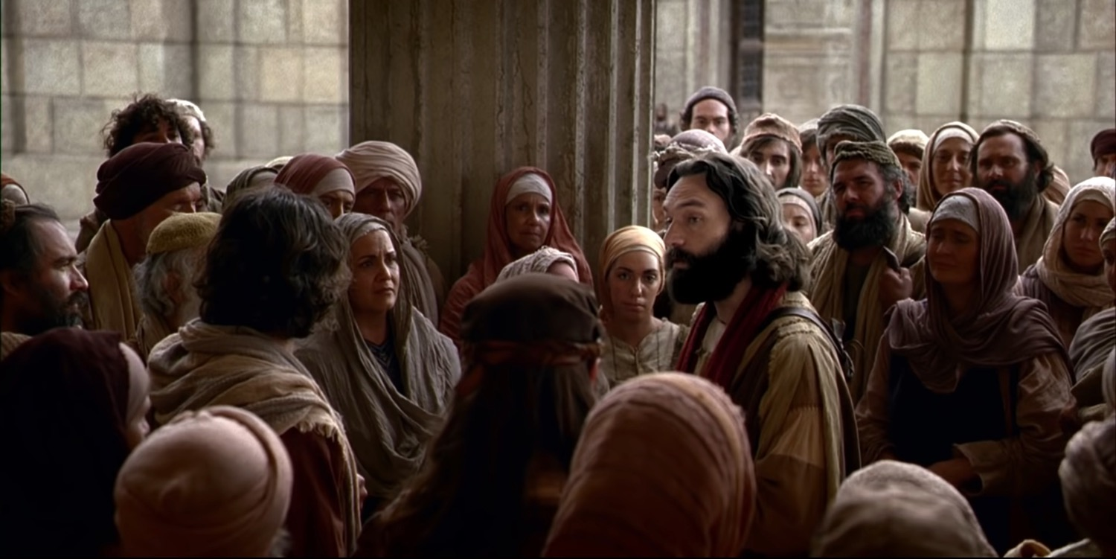
Acts 3:22-26

Slide 41
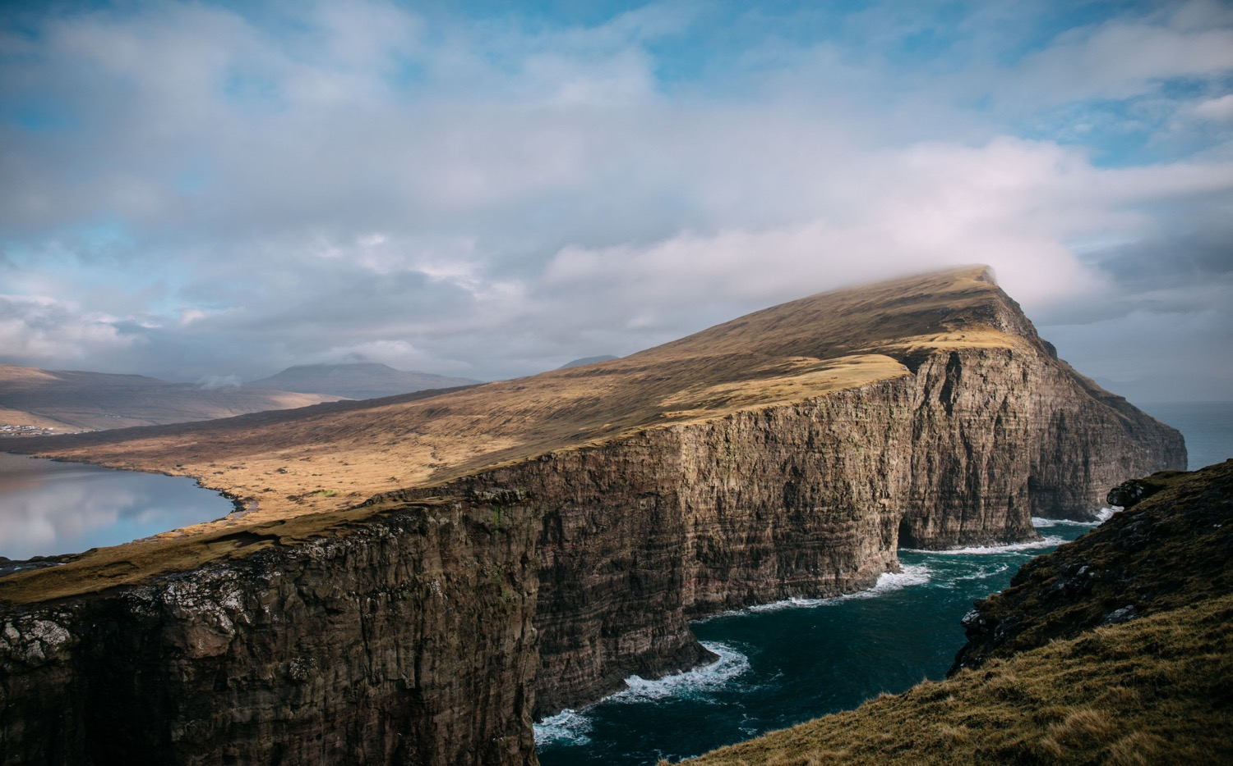
Main Idea of Acts 3
Seeing God work gives us open doors for witness!

Slide 42
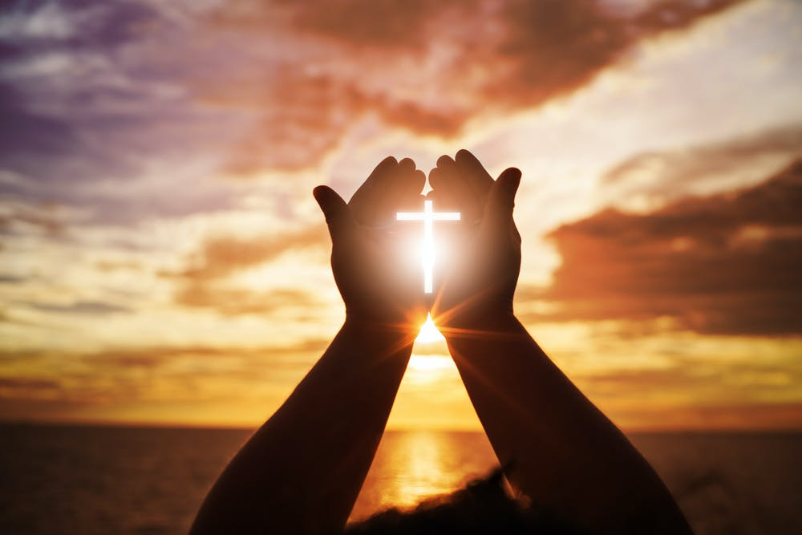
Speak the name—thus the authority—of Jesus
Peter healed the man in the name of Jesus (3:6).
Peter refused to take any credit for power or godliness (3:12).
Peter said that the man placed his faith in the name of Jesus (3:16).

Slide 43
Speak about Jesus!
Notes:
Too often we begin with meeting felt needs—but then we stay there and do not proclaim the gospel. Peter didn’t just stop when the cripple was healed. He gave God credit. What amazing things has God done where you have a front-row seat and need all the glory to go to God rather than to you?
The poor typically respond Jesus more easily than the wealthy as the poor better see their need for the Lord. I think the poor have a higher view of Jesus than we do—and that’s because we have too high a view of ourselves.

Slide 44
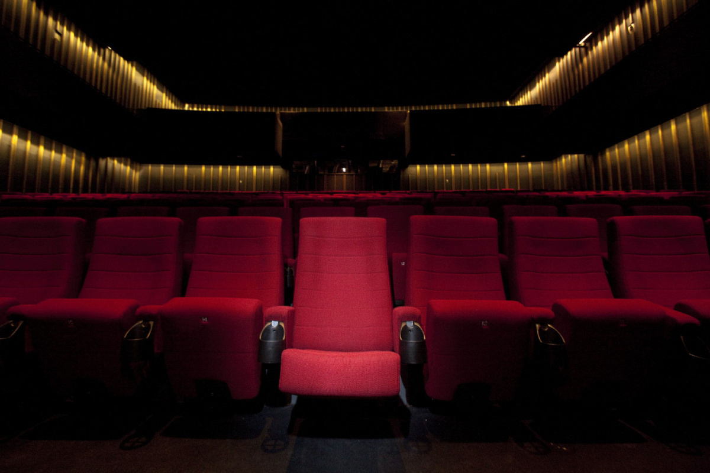
What amazing things has God done where you have a front-row seat?

Slide 45
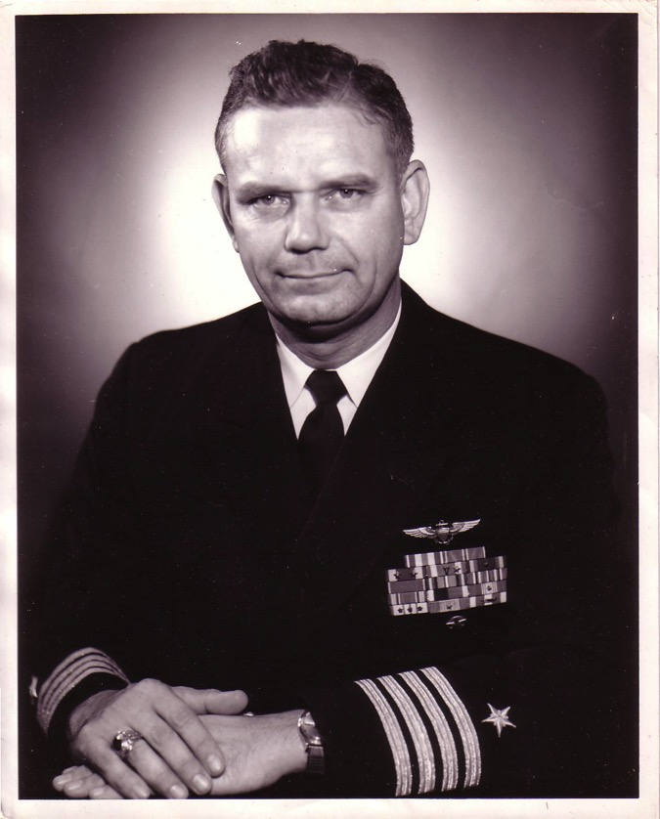
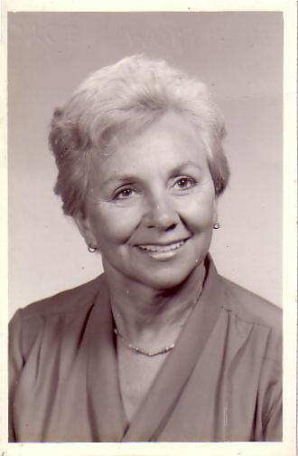
The Divorce
1962
Navy Commander
Harold F. Griffith (alias Dad)
Social Worker
Joyce I. Griffith (alias Mom)
Notes:
After my younger brother's birth my Mom concluded that my Dad was actually married to the Navy, so she divorced him. Ironically, she became a social worker to help other families put their lives together.

Slide 46
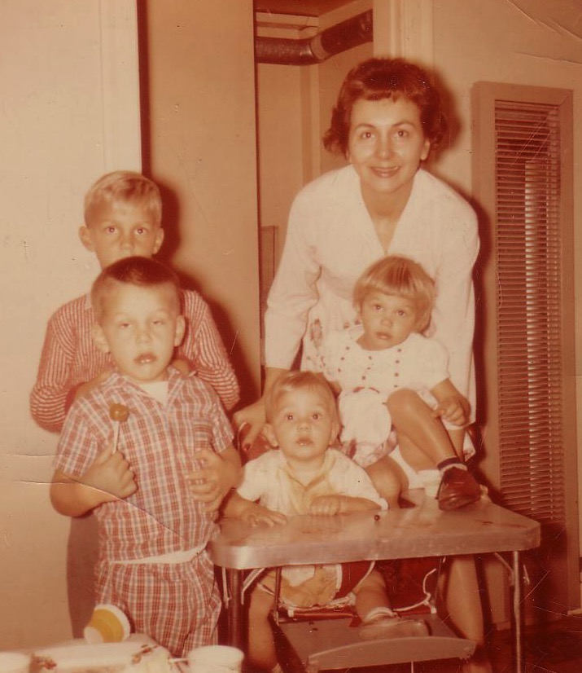
Divorce for Mom was tough…
Bobby, 6
Ricky, 4
Kathy, 3
Tommy, 1
Notes:
Those were tough years for Mom as a single mother with four kids age 6 and under. Yes, I'm the good looking one with the sucker!

Slide 47
He rescued me from a broken home and used me for his work for 41 years.
I couldn’t stand
I couldn’t see beyond lily white to 300 Japanese

Slide 48
The Crossroads (1981-83)
Notes:
After college it seemed the natural thing to do to join Campus Crusade staff in the Philippines on a seven-member music team.

Slide 49
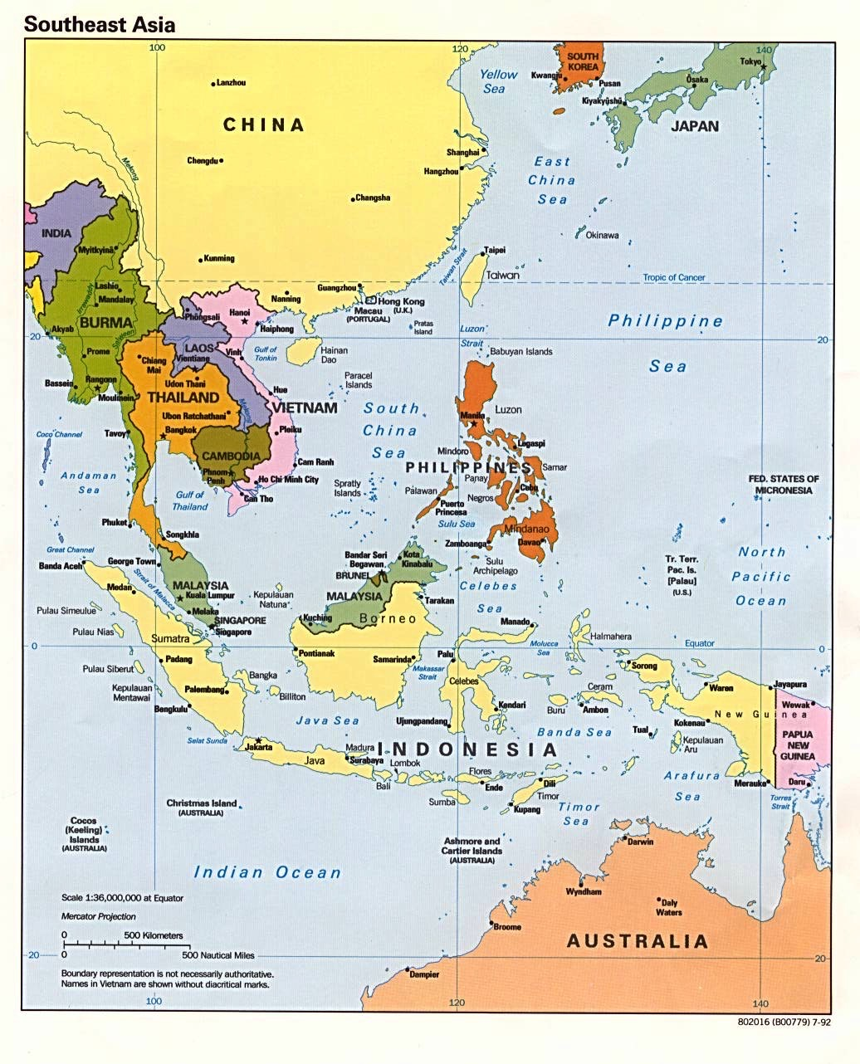
Crossroads Ministry
Korea
China
Japan
Hong Kong
Taiwan
Macau
Thailand
Philippines
Malaysia
Singapore
Indonesia
Notes:
The Crossroads team shared the gospel in 11 Asian nations and saw over 10,000 people indicate decisions to trust Christ! Again I was amazed at God's grace!

Slide 50
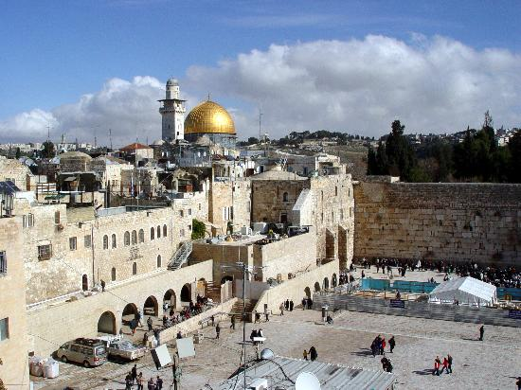
Jerusalem December 1995
Notes:
God met me in Jerusalem in December 1995.
You see, at that time I had served on the faculty of Singapore Bible College for four years and I started teaching some courses for the fourth time––that can lose its challenge.
But the chance came to lead trips to Israel. I'd never been there before, but 25 brave souls braved to pay the $3000 to come with me.
But at the antiquities shop in Jerusalem I was stunned to see one of my tour members argue with the shop owner about the price of an artifact. “What? You want $20? I saw this for $18 down the street!”
I was so embarrassed that I left the shop, sat down on the curb, and pouted like Elijah. “What are you doing here, Rick?” I sensed God say to me (not audibly, yet still real).
“Lord, I'm bringing Your people to Your land to get to know Your Word.”
“No, you're not,” I sensed God saying to me. “You can't afford to come Israel so you rounded up 25 wealthy people to pay your way.”
Then it struck me how little time Jesus spent in Jerusalem. Sure, he was a faithful Jew who made the required pilgrimages three times a year––and he spent the last week of his life in Jerusalem since he came there to die. But Jesus wasn't impressed with the wealth and power of Jerusalem.
Instead, he wanted to change the world through the poor. Jesus said that he had come to preach the gospel to the poor. And, as I thought about it, I realized that Jesus spent most of his ministry up in the poor north, in Galilee. He spent his time and energy in what people considered to be the place for roughnecks and insurrectionists.
Then I thought about the students that I had at SBC up to that point. I realized that the ones who came from the wealthy churches had to return back to their wealthy churches to pay back these churches for their support during seminary.
However, the ones from the poor countries returned to their countries had a tremendous impact for the cause of Christ.
So I said to the Lord, “OK, Lord, what do you want me to do? Where do you want me to go?”

Slide 51
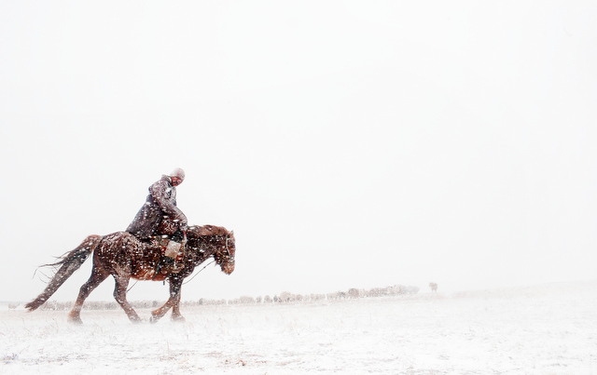
Mongolia December 1995
Notes:
Then God put on my mind Mongolia. “Mongolia? Are you telling me to go to Mongolia? I don't know a soul in Mongolia!
Besides, I am a tropical missionary. My blood has thinned in the five years I have lived in Singapore.”

Slide 52
Why does God do amazing things?

Slide 53
Main Idea of Acts 3
Seeing God work gives us open doors for witness!
How are you seeing God work in your life?

Slide 54
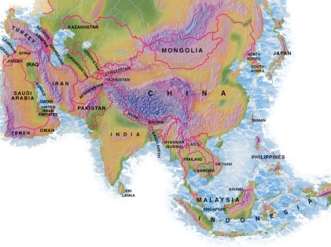
Crossroads Missions Funds 2020-2021
MONGOLIA
BANGLADESH
PAKISTAN
NEPAL
MYANMAR
INDIA
10-40 Window
THAILAND
SINGAPORE
Notes:
CIC regularly supports cross-cultural missionaries in Thailand, Myanmar, and India. Semi-regular gifts go to Pakistan, Bangladesh, Nepal, and Mongolia.

Slide 55
November 2018 Providence, RI

Slide 56
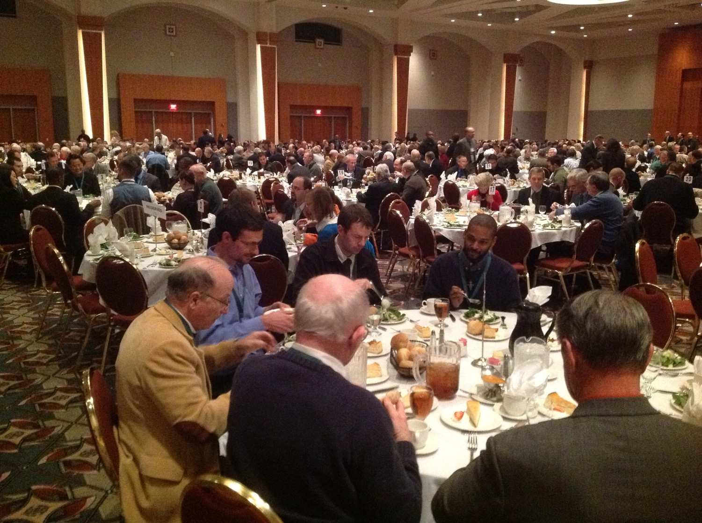
November 2018 Providence, RI

Slide 57
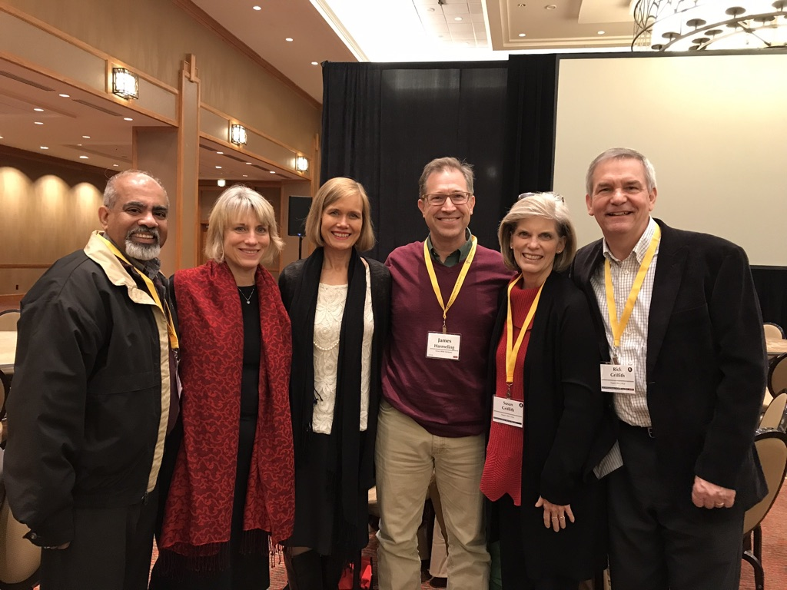
November 2018 Providence, RI

Slide 58
How can you give Jesus credit for his work?
Notes:
The recent growth of our church is not my fault! I blame Jim & Jacqui Harmeling, as well as Matt & Karla Lyle, supplemented by the consistent worship leader Momo, prayer director Rick, and a host of others that is growing.
Jesus himself brought the many new people to this church that has doubled in size the past two months. Ultimately, I give God credit, though.
This is the same type of team ministry that we see evident in Acts 3 and throughout the book of Acts. Glad to have you join the team!

Slide 59
Black

Slide 60
NT Preaching link at BibleStudyDownloads.org
Get this presentation and script for free!

