Slide 1
Now what
NEW YEAR
NEW ME

Slide 2
Stand Firm
Show Love
Walk by the Spirit

Slide 3
Walk in the Spirit,
die to the Flesh
You don’t need:
To be Circumcised
To follow OT Law
To eat Kosher
1 John 2:15 (ESV)
¹⁵ Do not love the world or the things in the world. If anyone loves the world, the love of the Father is not in him.

Slide 4
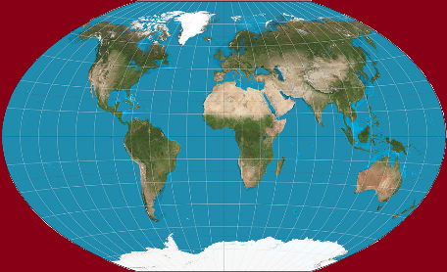
coexist
You don’t need:
To be Circumcised
To follow OT Law
To eat Kosher
JESUS

Slide 5
coexist
You need:
JESUS
1 John 1:5-7 (ESV)
⁵ . . . God is light, . . . ⁷ But if we walk in the light, . . . we have fellowship with one another, and the blood of Jesus his Son cleanses us from all sin.

Slide 6
Now JESUS
Now what
NEW YEAR
NEW ME

Slide 8
& 8 Authors
NT: 27 Books
48 49 50 52 53 57 60 62 67 68 95
Matt
Luke
Acts
Mark
John
Gal
1 Thess
1 Cor
Eph
1 Tim
2 Tim
Jude
James
2 Thess
2 Cor
Col
Titus
Heb
1 John
Romans
Philem
1 Pet
2 John
Phil
2 Pet
3 John
Rev
Gospels & Acts
5
Pauline Epistles
13
General Epistles
9
27

Slide 9
we heard of your FAITH in Christ Jesus and of the LOVE that you have for all the saints because of the HOPE laid up for you in heaven.
Col 1:3-5 ESV
Stand Firm
Show Love

Slide 10
Who is Jesus
¹⁵ He is the image of the invisible God,

Slide 11
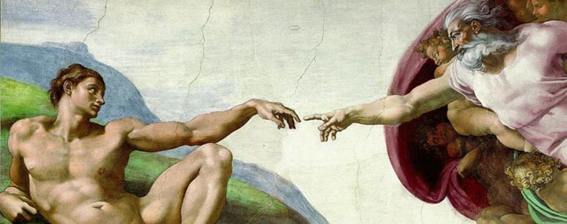
What about Man?
So God created man in his own image, in the image of God he created him; male and female he created them.
Gen 1:27 (ESV)

Slide 12
Who is Jesus
the firstborn of all creation.

Slide 13
Definition of Firstborn
Literal
Luke 2:7 & Heb 11:28
Place of Superiority
Heb 1:6 & Rev 1:5
πρωτότοκος
pro-to'-to-kos
Blue Letter Bible

Slide 14
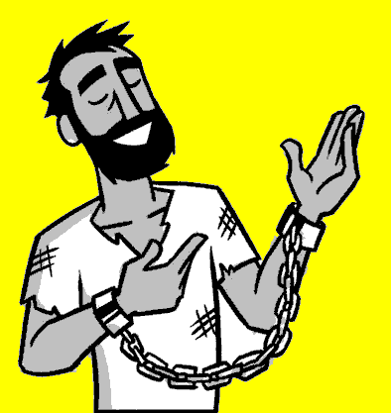
Definition of Firstborn
Created all things
Before all things
Holds all things
πρωτότοκος
pro-to'-to-kos

Slide 15
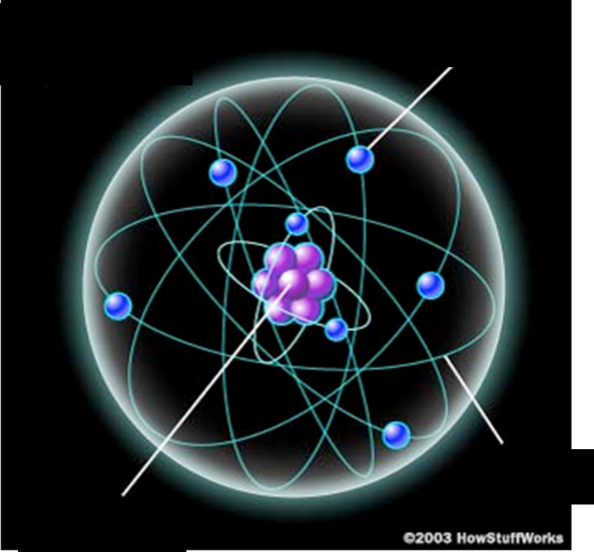
Inside an Atom
Electron (negative)
"…in Him all things hold together" (2:17)
Orbit
Proton Nucleus (positive)

Slide 16
Who is Jesus
¹⁸ And he is the head of
the body, the church.

Slide 17
Who is Jesus
Image of God
Firstborn of Creation
Head of the church.

Slide 18
¹⁸ . . . He is the beginning, the firstborn from the dead, that in everything he might be preeminent..

Slide 19
Who is Jesus
¹⁹ For in him all the fullness of God was pleased to dwell,
²⁰ and through him to reconcile to himself all things,
What Did Jesus Do?

Slide 20
¹⁹ . . . to reconcile to himself
all things,
What Did Jesus Do?

Slide 21
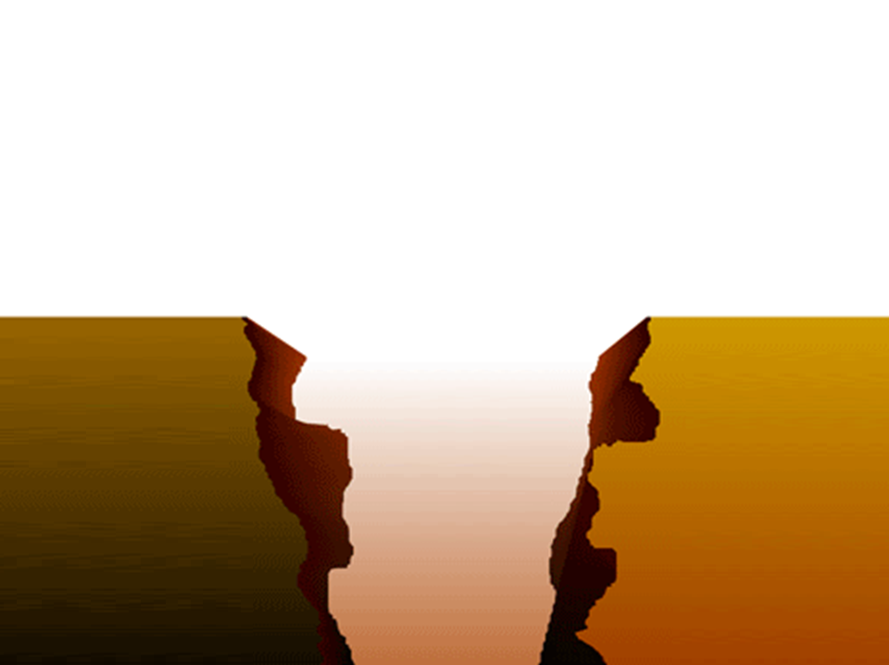
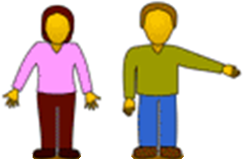
Our Problem:
Sin Separates Us from God
Sinful
Humanity
Holy
God

Slide 22
Our Problem:
Sin Separates Us from God
Religion
Sinful
Humanity
Holy
God
Good Works
Morality
Philosophy

Slide 23
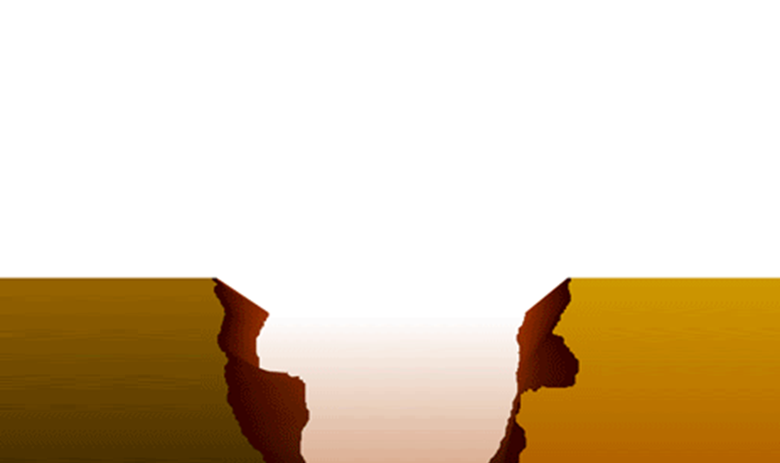
²¹ And you, who once were alienated and hostile in mind, doing evil deeds, ²² he has now reconciled in his body of flesh by his death, in order to present you holy and blameless and above reproach before him,
Christ’s Blood
Sinful
Humanity
Holy
God

Slide 24
²³ if indeed you continue in the faith, stable and steadfast, not shifting from the hope of the gospel that you heard, which has been proclaimed in all creation under heaven, and of which I, Paul, became a minister.
Christ’s Blood
Sinful
Humanity
Holy
God

Slide 25
¹⁹ . . .Present you holy and blameless
What Did Jesus Do?

Slide 26
Who is Jesus
Image of God
Firstborn of Creation
Head of the church.
What Did Jesus Do?
Reconcile all things
Present you holy and blameless

Slide 27
Now JESUS
NEW YEAR
NEW ME
Stand Firm
Show Love
Walk by the Spirit

