Slide 1
NEW YEAR
NEW ME

Slide 2



To look forward to
Fixing our sight on God’s revelation of the future

Slide 3
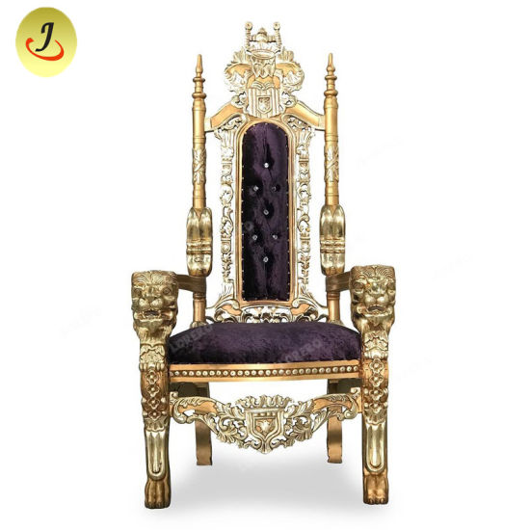


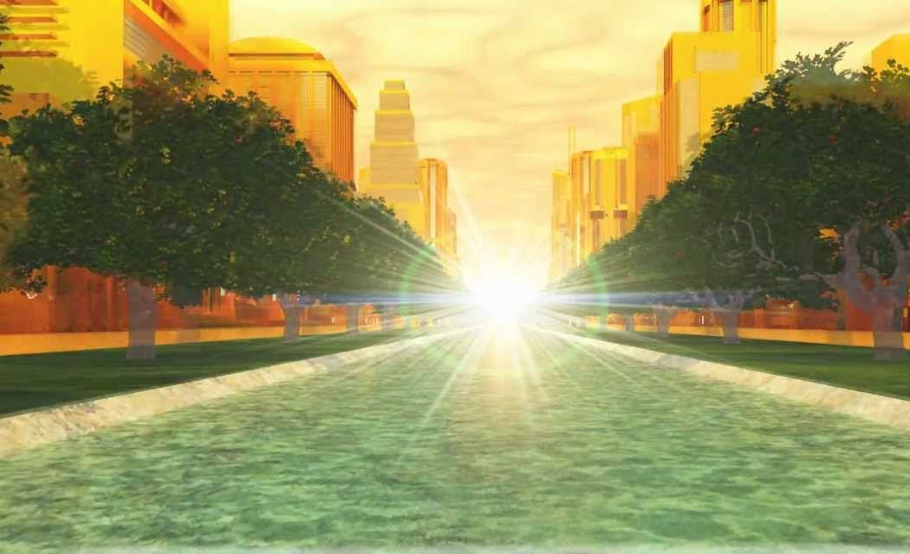

"I will keep you from the hour of testing that will come upon the whole world,
to test those who dwell upon the earth"
(Rev. 3:10)
Rapture
Christ Returns
with Church
New World, New Jerusalem
Church Age
7 years
1000 years
Eternity

Slide 4
Now what
NEW YEAR
NEW ME

Slide 5
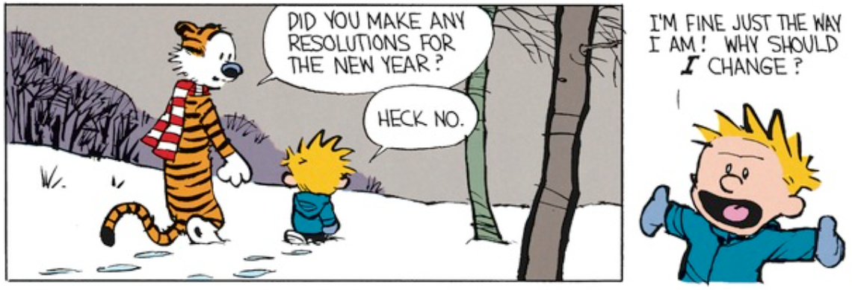
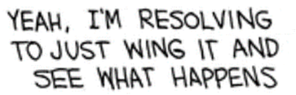


Slide 6
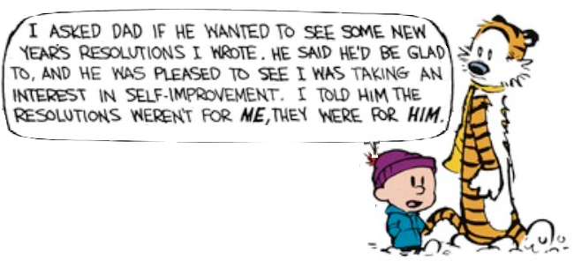

Slide 7

Ch 5

Slide 8

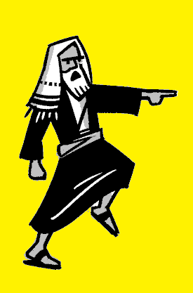

Ch 5

Slide 9
¹⁶ yet we know that a person is not justified by works of the law but through faith in Jesus Christ, so we also have believed in Christ Jesus, in order to be justified by faith in Christ and not by works of the law, because by works of the law no one will be justified.
Galatians 2:16 ESV

Slide 10
¹¹ Now it is evident that no one is justified before God by the law, for “The righteous shall live by faith.”
Habakkuk 2:4
Romans 1:17
Galatians 3:11
Hebrews 10:38
Galatians 3:11 ESV

Slide 11
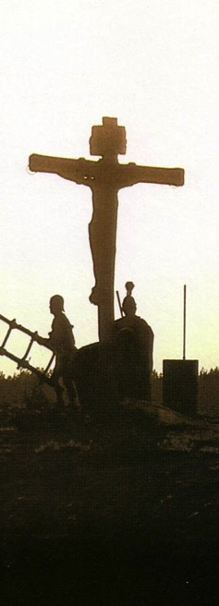
Salvation has always
been by faith
Now what
OT / B.C.
Faith looked forward to the Cross of Christ
NT / A.D.
Faith looks back at the Cross of Christ
Galatians

Slide 12
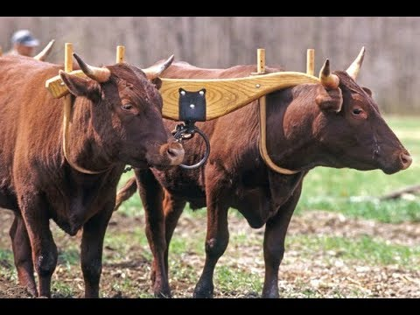
¹ For freedom Christ has set us free; stand firm therefore, and do not submit again to a yoke of slavery.
Gal 5:1 (ESV)

Slide 13


Slide 14
Gospels
Matthew 10:22 (NIV): You will be hated by everyone because of me, but the one who stands firm to the end will be saved.
Matthew 24:12-13 (NIV): ¹² Because of the increase of wickedness, the love of most will grow cold, ¹³ but the one who stands firm to the end will be saved.
Why / How

Slide 15
Paul
1 Corinthians 15:1 (NLT): Let me now remind you, dear brothers and sisters, of the Good News I preached to you before. You welcomed it then, and you still stand firm in it.
1 Corinthians 16:13 (ESV): Be watchful, stand firm in the faith, act like men, be strong.
Affirmation / Directive

Slide 16
Paul
1 Corinthians 15:58 (NIV): Therefore, my dear brothers and sisters, stand firm.
Let nothing move you. Always give yourselves fully to the work of the Lord, because you know that your labor in the Lord is not in vain.
Directive
/ Why / How

Slide 17
Peter
1 Peter 5:9 (NLT): Stand firm against him, and be strong in your faith. Remember that your family of believers all over the world is going through the same kind of suffering you are.
Directive / Why / How

Slide 18
James
James 5:8 (NIV): You too, be patient and stand firm, because the Lord’s coming is near.
To look forward to
Directive / Why / How

Slide 19
Gospels
2
Luke 6:47-48 (NLT): ⁴⁷ I will show you what it’s like when someone comes to me, listens to my teaching, and then follows it. ⁴⁸ It is like a person building a house who digs deep and lays the foundation on solid rock. When the floodwaters rise and break against that house, it stands firm because it is well built.
1
3
How

Slide 20
Paul
2 Thessalonians 2:15 (ESV): So then, brothers, stand firm and hold to the traditions that you were taught by us, either by our spoken word or by our letter.
How

Slide 21

For 2021, how do I
resolve to:
Stand Firm

Slide 22


³ I testify again to every man who accepts circumcision that he is obligated to keep the whole law.
Gal 5:3 (ESV)
10 Commandments
613 Commandments

Slide 23

³ I testify again to every man who accepts circumcision that he is obligated to keep the whole law. ⁴ You are severed from Christ, you who would be justified [counted righteous] by the law; you have fallen away from grace.

Slide 24
Faith, Hope, & Love
⁵ For through the Spirit, by faith, we ourselves eagerly wait for the hope of righteousness. ⁶ For in Christ Jesus neither circumcision nor uncircumcision counts for anything, but only faith working through love. . . .
Gal 5:5-6 (ESV)
=> 1 Cor 13

Slide 25
Faith, Hope, & Love
Love is:
Patient
Kind
Rejoices w/truth
Bears
Believes
Hopes
Endures
Love is not / does not:
Envy
Boast
Arrogant
Rude
Insist on its own way
Irritable
Resentful
Rejoice at wrong doing
1 Cor 13:4-7 (ESV)

Slide 26

Faith, Hope, & Love
To look forward to
1 Cor 13:8-12 (ESV)

Slide 27
Faith, Hope, & Love
So now faith, hope, and love abide, these three; but the greatest of these is love.
1 Cor 13:13 (ESV)

Slide 28
Faith, Hope, & Love
⁵ For through the Spirit, by faith, we ourselves eagerly wait for the hope of righteousness. ⁶ For in Christ Jesus neither circumcision nor uncircumcision counts for anything, but only faith working through love. . . .
¹⁴ For the whole law is fulfilled in one word: “You shall love your neighbor as yourself.”
Gal 5:5-6, 14 ESV

Slide 29
Faith, Hope, & Love
1 John 3:16 (NIV): This is how we know what love is: Jesus Christ laid down his life for us. And we ought to lay down our lives for our brothers and sisters.

Slide 30
For 2021, how do I
resolve to:
Stand Firm
Show Love

Slide 31
ESV
NLT
⁷ You were running well. Who hindered you from obeying the truth?
⁸ This persuasion is not from him who calls you.
⁹ A little leaven leavens the whole lump.
⁷ You were running the race so well. Who has held you back from following the truth?
⁸ It certainly isn’t God, for he is the one who called you to freedom.
⁹ This false teaching is like a little yeast that spreads through the whole batch of dough!
Gal 5:7-9

Slide 32


Walk by the Spirit
¹⁶ But I say, walk by the Spirit, and you will not gratify the desires of the flesh. ¹⁷ For the desires of the flesh are against the Spirit, and the desires of the Spirit are against the flesh, for these are opposed to each other, to keep you from doing the things you want to do. ¹⁸ But if you are led by the Spirit, you are not under the law.
Galatians 5:16-18 ESV

Slide 33
Love the World vs
Love of the Father
¹⁵ Do not love the world or the things in the world. If anyone loves the world, the love of the Father is not in him. ¹⁶ For all that is in the world—the desires of the flesh and the desires of the eyes and pride of life—is not from the Father but is from the world. ¹⁷ And the world is passing away along with its desires, but whoever does the will of God abides forever.
1 John 2:15-17 ESV

Slide 34
Walk by the Spirit
¹⁹ Now the works of the flesh are evident: . . .
²² But the fruit of the Spirit is . . .
Galatians 5:19-24 ESV

Slide 35
Walk by the Spirit
¹⁹ Now the works of the flesh are evident: sexual immorality, impurity, sensuality, ²⁰ idolatry, sorcery, enmity, strife, jealousy, fits of anger, rivalries, dissension, division, ²¹ envy, drunkenness, orgies, and things like these. I warn you, as I warned you before, that those who do such things will not inherit the kingdom of God.
Galatians 5:19-21 ESV

Slide 36
Walk by the Spirit
¹⁹ Now the works of the flesh are evident: sexual immorality, impurity, sensuality, ²⁰ idolatry, sorcery, enmity, strife, jealousy, fits of anger, rivalries, dissension, division, ²¹ envy, drunkenness, orgies, and things like these. I warn you, as I warned you before, that those who (make a practice of doing) such things will not inherit the kingdom of God.
Galatians 5:19-21 ESV

Slide 37
Walk by the Spirit
²² But the fruit of the Spirit is love, joy, peace, patience, kindness, goodness, faithfulness, ²³ gentleness, self-control; against such things there is no law.
Galatians 5:22-24 ESV

Slide 38
Walk by the Spirit
²² But the fruit of the Spirit is love, joy, peace, patience, kindness, goodness, faithfulness, ²³ gentleness, self-control; against such things there is no law. ²⁴ And those who belong to Christ Jesus have crucified the flesh with its passions and desires.
Galatians 5:22-24 ESV

Slide 39
Walk by the Spirit
²⁵ If we live by the Spirit, let us also keep in step with the Spirit. ²⁶ Let us not become conceited, provoking one another, envying one another.
Galatians 5:16-26 ESV

Slide 40
For 2021, how do I
resolve to:
Stand Firm
Show Love
Walk by the Spirit

Slide 41
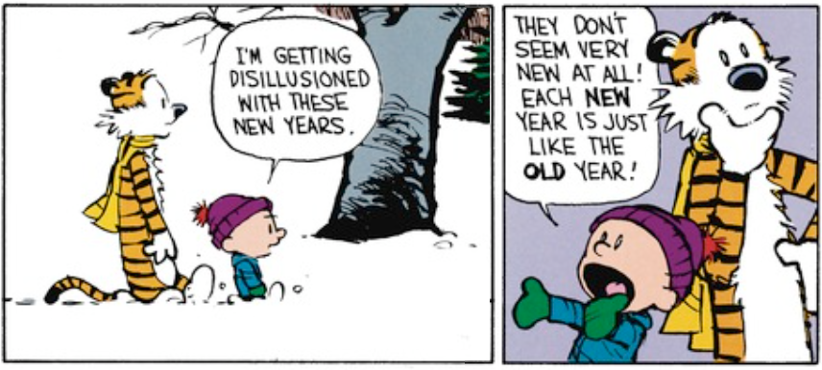
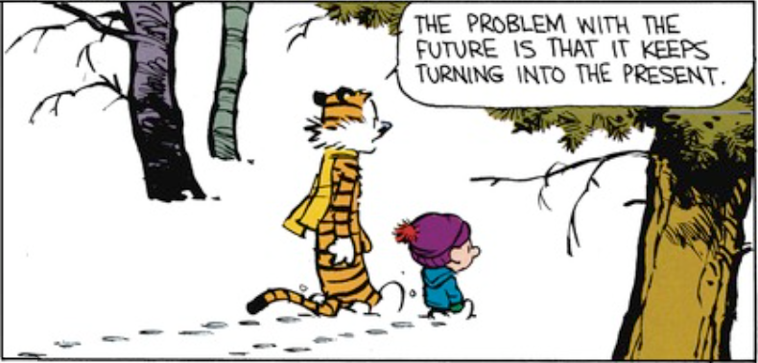

Slide 42
2021 does not have be like 2020

Slide 43
NEW YEAR
NEW ME
Stand Firm
Show Love
Walk by the Spirit

