Slide 1

STRANGER
IN A STRANGE LAND
EXODUS 2
Matt Lyle • Crossroads International Church Singapore
CICFamily.org

Slide 2
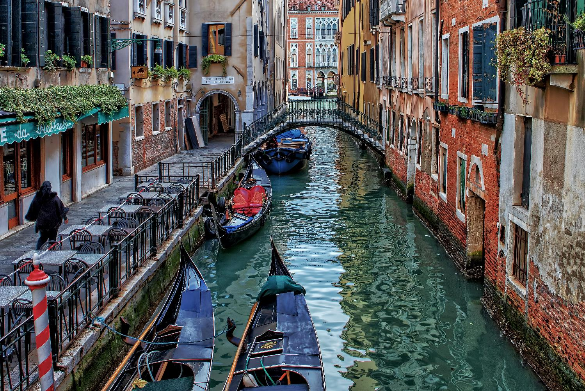
Venice
Italy

Slide 3
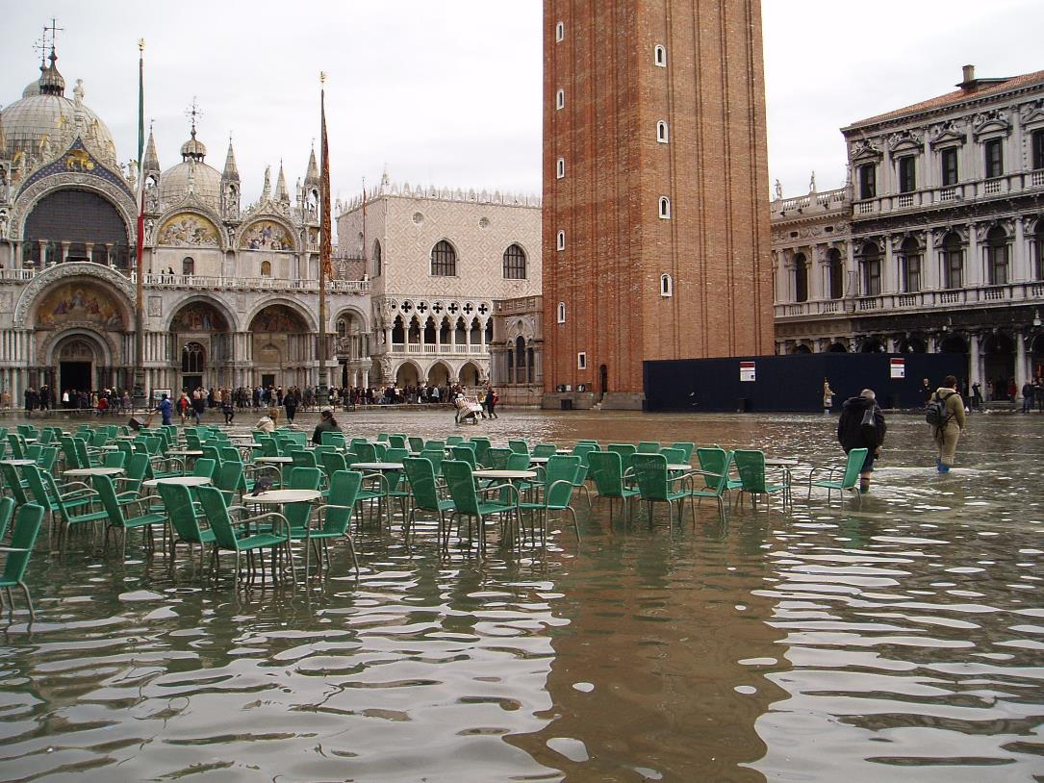

Slide 4
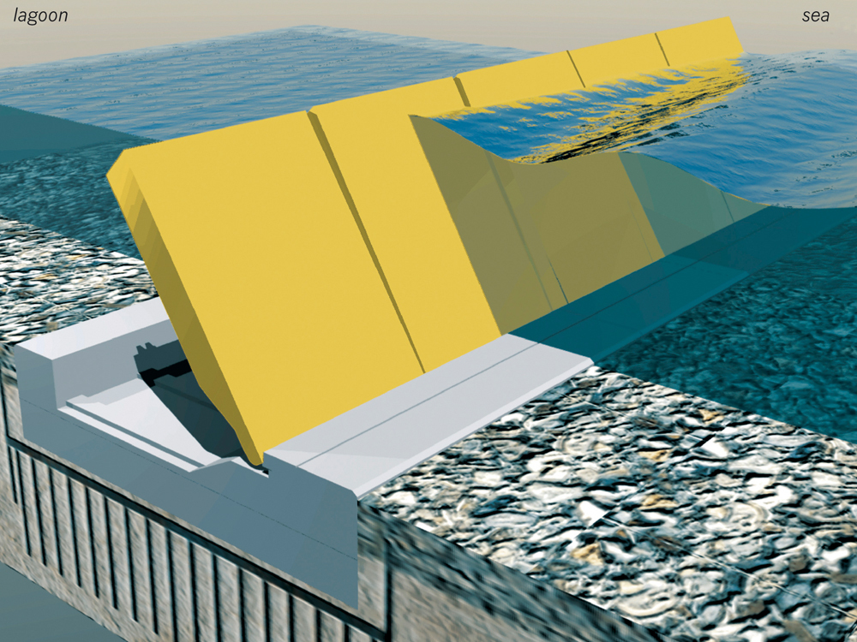
Project MOSE

Slide 5
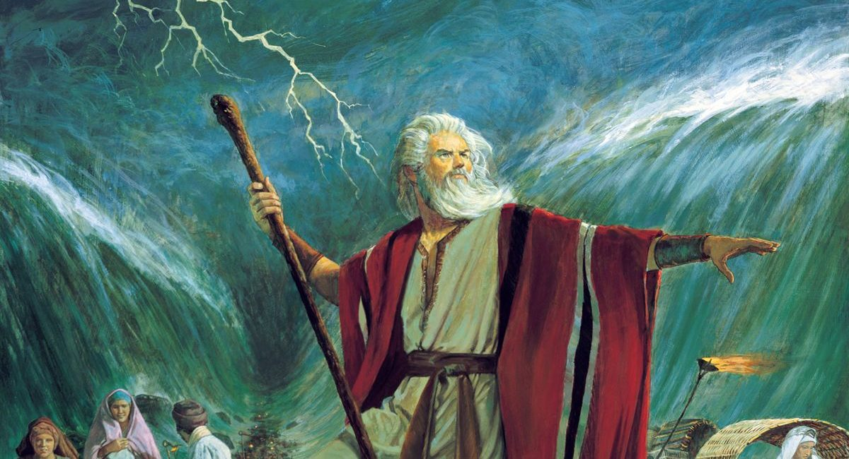
Moses raised his hand over the sea, and the Lord opened up a path through the water

Slide 6
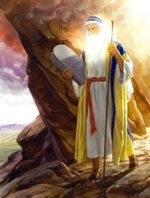
When they saw the radiance of Moses’ face, they were afraid

Slide 7
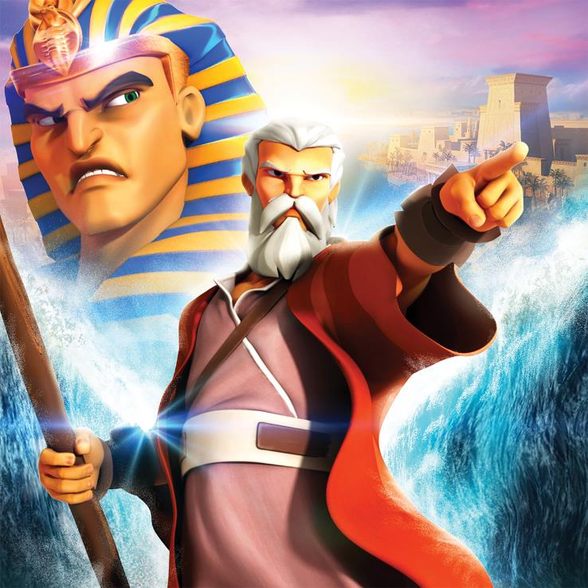
Let My People Go

Slide 8
STRANGER
IN A STRANGE LAND
EXODUS 2

Slide 9

Key Verse
²² Later she gave birth to a son, and Moses named him Gershom, for he explained,
“I have been a foreigner in a foreign land.”
Exodus Ch 2
Notes:
Our key verses for today are from 2 Thes 2 vs 2 and 15.
Read,
This composite verse highlights the fact that by understanding God’s word, we can stand firm in spite of the many different false teachings we are faced with today.

Slide 10











Books of the Bible
GENESIS
EXODUS
JUDGES
1 SAMUEL
ESTHER
LEVITICUS
2 SAMUEL
1 CHRON
NEHEMIAH
2 KINGS
JOSHUA
1 KINGS
2 CHRON
RUTH
EZRA
NUMBERS
DEUTERONOMY
LAW
HISTORY
Old
Testament
JOB
PSALMS
ISAIAH
JEREMIAH
LAMENTATIONS
EZEKIEL
DANIEL
PROVERBS
POETRY
MAJOR PROPHETS
Song of
Solomon
HOSEA
JONAH
NAHUM
MALACHI
MICAH
HABAKKUK
JOEL
OBADIAH
ZEPHANIAH
ZECHARIAH
AMOS
HAGGAI
Ecclesiastes
POETRY
MINOR PROPHETS
MATTHEW
New
Testament
MARK
ACTS
1 PETER
REVELATION
1 COR
PHILEMON
JAMES
1 JOHN
2 PETER
ROMANS
2 THES
2 JOHN
1 TIMOTHY
2 COR
1 THES
HEBREWS
PHILIPPIANS
2 TIMOTHY
JUDE
EPHESIANS
3 JOHN
LUKE
GALATIANS
COLOSSIANS
TITUS
JOHN
GOSPELS
HISTORY
PAULINE EPISTLES
GENERAL EPISTLES

Slide 11
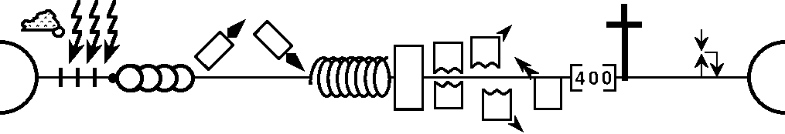

History of the World
Gen 1-11
Gen 12-50
Creation
Eternity
Fall
Babel
Eternity
Flood
Abraham
Joseph
Isaac
Jacob
Patriarchs
Church
Kingdom
Beginnings
Max Anders, Dallas Theological Seminary

Slide 12
History of the World
Exodus
Gen 1-11
Gen 12-50
Creation
Moses
Eternity
Fall
Babel
Eternity
Flood
Abraham
Joseph
Isaac
Jacob
Patriarchs
Church
Kingdom
Beginnings
Max Anders, Dallas Theological Seminary

Slide 13
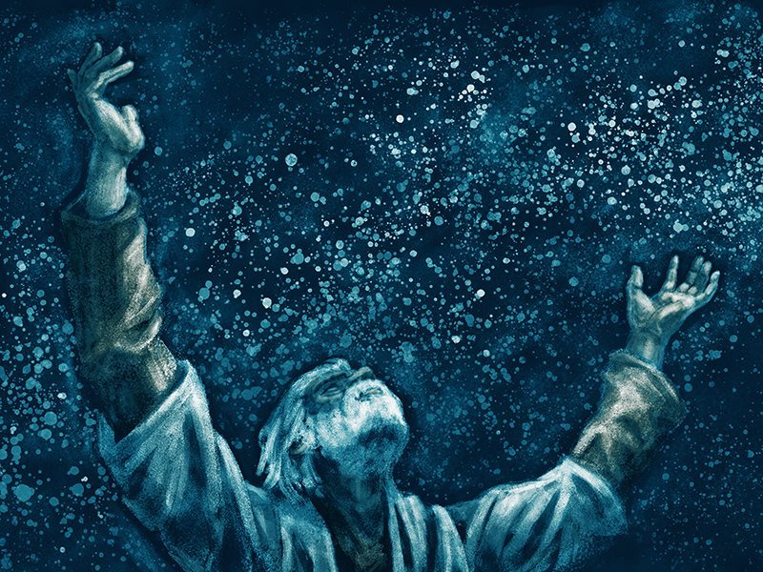
Exodus Ch 1
⁷ . . .the Israelites, had many children and grandchildren. In fact, they multiplied so greatly that they became extremely powerful and filled the land.
  Gen 12:2
  Gen 13:16
  Gen 15:5
  Gen 17:6
  Gen 22:17
  Gen 26:4
  Gen 26:24
  Gen 28:14
  Gen 35:11

Slide 14
Exodus Ch 1
⁸ Eventually, a new king came to power in Egypt who knew nothing about Joseph or what he had done.
Enslaved Israelites
Ordered midwives to kill baby boys
Ordered his people to throw every newborn Hebrew boy into the river

Slide 15
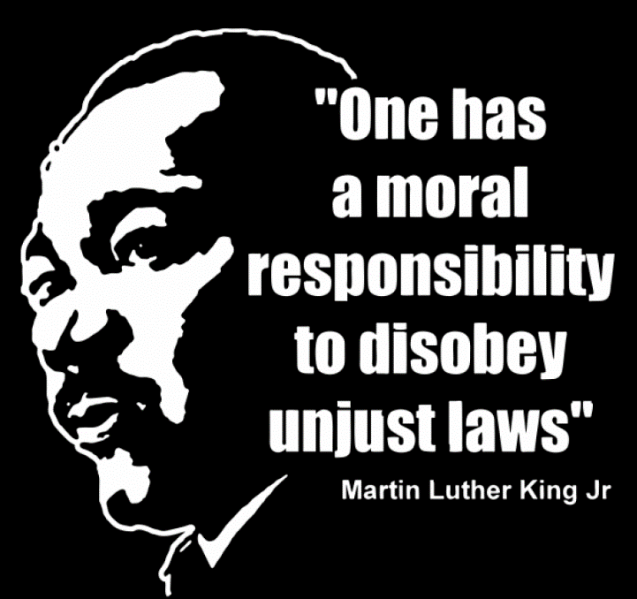
Exodus Ch 1 & 2
Midwives
Mother of Moses
Daughter of Pharaoh
COMPASSION

Slide 16
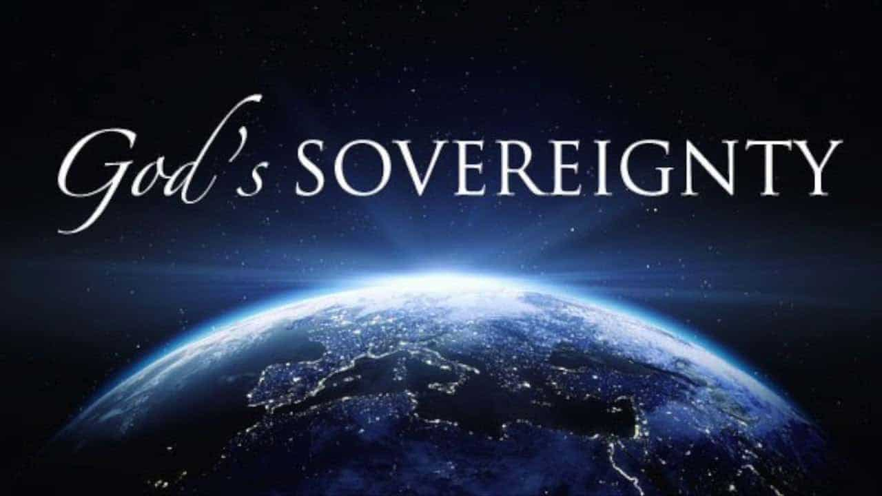
Exodus Ch 2
Mother of Moses
Daughter of Pharaoh

Slide 17
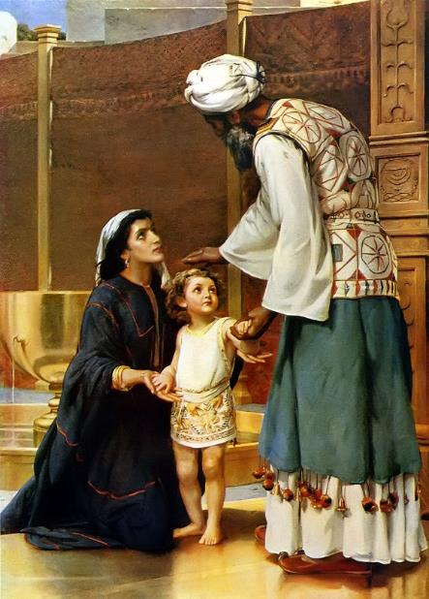
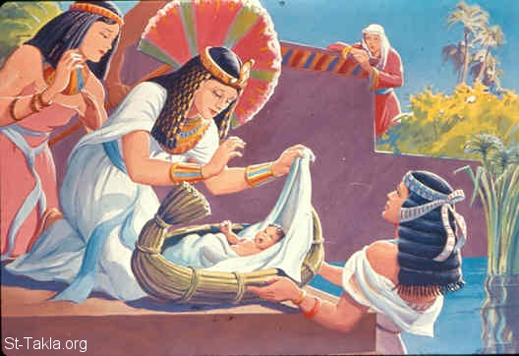
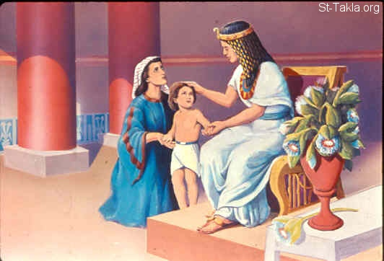
Exodus Ch 2
A mother’s sacrifice
Hannah and Samuel

Slide 18
Moses finally receives a name
Footnote
Moses sounds like a Hebrew term that means “to lift out.”

Slide 19
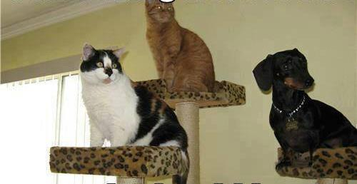
Growing up in Pharaoh’s House

Slide 20
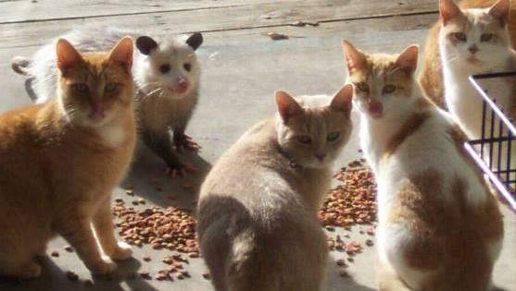
Growing up in Pharaoh’s House

Slide 21
Growing up in Pharaoh’s House
Hebrew Child
Hebrew Name
Moses was taught all the wisdom of the Egyptians, and he was powerful in both speech and action (Acts 7:22 NLT)
Moses was a stranger in his own land

Slide 22
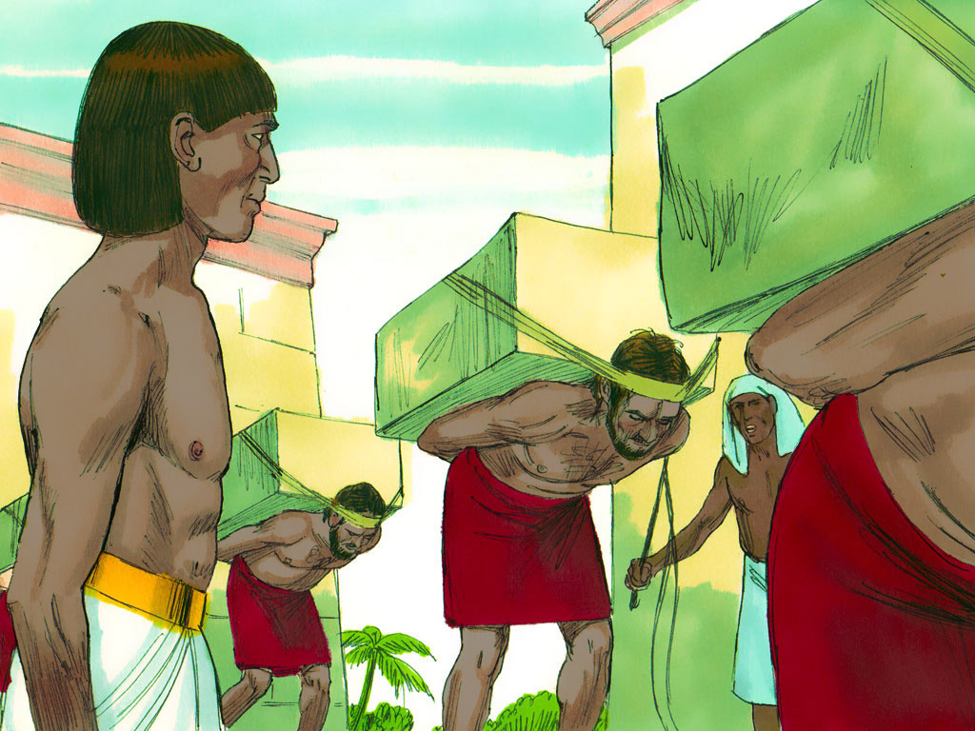
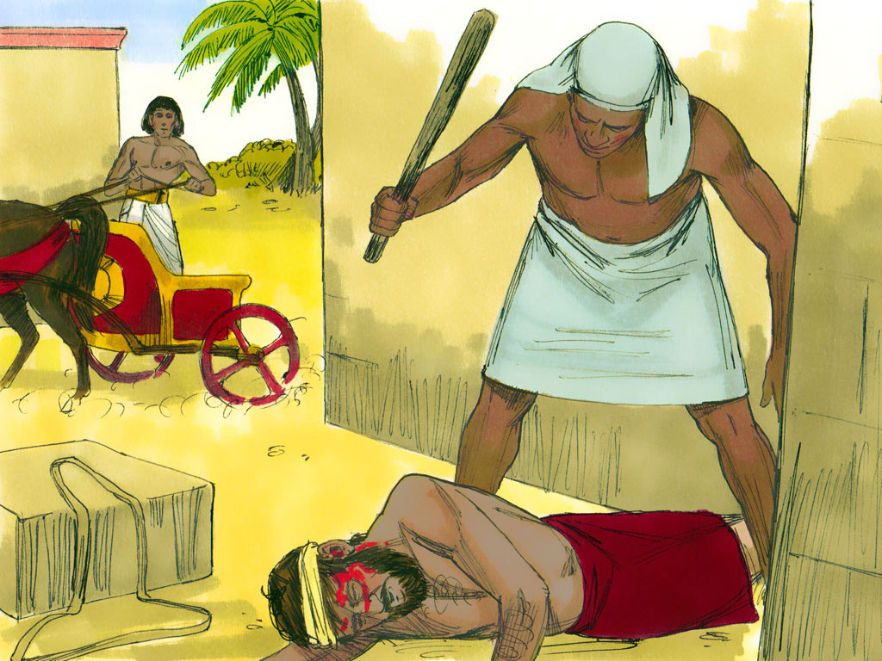
Moses sees the burden of his people

Slide 23
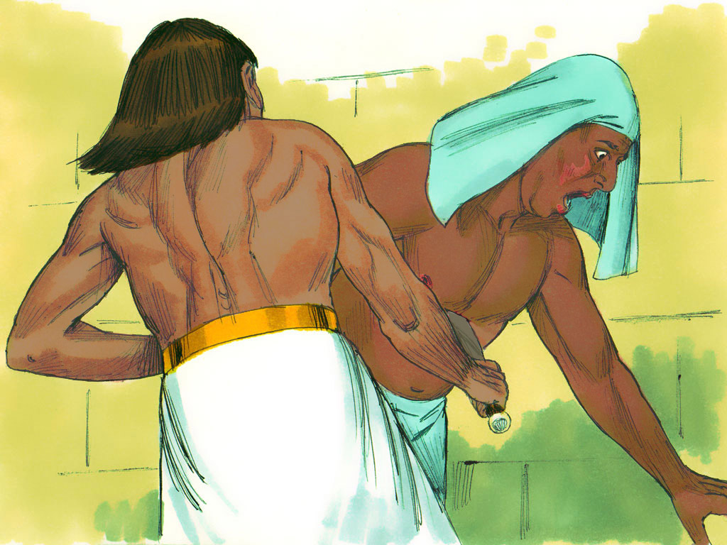
Moses Fighting Social Injustice?
After looking in all directions to make sure no one was watching, Moses killed the Egyptian and hid the body in the sand. (Exo 2:12 NLT)

Slide 24
Moses was missing COMPASSION
Moses
Fighting Social Injustice?
After looking in all directions to make sure no one was watching, Moses killed the Egyptian and hid the body in the sand. (Exo 2:12 NLT)

Slide 25
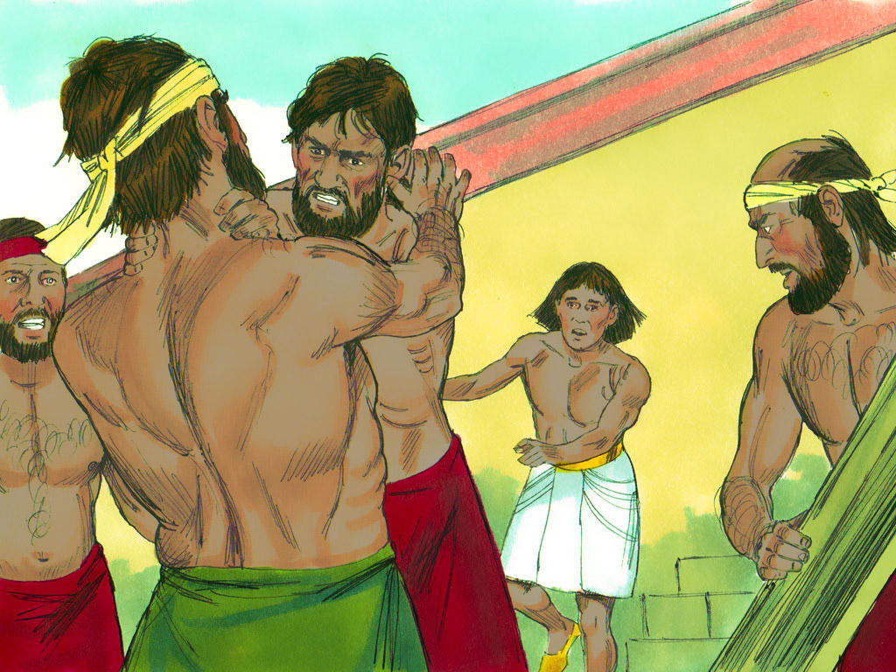
Moses the peacemaker?
Why are you fighting
Who made you a ruler and judge over us?
‘Are you going to kill me as you killed that Egyptian yesterday?

Slide 26
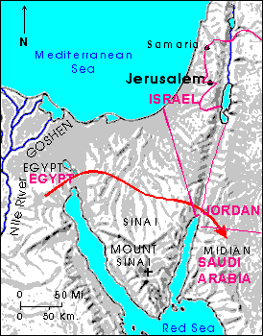
Moses flees to Midian
Moses was a stranger in a strange land

Slide 27

Stranger in a Strange Land
(in Singapore)
Total foreign workforce: 1,351,800
Total Population: 5,863,276
23%

Slide 28
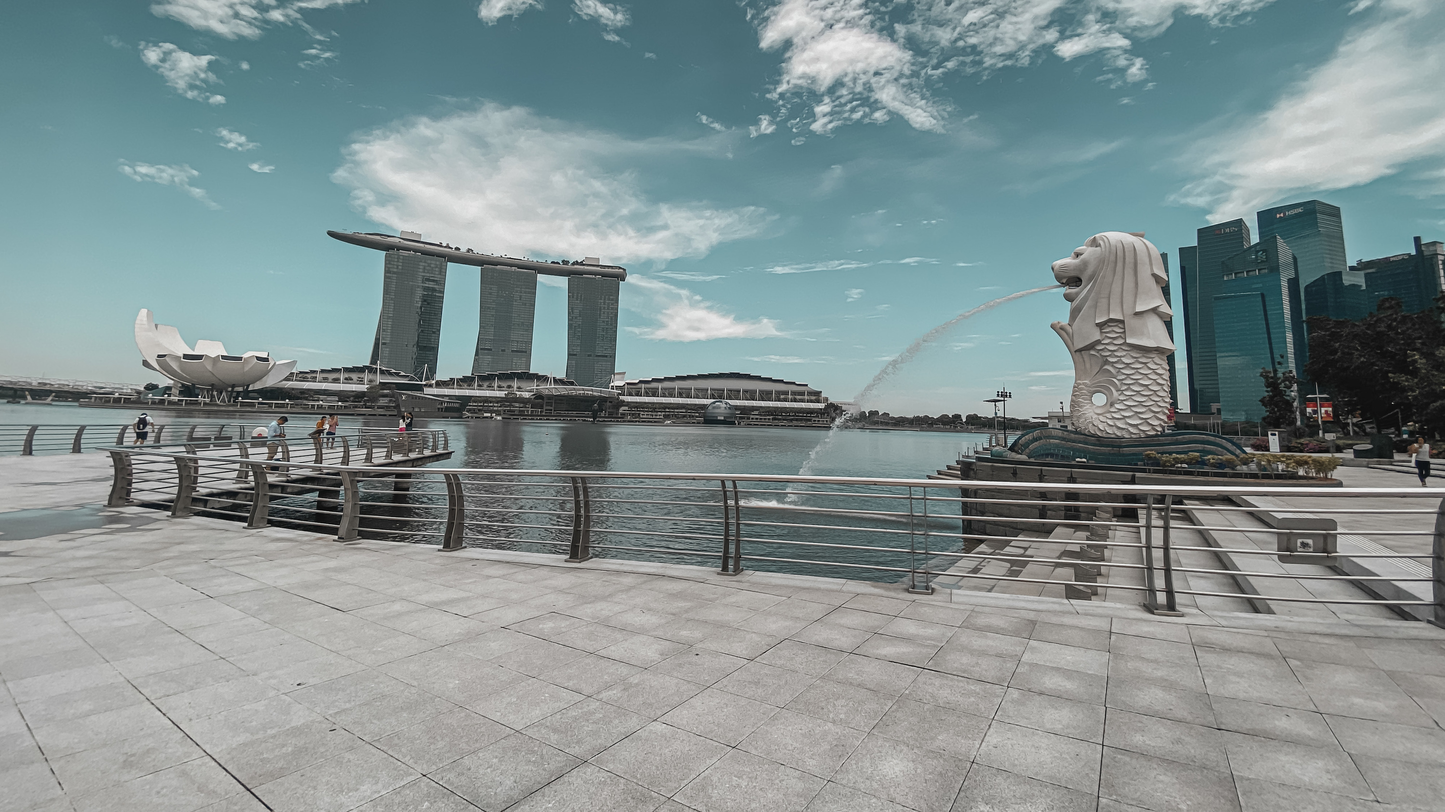
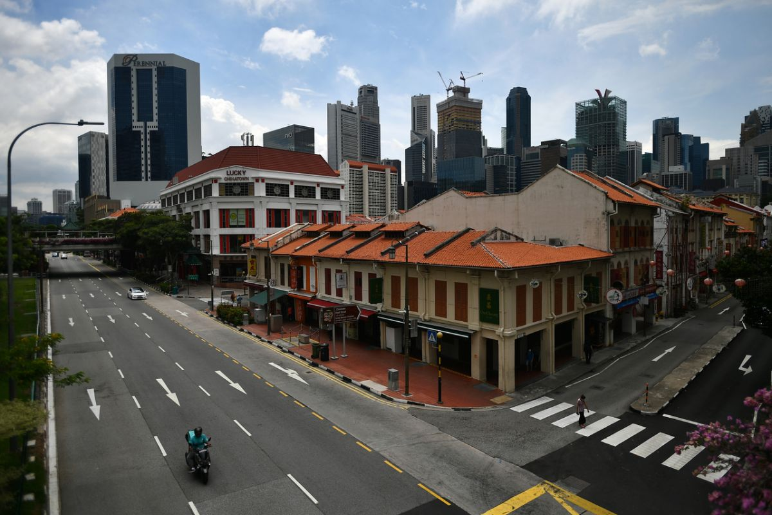
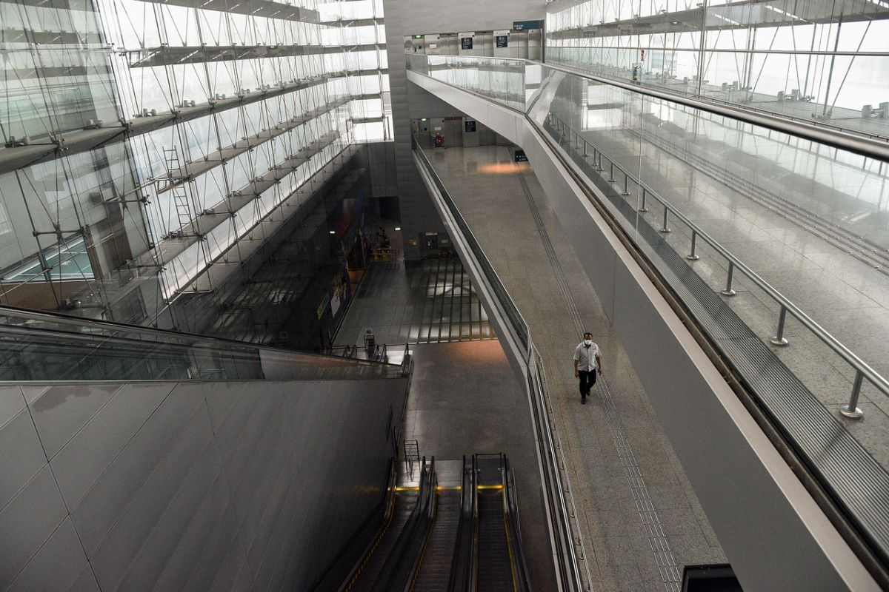
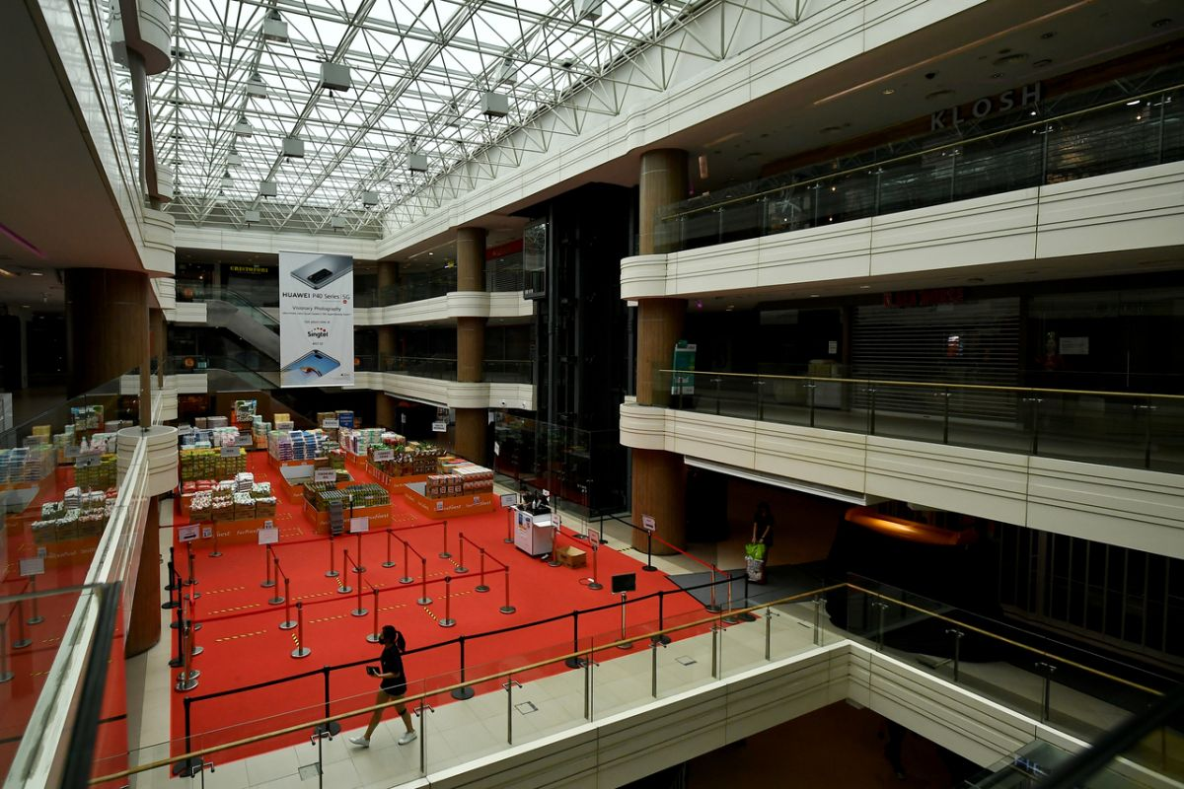
Stranger in a Strange Land
(in Singapore)

Slide 29
Stranger in a Strange Land
(in Singapore)
The church finds itself a stranger in a strange land. Christians are, like resident aliens. Like the exiled Israelites we live in a culture foreign and strange to the gospel.
Rev Wong Chiau Yau
SBC Combined Chapel 1 Oct 2020
Live as exiles 1 Peter 2:11-13
Do not love the world 1 John 2:15-17

Slide 30
Moses in Midian
Moses was a stranger in a strange land

Slide 31
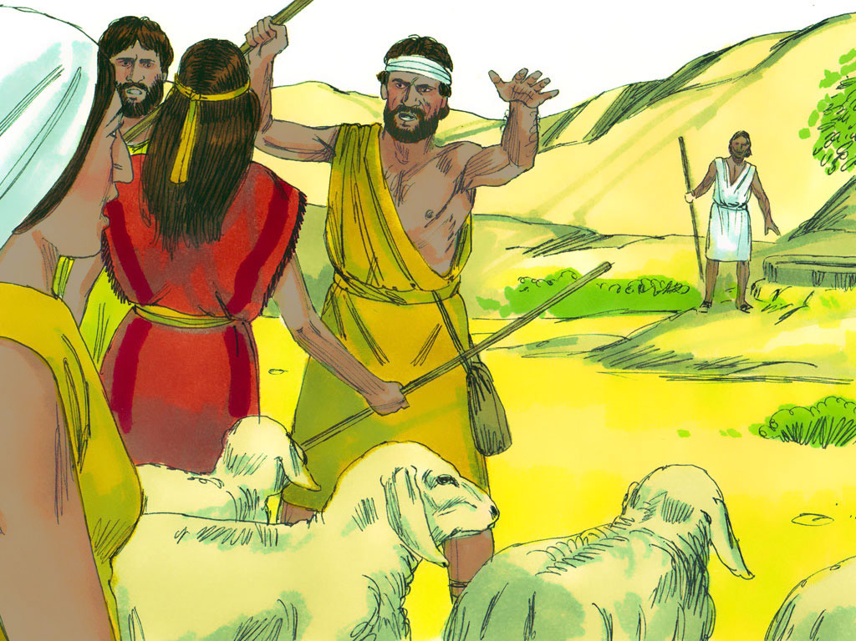
Moses fights injustice
7 sisters came to water sheep
Sisters chased away by mean shepherds
Moses chased away mean shepherds and drew water for sister’s sheep

Slide 32
Moses fights injustice
Moses shows COMPASSION

Slide 33
Pharaoh’s Daughter showed COMPASSION
Midwives showed COMPASSION
Mother showed COMPASSION
Moses shows COMPASSION
Moses is shown COMPASSION
Immediate Needs: food, shelter, companionship
Long term needs: job and a wife
LOVE YOUR NEIGHBOR

Slide 34
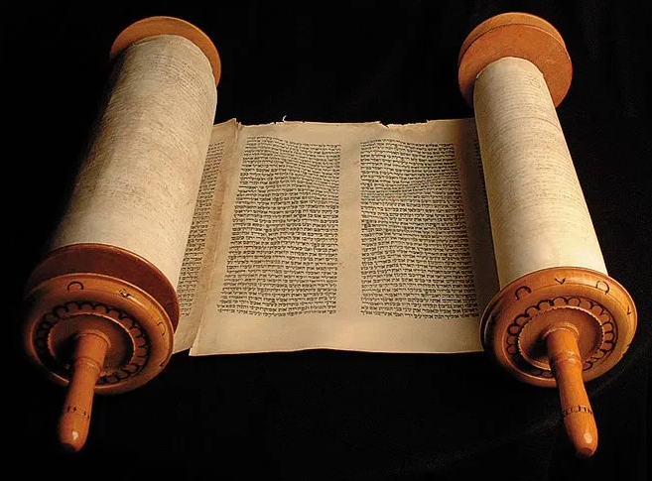

Love Your Neighbor
Self-righteous lawyer summarizes the OT Law
‘You must love the Lord your God with all your heart, all your soul, all your strength, and all your mind.’ And, ‘Love your neighbor as yourself.’ (Luke 10:27 NLT)

Slide 35
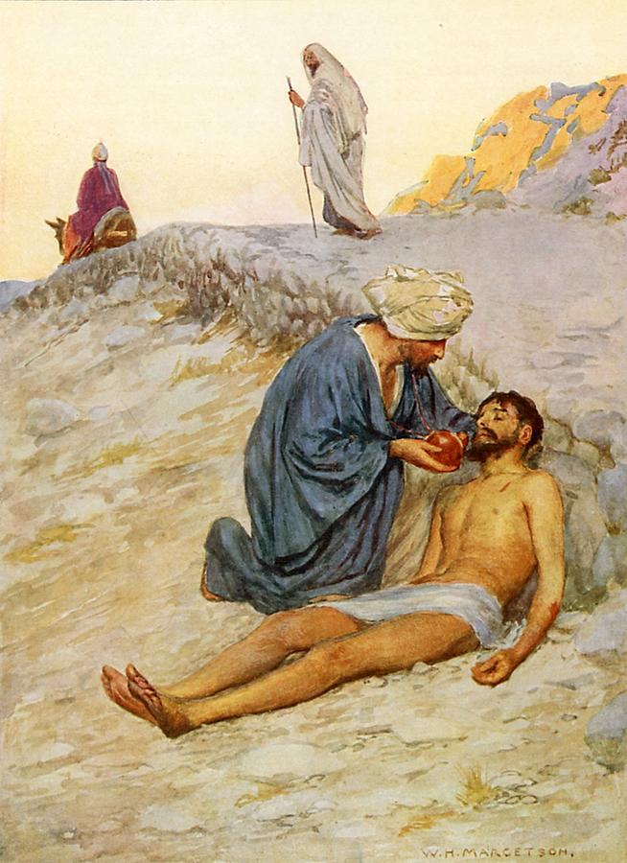
The Good Samaritan
Priest
Levite
Samaritan
Traveler

Slide 36
The Good Samaritan
Priest
Levite
Leviticus 21:1 (NLT)
21 The Lord said to Moses, “Give the following instructions to the priests, the descendants of Aaron.
“A priest must not make himself ceremonially unclean by touching the dead body of a relative.

Slide 37
The Good Samaritan
Q: ³⁶ “Now which of these three would you say was a neighbor to the man who was attacked by bandits?” Jesus asked.
A: ³⁷ The man replied, “The one who showed him mercy.”
C: Then Jesus said, “Yes, now go and do the same.”
COMPASSION

Slide 38
Love Your Neighbor
Expand the Summary
v9: harvest edge of fields
v18: love your neighbor as yourself
v33: love foreigner / stranger as yourself
v34: For you were once foreigners
Leviticus ch 19
Shows us what loving our neighbor looks like

Slide 39
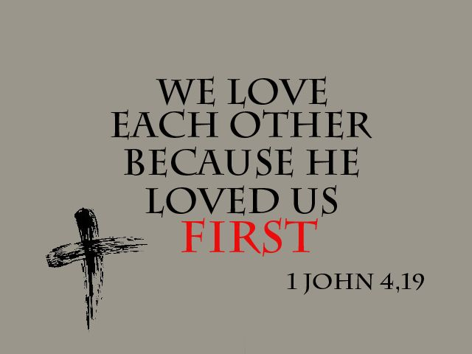

Slide 40
The Good Samaritan
The Church
Q: ³⁶ “Now which of these three would you say was a neighbor to the man who was attacked by bandits?” Jesus asked.
A: ³⁷ The man replied, “The one who showed him mercy.”
C: Then Jesus said, “Yes, now go and do the same.”
COMPASSION
Immediate Needs: food, shelter, companionship
Long term needs: job and a wife

Slide 41
Review
Moses was a stranger in a strange land
Love the stranger for you were once a stranger
We are strangers in a strange land
We love because He first loved us
Loving your neighbor includes loving the stranger

