Slide 1
Love your Enemies
2 KINGS 5:1-19
Matt Lyle • Crossroads International Church Singapore
CICFamily.org

Slide 2
Liverpool vs
Man United

Slide 3
Army Navy Game
The Game
American College Football Rivalries

Slide 4
Geography
American College Football Rivalries

Slide 5
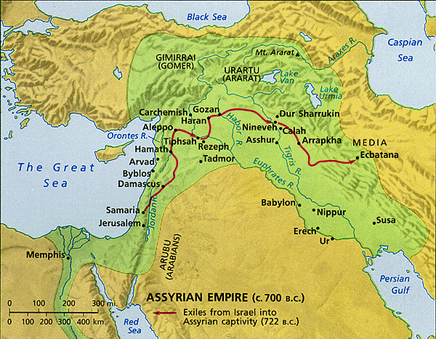
Geography Lesson
Fertile Crescent
Akkadian
Egypt
2000 BCE

Slide 6
Geography Lesson
Assyrian
Israel
Egypt
~850 BCE

Slide 7
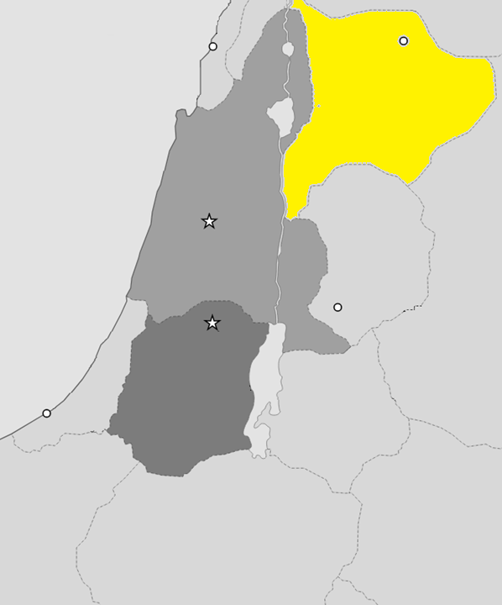
Aram
(aka Syria)
Israel
Judah

Slide 8
Books of the Bible
GENESIS
EXODUS
JUDGES
1 SAMUEL
ESTHER
LEVITICUS
2 SAMUEL
1 CHRON
NEHEMIAH
2 KINGS
JOSHUA
1 KINGS
2 CHRON
RUTH
EZRA
NUMBERS
DEUTERONOMY
LAW
HISTORY
Old
Testament
JOB
PSALMS
ISAIAH
JEREMIAH
LAMENTATIONS
EZEKIEL
DANIEL
PROVERBS
POETRY
MAJOR PROPHETS
Song of
Solomon
HOSEA
JONAH
NAHUM
MALACHI
MICAH
HABAKKUK
JOEL
OBADIAH
ZEPHANIAH
ZECHARIAH
AMOS
HAGGAI
Ecclesiastes
POETRY
MINOR PROPHETS
MATTHEW
New
Testament
MARK
ACTS
1 PETER
REVELATION
1 COR
PHILEMON
JAMES
1 JOHN
2 PETER
ROMANS
2 THES
2 JOHN
1 TIMOTHY
2 COR
1 THES
HEBREWS
PHILIPPIANS
2 TIMOTHY
JUDE
EPHESIANS
3 JOHN
LUKE
GALATIANS
COLOSSIANS
TITUS
JOHN
GOSPELS
HISTORY
PAULINE EPISTLES
GENERAL EPISTLES

Slide 9
EXODUS
JUDGES
1 SAMUEL
LEVITICUS
JOSHUA
2 SAMUEL
2 KINGS
RUTH
1 KINGS
NUMBERS
DEUTERONOMY
Gen
12-50
Gen 1-11
Abraham
Isaac
Jacob
Joseph
Genesis
Exodus
Conquests
Cycles/Judges
Church
Kingdom
Patriarchs
Beginnings
United Kingdom
Divided Kingdom
Max Anders, Dallas Theological Seminary

Slide 10
Love your Enemies
2 KINGS 5:1-19

Slide 11
Key Verses
³ “I wish my master would go to see the prophet in Samaria. He would heal him of his leprosy.”
¹⁵ “Now I know that there is no God in all the world except in Israel
2 Kings 5
Notes:
Our key verses for today are from 2 Thes 2 vs 2 and 15.
Read,
This composite verse highlights the fact that by understanding God’s word, we can stand firm in spite of the many different false teachings we are faced with today.

Slide 12
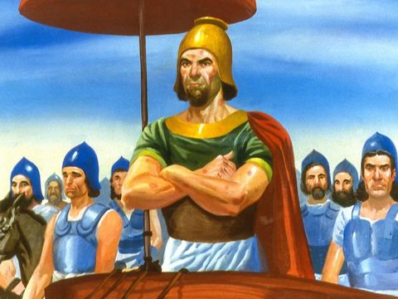
2 Kings 5
Through him the Lord had given Aram great victories.
Mighty warrior
Gen
Had leprosy
Naaman

Slide 13
Retribution Principle
Various forms of the belief that the righteous will prosper while the wicked will suffer
Job: God’s justice cannot be reduced to a simple formula like the retribution principle
Gen

Slide 14
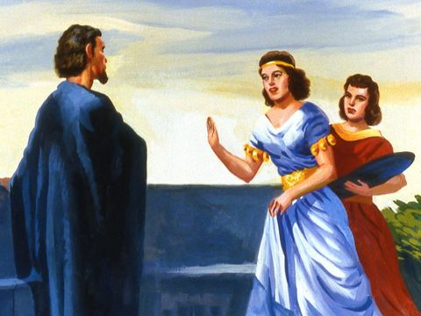
2 Kings 5
I wish my master would be healed
Gen
Loving your Enemy

Slide 15
Loving your Enemy
New Testament
Matthew 5:43-48
Luke 6:27-35
Romans 12:14
1 Peter 3:9

Slide 16
Loving your Enemy
Old Testament
Exodus 23:4-5
Proverbs 24:17
Proverbs 25:21-22
Examples
1 Samuel 24:4-13
1 Kings 17:7-24
2 Kings 5

Slide 19
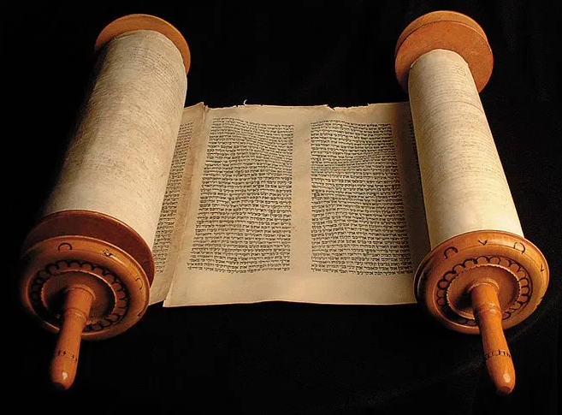
Love Your Neighbor
Love your neighbor includes loving your enemy
‘You must love the Lord your God with all your heart, all your soul, all your strength, and all your mind.’ And, ‘Love your neighbor as yourself.’ (Luke 10:27 NLT)

Slide 20
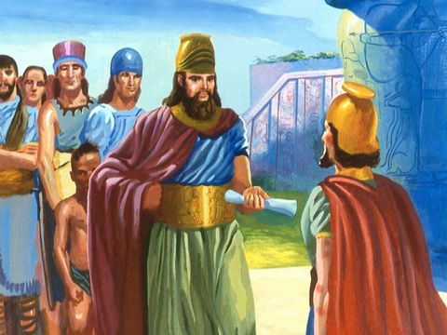
2 Kings 5
Naaman had favor with the King
Gen

Slide 21
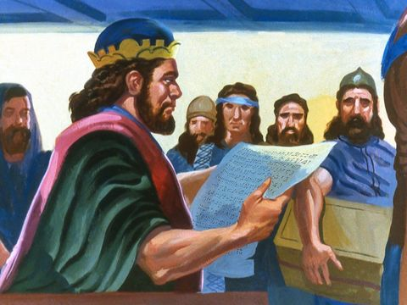
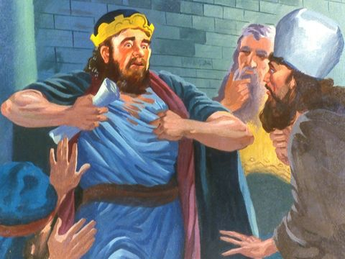
2 Kings 5
Asking for the impossible
With man this is impossible, but with God all things are possible
(Matt 19:26 NIV)

Slide 22
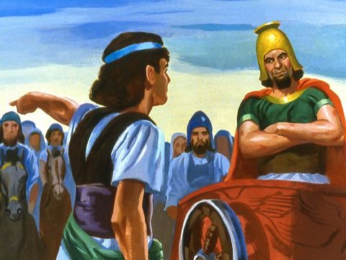
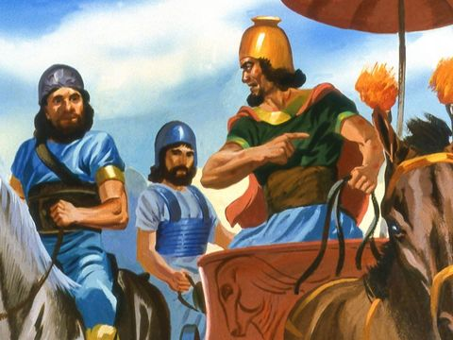
2 Kings 5
Pride gets in the way
• I am special
• I want to do it my way
• Not going to do it
your way

Slide 23
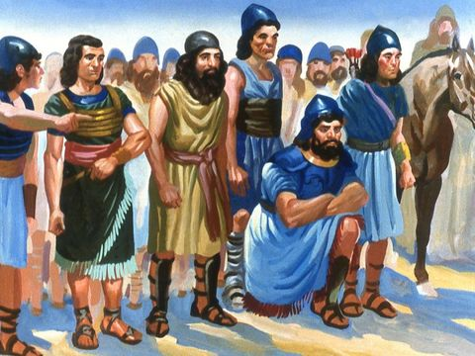
2 Kings 5
Attempts to reason
It’s that simple

Slide 24
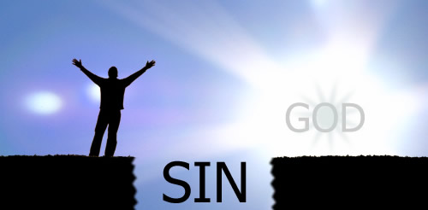
Another Simple Plan
2:1 . . . we have an advocate who pleads our case before the Father. He is Jesus Christ, the one who is truly righteous.
2:2 He himself is the sacrifice that atones for our sins
1:9 . . . if we confess our sins to him, he is faithful and just to forgive us our sins and to cleanse us from all wickedness.
Religion
Good Works
Morality
Sinful
Humanity
Holy
God
Philosophy

Slide 25
Simple Plan for Salvation
a person must :
admit that he/she is a sinner
repent and believe that Jesus died and rose again
receive the Lord Jesus Christ personally as the only Savior
As a result
New Nature
True born-again Christian
Sinful
Humanity
Holy
God

Slide 26
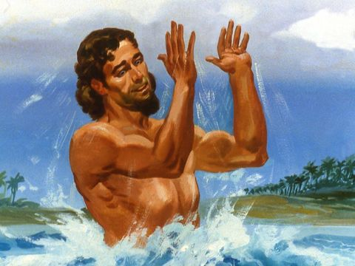
2 Kings 5
• Humbles himself
• Follows directions
• Is healed

Slide 27
displayed through:
Naaman’s wife’s maidservant
Elisha
Naaman’s companions

Slide 28
2 Kings 5
• A New Creation
• No sacrifices to other gods
• Bring knowledge of true God back
• Recognizes difficulties ahead
‘You must love the Lord your God with all your heart, all your soul, all your strength, and all your mind.’ And, ‘Love your neighbor as yourself.’ (Luke 10:27 NLT)

Slide 29
Review
Success or failure does not indicate righteousness or wickedness
Loving your enemy is loving your neighbor
Salvation results from humbling ourselves
A new nature, no other gods

